Slide 1

January 2022 Meetup
Presented by DotNetDevs.at

Slide 2
Thank you for joining!

Slide 3





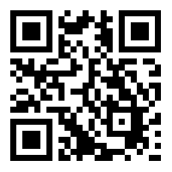
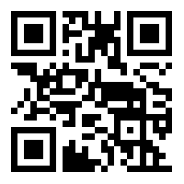
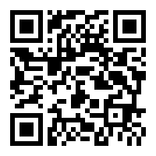
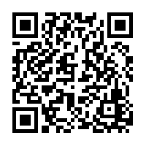
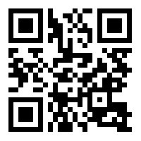
DotNetDevs.at
Notes:
DotNetDevs.at is an non- profit association, whose purpose is to spread of knowledge and experience about usage of .NET technologies.
Our goals are:
making it easier for new participants to find existing communities
offering existing members more choices
promoting the exchange between the different communities

Slide 4
Thanks to our sponsors!

Slide 5





Slide 6
How to take part in the raffle?
Type #jetbrains in the chat

Slide 7
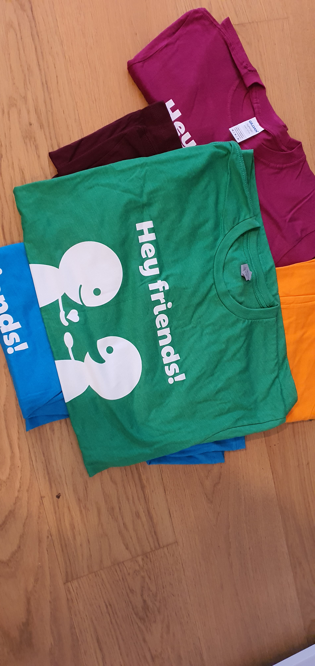

Slide 8
News from the Community

Slide 9

Independent. Innovative. And always open source.
dotnetfoundation.org

Slide 10
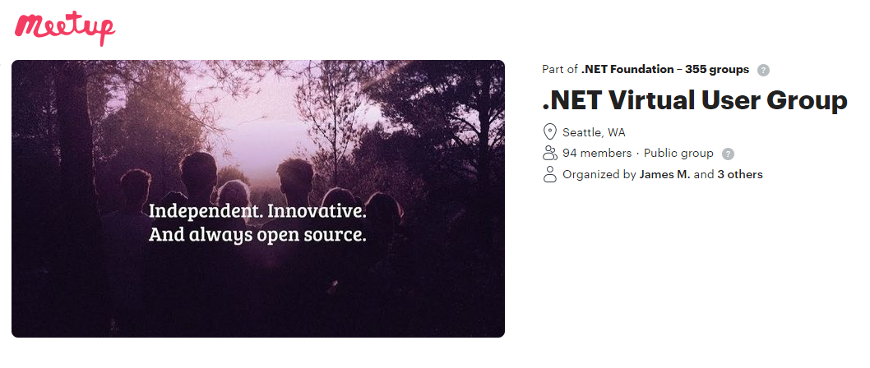
.NET Foundation Virtual User Group
Find virtual user groups happening around the globe!
meetup.com/dotnet-virtual-user-group

Slide 11
Our Plans for the Future
Plan to have in-person events starting March/April 2022
It will be a hybrid event
On location
Per Stream
2G + valid PCR Test needed to enter Location
Info about Vaccination: https://www.oesterreich-impft.at/

Slide 12
News
New Kollektivvertrag - https://go.dotnetdevs.at/kv2022

Slide 13
Interesting Events

Slide 14
MudBlazor – A Gateway Drug for Desktop Dev towards Web Dev by Meinrad Recheis

Slide 15
Thank you Meinrad!

Slide 16
Thank you for joining!

Slide 17
Thanks to our sponsors!

Slide 19
Do your company or you want to sponsor us?

Slide 20
Do you want to host a Meetup?

Slide 21
Talk with us!
General Information:
https://dotnetdevs.at/sponsoring/

Slide 22
Next meetups
February 2022
TBD
March 2022
TBD
April 2022
TBD

Slide 23
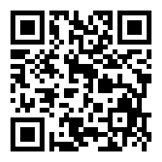
Requested Topics for future Meetups:
Blazor
Paket
NodaTime
...
All under https://github.com/dotnetdevsaustria/topic-requests
Please enter your requests!

Slide 24

Spread the word!
Invite colleagues
Invite friends
Invite customers
Tweet! @DotNetDevsAT
Invite everyone that has to do with .NET

Slide 25
DotNetDevs.at
Notes:
DotNetDevs.at is an non- profit association, whose purpose is to spread of knowledge and experience about usage of .NET technologies.
Our goals are:
making it easier for new participants to find existing communities
offering existing members more choices
promoting the exchange between the different communities

Slide 26
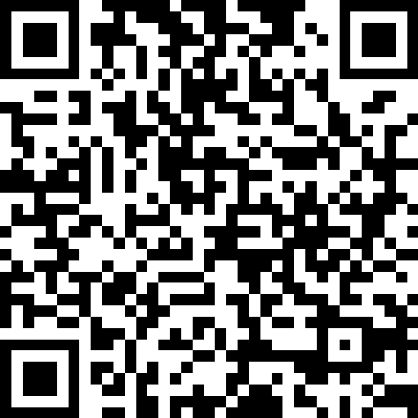
We want to hear your feedback
https://go.dotnetdevs.at/feedback-202201

