Slide 1

March 2022 Meetup
Presented by DotNetDevs.at

Slide 2
Thank you for joining!

Slide 3





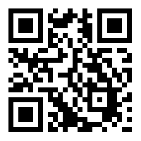
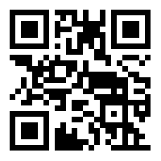
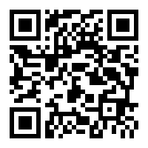
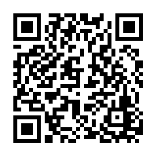
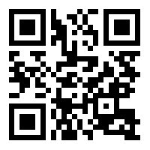
DotNetDevs.at
Notes:
DotNetDevs.at is an non- profit association, whose purpose is to spread of knowledge and experience about usage of .NET technologies.
Our goals are:
making it easier for new participants to find existing communities
offering existing members more choices
promoting the exchange between the different communities

Slide 4
Thanks to our sponsors!

Slide 5





Slide 6
How to take part in the raffle?
Type #jetbrains in the chat

Slide 7
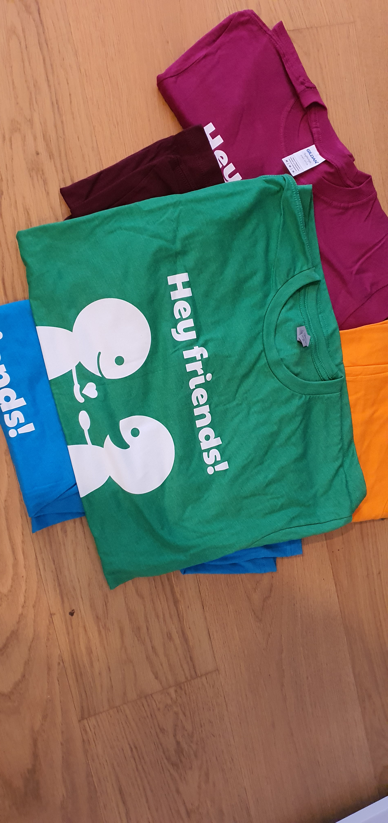

Slide 8
News from the Community

Slide 9

Independent. Innovative. And always open source.
dotnetfoundation.org

Slide 10
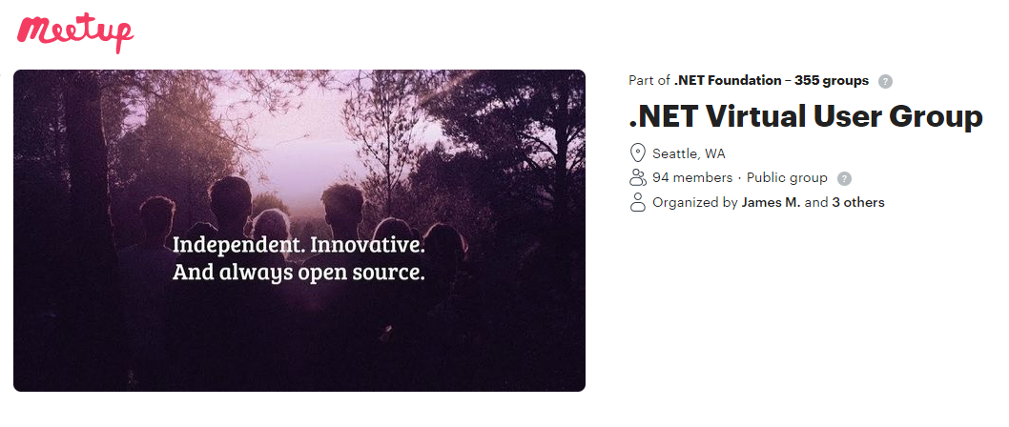
.NET Foundation Virtual User Group
Find virtual user groups happening around the globe!
meetup.com/dotnet-virtual-user-group

Slide 11
News
New Kollektivvertrag - https://go.dotnetdevs.at/kv2022

Slide 12
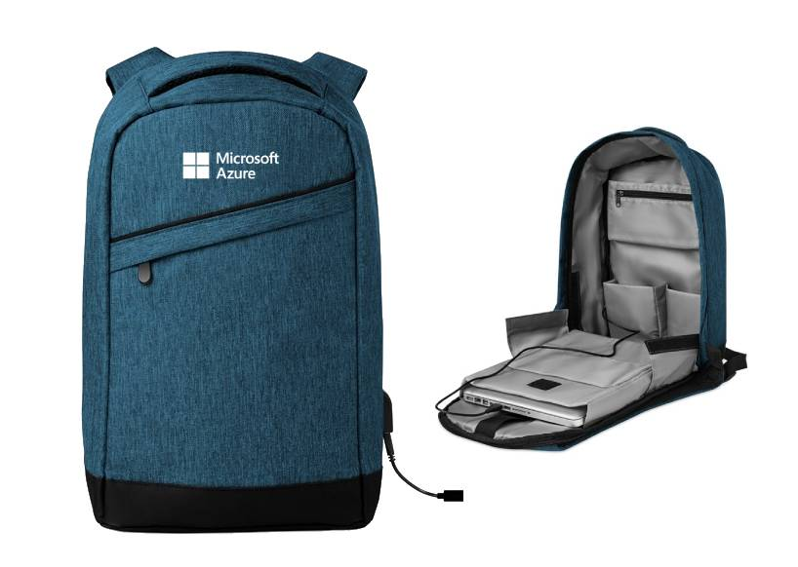
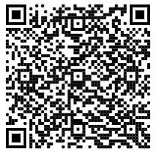
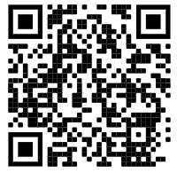

1. Cloud Region Info Session Insights from the Austrian Team into the new Azure Cloud Region Austria Microsoft Event (mktoevents.com)
2. Join the Spring Skills Challenge
learn, get certified, win! https://aka.ms/spring-skills-at
@MSDev_AT don’t forget to follow for local developer news & events

Slide 13
Our Plans for the Future
Plan to have in-person events starting May/June 2022
It will be a hybrid event
On location
Per Stream
2G + valid PCR Test needed to enter Location
Info about Vaccination: https://www.oesterreich-impft.at/

Slide 14
Zero to Document Hero - Intro to MongoDB and .NET by Luce Carter

Slide 15
Thank you Luce!

Slide 16
Thank you for joining!

Slide 17
Thanks to our sponsors!

Slide 19
Do your company or you want to sponsor us?

Slide 20
Do you want to host a Meetup?

Slide 21
Talk with us!
General Information:
https://dotnetdevs.at/sponsoring/

Slide 22
Next meetups
April 2022
TBD
May 2022
TBD
June 2022
TBD

Slide 23
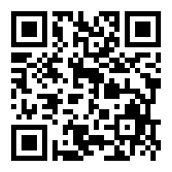
Requested Topics for future Meetups:
Blazor
Paket
NodaTime
...
All under https://github.com/dotnetdevsaustria/topic-requests
Please enter your requests!

Slide 24

Spread the word!
Invite colleagues
Invite friends
Invite customers
Tweet! @DotNetDevsAT
Invite everyone that has to do with .NET

Slide 25
DotNetDevs.at
Notes:
DotNetDevs.at is an non- profit association, whose purpose is to spread of knowledge and experience about usage of .NET technologies.
Our goals are:
making it easier for new participants to find existing communities
offering existing members more choices
promoting the exchange between the different communities

Slide 26
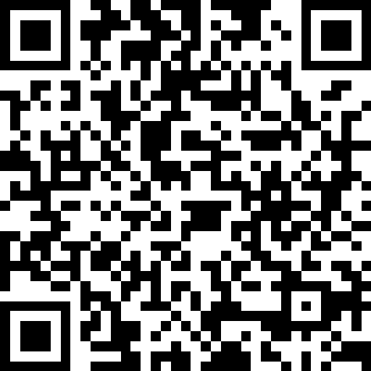
We want to hear your feedback
https://go.dotnetdevs.at/feedback-202203

