Slide 1

July 2022 Meetup
Presented by DotNetDevs.at

Slide 2
Thank you for joining!

Slide 3





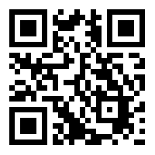
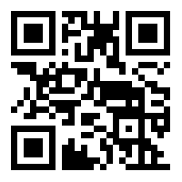
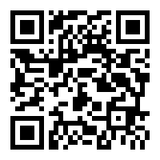
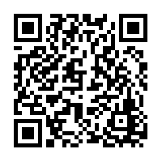
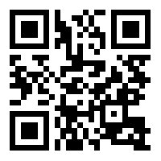
DotNetDevs.at
Notes:
DotNetDevs.at is an non- profit association, whose purpose is to spread of knowledge and experience about usage of .NET technologies.
Our goals are:
making it easier for new participants to find existing communities
offering existing members more choices
promoting the exchange between the different communities

Slide 4
Thanks to our sponsors!

Slide 5




Slide 6
How to take part in the raffle?
Type #jetbrains in the chat

Slide 7
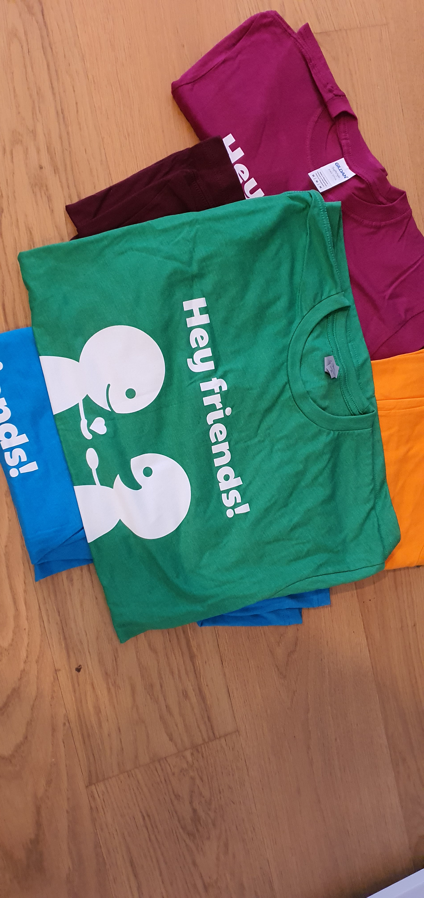

Slide 8
News from the Community

Slide 9

Independent. Innovative. And always open source.
dotnetfoundation.org

Slide 10
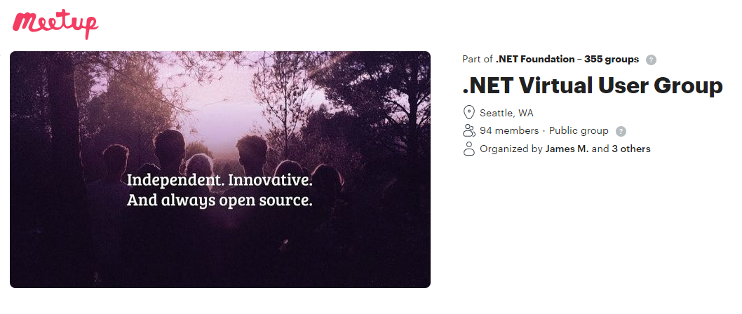
.NET Foundation Virtual User Group
Find virtual user groups happening around the globe!
meetup.com/dotnet-virtual-user-group

Slide 11

FlashOWare’s Livestream
Sundays, 09:00 – 11:00 CEST
www.twitch.tv/FlashOWare/

Slide 12
Ask Me Anything with the ILSpy Team

Slide 13
Thank you!

Slide 14
Thank you for joining!

Slide 15
Thanks to our sponsors!

Slide 17
Do your company or you want to sponsor us?

Slide 18
Do you want to host a Meetup?

Slide 19
Talk with us!
General Information:
https://dotnetdevs.at/sponsoring/

Slide 20
Next meetups
August 2022
TBD
September 2022
TBD
October 2022
TBD

Slide 21
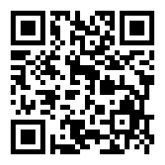
Requested Topics for future Meetups:
Blazor
Paket
NodaTime
...
All under https://github.com/dotnetdevsaustria/topic-requests
Please enter your requests!

Slide 22

Spread the word!
Invite colleagues
Invite friends
Invite customers
Tweet! @DotNetDevsAT
Invite everyone that has to do with .NET

Slide 23
DotNetDevs.at
Notes:
DotNetDevs.at is an non- profit association, whose purpose is to spread of knowledge and experience about usage of .NET technologies.
Our goals are:
making it easier for new participants to find existing communities
offering existing members more choices
promoting the exchange between the different communities

Slide 24
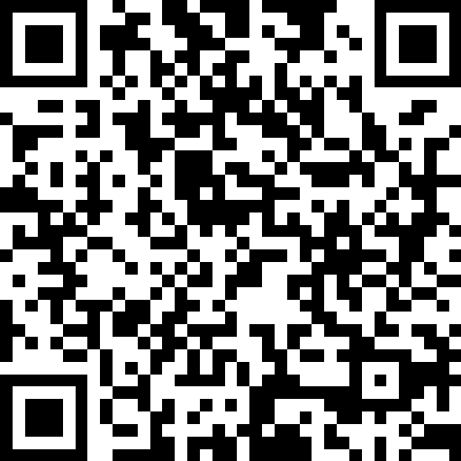
We want to hear your feedback
https://go.dotnetdevs.at/feedback-202207

