Slide 1

August 2022 Meetup
Presented by DotNetDevs.at

Slide 2
Thank you for joining!

Slide 3





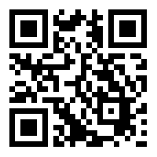
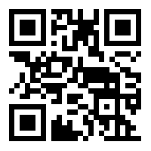
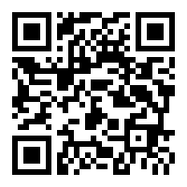
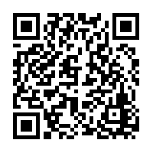
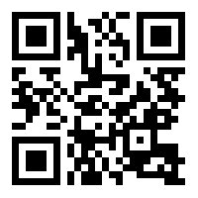
DotNetDevs.at
Notes:
DotNetDevs.at is an non- profit association, whose purpose is to spread of knowledge and experience about usage of .NET technologies.
Our goals are:
making it easier for new participants to find existing communities
offering existing members more choices
promoting the exchange between the different communities

Slide 4
Thanks to our sponsors!

Slide 5




Slide 6
How to take part in the raffle?
Type #jetbrains in the chat

Slide 7
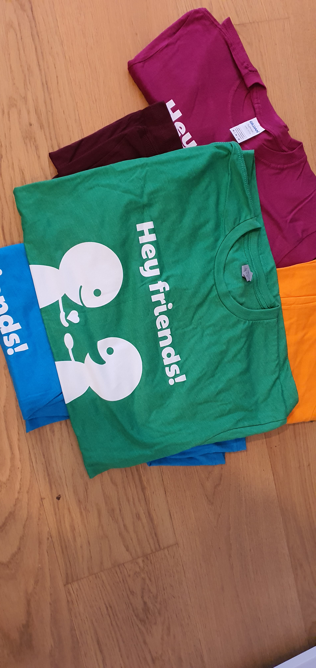

Slide 8
News from the Community

Slide 9

Independent. Innovative. And always open source.
dotnetfoundation.org

Slide 10
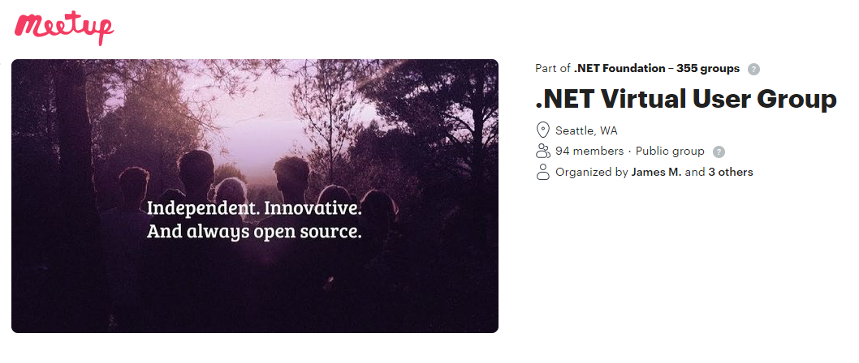
.NET Foundation Virtual User Group
Find virtual user groups happening around the globe!
meetup.com/dotnet-virtual-user-group

Slide 11
Recommended .NET Content Creators

Slide 12

FlashOWare’s Livestream
Sundays, 09:00 – 11:00 CEST
www.twitch.tv/FlashOWare/

Slide 13

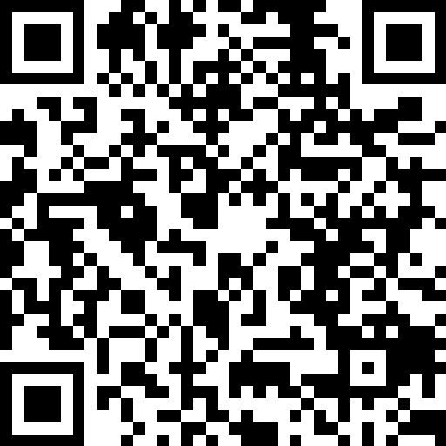
Claudio Bernasconi
https://go.dotnetdevs.at/ClaudioBernasconi

Slide 14

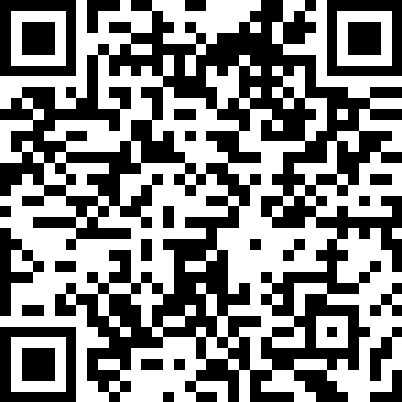
Nick Chapsas
https://go.dotnetdevs.at/NickChapsas

Slide 15
Lightning Talks by You!

Slide 16
Thank you!

Slide 17
Thank you for joining!

Slide 18
Thanks to our sponsors!

Slide 20
Do your company or you want to sponsor us?

Slide 21
Do you want to host a Meetup?

Slide 22
Talk with us!
General Information:
https://dotnetdevs.at/sponsoring/

Slide 23
Next meetups
September 2022
Modern observability for your .NET apps with OpenTelemetry by Joao Grassi
October 2022
TBD
November 2022
TBD

Slide 24
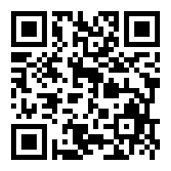
Requested Topics for future Meetups:
Blazor
Paket
NodaTime
...
All under https://github.com/dotnetdevsaustria/topic-requests
Please enter your requests!

Slide 25

Spread the word!
Invite colleagues
Invite friends
Invite customers
Tweet! @DotNetDevsAT
Invite everyone that has to do with .NET

Slide 26
DotNetDevs.at
Notes:
DotNetDevs.at is an non- profit association, whose purpose is to spread of knowledge and experience about usage of .NET technologies.
Our goals are:
making it easier for new participants to find existing communities
offering existing members more choices
promoting the exchange between the different communities

Slide 27
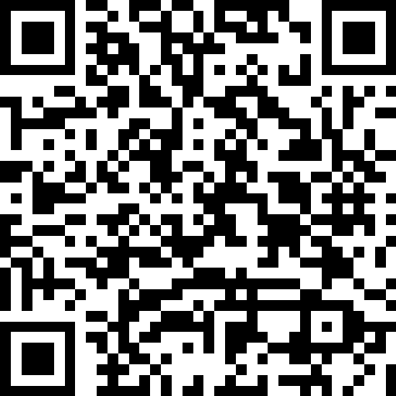
We want to hear your feedback
https://go.dotnetdevs.at/feedback-202208

