Slide 1

November 2022 Meetup
Presented by DotNetDevs.at

Slide 2
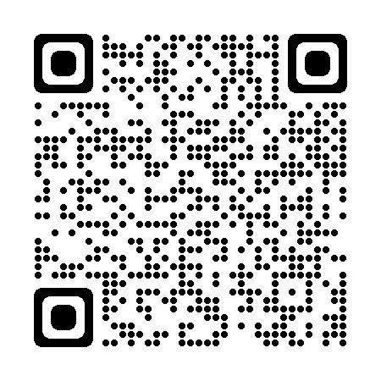




DotNetDevs.at
Notes:
DotNetDevs.at is an non- profit association, whose purpose is to spread of knowledge and experience about usage of .NET technologies.
Our goals are:
making it easier for new participants to find existing communities
offering existing members more choices
promoting the exchange between the different communities

Slide 3
Thank you for joining!

Slide 4
Thanks to our sponsors!

Slide 5




Slide 6
News from the Community

Slide 7

Independent. Innovative. And always open source.
dotnetfoundation.org

Slide 8

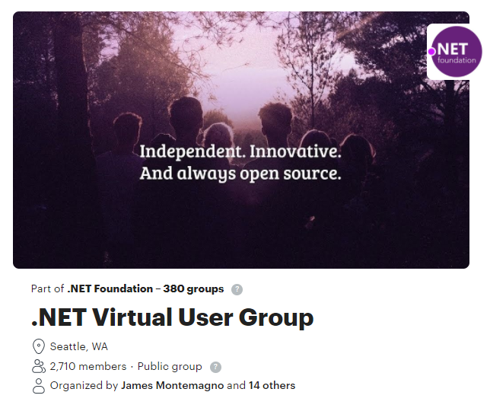
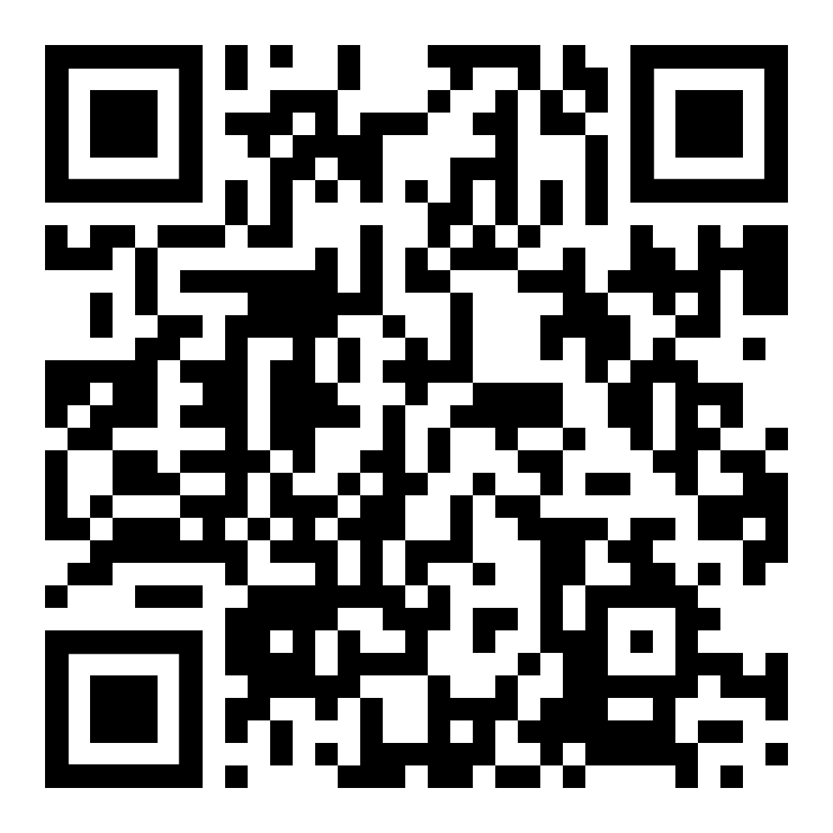
.NET Foundation Virtual User Group
Find virtual .NET events happening around the globe!
meetup.com/dotnet-virtual-user-group

Slide 9
Events
November 17th – Rise above the Cloud - https://www.riseabovethecloud.at/ - -10% Code: dotnetaustria
December 1st - Unity Meetup Vienna –https://www.meetup.com/Unity-Meetup-Vienna/events/289490107/

Slide 10
Recommended .NET Content Creators

Slide 11

FlashOWare’s Livestream
Saturdays, 11:00 – 12:00 CET
www.twitch.tv/FlashOWare/

Slide 12

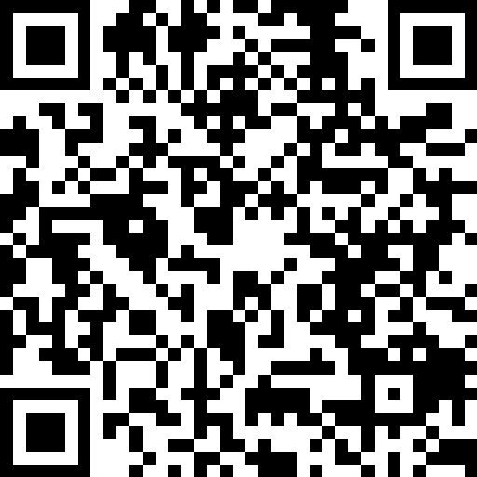
Claudio Bernasconi
https://go.dotnetdevs.at/ClaudioBernasconi

Slide 13

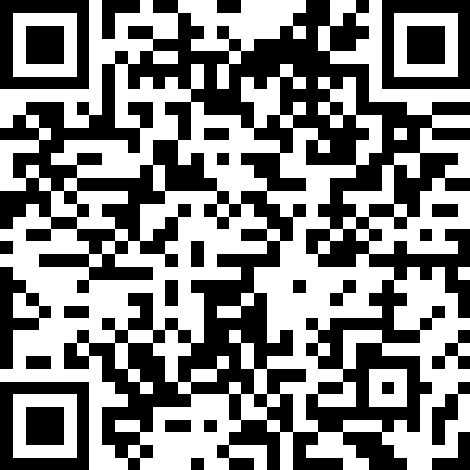
Nick Chapsas
https://go.dotnetdevs.at/NickChapsas

Slide 14
Verifiable Trust: Improving Supply Chain Security with Code Signing by Stefan Wenig und Ulrich Buchgraber

Slide 15
Thank you!

Slide 16
Thank you for joining!

Slide 17
Thanks to our sponsors!

Slide 19
Do you want to host a Meetup?

Slide 20
Next meetups
December 2022
TBD
January 2023
TBD
February 2023
TBD

Slide 21

Spread the word!
Invite colleagues
Invite friends
Invite customers
Tweet! @DotNetDevsAT
Invite everyone that has to do with .NET

Slide 22
DotNetDevs.at
Notes:
DotNetDevs.at is an non- profit association, whose purpose is to spread of knowledge and experience about usage of .NET technologies.
Our goals are:
making it easier for new participants to find existing communities
offering existing members more choices
promoting the exchange between the different communities

Slide 23
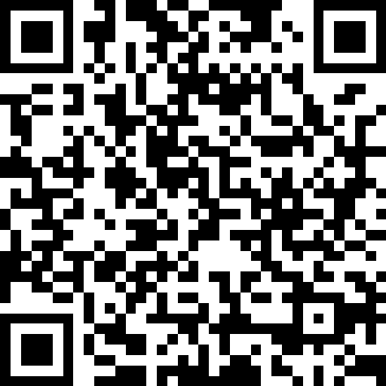
We want to hear your feedback
https://go.dotnetdevs.at/feedback-202211

