Slide 1

February 2023 Meetup
Presented by DotNetDevs.at

Slide 2
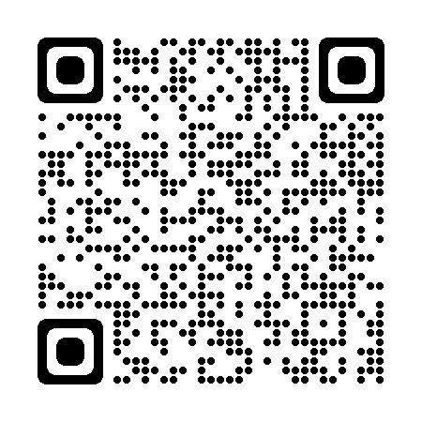




DotNetDevs.at
Notes:
DotNetDevs.at is an non- profit association, whose purpose is to spread of knowledge and experience about usage of .NET technologies.
Our goals are:
making it easier for new participants to find existing communities
offering existing members more choices
promoting the exchange between the different communities

Slide 3
Thank you for joining!

Slide 4
Thanks to our sponsors!

Slide 5


Slide 6




Slide 7
How to take part in the raffle?
Type #jetbrains in the chat

Slide 8
News from the Community

Slide 9

Independent. Innovative. And always open source.
dotnetfoundation.org

Slide 10

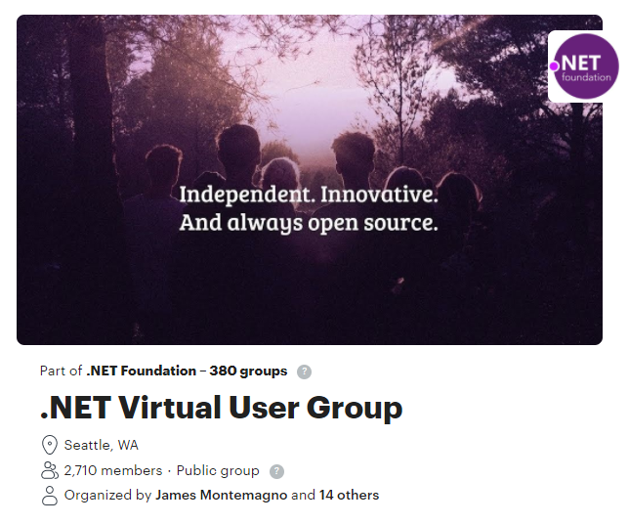
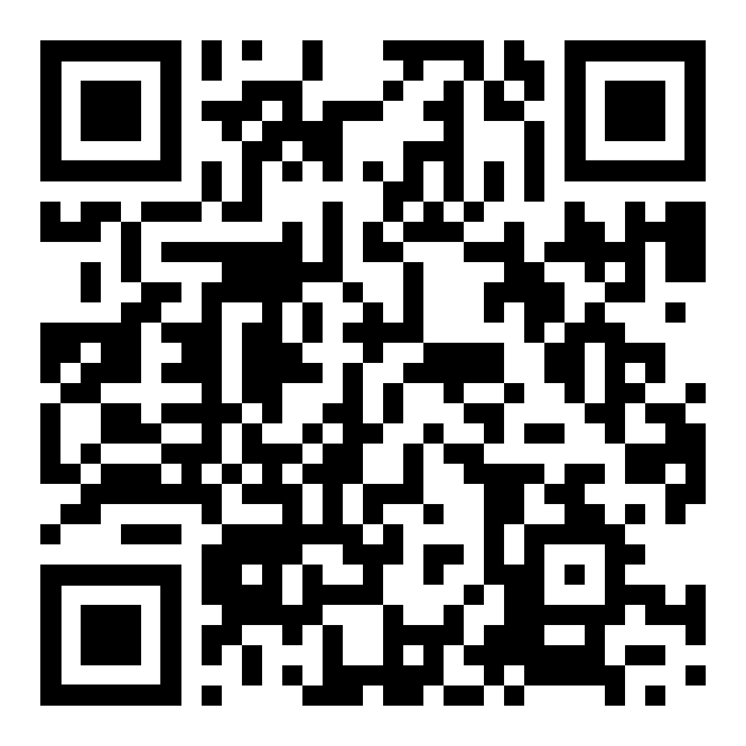
.NET Foundation Virtual User Group
Find virtual .NET events happening around the globe!
meetup.com/dotnet-virtual-user-group

Slide 11
Events
Global Azure Austria 2023 – May 12th - https://globalazure.at/

Slide 12
Recommended .NET Content Creators

Slide 13

FlashOWare’s Livestream
www.twitch.tv/FlashOWare/

Slide 14

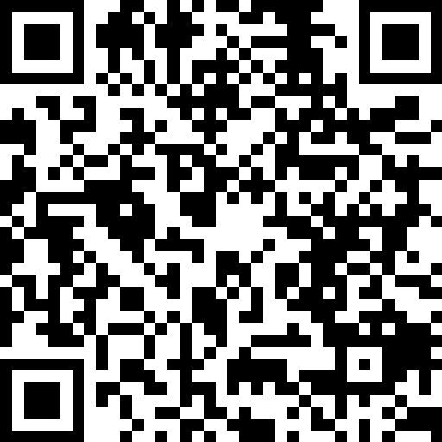
Claudio Bernasconi
https://go.dotnetdevs.at/ClaudioBernasconi

Slide 15

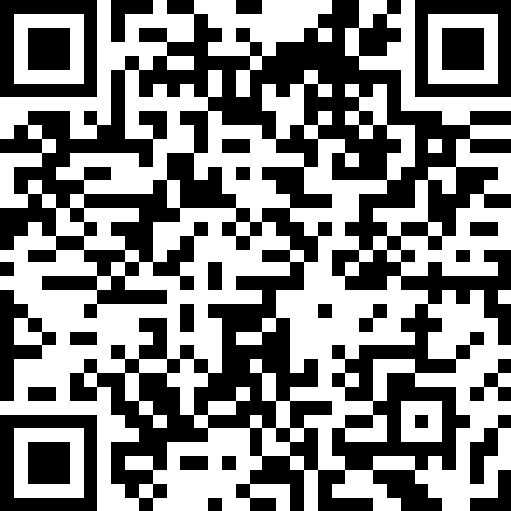
Nick Chapsas
https://go.dotnetdevs.at/NickChapsas

Slide 16
Real-World Distributed Systems with Microsoft Orleans by Raffael & Paul

Slide 17
Thank you!

Slide 18
Thank you for joining!

Slide 19
Thanks to our sponsors!

Slide 21
JetBrains Raffle
Contact us at team@dotnetdevs.at

Slide 22
Do you want to host a Meetup?

Slide 23
Next meetups
March 28th
Minimal APIs by Poornima
Remote
April 11th
MAUI by Roman Jasek
In- Person

Slide 24

Spread the word!
Invite colleagues
Invite friends
Invite customers
Tweet! @DotNetDevsAT
Invite everyone that has to do with .NET

Slide 25
DotNetDevs.at
Notes:
DotNetDevs.at is an non- profit association, whose purpose is to spread of knowledge and experience about usage of .NET technologies.
Our goals are:
making it easier for new participants to find existing communities
offering existing members more choices
promoting the exchange between the different communities

Slide 26
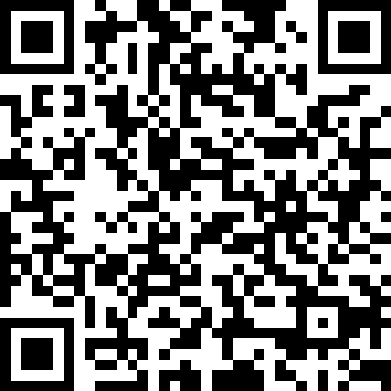
We want to hear your feedback
https://go.dotnetdevs.at/feedback-202302

