Slide 1
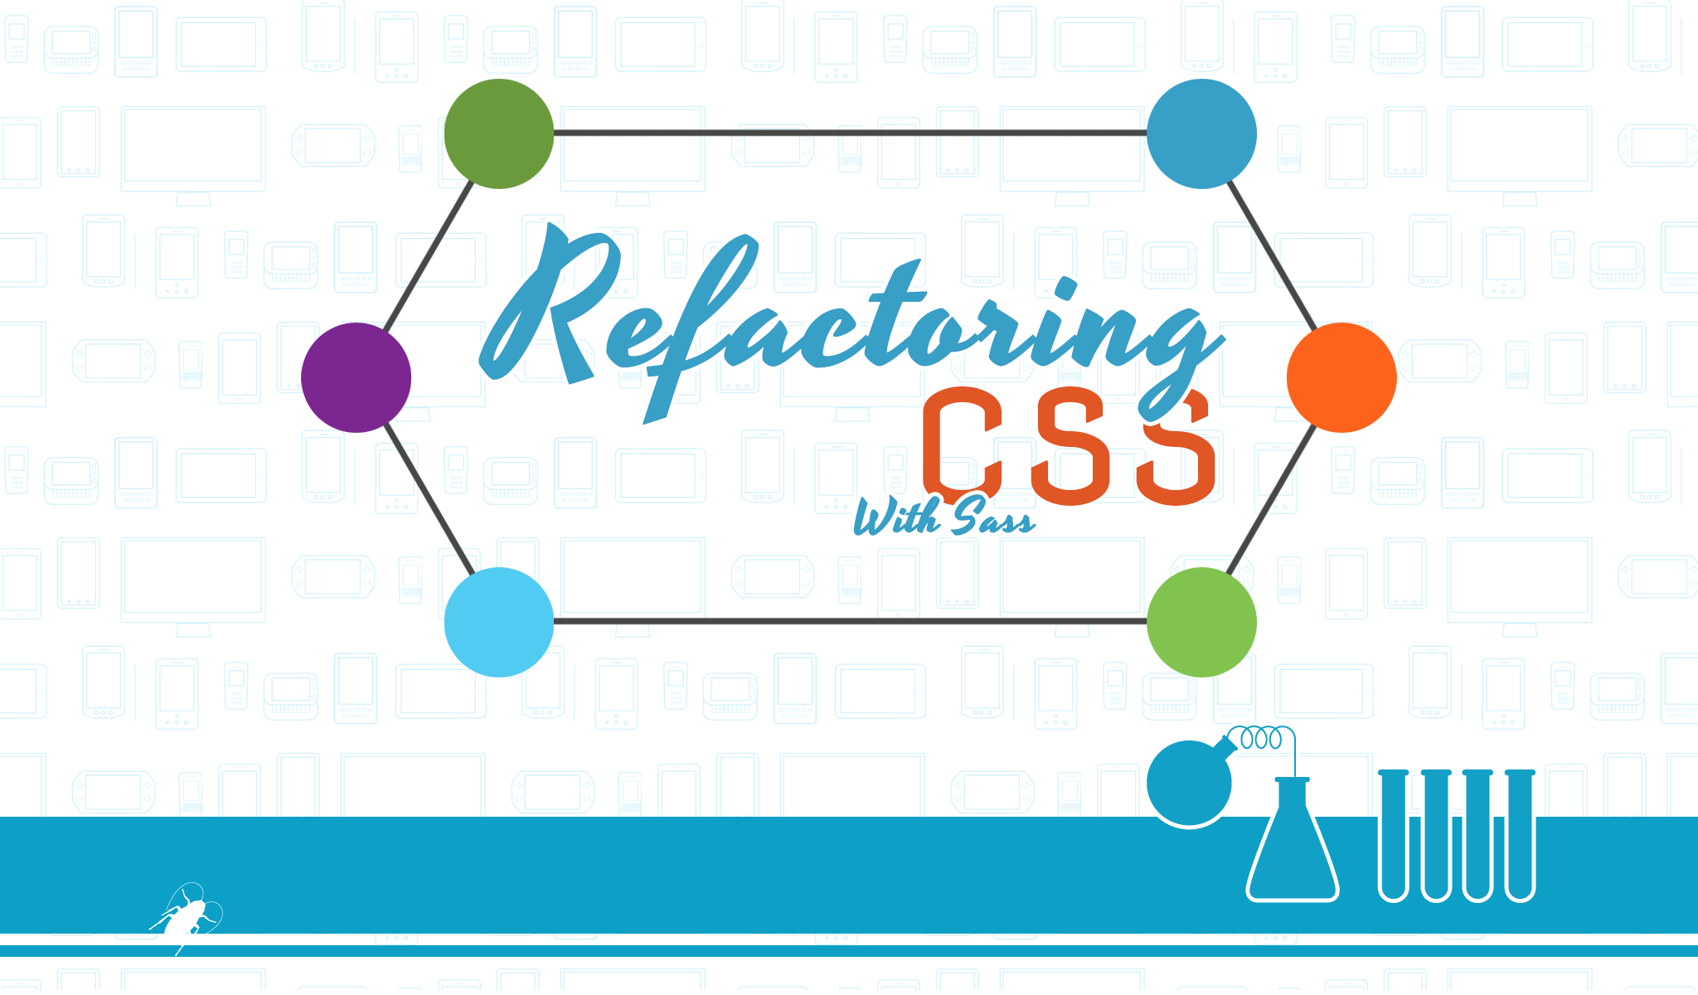
3.0

Slide 2
Ed Charbeneau
Developer Advocate, Telerik
Author: Telerik, Simple-Talk
Podcast: Eat Sleep Code the Official Telerik Podcast
Twitter: @EdCharbeneau
Refactoring
CSS

Slide 3
CSS??
Notes:
Have you written CSS?

Slide 4
CSSS??
Notes:
How about CSSS?
I have a story that reminds me of how bad CSS is written. Before I was a web developer, I worked in manufacturing. Every day at lunch a food truck stopped by. A food truck we affectionately named “The Roach Coach”.

Slide 5

Menu
Day 1
Chicken
Refactoring
CSS
Notes:
One week the Roach Coach had planned to serve chicken.
On the first day, they sold plain chicken.

Slide 6
Menu
Day 2
Chicken Sandwich
Refactoring
CSS
Notes:
The next day the Roach Coach decided to serve left overs, so they put chicken on bread and made Chicken Sandwiches.

Slide 7
Menu
Day 3
Chicken Sandwich
Salad
Refactoring
CSS
Notes:
By the third day, they were still getting rid of leftovers, so they chopped up the chicken, added some dressing, and served Chicken Salad Sandwiches.

Slide 8
Menu
Day 4
Chicken Sandwich
Salsa
Salad
Refactoring
CSS
Notes:
By day 4 things started got scary when they took their chicken salad sandwiches and decided re-serve the sandwiches again. This time they added salsa to the mix and changed the sticker to Chicken Salsa Sandwich.
They even struck through “Salad” the old label, maybe to save money?

Slide 9
Menu
Day 5?
Chicken Salsa Salad Sandwich
Food Poisoning!
Refactoring
CSS
Notes:
In my opinion, they could have just labeled them Food Poisoning.
And what does all of this have to do with writing CSS?...

Slide 10

Cooking bad code
Revision 1
.menu .chicken { display: block }
Refactoring
CSS
Notes:
Developers do the same thing, we cook bad code. A project gets finished, the team moves on and “maintenance mode” begins.

Slide 11
Cooking bad code
Revision 1
.menu .chicken { display: block }
Revision 2
.menu .chicken { float: left }
Refactoring
CSS
Notes:
For some reason, the code requires an update. So what is the easiest thing to do?
Open the CSS file and override the styles by adding new code to the bottom.

Slide 12

Cooking bad code
Revision 1
.menu .chicken { display: block }
Revision 2
.menu .chicken { float: left }
Revision 3
.menu .chicken { float: right }
Refactoring
CSS
Notes:
And we do it over and over again.

Slide 13
Cooking bad code
Revision 1
.menu .chicken { display: block }
Revision 2
.menu .chicken { float: left }
Revision 3
.menu .chicken { float: right }
Revision 4
.menu .chicken { float: none !important } //food poisoning
Refactoring
CSS
Notes:
Until we get food poisoning. (see: !important)

Slide 14
Reasons to refactor
Maintainability & Readability
Extensibility
Improving performance
Semantics
Notes:
What can we do to fix this problem?

Slide 15
Maintainability & Readability
We need to make it easier for others to read our code,
and to understand the intention behind it.
Smaller, more concise chunks of code
Semantic naming conventions
Refactoring
CSS
Notes:
We need to make it easier for others to read our code, and to understand the intention behind it. Sass and Compass are preprocessors, and we can use them with CSS to provide semantic naming conventions for values (eg: $base-color) and dividing code into smaller, more concise, chunks. Sass allows us to use variables in place of literals to hold values, while Compass encapsulates common coding patterns. By using them, there is less code to maintain.

Slide 16
Extensibility
Object Oriented Programming (OOP)
Don’t Repeat Yourself (DRY)
Modular programming & Portability
module
module
module
Refactoring
CSS
Notes:
Familiar software development practices like OOP (object oriented programming) and DRY (don’t repeat yourself) are made possible by using Sass mixins. Mixins can be used to define styles of common UI elements with a modular approach so that they are portable within a project as well as in other projects.

Slide 17
Improving Performance
Reduce page load times by reducing requests to the server
request
.min
Refactoring
CSS
Notes:
You can certainly achieve better performance in page-loading by refactoring your CSS code but, unlike refactoring C#, VB, or JavaScript code, the benefits are more likely from decreasing the load time of the code rather than from increasing the execution (rendering) speed.

Slide 18
Semantic Layout
Separation of Concerns (SoC), decoupling of CSS and HTML
header
column
HTML
document
CSS
visual style
article
row
layout
aside
menu
Refactoring
CSS
Notes:
We will use refactoring to define a clear SoC (Separation of Concerns). HTML is responsible for describing the document, while the role of CSS is to provide a visual style. We can create a clear separation between HTML and CSS by writing styles that can be applied directly to HTML elements rather than through class attributes.

Slide 19
Tools
compile
Sass
Mixins
CSS
Notes:
Read the article https://www.simple-talk.com/dotnet/asp.net/refactoring-css-with-sass-and-compass/ for more details.
Follow commits on https://github.com/EdCharbeneau/RefactoringCSS for step by step techniques

Slide 20
Sass overview
Sass code .SCSS is a superset of CSS
CSS is valid SCSS
Nesting
Variables
Mixins
http://sass-lang.com/
Refactoring
CSS

Slide 21
Converting CSS to Sass
Conversion tools
Online http://css2sass.heroku.com/
Rename .css to .scss
Refactoring
CSS
Notes:
Convert this using http://css2sass.heroku.com
https://gist.github.com/EdCharbeneau/bb6a1846c55eb05ef2af
Checkout branch 1

Slide 22
Cleaning up with variables
// Color variables
$base-color: #d0d0d0;
$accent-color: #0ca0c6;
$highlight-color: #FFF;
$contrast-color: #1e1e1e;
Refactoring
CSS

Slide 23
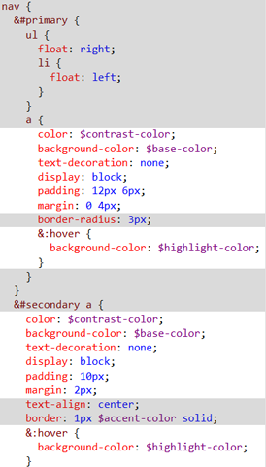
Reusable modules with mixins
@mixin button-base($margin: 2px, $padding: 10px) {
color: $contrast-color;
background-color: $base-color;
text-decoration: none;
display: block;
padding:$padding;
margin: $margin;
&:hover {
background-color: $highlight-color;
}
}
Refactoring
CSS

Slide 24
Cleaning up your HTML with semantic styles
HTML
CSS
<header id="master-header">
<div class=“row">
<h1 class="col third">Example</h1>
<nav class="col two-thirds" id="primary">
Content…
</nav>
</div>
</header>
#master-header > div {
@include row;
h1 {
@include column($third);
}
nav#primary {
@include column($two-thirds);
}
}
Refactoring
CSS

Slide 25
Partials and Imports
Prefixing an underscore to a Sass file name tells Sass we intend to import the code as a module
No .css file is generated by the compiler
module
module
Directory / Files
/modules/_typography.scss
/modules/_grid.scss
module
Site.scss
@import "modules/typography";
@import "modules/grid";
Refactoring
CSS
Notes:
We can make our code more modular by using ‘partials’ and imports in order to separate code by its responsibilities. By modularizing the code, we can restructure our files so they are portable and easier to locate within a project.
Partials are a naming convention that tells Sass that we do not wish to generate a .css file from the Sass code. Instead of generating a .css file for each module in our project, we will instead use the @import method.

Slide 26
Notes:
Discover Sass & Compass Extensions
Find the perfect tool for your next Sass or Compass project.
http://www.sache.in/

Slide 27

Bower Overview
Easy to use
Front end package management
Many Sass libraries available
Refactoring
CSS

Slide 28
Using Bower
Replace standard boilerplate markup with mixins
Bower.json
"normalize-scss": “version"
Site.scss
//removed @import "modules/reset";
@import "../lib/normalize-scss/normalize";
Refactoring
CSS

Slide 29
Finalizing the project
Minify
gulp.watch(paths.sass, ['sass', 'min:css']);
.min
Refactoring
CSS

Slide 30
Does refactoring make sense?
Some projects may be too large or complex
Practice refactoring with a smaller project first
Apply the patterns to new projects
Notes:
Practice the techniques of refactoring with Sass on a smaller project first and learn a disciplined approach to writing DRY Sass code and understand better when modular code can be abstracted.

Slide 31
Questions??
?

Slide 32
Resources
Reading
Refactoring CSS with Sass and Compass
Code Samples
github.com/EdCharbeneau/RefactoringCSS/
github.com/EdCharbeneau/SimpleCompassMVCExample
Tools
Gulp-sass
Sass
Refactoring
CSS

Slide 33
Thank
You

