Slide 1
Destructors in C++

Slide 2
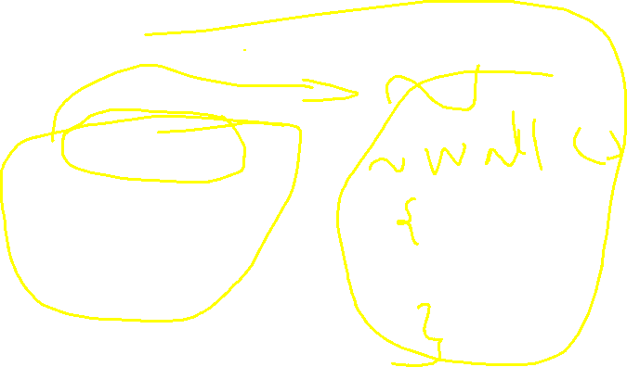
What is destructor
~class_name() { //Some code }
~class_name() { //Some code }
A destructor is a special member function that works just opposite to constructor, unlike constructors that are used for initializing an object, destructors destroy (or delete) the object
~class_name()
{
//Some code
}

Slide 3
When does the destructor get called?
The program finished execution.
When a scope (the { } parenthesis) containing local variable ends.

Slide 4
Destructor rules
1) Name should begin with tilde sign(~) and must match class name. 2) There cannot be more than one destructor in a class. 3) Unlike constructors that can have parameters, destructors do not allow any parameter. 4) They do not have any return type, just like constructors. 5) When you do not specify any destructor in a class, compiler generates a default destructor and inserts it into your code.

