Slide 1
Inline Functions

Slide 2
Stack
Push
Pop
Element 4
Element 3
Works on Principle of Last In First Out
( LIFO )
STACK
Element 2
Element 1

Slide 3
What happens when we call a function ?

Slide 4
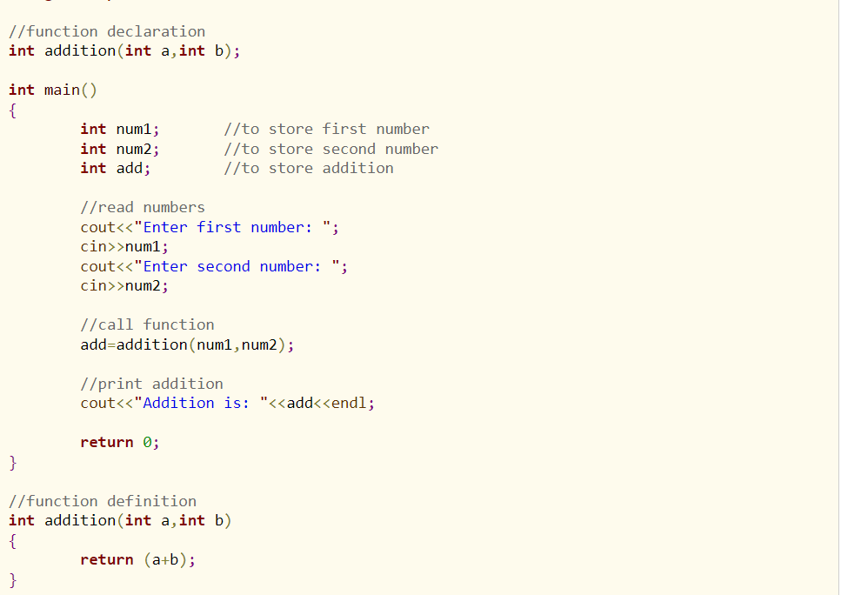

Slide 5
Function Call located at memory address 2000
Main Program execution at memory location 100
2000
First instruction in Function
Instruction 1 at 100
.
.
2005
Last Instruction in Function
Function Call
Instruction at 104

Slide 6
How does function know where to return ????

Slide 7
Function Call located at memory address 2000
Main Program execution at memory location 100
2000
First instruction in Function
Instruction 1 at 100
.
.
2005
Last Instruction in Function
Function Call
Go to location 104
POP
Instruction at 104
PUSH To STACK
Local variable
Return Address (104 )
Method parameter

Slide 8
What is Inline Functions???
This copies the function to the location of the function call in compile-time and may make the program execution faster.
Inline returntype nameOfFunction{
}

Slide 9
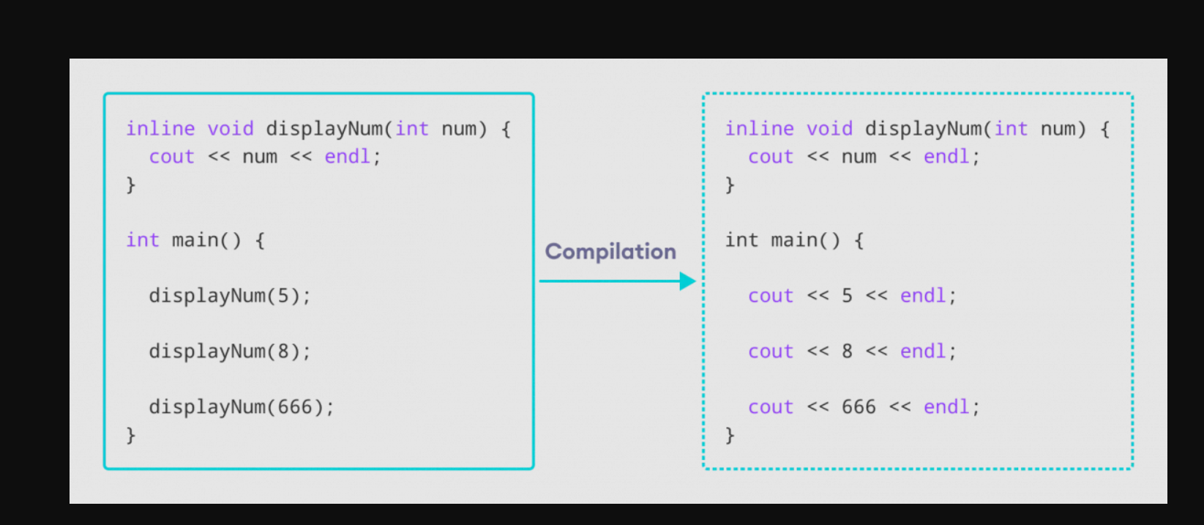

Slide 10
When Inline Function will Not work
If a function contains a loop. ( for, while, do-while)
If a function contains static variables.
If a function is recursive.
If a function return type is other than void, and the return statement doesn't exist in function body.

