Slide 1
Polymorphism

Slide 2
Its an Ability of single thing to have more than one form
It is an important concept of object-oriented programming. It simply means more than one form.
That is, the same entity (function or operator) behaves differently in different scenarios.

Slide 3
4 Ways to implement Polymorphisam
Function Overloading
Operator Overloading
Function overriding
Virtual Functions
Compile Time Polymorphism
Run Time Polymorphism

Slide 4

Function Overloading
we can use two functions having the same name if they have different parameters (either types or number of arguments).
Depending upon the number/type of arguments, different functions are called.
It's a compile-time polymorphism because the compiler knows which function to execute before the program is compiled.

Slide 5
How does compiler decide which function to call ???

Slide 6
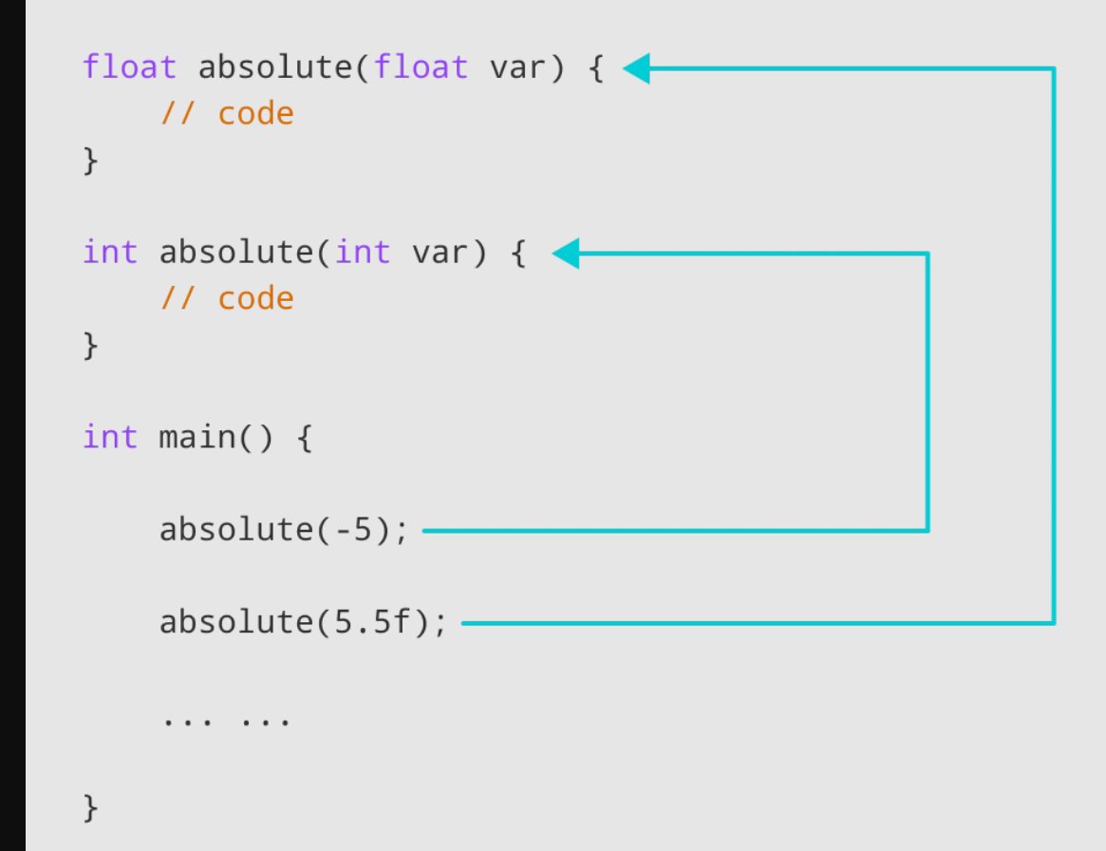
Calling with different type of paramter

Slide 7
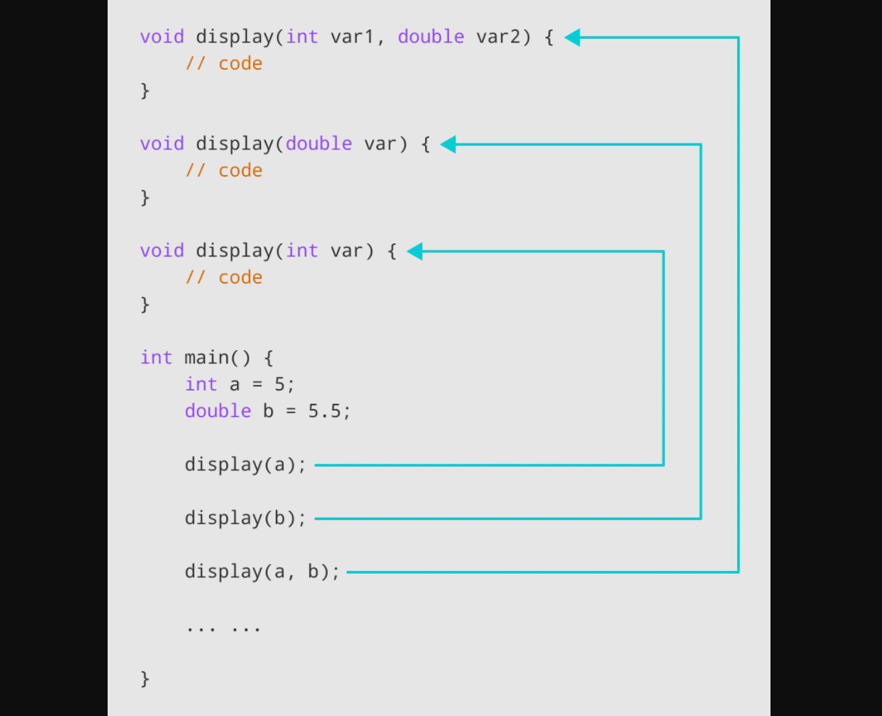
Calling with different number of parameter

Slide 8
Operator Overloading
In C++, we can overload an operator as long as we are operating on user-defined types like objects
Operator overloading is basically function overloading, where different operator functions have the same symbol but different operands.And, depending on the operands, different operator functions are executed
We cannot use operator overloading for basic types such as int, double, etc.

Slide 9
Syntax
class className
{
... .. ...
public returnType operator symbol (arguments)
{
... .. ...
}
... .. ...
};
Return type => Return type of function
Operator ➔ Keyword
Symbol => operator we want to overload ( +,-,*,/ ++)
Arguments = > Argument to the function

Slide 10
Overloading Unary Operator
Operator “++” and “--” are unary operator
Example ::
Num++ will increase the value of num by 1
In this only one oprand is needed and involved
Overload Prefix ++ and Postfix ++ Operator
Unary Operator work on Single operand

Slide 11
Overloading Binary Operator
Example
Result=num+10
Here + is operating on two operands
Num and 10;
Lets overload + Operator
Binary operators work on two operands
Lets add complex number
Complex number consist of two parts
Real part and imaginary part

Slide 12
Operators which cannot be overloaded
:: (scope resolution)
. (member selection)
.* (member selection through pointer to function)
?: (ternary operator)

