Slide 1

Inheritance

Slide 2
Inheritance Basics
Inheritance is one of the key features of Object-oriented programming in C++. It allows us to create a new Class (derived class) from an existing class (base class).
The derived class inherits the features from the base class and can have additional features of its own

Slide 3
How Inheritance Looks
Animal
Base Class
Eat()
Sleep()
Dog
Derived Class
Bark()

Slide 4
Syntax of Inheritance
class derived_class_name : access_mode base_class1
{
// body of subclass
};
Class➔ Key word
Derived_class_Name➔ Name of the derived class
Access_mode➔ public , private ,protected
Base_class ➔ Name of the base class.

Slide 5
Is- A Relationship
Inheritance is an is-a relationship.
We use inheritance only if an is-a relationship is present between the two classes.
A car is a vehicle,A dog is an animal
Example:

Slide 6

C++ protected Members
The access modifier protected is especially relevant when it comes to C++ inheritance.
Like private members, protected members are inaccessible outside of the class. However, they can be accessed by derived classes and friend classes/functions.
We need protected members if we want to hide the data of a class, but still want that data to be inherited by its derived classes

Slide 7



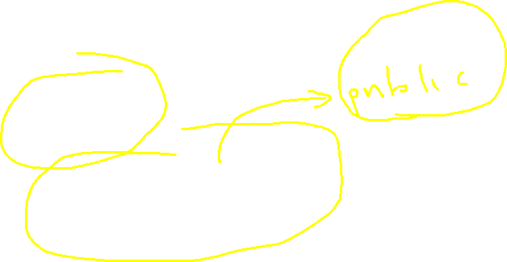
Access Modes in C++
class Base {
.... ... ....
};
class Derived : public Base {
.... ... ....
};
This means that we have created a derived class from the base class in public mode. Alternatively.
In the same way we can use the other modes like private and protected and derive the classes from that.

Slide 8
Public, Protected and Private inheritance in C++
Private Members are never inherited in derived classes
Only Public and Protected members are inherited in derived classes and Access Mode sets the visibility of these members in the derived classes

Slide 9
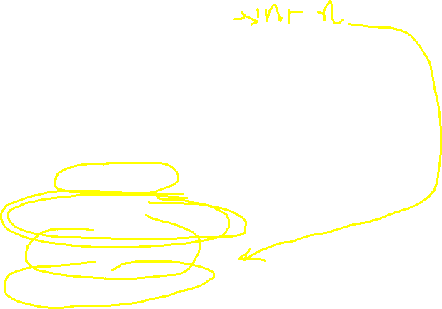
Public inheritance
Base Class
Private Member
NEVER INHERITED
Public Members
Protected Members
Derived class
Private Member
Becomes
Public Members
Protected Members
Becomes
Notes:
Here, we have derived PublicDerived from Base in public mode.
As a result, in PublicDerived:
prot is inherited as protected.
pub and getPVT() are inherited as public.
pvt is inaccessible since it is private in Base.
Since private and protected members are not accessible from main(), we need to create public functions getPVT() and getProt() to access them:

Slide 10
Protected inheritance
Base Class
Private Member
NEVER INHERITED
Public Members
Protected Members
Derived class
Private Member
Becomes
Public Members
Becomes
Protected Members

Slide 11
Private inheritance
Base Class
Private Member
NEVER INHERITED
Public Members
Protected Members
Becomes
Derived class
Private Member
Becomes
Public Members
Protected Members

Slide 12
Types of Inheritance
Single
Multiple
Inheritance
Multilevel
Hybrid
Hierarchical

Slide 13
Single Inheritance
A Inheritance in which derived class is Inherited from a single class.
Base Class
Animal
Dog
Derived class

Slide 14
Multilevel Inheritance
Multilevel inheritance is a process of deriving a class from another derived class.
Base Class
Animal
Dog
Derived class
German Shepherd
Another Derived class

Slide 15
Multiple Inheritance
Multiple inheritance is the process of deriving a new class that inherits the attributes from two or more classes.
Base 1
Base 1
Base n
Derived

Slide 16
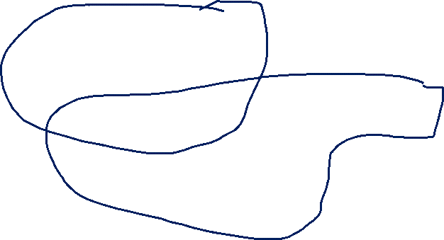
Hybrid Inheritance
The process of combining more than one type of Inheritance together while deriving subclasses in a program is called a Hybrid Inheritance.
A
B
C
Single+Multiple
D

Slide 17
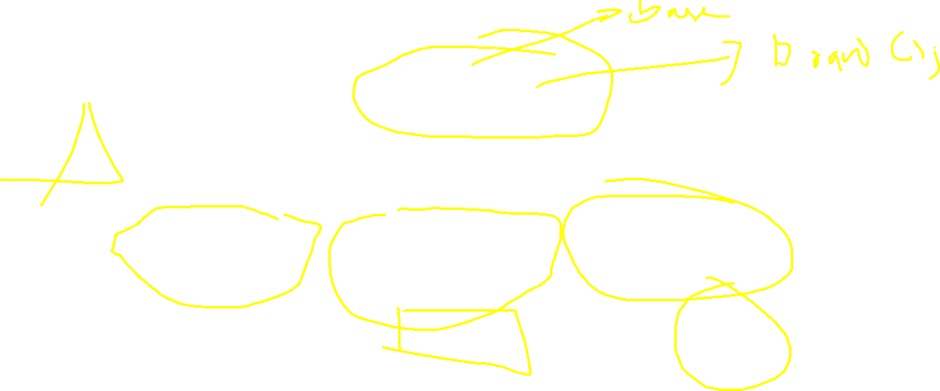
Hierarchical Inheritance
Hierarchical inheritance is defined as the process of deriving more than one class from a base class.
Shape
Triangle
Rectangle
Circle

Slide 18
Virtual function
Shape
Draw()
Rectangle
Draw()
Line
Draw()
Triangle
Draw()
Circle
Draw()

Slide 19
What is Virtual Function ???
A virtual function is nothing but a member function of a base class that you redefine in a derived class.

Slide 20
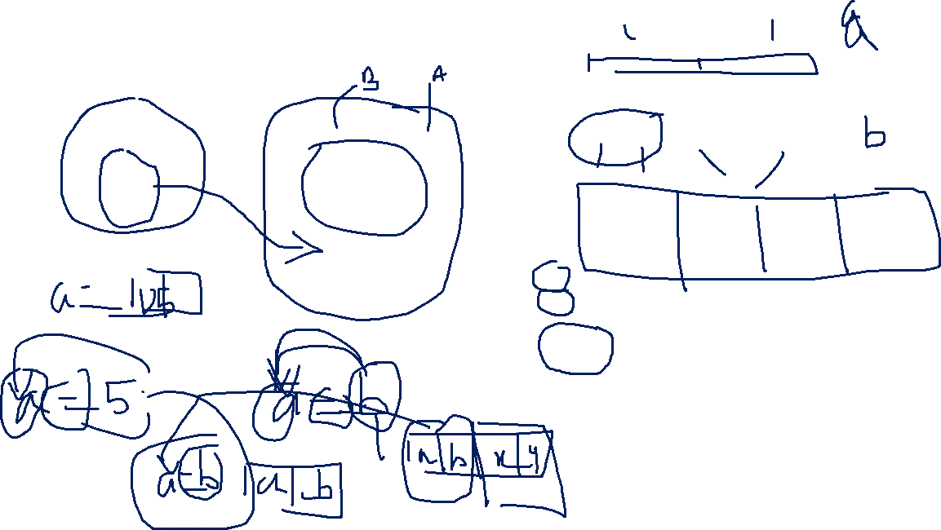
Object slicing
Object of Class A
a b
Class A
Int x;
Int y;
Class B: Public A
Int a ;
Int b
Int x;
Int y;
Object of Class B
a b x y
When we do
A a; // Create Object of Base
B b; // Create Object of b
a=b;
Object a has less memory so only member belonging to the base class and derived class members are ignored / Sliced off
This is called Object slicing

Slide 21
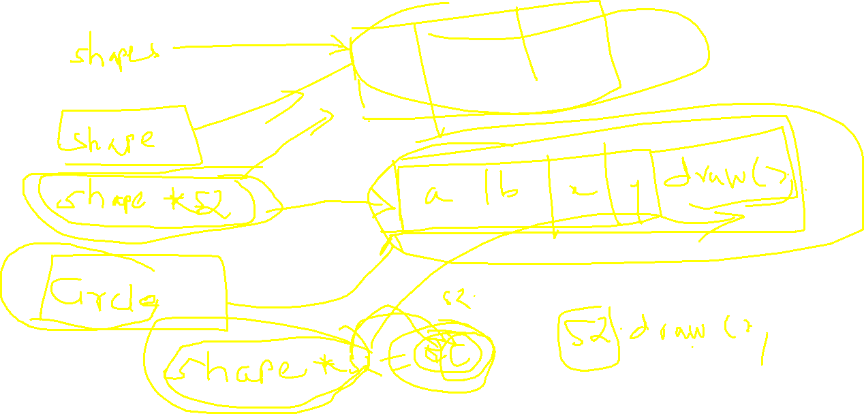
Run time polymorphisam
Runtime polymorphism is a process in which call to an overridden method is resolved at runtime rather than compile time. Runtime polymorphism is achieved by virtual function.
Run time polymorphism is achieved only through the pointer (or reference) of base class type. Late binding(Runtime) is done in accordance with the content of pointer (i.e. location pointed to by pointer)
since Draw() function is declared with virtual keyword so it will be binded at run-time (output is draw in derived class as pointer is pointing to object of derived class ).
Notes:
While in case 4, b2 is a pointer to base class and contains the address of object of Child class so when we call Draw() on b2 object, runtime polymorphism takes place which decides dynamically which function to call, as the Base class print function is made virtual so runtime polymorphism chooses Child::print() not Base::print().

Slide 22
Rules for defining Virtual Function:
They Must be declared in public section of class.
Virtual functions cannot be static and also cannot be a friend function of another class.
Virtual functions should be accessed using pointer or reference of base class type to achieve run time polymorphism.
They are always defined in base class and overridden in derived class. It is not mandatory for derived class to override (or re-define the virtual function), in that case base class version of function is used.

Slide 23
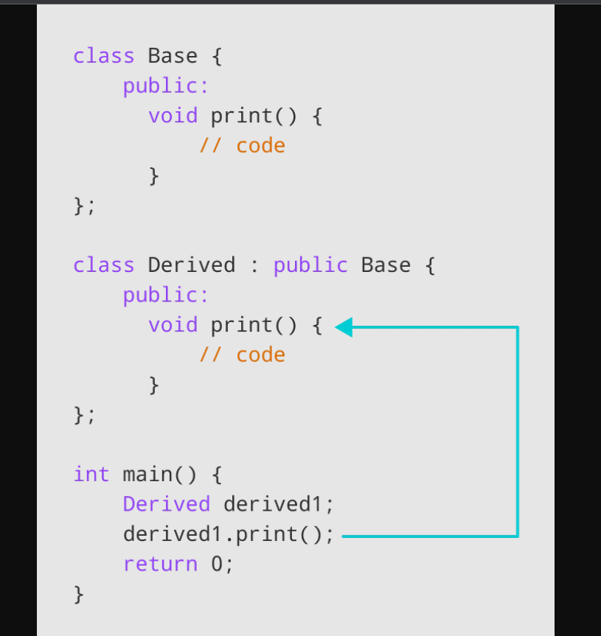
Function Overriding
When the base class and derived class have member functions with exactly the same name, same return-type, and same arguments list, then it is said to be function overriding.

Slide 24
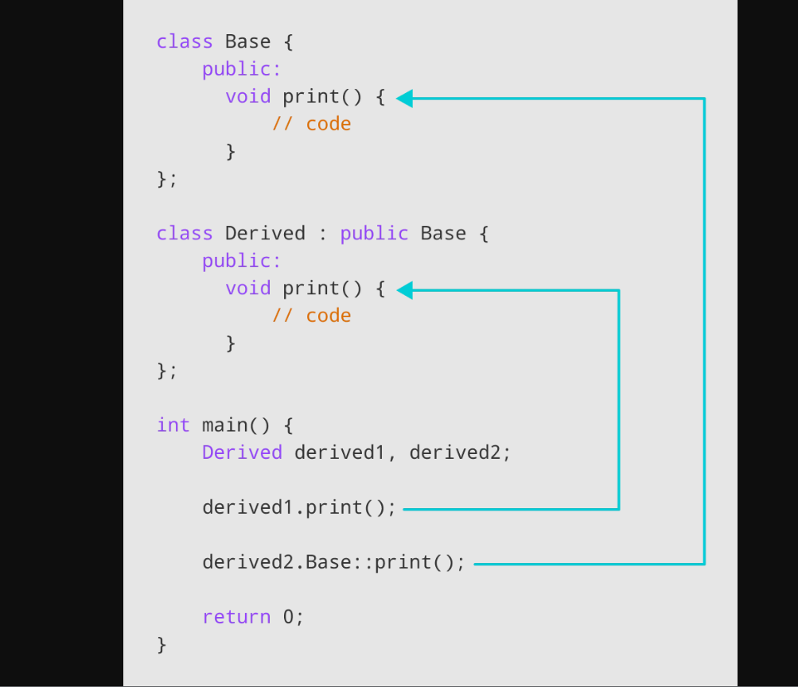
Access Overriden method from Base class
To access the overridden function of the base class, we use the scope resolution operator ::.

