Slide 1
DOTNETVN
WHAT IS API GATEWAY? HOW TO BUILD IT IN NETCORE?
Author: Linh Pham
Website: http://dotnetvn.com
Facebook Page: https://www.facebook.com/dotnetvn/
Facebook Group: https://www.facebook.com/groups/2358330047574166/
Facebook Profile: https://www.facebook.com/linh.pham.96155

Slide 2
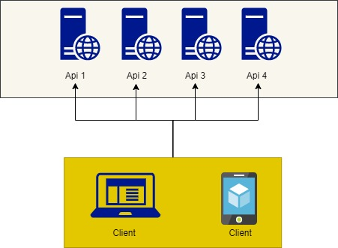
PROBLEM?
We have a system with multiples micro services and clients have to connect to every single service
1. Clients must connect to multiples endpoints.
2. Spending a lot of effort to manage authentication and authorization when work with multiples endpoints
3. Less security
4. Request Aggregation?
5. How to monitor when we have too many API Server?

Slide 3
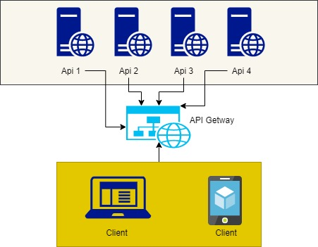
USE API GATEWAY TO RESOLVE THE PROBLEMS AT PREVIOUS SLIDE

Slide 4
WHAT IS API GATEWAY?
An API gateway is an API management tool that sits between a client and a collection of backend services.
An API gateway acts as a reverse proxy to accept all application programming interface (API) calls, aggregate the various services required to fulfill them, and return the appropriate result.
Most enterprise APIs are deployed via API gateways. It’s common for API gateways to handle common tasks that are used across a system of API services, such as user authentication, rate limiting, and statistics.

Slide 5
ADVANTAGES OF USING API GATEWAY
1. Hide micro services in system by only exposing via one API gateway => more security
2. You use an authentication service and rate limiting.
3. Easy to manage and monitor APIs
4. Clients only focus on one unique endpoint
5. Aggregate the various services

Slide 6
BUILD A API GATEWAY DEMO IN NETCORE VIA USING OCELOT
https://ocelot.readthedocs.io/en/latest/
SAMPLEAPI2
POST MAN
API GATEWAY
SAMPLEAPI1
Notes:
https://www.pogsdotnet.com/2018/09/api-gateway-response-aggregation-with.html

Slide 7
PROJECT’s CONFIGURATION
1. Create new project with API Template and set name is “SampleApi1” (NetCore 3.1)
Install these packages from nugget:
Microsoft.AspNetCore.Mvc.Versioning.
Swashbuckle.AspNetCore
After the project has created successfully, open the source code that attached with this document and copy all from startup.cs in “SampleApi1” to your “SampleApi2” project.
Notes:
"Aggregates": [
{
"ReRouteKeys": [
"user-info",
"user-auditlog"
],
"UpstreamPathTemplate": "/user/tracelog/{accountName}"
}
],

Slide 8
PROJECT’s CONFIGURATION
2. Create new project with API Template and set name is “SampleApi2” (NetCore 3.1)
Install these packages from nugget:
Microsoft.AspNetCore.Mvc.Versioning.
Swashbuckle.AspNetCore
After the project has created successfully, open the source code that attached with this document and copy all from startup.cs in “SampleApi2” to your “SampleApi2” project.
Notes:
"Aggregates": [
{
"ReRouteKeys": [
"user-info",
"user-auditlog"
],
"UpstreamPathTemplate": "/user/tracelog/{accountName}"
}
],

Slide 9
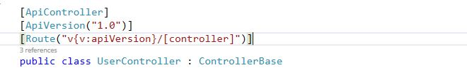
Create your controller in SampleApi1 and SampleApi2 as format below

Slide 10
GATEWAY PROJECT CONFIGURATION
3. Create new project with API Template and set name is “ApiGateWayDemo” (NetCore 3.1)
Install these packages from nugget:
Ocelot
Ocelot.Provider.Consul
After the project has created successfully, open the source code that attached with this document and copy all from startup.cs and Program.cs in “ApiGateWayDemo” to your “ApiGateWayDemo” project.

Slide 11
In APIGATEWAYDEMO Project create a new json file set name is “gateways.json” with schema as below
{
"Routes": [],
"GlobalConfiguration": {
"BaseUrl": https://api.mybusiness.com
}
}
Please watch the video to know how to config Api Gateway with Ocelot ☺
Or If you are lazy and do not wanna watch the video please download the source code at HERE.
Notes:
https://github.com/dotnetvn-projects/ApiGateWayDemo

Slide 12
DEMO

