Slide 1
DOTNETVN
DEPENDENCY INJECTION
To be a professional developer
Author: Linh Pham
Website: http://dotnetvn.com
Facebook Page: https://www.facebook.com/dotnetvn/
Facebook Group: https://www.facebook.com/groups/2358330047574166/
Facebook Profile: https://www.facebook.com/linh.pham.96155

Slide 2
WHAT IS IT?
Dependency injection is a technique in which an object receives other objects that it depends on via using Abstraction (Inject)
Using this technique helps to reduce the dependent between objects
Dependency Injection is one form of Inversion of Control Pattern (Dependency Inversion Principle)

Slide 3
DEPENDENCY NVERSION PRINCIPLE
INVERSION OF CONTROL PATTERN
SERVICE LOCATOR
EVENT
DELEGATE
DEPENDENCY INJECTION

Slide 4
HOW MANY WAYS TO INJECT A OBJECT TO ANOTHER OBJECT?
CONSTRUCTOR INJECTTION
public MobilePhone(IBattery battery)
{
Battery = battery;
}
private IBattery _battery;
public IBattery Battery
{
get { return _battery; }
set { _battery = value; }
}
PROTERTY INJECTTION
public IBattery Battery { get; private set; }
public void SetDI(IBattery battery)
{
Battery = battery;
}
METHOD INJECTTION

Slide 5
DI AND DI CONTAINER (IoC Container)
DI CONTAINER
DI Object
DI Object
DI Object
DI Object
DI Object
DI Object
A software library that that provides DI functionality and allows automating many of the tasks involved in Object Composition, Interception, and Lifetime Management. DI Containers are also known as Inversion of Control (IoC) Containers.
It manages object creation and it's life-time, and also injects dependencies to the class

Slide 6
AVAILABLE DI CONTAINERS
FOR ASP NET CORE: we do not to install third party library because Microsoft built in it a DI Container
FOR OTHERS: AUTOFAC, UNITY, STRUCTURE MAP… https://www.tutorialsteacher.com/ioc/ioc-container
CREATE YOURN OWN DI CONTAINER? WHY NOT? => GO TO DEMO I WILL SHOW YOU ☺

Slide 7
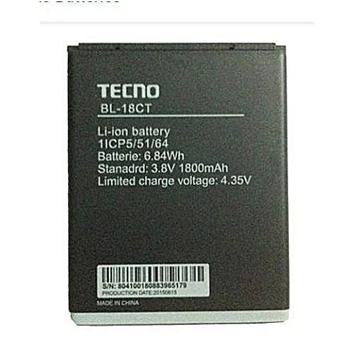
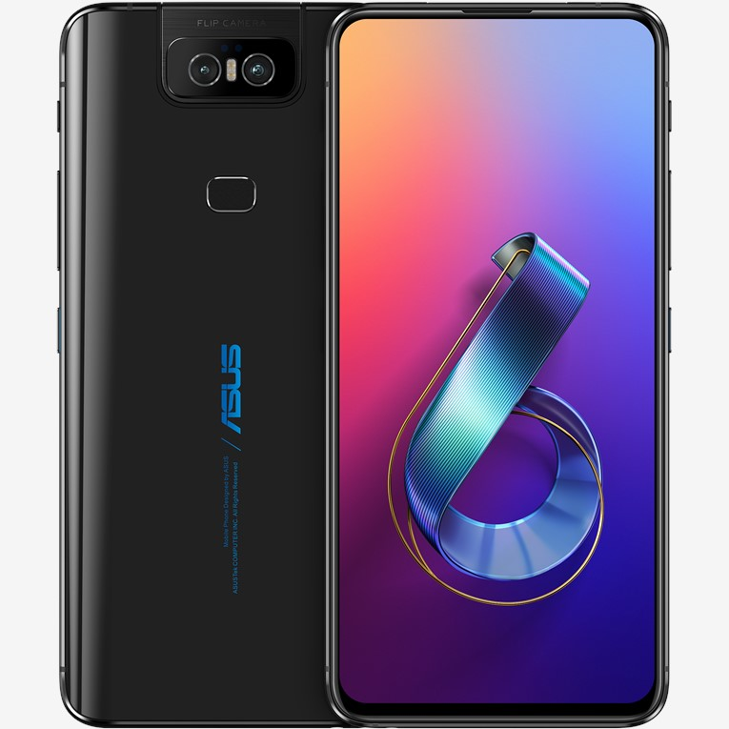
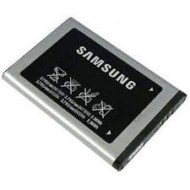
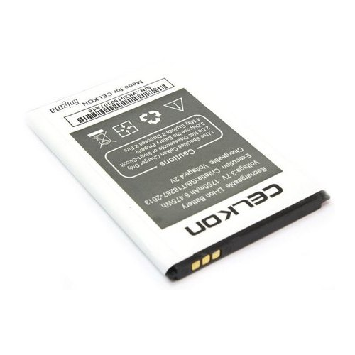
EXAMPLE IN REAL LIFE
Accept
There are many of manufactures can produce a battery for Asus Mobile with their own technology by base on technical parameters of Asus phone (Abstraction)
Accept
Accept

Slide 8
DEMO
Please continue to watch the video ☺

