Slide 1
MODULARIZATION OF AN ASPNET CORE WEB APPLICATION

Slide 2
What is modularization ?
Customer Service Module
Modular programming is a software design technique that emphasizes separating the functionality of a program into independent, interchangeable modules, such that each contains everything necessary to execute only one aspect of the desired functionality.
Load
Products module
APPLICATION
News module
Load
Load
Load
- “Breaking down" of projects into several smaller projects
Shopping Cart Module
- Modules may then be reused (without change) in other projects
- Extendable or add more plugins in system (without change)
- Independent in development

Slide 3
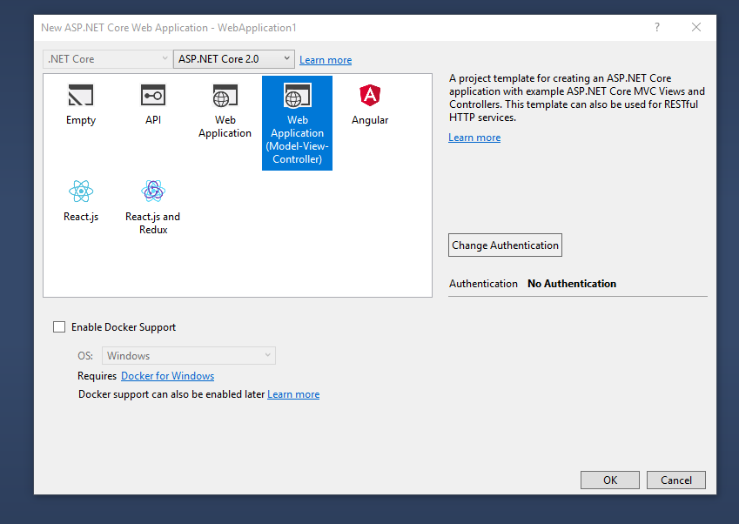
Do a Simple Application uses modular technique in AspNet Core
Step 1: Create an AspNet Core Web Application (MVC)
Open VS 2017 => File => New Project => NET Core => ASP.NET Core Web Application => Select MVC Template
Set Project Name is DemoModular

Slide 4
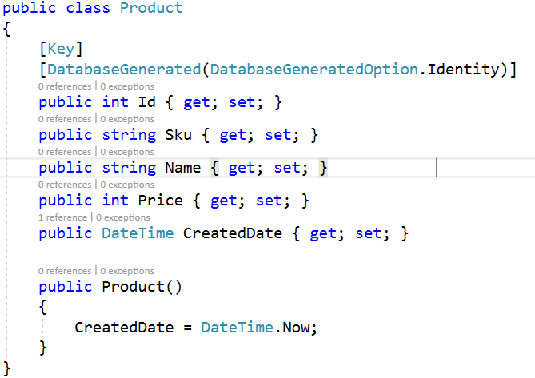
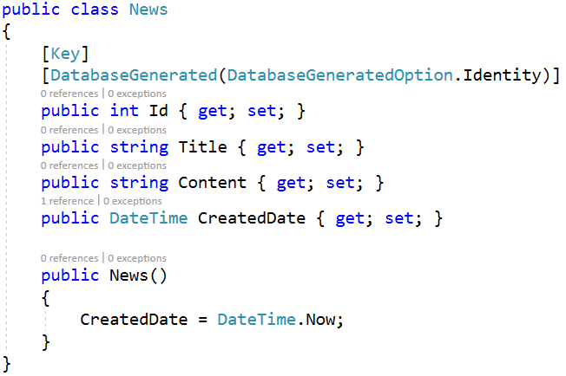
Step 2: Work With Database
(Use Entity Framework Core)
News
Product
There are 2 tables in this demo:

Slide 5
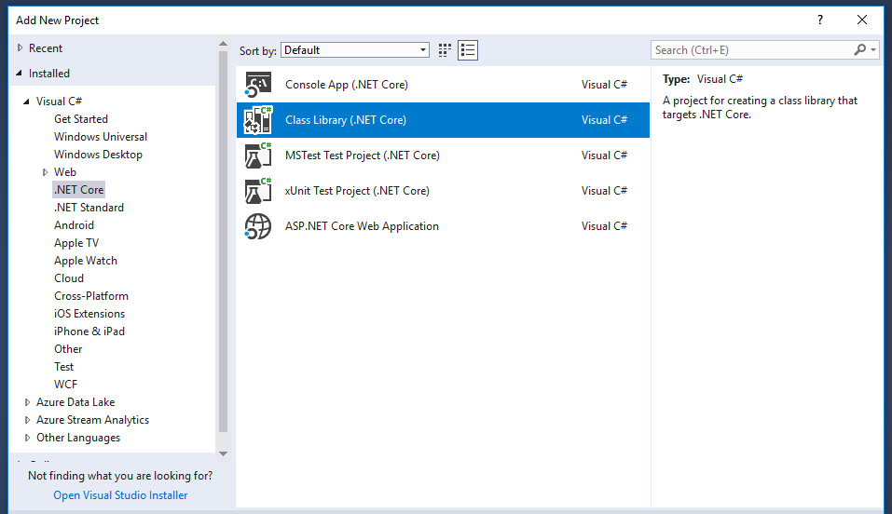
Step 2.1: Create a DataAccess Library
In order to create Net Core Library you right click on solution and select “Add new project” from menu
After “Add new project” dialog has opened, in the right panel select “.Net Core” and in the left panel select “Class Library”
Set Project Name is DataAccess

Slide 6
Step 2.2: Add 2 classes: News.cs And Product.cs

Slide 7
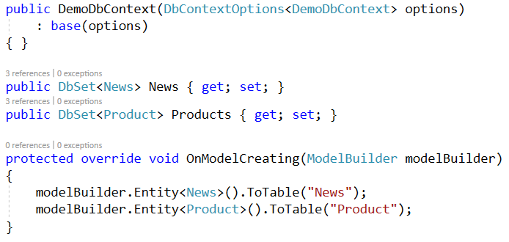
Step 2.3: Add DbContext Class: DemoDbContext.cs

Slide 8

Step 2.4: Add DbContext to ServiceCollection
1. Open Startup.cs file from DemoModular Project.
2. Inside ConfigureServices function adds the line of code as below:

Slide 9
Step 3: Create Modules
In this demo, I’ll create 3 modules: Home, News and Product module.
Home Module
News Module
Product Module
Load
Load
Load
DemoModular (WebHost)

Slide 10
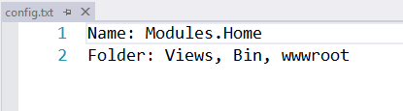
Step 3.1: Create Home, News and Products modules
1. Right click on solution and select “Add New Project”.
2. In the right panel select “Net Core” then select “ASP.NET Core Web Application”.
3. Create module by choosing MVC Template.
4. Set name for module project is “Modules.Home”.
5. Right click on “Modules.Home” then select “Properties” from menu
6. Focus on “Application Tab” and change “Output Type” from “Console Application” to “Class Library”
7. Remove program.cs, startup.cs, HomeController.cs, folders inside View folder
and remove files inside subfolders of wwwroot folder.
8. Create configuration file: config.txt
Do the same this for News and Product modules

Slide 11

Step 3.2: Implement code logic for News and Product Module
Note: For Home module, we will not implement any code logic,
Therefore in this module will be a HomeController.cs and an empty view
1. Work on Modules.News
1.1 Create NewsModel in Models folder
1.2 Create Mapper class to map data between model and entity
1.3 Create NewsController in Controller folder
1.4 Create Index Action in NewsController
Please go to the source code for more details
1.5 Query News list from DbContext
1.6 Create Index view

Slide 12
2. Work on Modules.Product
1.1 Create ProductModel in Models folder
1.2 Create Mapper class to map data between model and entity
1.3 Create ProductController in Controller folder
1.4 Create Index Action in ProductController
1.5 Query Product list from DbContext
1.6 Create Index view
Please go to the source code for more details

Slide 13
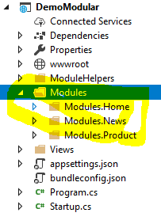
Step 4. Load modules
1. Go to DemoModular project.
2. Create a folder and set name is “Modules”
3. Build projects Modules.Home, Modules.News and Modules.Product.
4. Create 3 Module folders with its name.
5. Copy bin, view and wwwroot (if any) of every module project to folders which created at step 4.

Slide 14
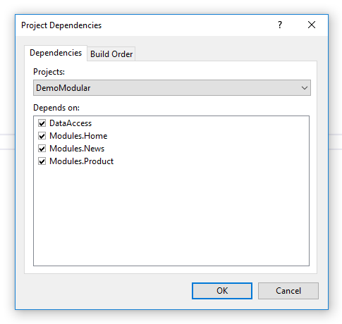
Tips for building module projects automatically:
- Right click on “DemoModular” project => “Build Dependencies” => “Project Dependencies”.
- In Project Dependencies dialog, Click on checkbox to select which projects will be built along with when you build “DemoModular” project .
Tips for copying modules to Modules folder of “DemoModular” project automatically:
- Create class “ModuleCopier.cs” to execute copy files and folder from module project to “Modules” folder in DemoModular project (please go to source code for more details).
- Call “CopyModules” function from ModuleCopier.cs in ConfigureServices function of Startup.cs

Slide 15
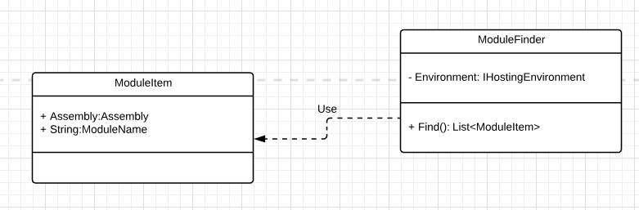
How to load modules ?
In order to load modules in net core you have to add assembly of module to ApplicationParts by using
“AddApplicationPart” method from IMvcBuilder.
ApplicationParts details: https://docs.microsoft.com/en-us/aspnet/core/mvc/advanced/app-parts?view=aspnetcore-2.0
Loading module in step by step
Step 1: Load modules to memory

Slide 16
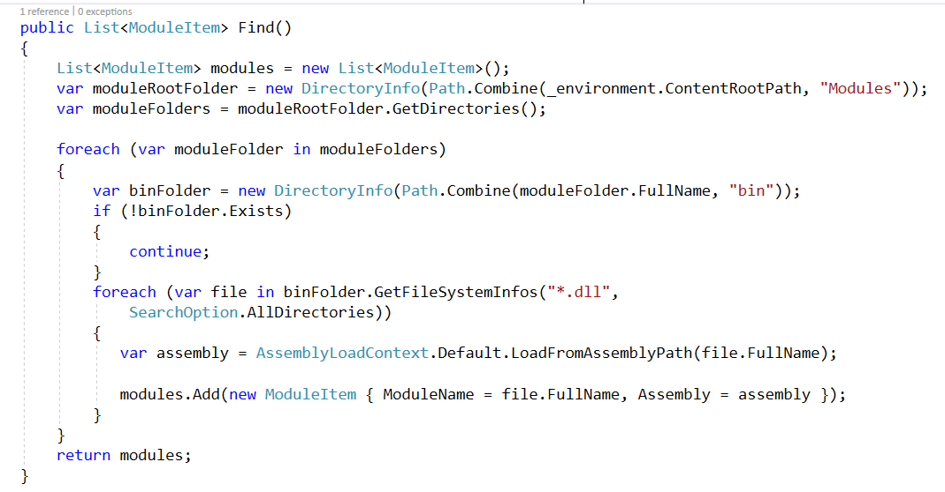

Slide 17
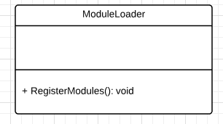
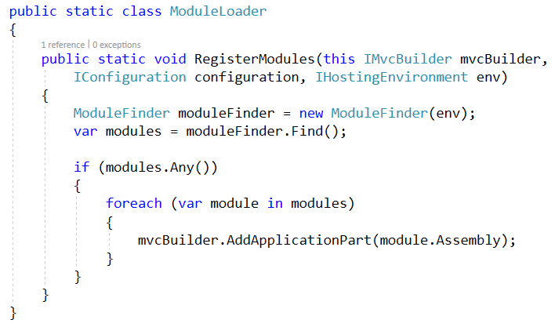
Step 2: Add modules to ApplicationParts
1. RegisterModules function uses ModuleFinder to load modules to memory.
2. Add modules to ApplicationParts.

Slide 18
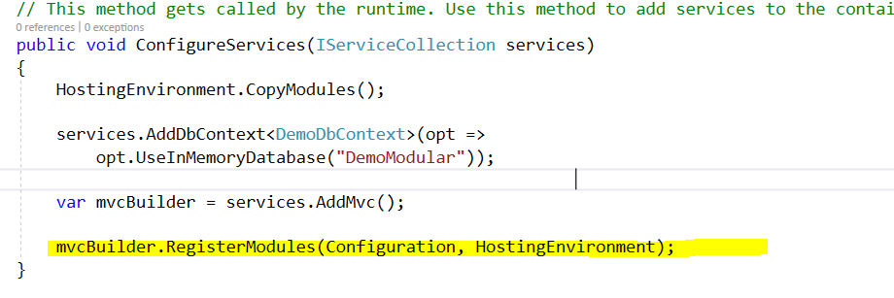
Step 3: Call RegisterModules in Startup.cs

Slide 19
Step 4: Find view of module
By default when we add modules to ApplicationParts, it only understands the code logic which implemented inside module assembly.
So Every time module is executed, there is an error occurs because MVC cannot find module’s view.
=> To resolve this problem you need to work with ViewLocationExpander
1. Create a new class and set its name is “ModuleViewLocationExpander”
2. Implement 2 methods “ExpandViewLocations” and “PopulateValues” from an interface is IViewLocationExpander
3. Modify RegisterModules function of ModuleLoader class to configure our “ModuleViewLocationExpander”

Slide 20
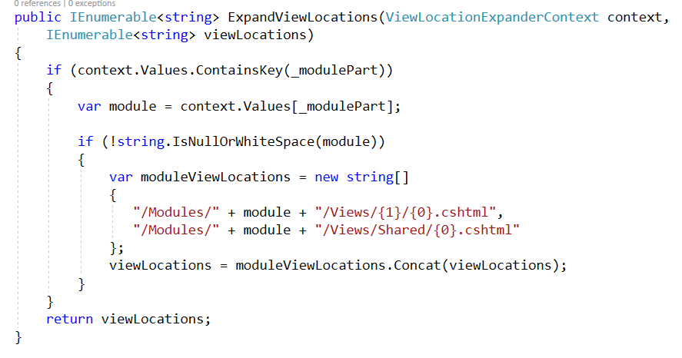

Slide 21
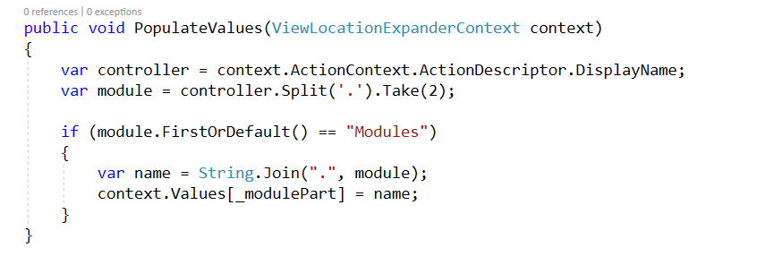

Slide 22
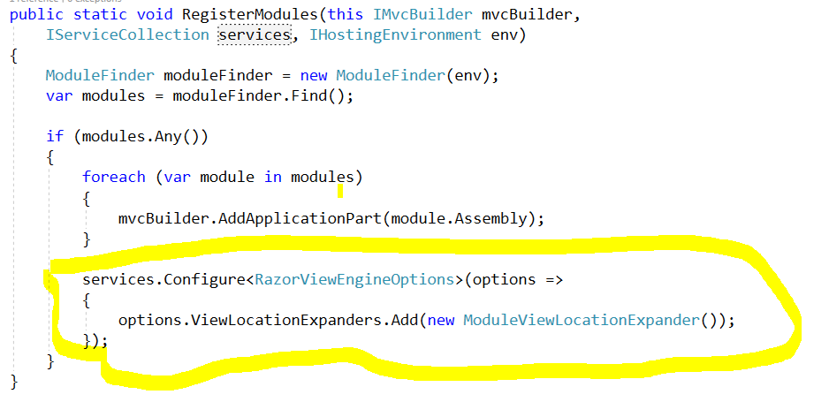

Slide 23
THANK YOU !

