Slide 1


Slide 2
GENERIC REPOSITORY AND UNIT OF WORK

Slide 3
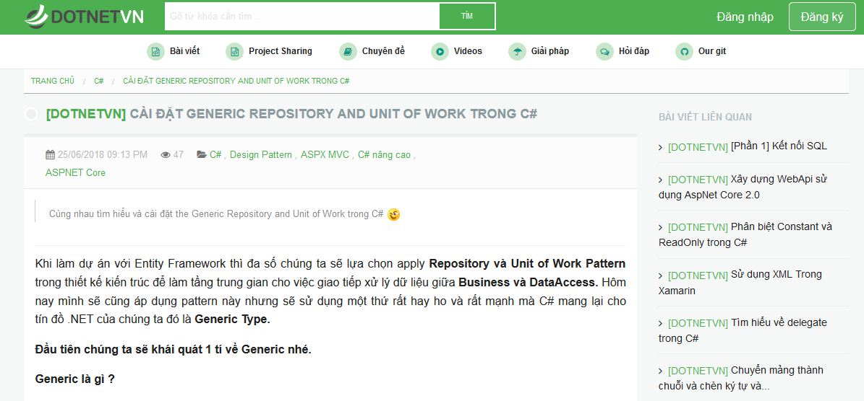
1. WHAT IS GENERIC IN C# ?
Please read more details by clicking the link below:
http:/dotnetvn.com/Cai-dat-Generic-Repository-and-Unit-of-Work-trong-C%23-p114.html

Slide 4
2. WHAT IS REPOSITORY PATTERN ?
Repository pattern is intended to act like a abstraction layer between business logic and data access layer
by focusing on operations (CRUD) of every single entity
WITHOUT REPOSITORY:
- It may has duplicate database operations codes.
- It’s hard to implement Unit Test of database operations and business logic.
- It’s hard to implement database access policies.
WITH REPOSITORY:
- Easily to apply testing for Business logic without data access layer.
- The database access code can be reused.
- Easily to implement database access policies.
- Easily to implement domain logic, only focus on logic of business.

Slide 5
3. WHAT IS UNIT OF WORK?
UnitOfWork is used to make sure database operations like INSERT, UPDATE, DELETE are executed in one transaction. It means that Package all individual actions into a transaction to ensure data integrity.
UnitOfWork
All operations are executed in one transaction
Ensure data integrity

Slide 6
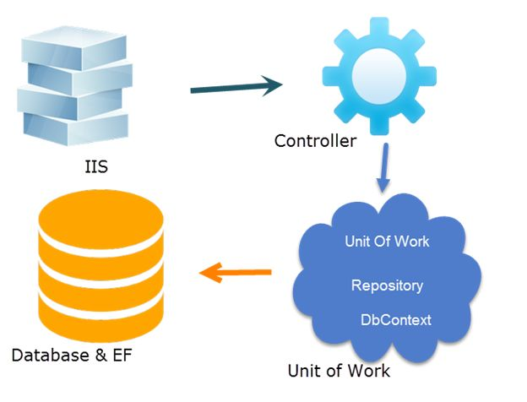
4. COMBINATION BETWEEN REPOSITORY AND UNIT OF WORK

Slide 7
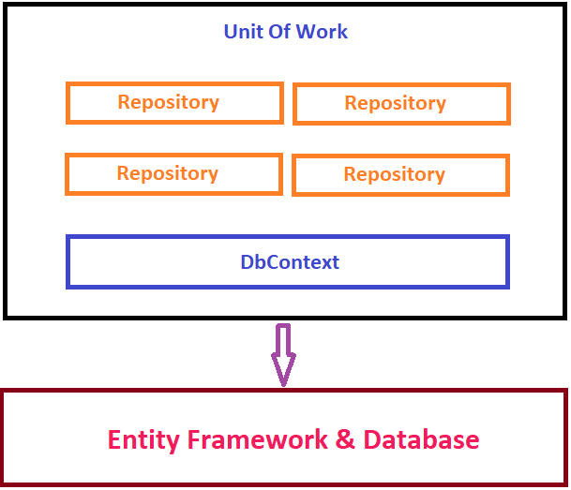
5. IMPLEMENTATION
1. Create new simple web application project uses net core.
2. Build a generic repository class for all entity include database operations:
Insert, Update, Delete, Select
3. Combine UnitOfWork And Generic Repository
Generic Repository ?
A repository generic is one can be used for all entity
without creating single class for every single entity
Source code : http://dotnetvn.com/Cai-dat-Generic-Repository-and-Unit-of-Work-trong-C%23-p114.html

