Slide 1
DOTNETVN
QUEUE AND BACKGROUD JOB IN NET CORE
Author: Linh Pham
Website: http://dotnetvn.com
Facebook Page: https://www.facebook.com/dotnetvn/
Facebook Group: https://www.facebook.com/groups/2358330047574166/
Facebook Profile: https://www.facebook.com/linh.pham.96155

Slide 2
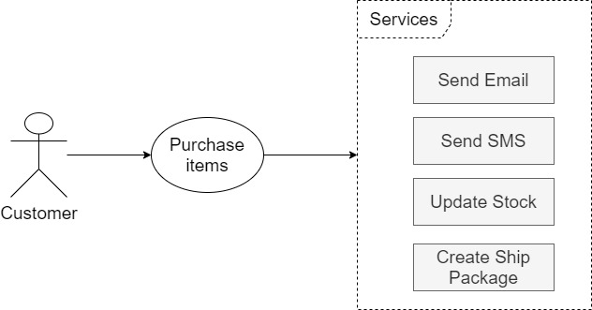
GIVE A PROBLEM AS BELOW
Customer go to our website.
They decided to place a order.
Send email / sms to confirm after order placed.
Update quantity of products in stock
Create shipping information.

Slide 3
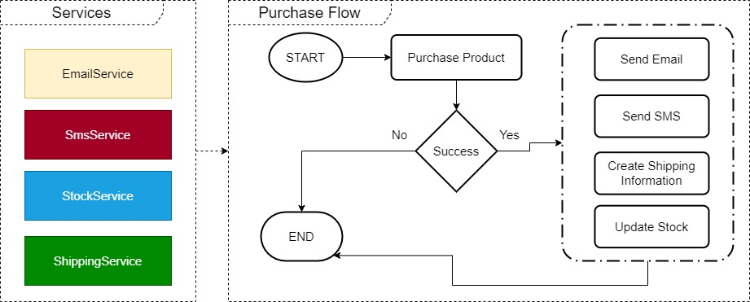
BUILD SOLUTION FOR THIS SCENARIO
SOLUTION 1

Slide 4
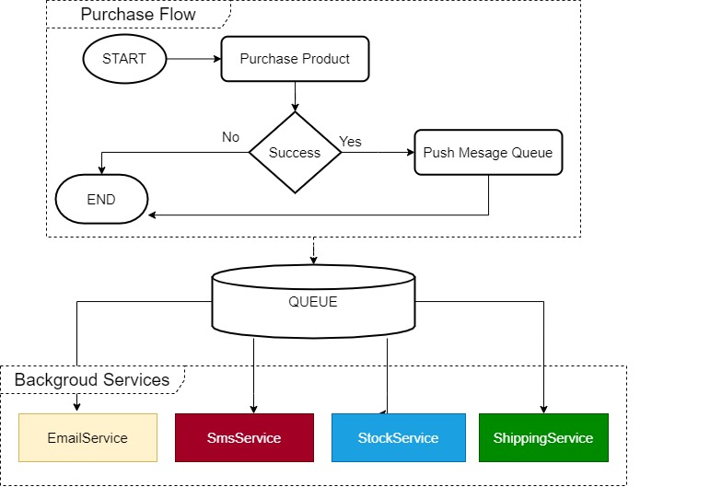
SOLUTION 2

Slide 5
 | SOLUTION 1 | SOLUTION 2
Implement and Deploy | Easy | Difficult
Data size is large | Take time to execute multiples services in one purchase function | Work fine
Multiple connections | Not Stable | Work fine
Scale-able | No | Yes

Slide 6
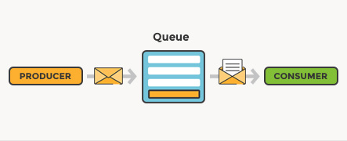
WHAT IS MESSAGE QUEUE
Message queuing allows applications to communicate by sending messages to each other. The message queue provides temporary message storage and the data transported between the sender and the receiver application.
The basic architecture of a message queue is simple. There are client applications called producers that create messages and deliver them to the message queue. Another application, called a consumer, connects to the queue and gets the messages to be processed. Messages placed onto the queue are stored until the consumer retrieves them.
A message queue provides an asynchronous communications protocol, which is a system that puts a message onto a message queue and does not require an immediate response to continuing processing

Slide 7
WHAT IS BACKGROUD JOB SERVICE
A background service is service that run in background thread. It is a non-interactive process that runs behind the normal interactive operations. They run in parallel and do not disturb interactive (foreground jobs) processes and operations
Background Service can be hosted in main Application or can be hosted on a separated application.
APPLICAITON
BACKGROUND SERVICE 1
BACKGROUND SERVICE 2

Slide 8
A FEW MESSAGE QUEUE PROVIDERS TO SHARE YOU GUYS
GOOLE CLOUD MESSAGE QUEUE
AMAZON CLOUD MESSAGE QUEUE
AZURE SERVICE BUS
GOOGLE
AMAZON
MICROSOFT
RABBIT MQ
DATABASE QUEUE
OPEN SOURCE
CREATE QUEUE TABLE (MSSQL, MYSQL…)

Slide 9
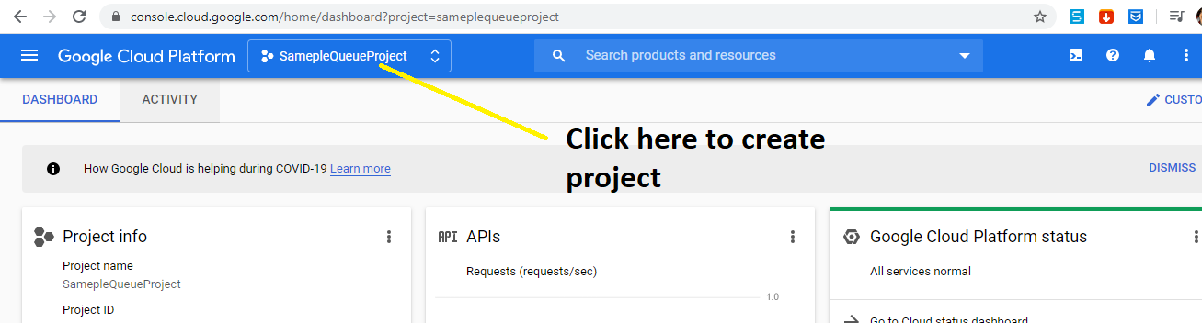
BUILD SOLUTION 2 USE GOOGLE CLOUD
Google Cloud provides a message called is “PUB/SUB”.
Before you go to the demo, please setup environment by following the steps below:
1. You must have a google account (gmail account)
2. Open google console and create a new project or use your existed project: https://console.cloud.google.com/

Slide 10
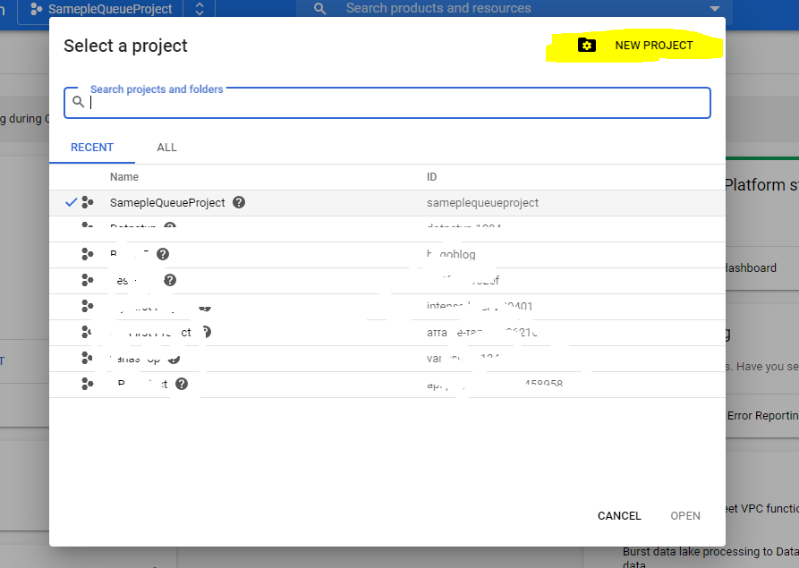

Slide 11
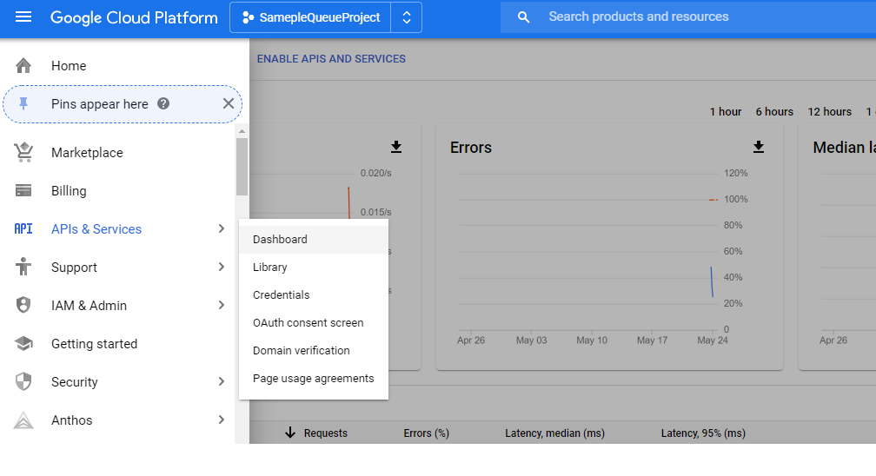
3. Enable Pub/Sub Service
Go to API & Services then open dashboard page

Slide 12
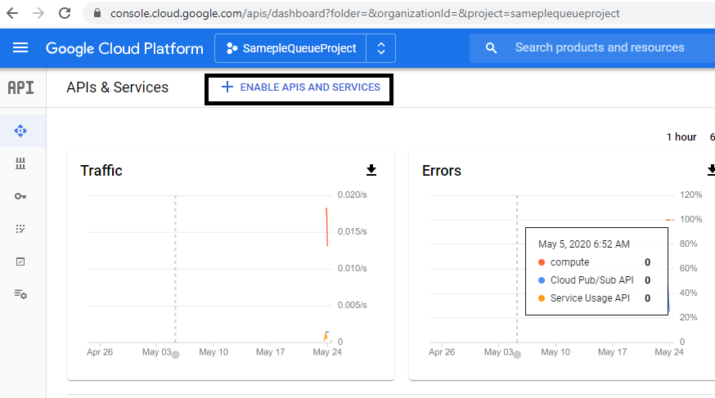
Click “ENABLE APIS AND SERVICES” button

Slide 13
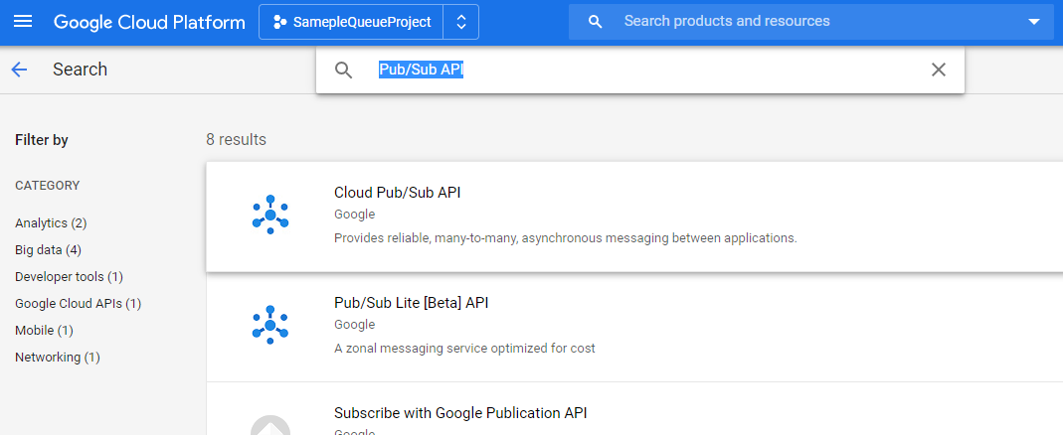
Search: “Pub/Sub API” then click Cloud Pub/Sub API to enable this API

Slide 14
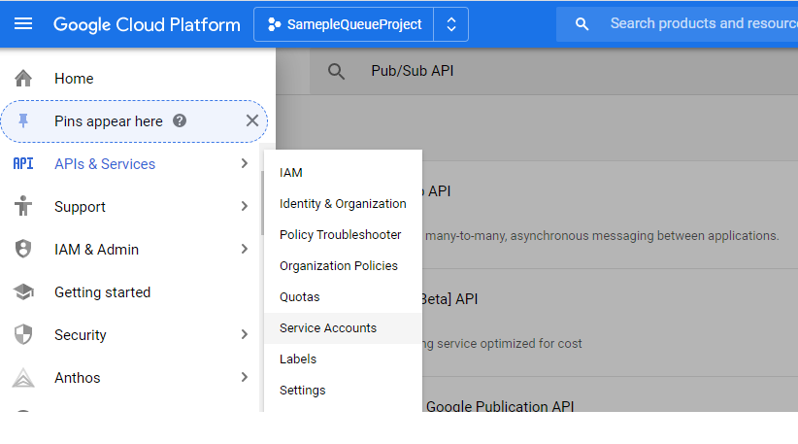
4. Create service account
Back to “Main Menu” then go to “IAM & Admin” and open Service Accounts Page

Slide 15
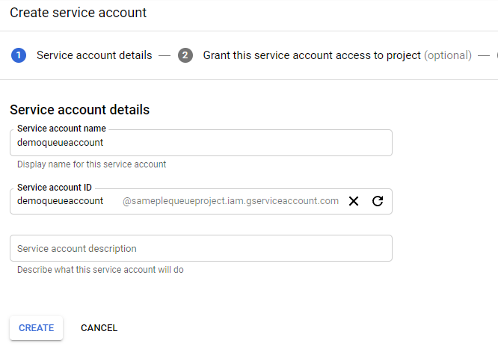
Create a new service account by clicking “CREATE SERVICE ACCOUNT” button

Slide 16
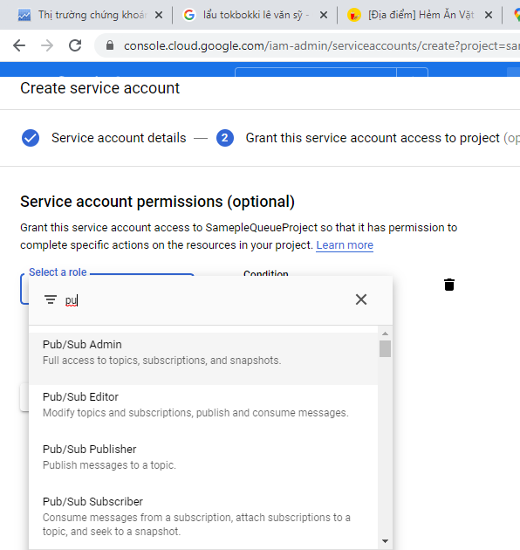
Assign “Pub/Sub Admin” Role for your account and click continue to move to next step

Slide 17
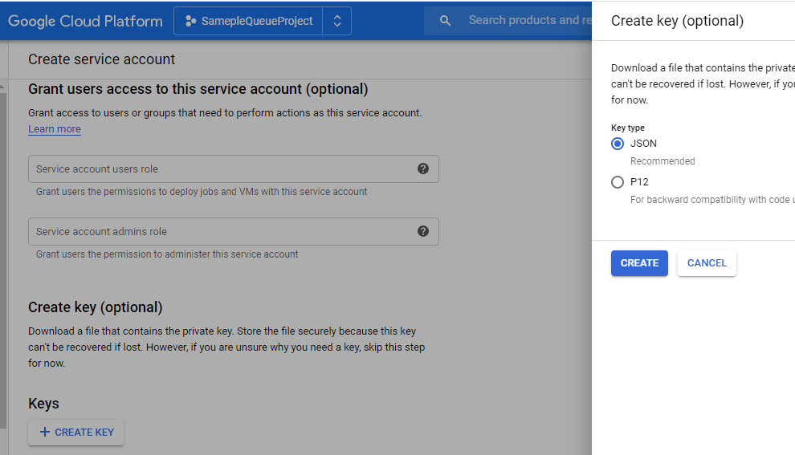
Click “CREATE KEY” button and choose key type is “JSON” then continue to click CREATE button
1. A json file will be generated and download automatically to your machine, please keep this file to use for your project.
2. Click on “Done” button to finish

Slide 18
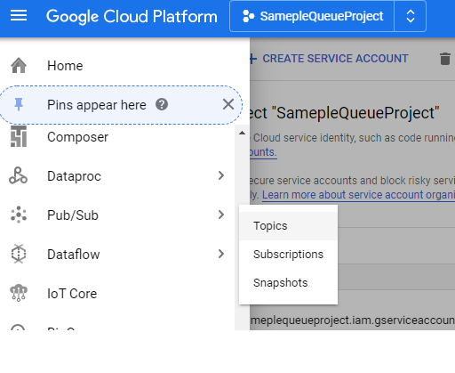
5. Create Topic and Subscription
Back to “Main Menu” scroll down to see “Pub/Sub” Menu
TOPIC: A topic is the subject of the information that is published in a publish/subscribe message
SUBCRIPTION: A subscription is a discrete pull of messages from a topic

Slide 19
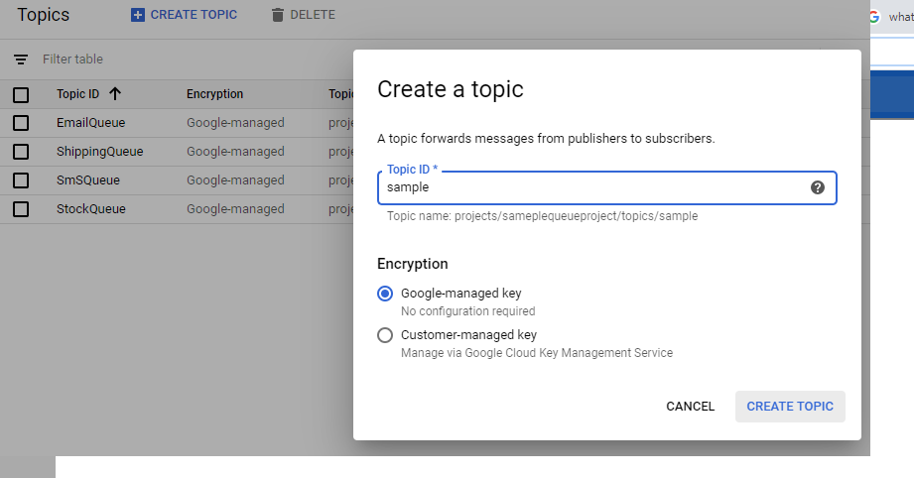
Create a topic that you want

Slide 20
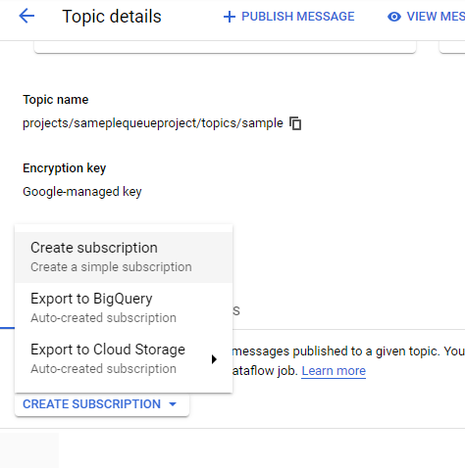
Go to Topic detail and create a subscription for your topic

Slide 21
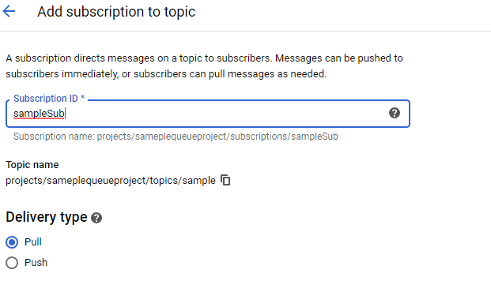
Input name of subscription and select Delivery type is “Pull” then click Create button to finish

Slide 22
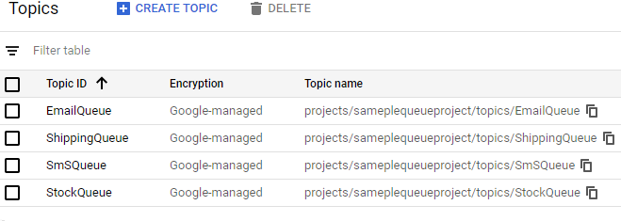
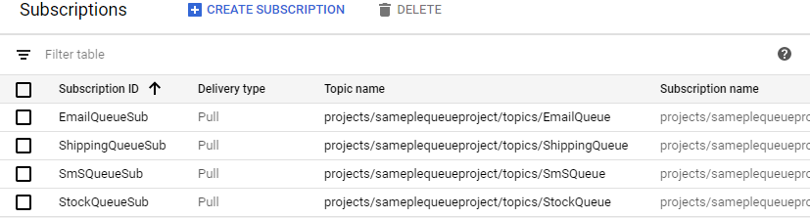
Finally we got some topics and subscriptions like this

Slide 23

EVERYTHING IS ALREADY NOW
OK WE MOVE TO CODING
TECHNICAL IN USE:
NET CORE 3.1.
GOOGLE PUB/SUB API (MESSAGE QUEUE PROVIDER).
SERVICE WORKER IN NET CORE 3 (SUBCRIBER).
BACKGROUD SERVICE USE IHOSTED SERVICE IN ASP NET CORE (PUBLISHER).

Slide 24
SOURCE AND REFERENCES
1. Source Code: https://github.com/dotnetvn-projects/MessageQueueAndBackgroudJob
2. Backgroud Task In ASPNET CORE: https://docs.microsoft.com/en-us/aspnet/core/fundamentals/host/hosted-services?view=aspnetcore-3.1&tabs=visual-studio
3. Worker Service NET CORE 3: https://devblogs.microsoft.com/premier-developer/demystifying-the-new-net-core-3-worker-service/

