Slide 1
DOTNET VN
MIDDLEWARE IN ASPNET CORE 2.x

Slide 2

1. WHAT IS MIDDLEWARE?
ASP.NET Core introduced a new concept called middleware.
Middleware is nothing but software component that is assembled into an application pipeline to handle requests and responses
What can Middleware do?
Controls how application respond to HTTP requests
How to authenticate and authorize a user to perform specific actions
How the application behaves if there is an error.
More……

Slide 3
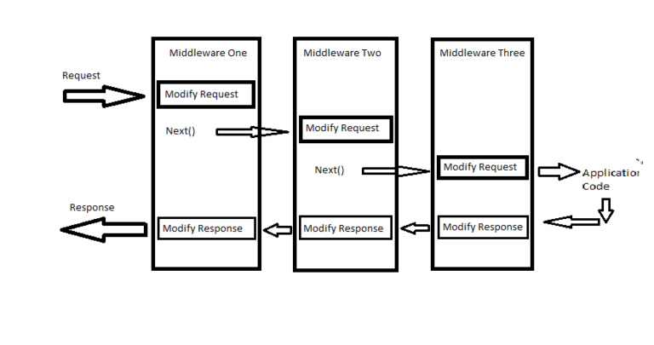
2. HOW DOES MIDDLEWARE WORK?

Slide 4
3. HOW TO CONFIG MIDDLEWARE IN ASPPNET CORE?
We can configure middleware in the Configure method of our startup class using IApplicationBuilder Instance
Basically of creating middleware in AspNet Core:
4. app.Map("/test", (appBuilder) =>
{
appBuilder.Run(async (context) => {
await context.Response.WriteAsync("Hello ");
});
});
1. app.Use((context, next) =>
{
// Your code
});
2. app.UseMiddleware<YourMiddlewareClass>()
3. app.Run(async (context) =>
{
await context.Response.WriteAsync("Hello World!");
});

Slide 5
4. HOW MANY TYPE OF MIDDLEWARE IN ASPNET CORE?
Main point: Middleware will do some businesses that you need to handle request or response
In AspNet Core, they support 3 types of middleware
USE
RUN
MAP / MAPWHEN
The middleware can decide whether it will continue to pass the processed request to the next middleware.
In case It call the next middleware, we call it is “SHORT CIRCUIT”
End of the Pipeline
Note: No “SHORT CIRCUIT”
Map: Branch the request based on match of the specified request path only.
MapWhen: Allows you to use very specific conditions for branching request pipeline
Note: No “SHORT CIRCUIT”

Slide 6
5. HOW CREATE A CLASS AS A MIDDELWARE?
public class MyMiddleware
{
private readonly RequestDelegate _next;
public MyMiddleware(RequestDelegate next)
{
_next = next;
}
public async Task Invoke(HttpContext context)
{
//Do somethings
await _next(context);
}
}
Use Middleware in (startup.cs):
app.UseMiddleware<MyMiddleware>();

Slide 7
Built-in Middleware in ASP NET Core
There are many other built-in middleware plug-ins available at NuGet Package. That we can use in our ASP.NET Core application. See below the list of Built-in plugins.
Authentication: Provides authentication support.
CORS: Configures Cross-Origin Resource Sharing.
Diagnostics: Configures diagnostics.
Response Caching: Provides support for caching responses.
Response Compression: Provide support for compressing support.
Routing: Defines and constrains request routes.
Session: Provides support for managing the user session.
Static Files: Provides support for serving static files and directory browsing.
URL Rewriting: Provides support for rewriting URLs and redirecting requests.
WebSockets: Enables the WebSockets protocol.

Slide 8
5. DEMO IN ASPNET CORE
We are going to build a middleware to handle authentication and exception
Please open source code for more details!.

