Slide 1
DOTNETVN
SOLID DESIGN PRINCIPLES - #3 LISKOV-SUBstitution PRINCIPLE
To be a professional developer
Author: Linh Pham
Website: http://dotnetvn.com
Facebook Page: https://www.facebook.com/dotnetvn/
Facebook Group: https://www.facebook.com/groups/2358330047574166/
Facebook Profile: https://www.facebook.com/linh.pham.96155

Slide 2
WHAT IS IT?
Let q(x) be a property provable about objects of x of type T. Then q(y) should be provable for objects y of type S where S is a subtype of T.
=> It extends Open-Closed Principle by focusing on the behavior of a superclass and its subtypes
If S is a subtype of T, then objects of type T may be replaced with objects of type S (i.e., objects of type S may substitute objects of type T) without altering any of the desirable properties of that program

Slide 3
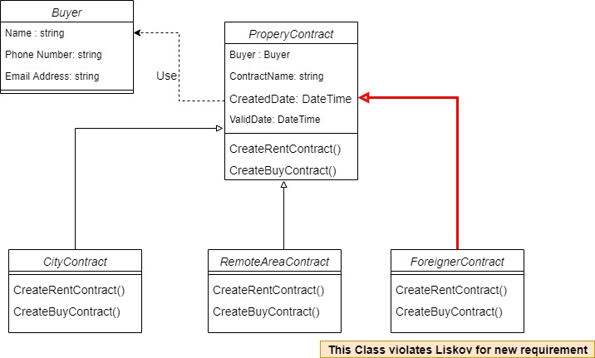
Before using Liskov-Substitution

Slide 4
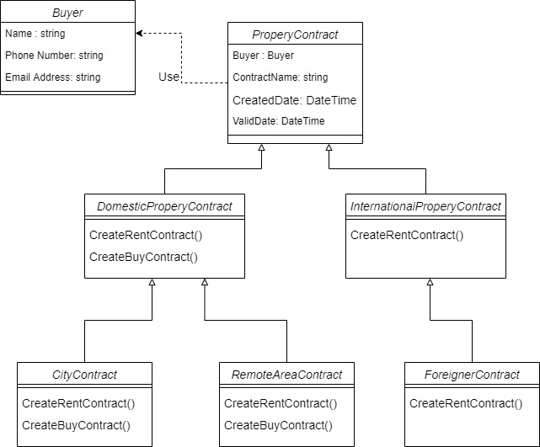
After using Liskov-Substitution

Slide 5
START CODING WITH CONTRACT FOR BUYING HOUSING PROGRAM
Write a program uses C# language in console mode to create a contract for buying housing in Viet Nam as below:
For Rent Contract.
For Sell Contract.
NEW REQUIREMENT:
Now we accepted to foreigner who can own property in Viet Nam but only for rent within 50 years

Slide 6
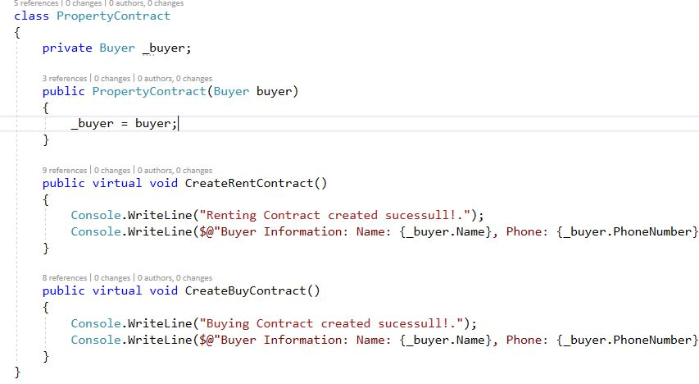
It looks good ☺

