Slide 1
DOTNETVN
SOLID DESIGN PRINCIPLES - #4 Interface Segregation PRINCIPLE
To be a professional developer
Author: Linh Pham
Website: http://dotnetvn.com
Facebook Page: https://www.facebook.com/dotnetvn/
Facebook Group: https://www.facebook.com/groups/2358330047574166/
Facebook Profile: https://www.facebook.com/linh.pham.96155

Slide 2
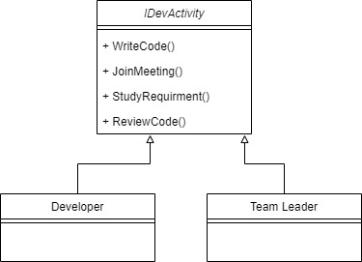
WHAT IS IT?
A client should never be forced to implement an interface that it doesn't use or clients shouldn't be forced to depend on methods they do not use.
Before Applying ISP

Slide 3
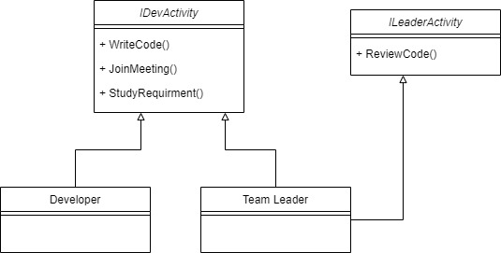
After Applying ISP

Slide 4
START CODING DEVELOPER ACTIVITY PROGRAM
Write a program uses C# language in console mode to demonstrate Dev Activity:
- WriteCode()
- JoinMeeting()
- StudyRequirement()
- ReviewCode()

Slide 5
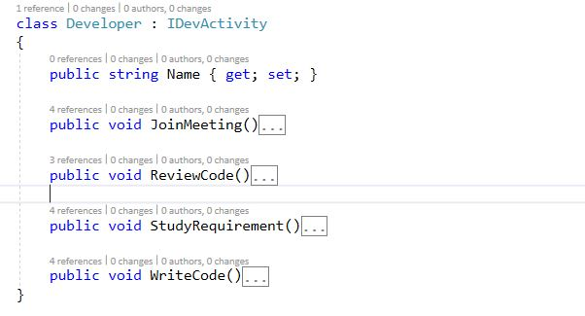
It looks good ☺

