Slide 1
DOTNETVN
SOLID DESIGN PRINCIPLES - #2 OPEN-closed PRINCIPLE
To be a professional developer
Author: Linh Pham
Website: http://dotnetvn.com
Facebook Page: https://www.facebook.com/dotnetvn/
Facebook Group: https://www.facebook.com/groups/2358330047574166/
Facebook Profile: https://www.facebook.com/linh.pham.96155

Slide 2
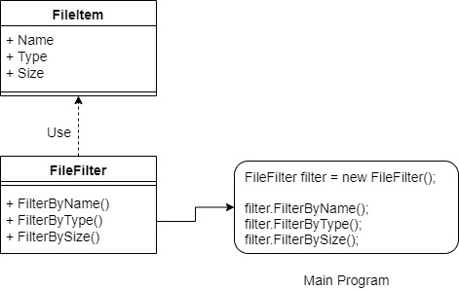
WHAT IS IT?
Objects or entities should be open for extension, but closed for modification.
Before using Open-Closed

Slide 3
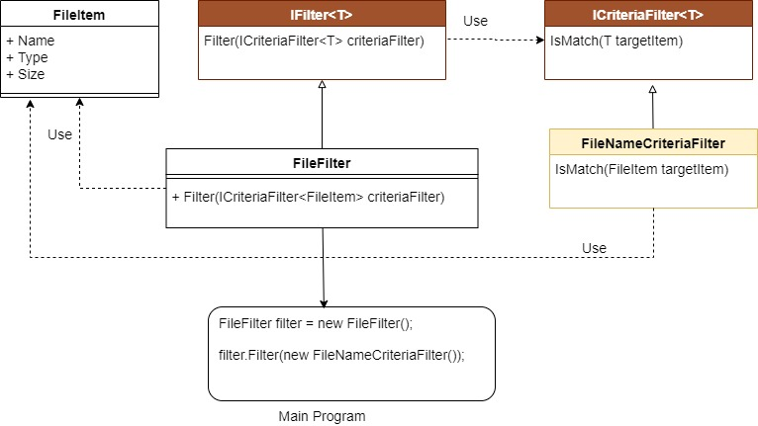
After using Open-Closed

Slide 4
START CODING WITH FILLTER PROGRAM
Write a program uses C# language in console mode to create files filter functions as below:
FilterByName
FilterByType
FilterByFileSize

Slide 5
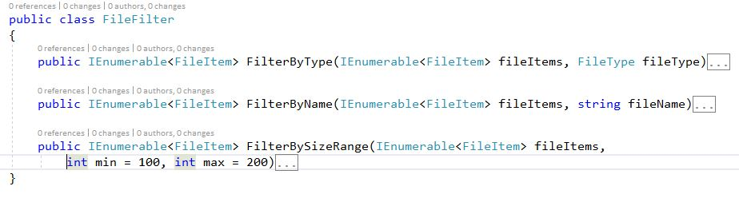
It looks good ☺

