Slide 1
DOTNETVN
SOLID DESIGN PRINCIPLES - #1 Single Responsibility principle
To be a professional developer
Author: Linh Pham
Website: http://dotnetvn.com
Facebook Page: https://www.facebook.com/dotnetvn/
Facebook Group: https://www.facebook.com/groups/2358330047574166/
Facebook Profile: https://www.facebook.com/linh.pham.96155

Slide 2
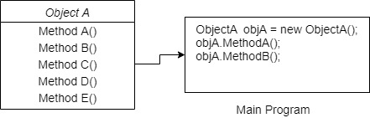
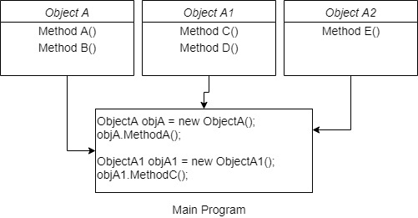
WHAT IS IT?
A class should have one and only one reason to change, meaning that a class should have only one job.
Before using Single Responsibility
After using Single Responsibility

Slide 3
START CODING WITH MY DIARY BOOK PROGRAM
Write a program uses C# language in console mode to create a diary book with functions as below:
Add a diary
Remove a diary
Save to text file
GetDiaryBook
Log error

Slide 4

It looks good ☺

