Slide 1
DOTNETVN
SOLID DESIGN PRINCIPLES - #5 Dependency inversion principle
To be a professional developer
Author: Linh Pham
Website: http://dotnetvn.com
Facebook Page: https://www.facebook.com/dotnetvn/
Facebook Group: https://www.facebook.com/groups/2358330047574166/
Facebook Profile: https://www.facebook.com/linh.pham.96155

Slide 2
WHAT IS IT?
Entities must depend on abstractions not on concretions. It states that the high level module must not depend on the low level module, but they should depend on abstractions.

Slide 3
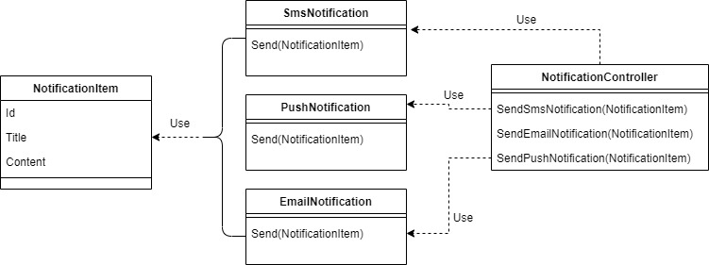
Before Applying DI

Slide 4
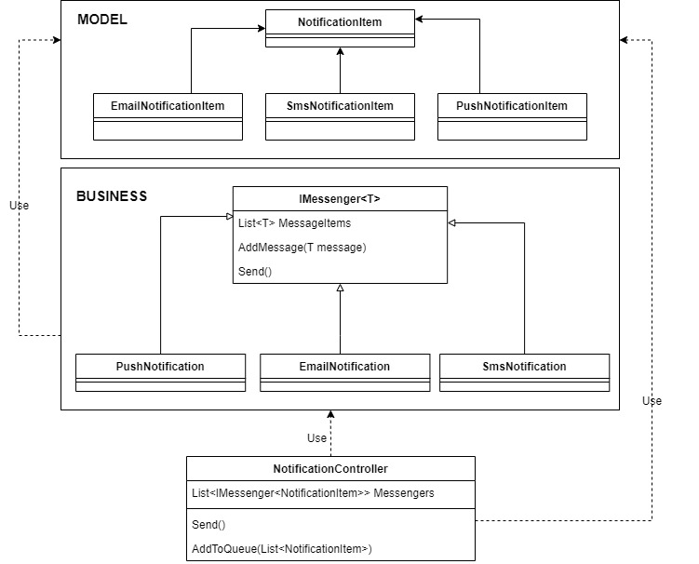
After Applying DI

Slide 5
START CODING NOTIFICATION PROGRAM
Write a program uses C# language in console mode to demonstrate sending notification with type as below:
- Send notification via Email
- Send notification via Sms
- Send notification via Push

Slide 6
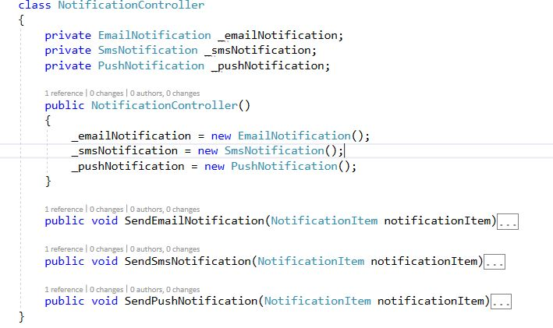
It looks good ☺

