Slide 1
INVESTMENT HOME
For the AirBnB Rental

Slide 2
Introduction
Create a company that provides house and hotel-grade service with housekeeping in Istanbul
Istanbul is a historical and popular place to visit.
For that reason, we are wondering which locations are suitable.

Slide 3
Data
AirBnB Istanbul Dataset
Endeksa House Indexing Website
Foursquare API

Slide 4
Methodology
Show Locations on Map
Find Popular Plaes in Neighbourhood Basis
Find Centroid of the Dataset Using K-Mean Clustering
Find Popular Centroids according to Hotel Numbers Around
Determine AirBnB Prices According to Frequency Distribution

Slide 5
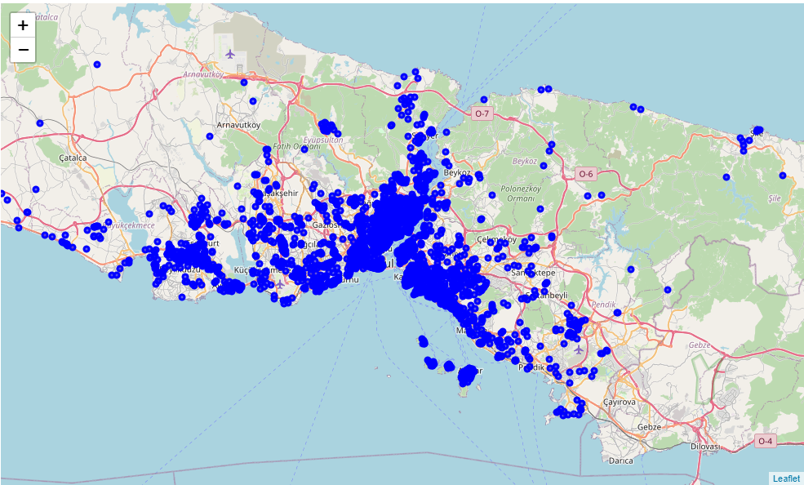
AirBnB Rentals Over Istanbul

Slide 6
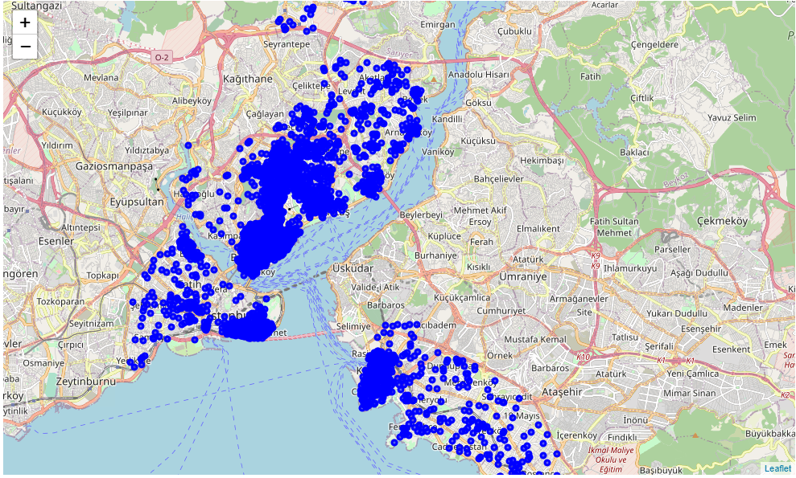
Limited Rentals in Neighborhood Basis
Places that have more than 500 AirBnB
Beyoğlu
Şişli
Fatih
Kadıköy
Beşiktaş

Slide 7
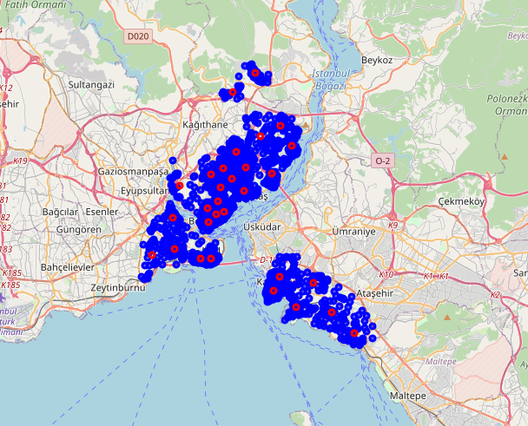
K-Mean Centroids (30 Clusters)

Slide 8
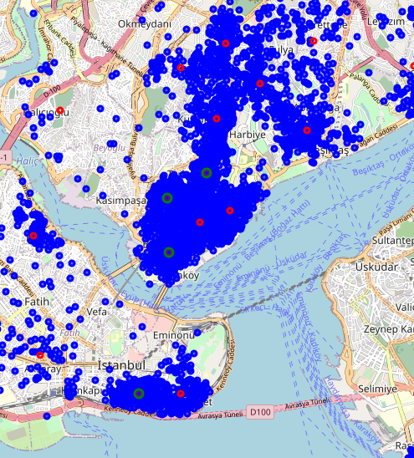
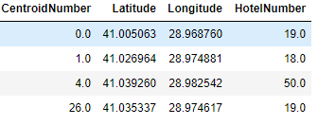
Popular Centroids according to Hotel Numbers Around
More than 10 Hotels in 100m Radius
The places are in the Fatih and Beyoğlu.

Slide 9
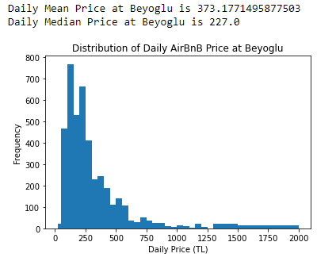
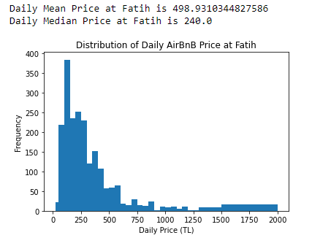
Determine AirBnB Prices According to Frequency Distribution
Daily Rental for Beyoglu is selected 450 TL per day and Daily Rental for Fatih is Selected 500 TL per day.
Occupancy rate at montly basis is assumed %45 percent of the month.
Monthly airBnB rental prices of Beyoglu and Fatih is 6075.0 TL and 6750.0 TL per month, respectively.

Slide 10
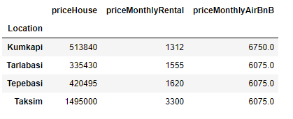
Results

Slide 11
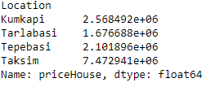
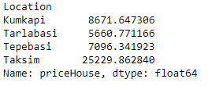
Discussion – Loan Based Investment
Interest : %1.35
Period: 120 Month
Future Values
Monthly Payments

Slide 12
Discussion – Profit
The only profitable place is Tarlabasi with %6.8 in monthly basis.
Turkey's infilation rate is %12 according to TUIK data. We can calculate net present value of the profit from house at Tarlabasi. Net Present value of Tarlabasi investment is 29160 TL.

Slide 13
Conclusion
We can profit %8.6 if we invest house at Tarlabasi.
Payback period of the investment is 102 months.
For Other Places we make loss. For Kumkapı, Tepebaşı and Taksim, we make loss %28.4, %16.8 and %315 in monthly basis.
This investment is not a good investment.

