Slide 1




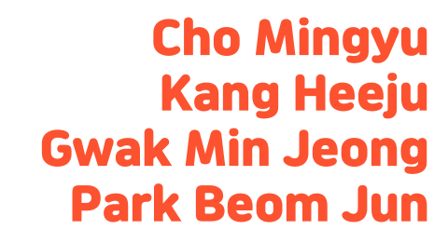

Slide 2

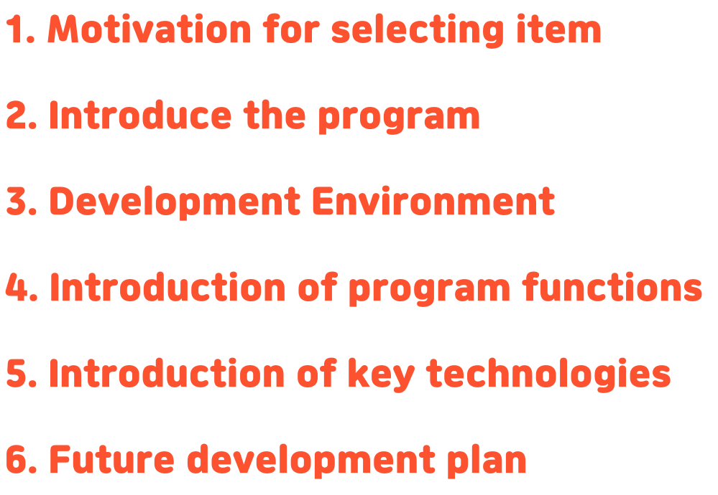

Slide 3
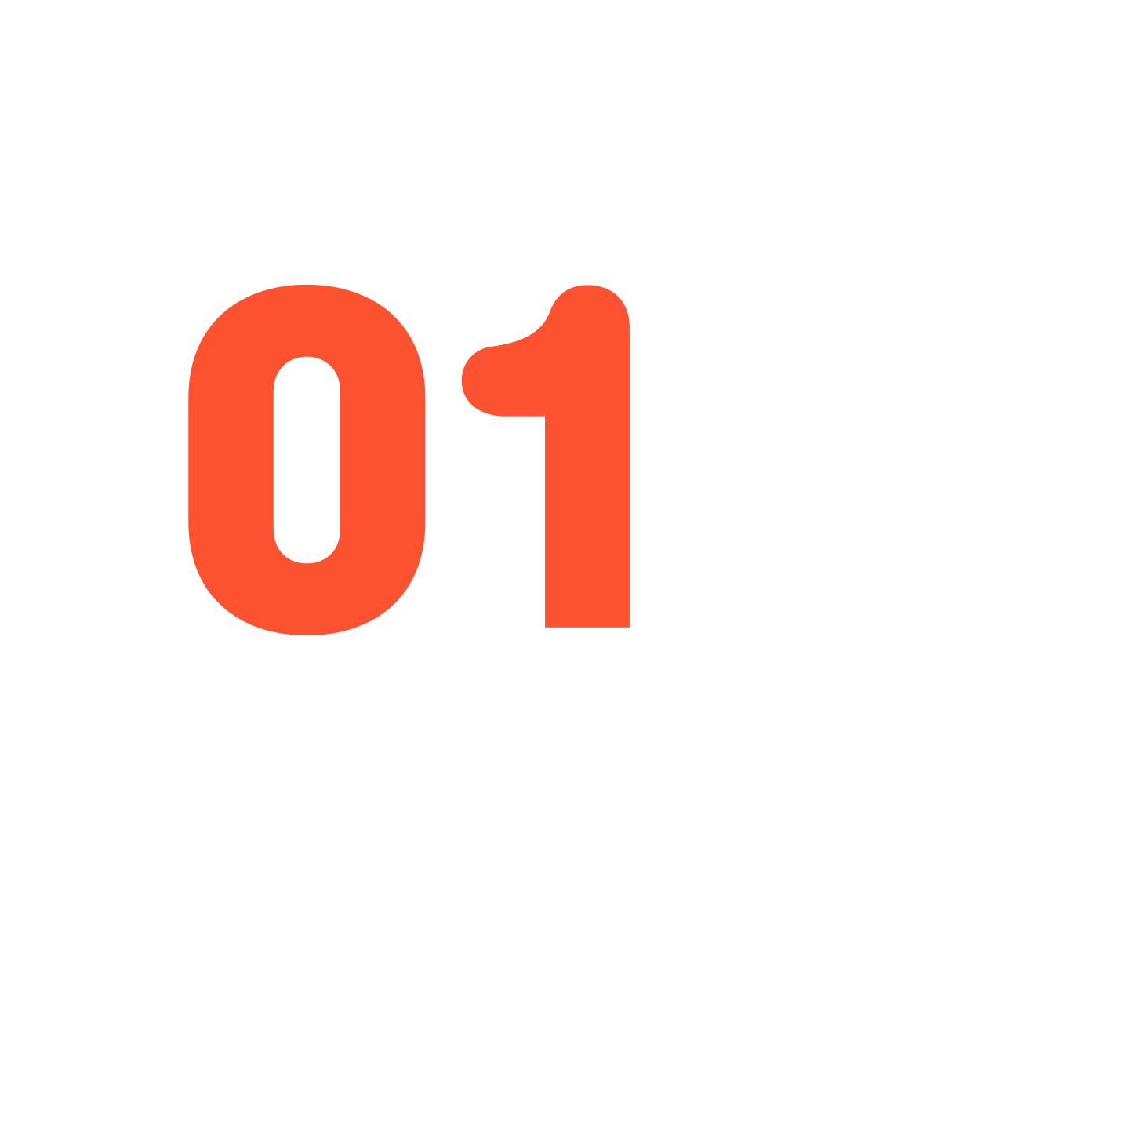


Slide 4







Slide 5
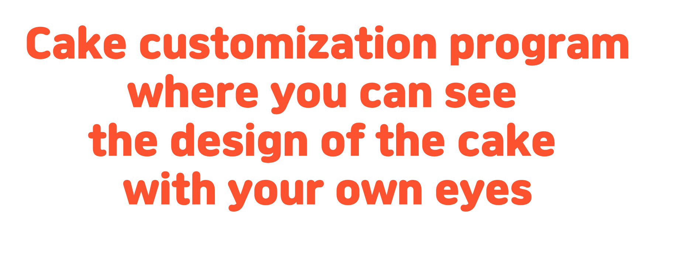

Slide 6
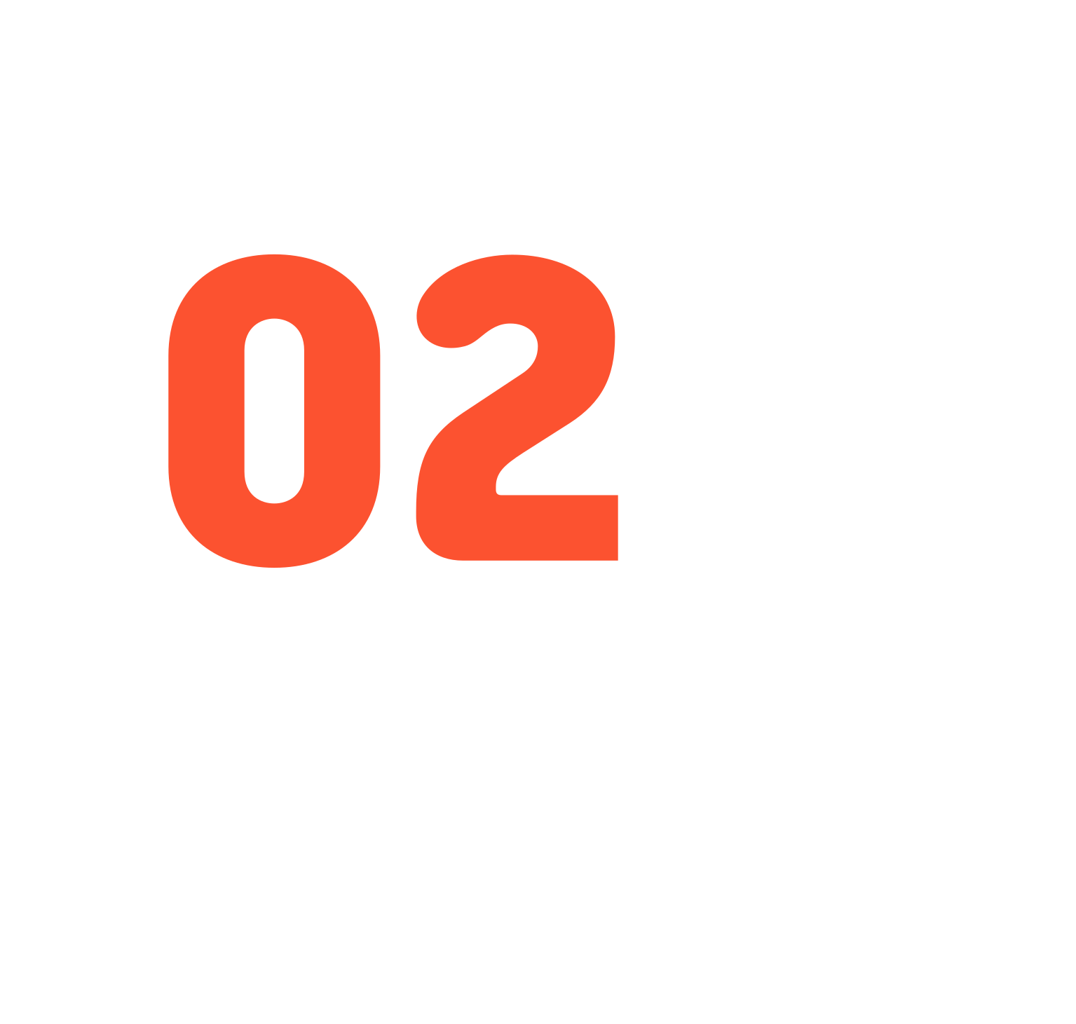

Notes:
now let me introduce the program. We developed a program that consumers can use to trade custom cakes.

Slide 7

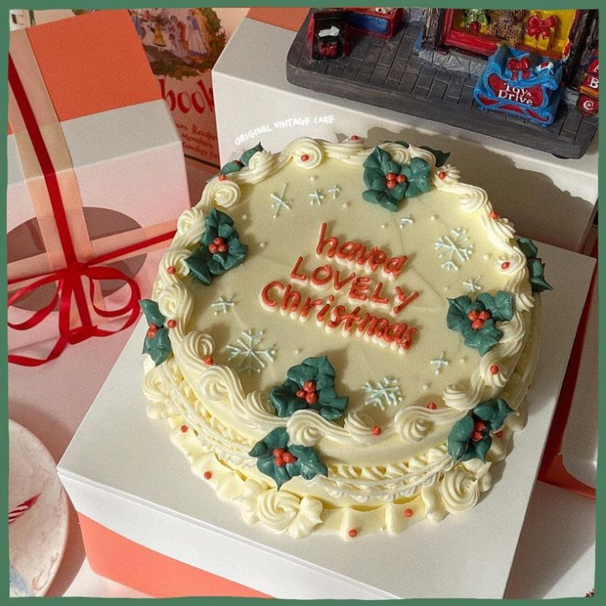
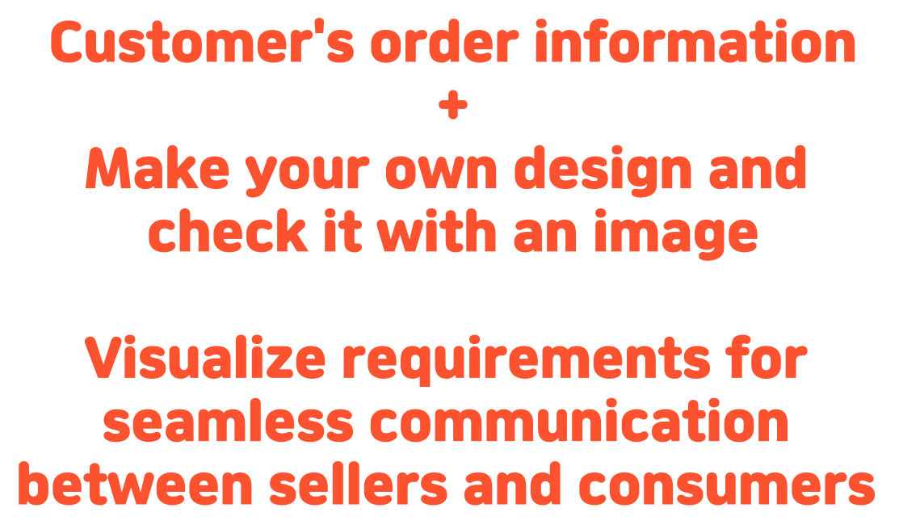
Notes:
This program helps smooth communication between sellers and consumers. The main function is to receive the information of the consumer needed when purchasing and to draw the desired cake design. First, customers can enter their own information like name, phoneNumber, pickup-date, and requirements. Then, draw the design they want. When drawing a design, customer can add whipped cream and write down a phrase. You can complete the design you want like this. Once an order has been received, the seller will be able to view the order's information through the database. The seller doesn't care about missing information. And the seller can make the cake by looking at the design made by the customer.

Slide 8
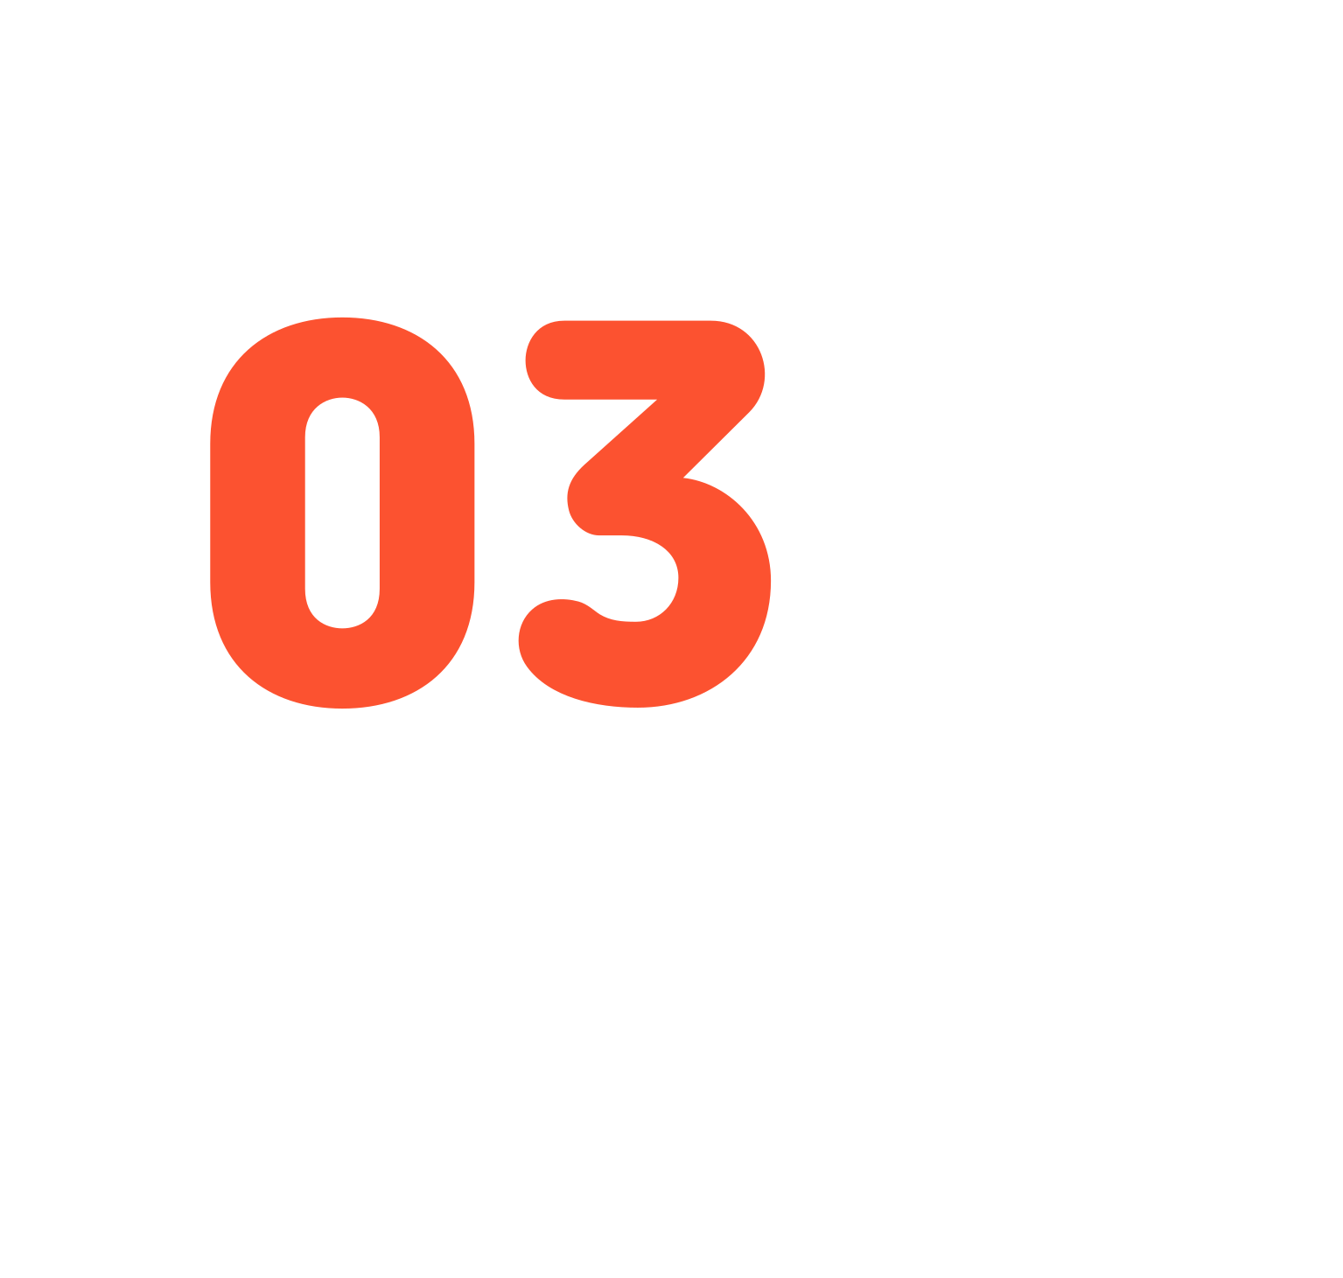


Slide 9





Slide 10
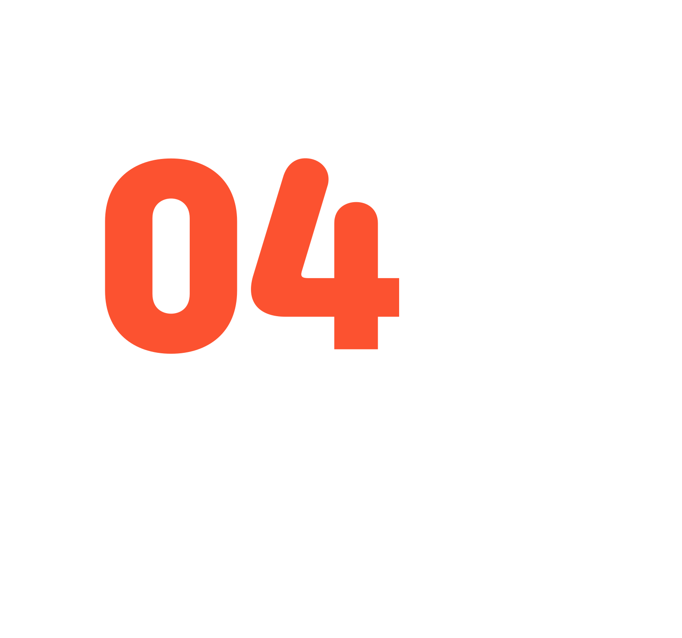

Slide 11
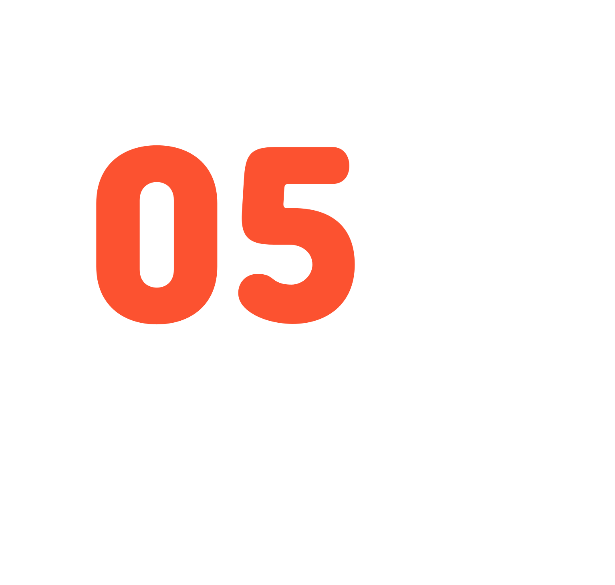


Slide 12

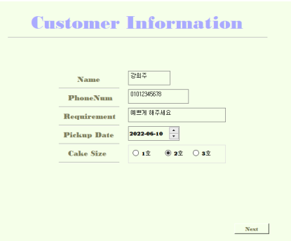

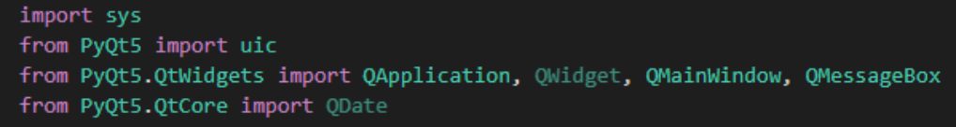
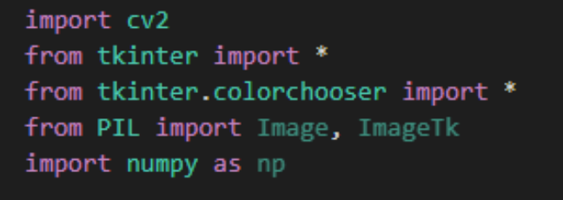

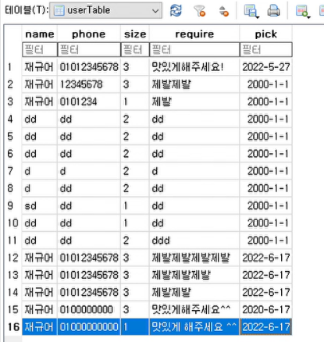

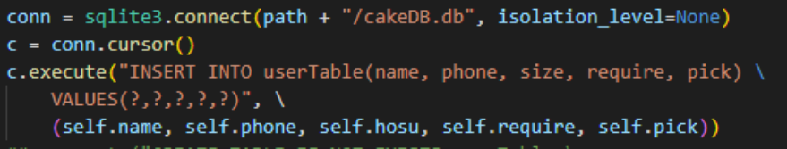
Notes:
I used the pyqt library to call up the ui that Hijoo made and implemented the function. When the next button is pressed, the btnClick() function is executed The btnClick() function retrieves information from text box, radio button, and a calendar containing name, phone number, requirements, pick-up date, cake size information, and stores it in a database. If the information is insufficient, a warning phrase is displayed. After storing the data in the database, call a function that allows you to edit the design.

Slide 13
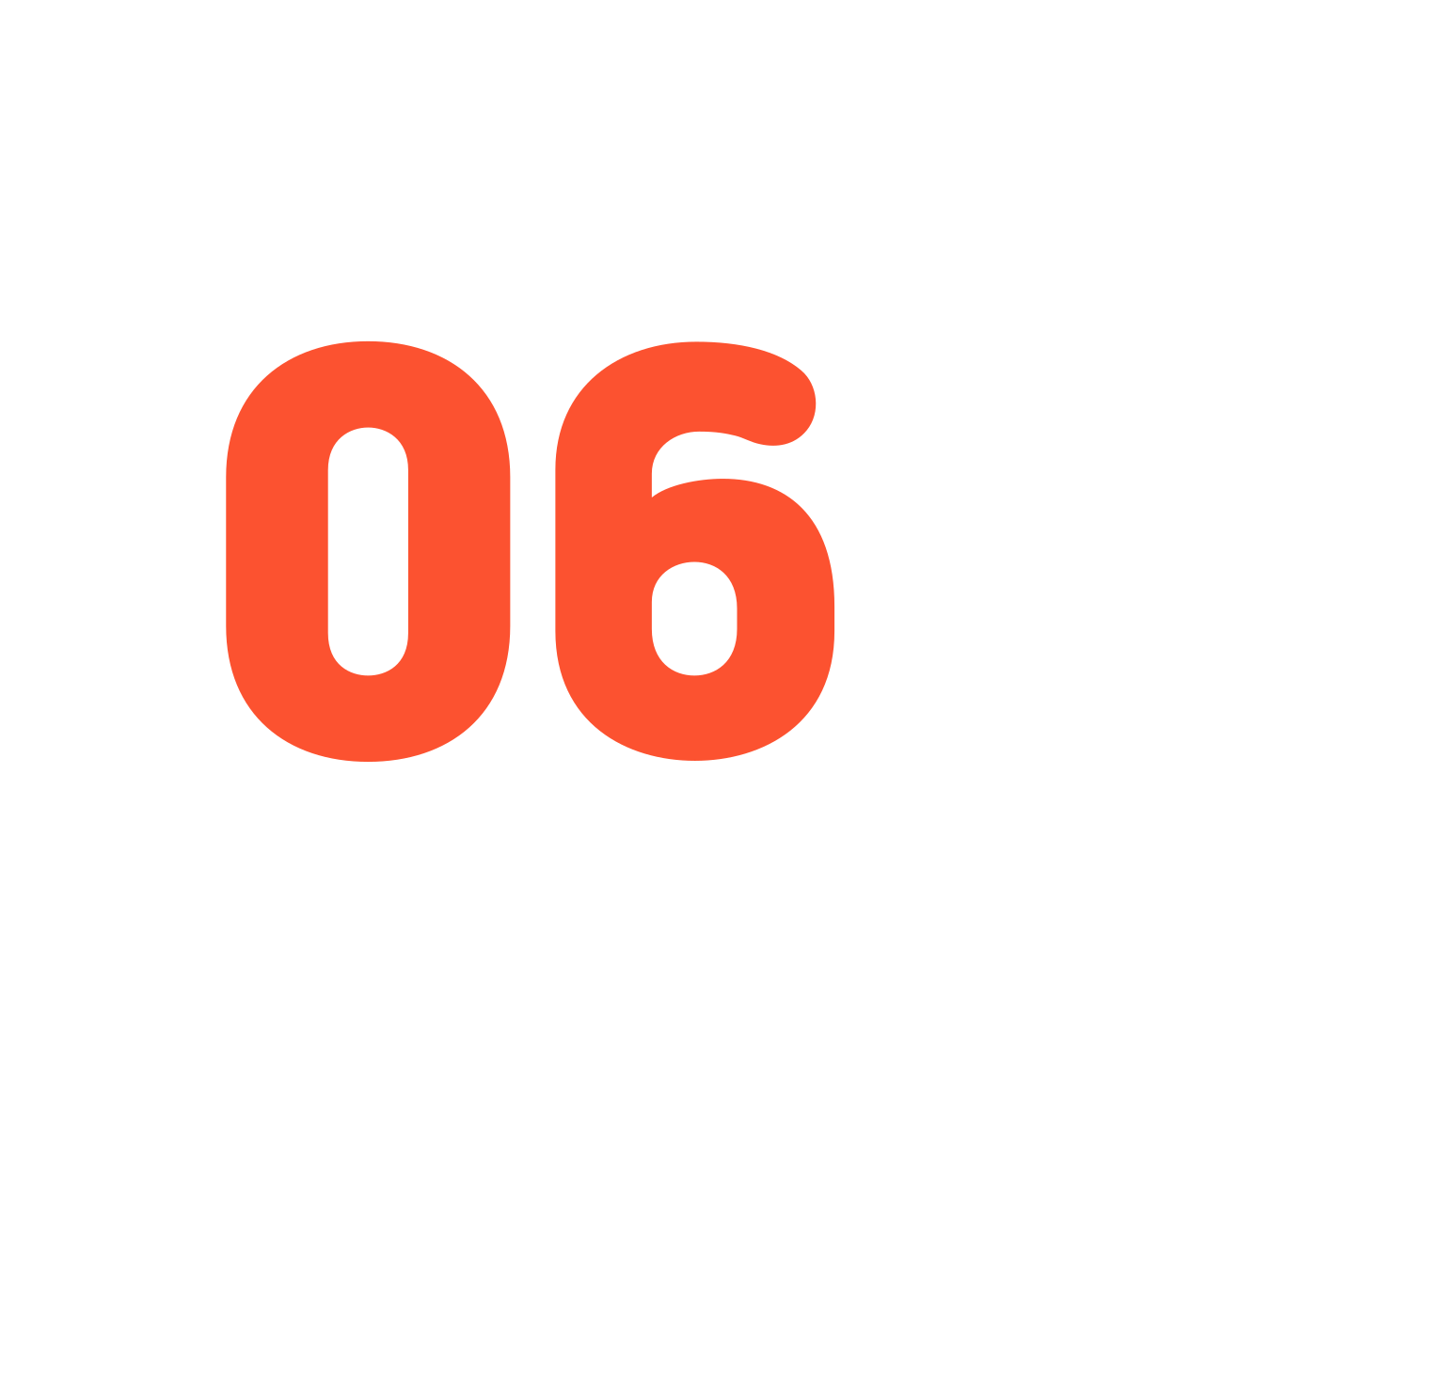


Slide 14

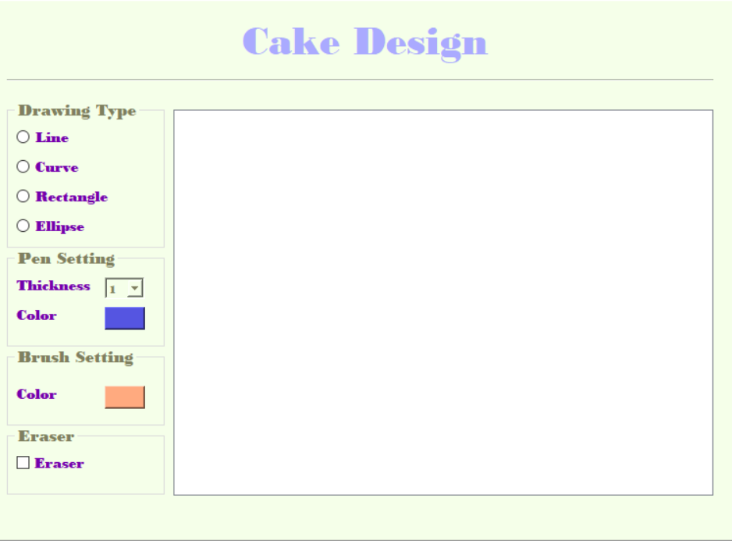
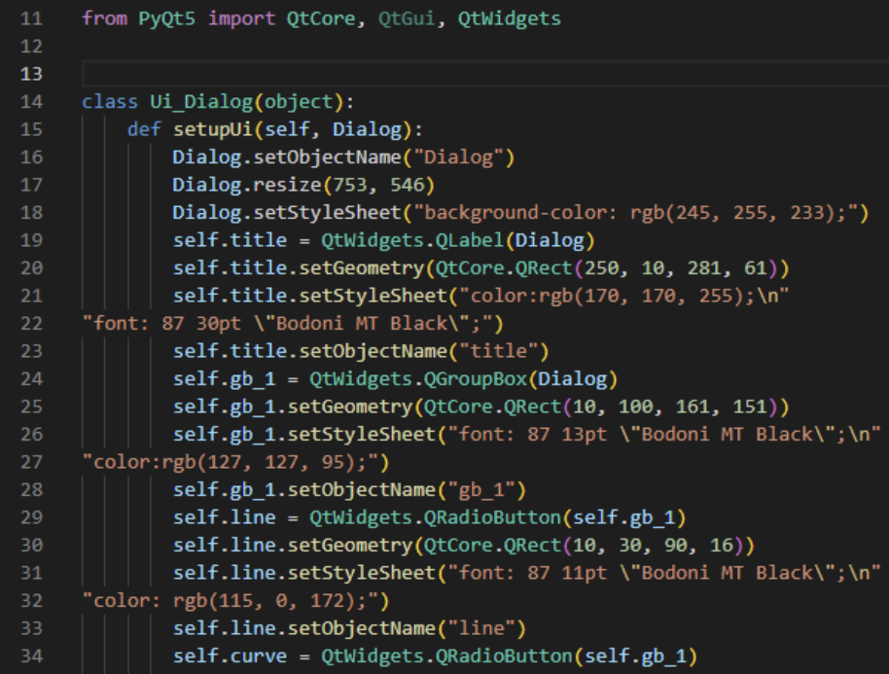

Slide 15








Slide 16



