Slide 1
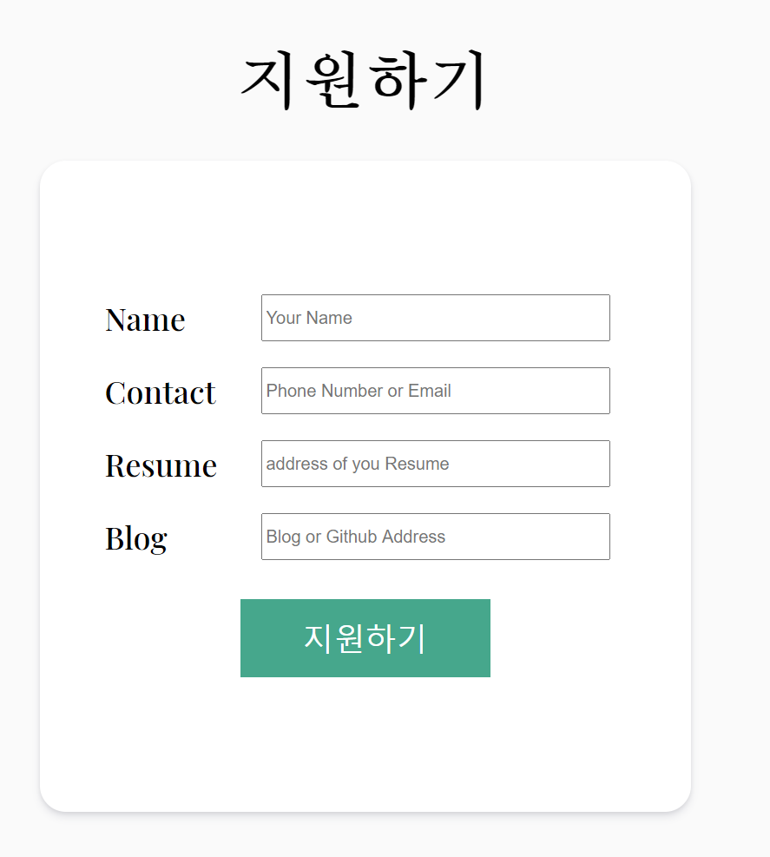
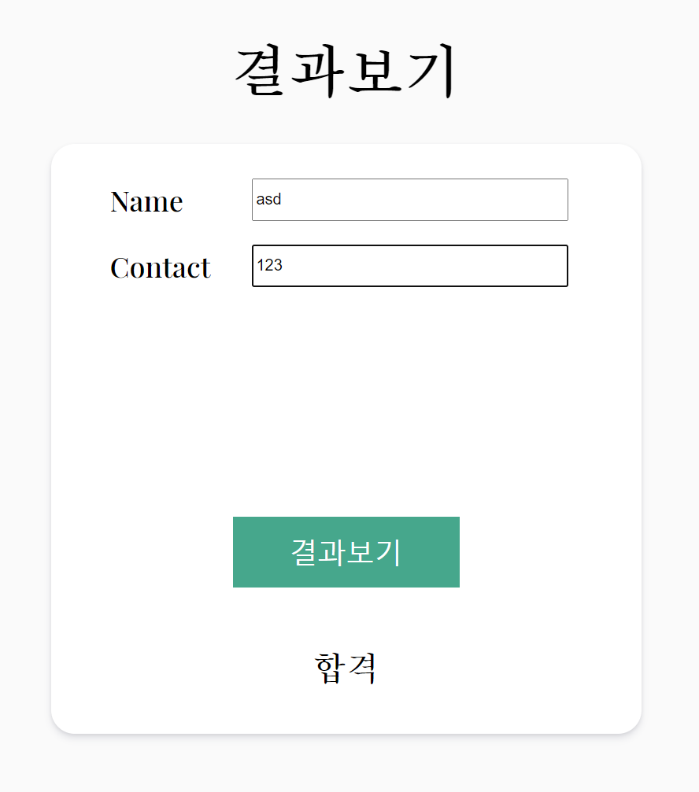

Slide 2
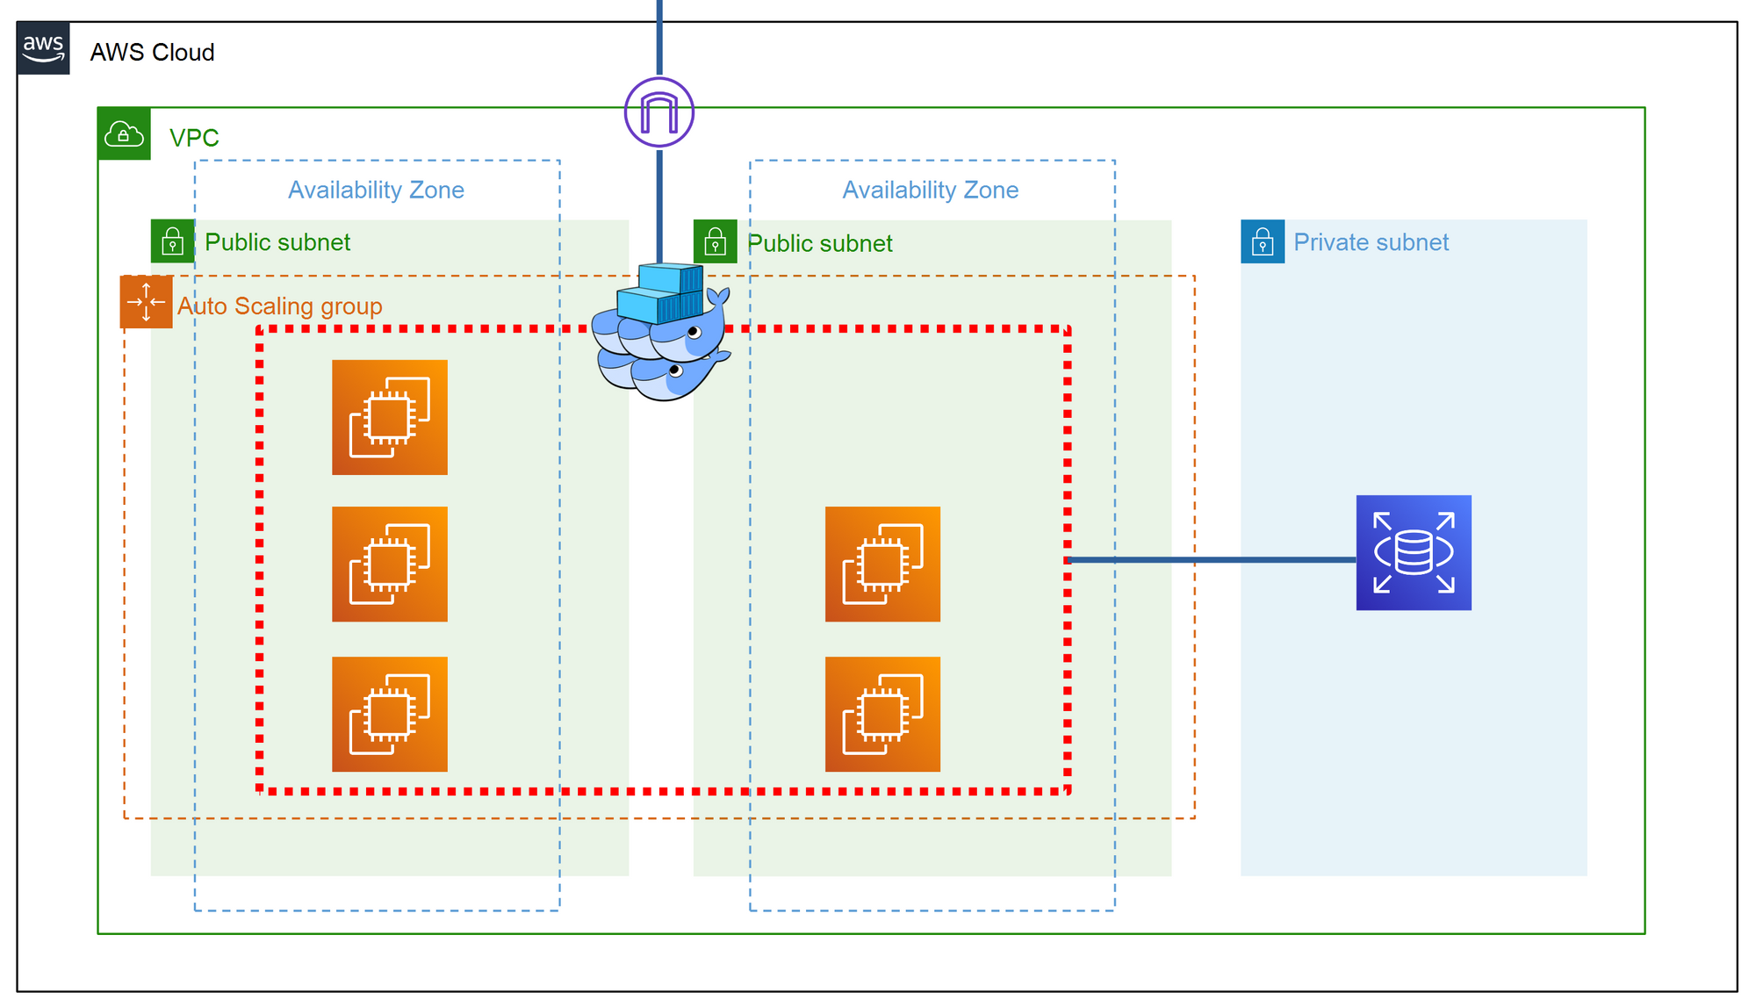

Slide 3
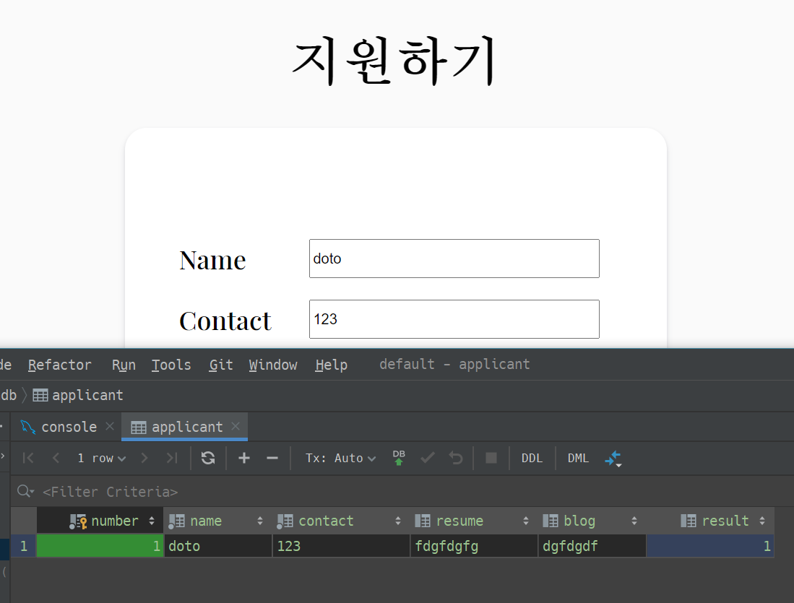

Slide 4
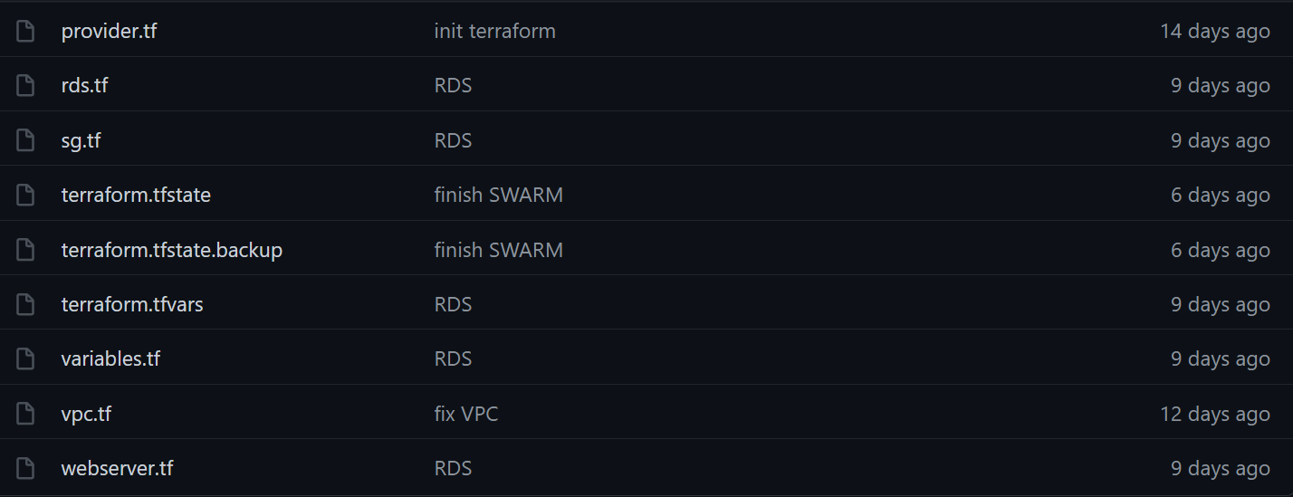
▶ IaC
terraform

Slide 5
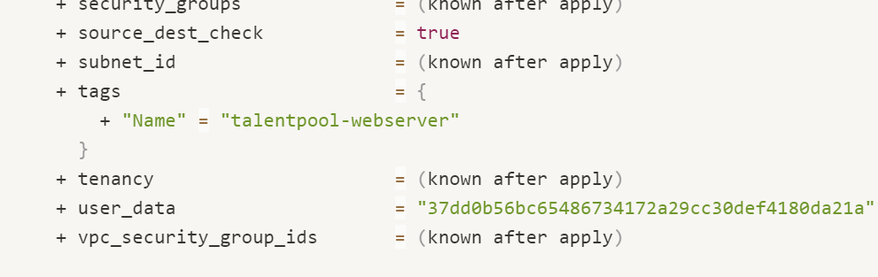
▶ IaC
terraform-ec2

Slide 6
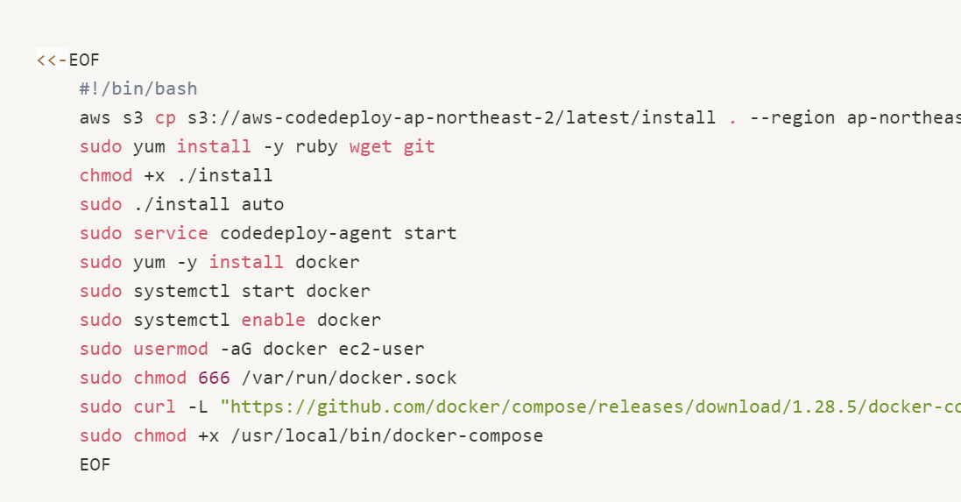
▶ IaC
User_data

Slide 7
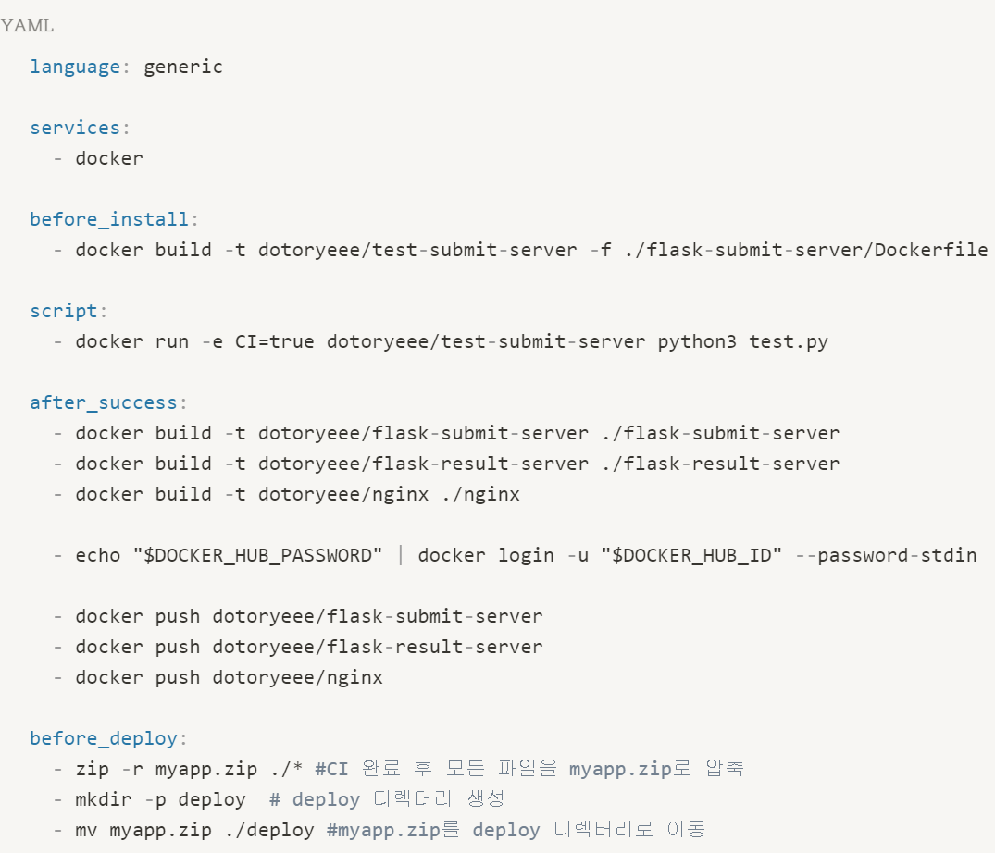
▶ CICD
.travis.yaml

Slide 8
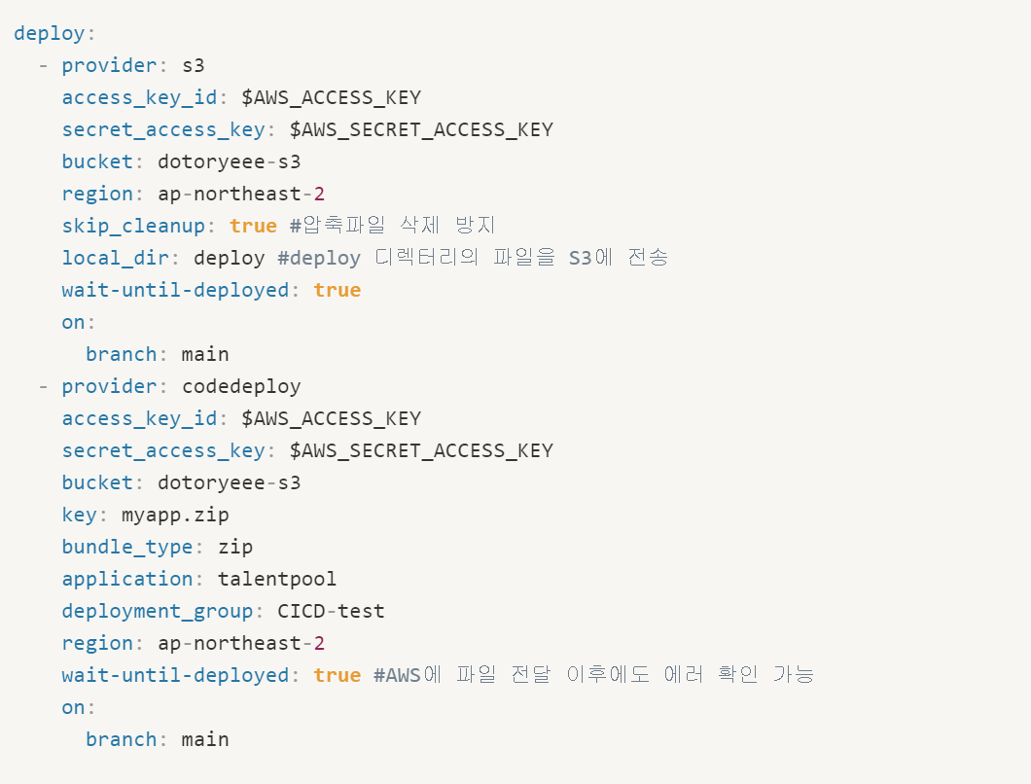
▶ CICD
.travis.yml

Slide 9
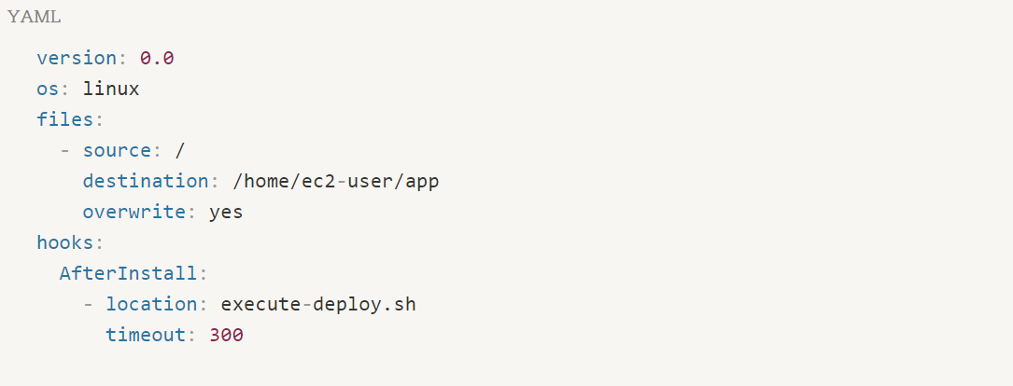
▶ CICD
appspec.yaml

Slide 10
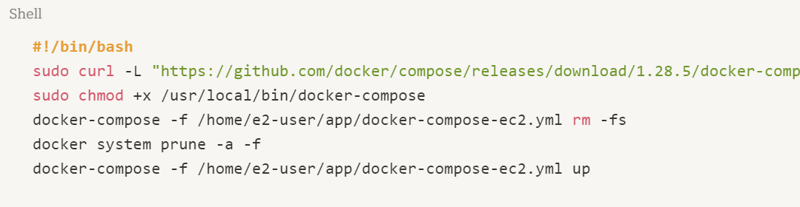
▶ CICD
execute-deploy.sh

Slide 11
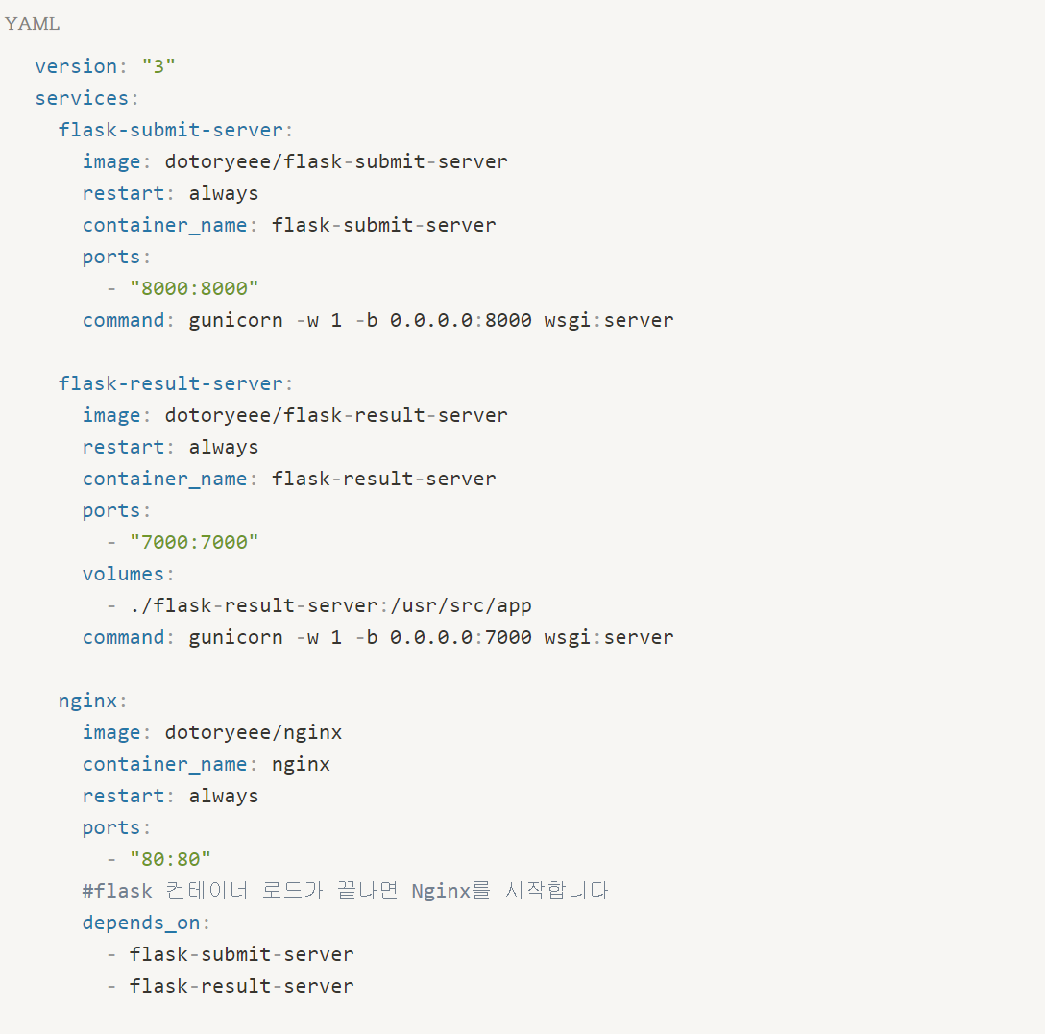
docker-compose.yml
▶ CICD

Slide 12
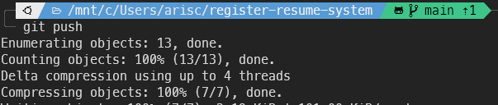
▶ CICD
git push

Slide 13
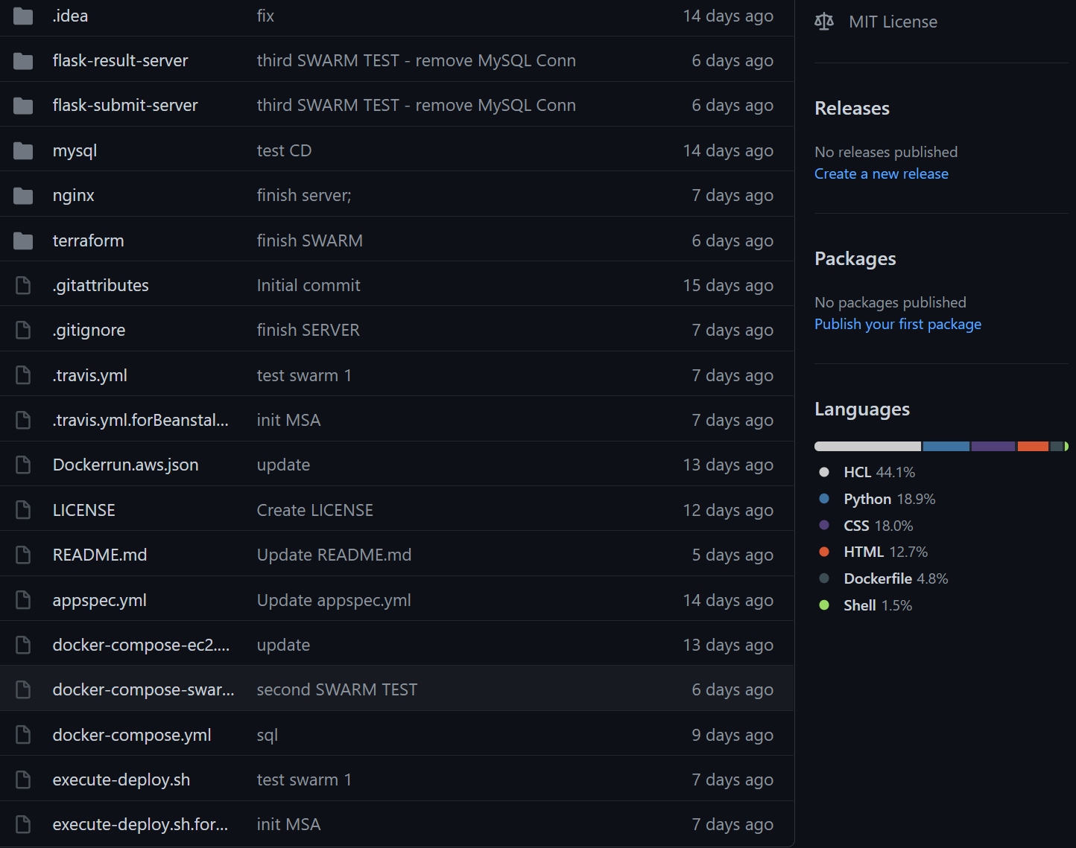
▶ CICD
github

Slide 14
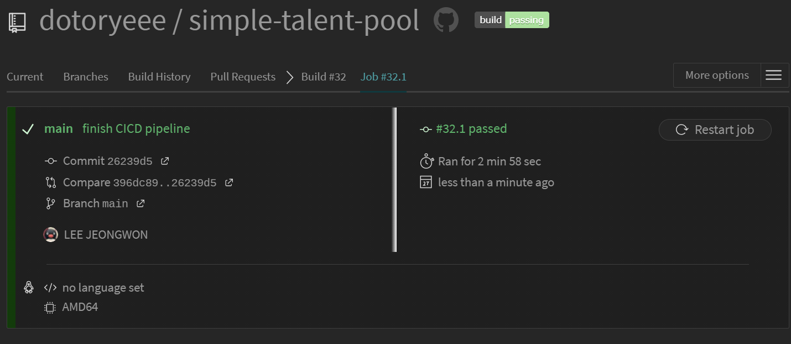
▶ CICD
travis test

Slide 15
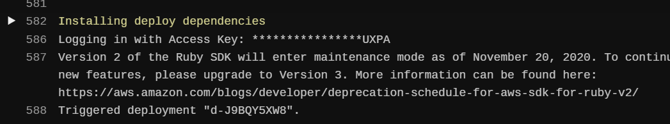
▶ CICD
travis deploy

Slide 16
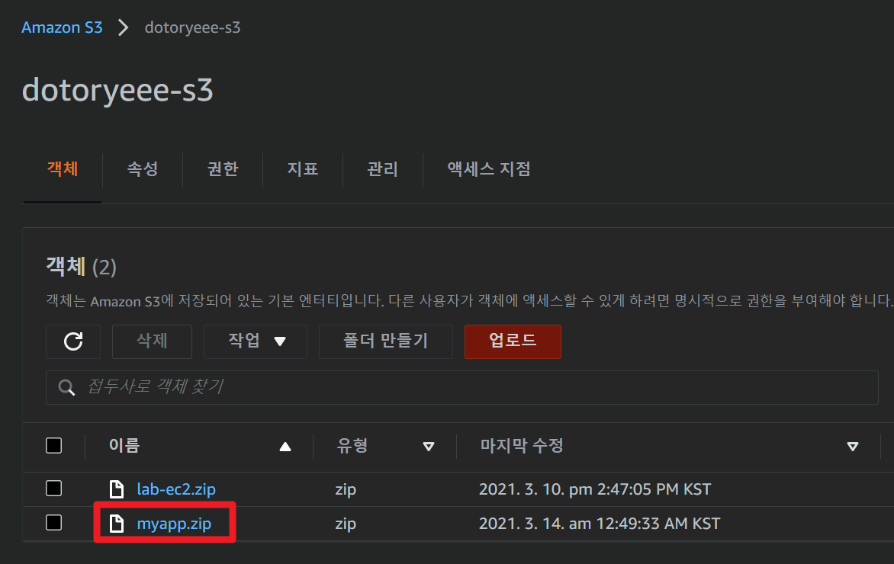
▶ CICD
S3

Slide 17
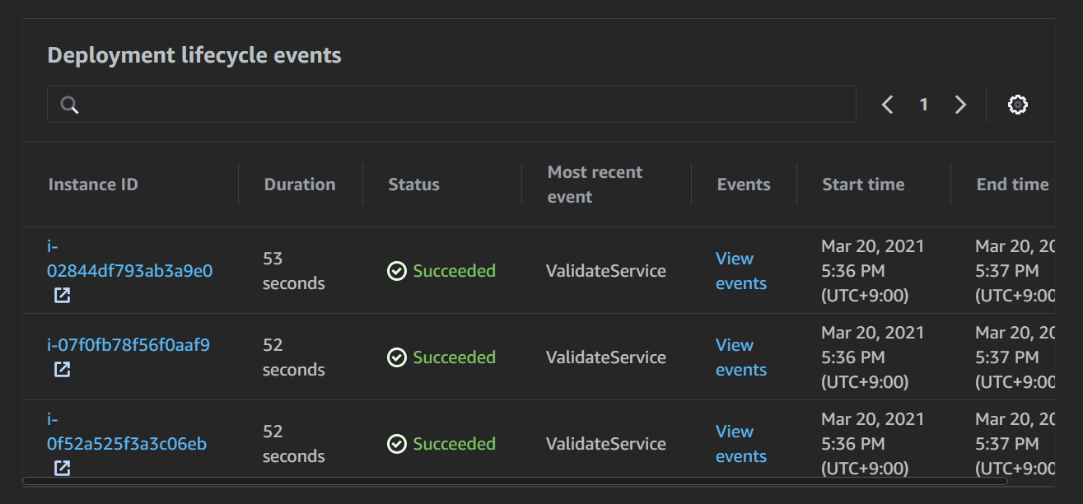
▶ CICD
code deploy

Slide 18
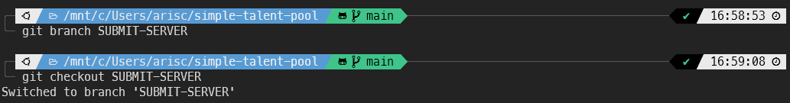
▶ Version control
new branch

Slide 19
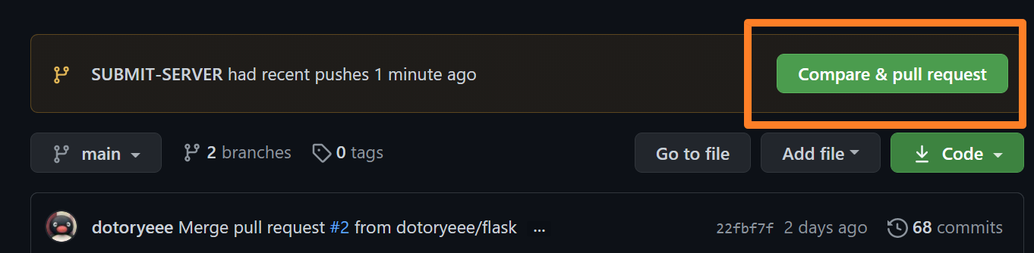
▶ Version control
PR

Slide 20
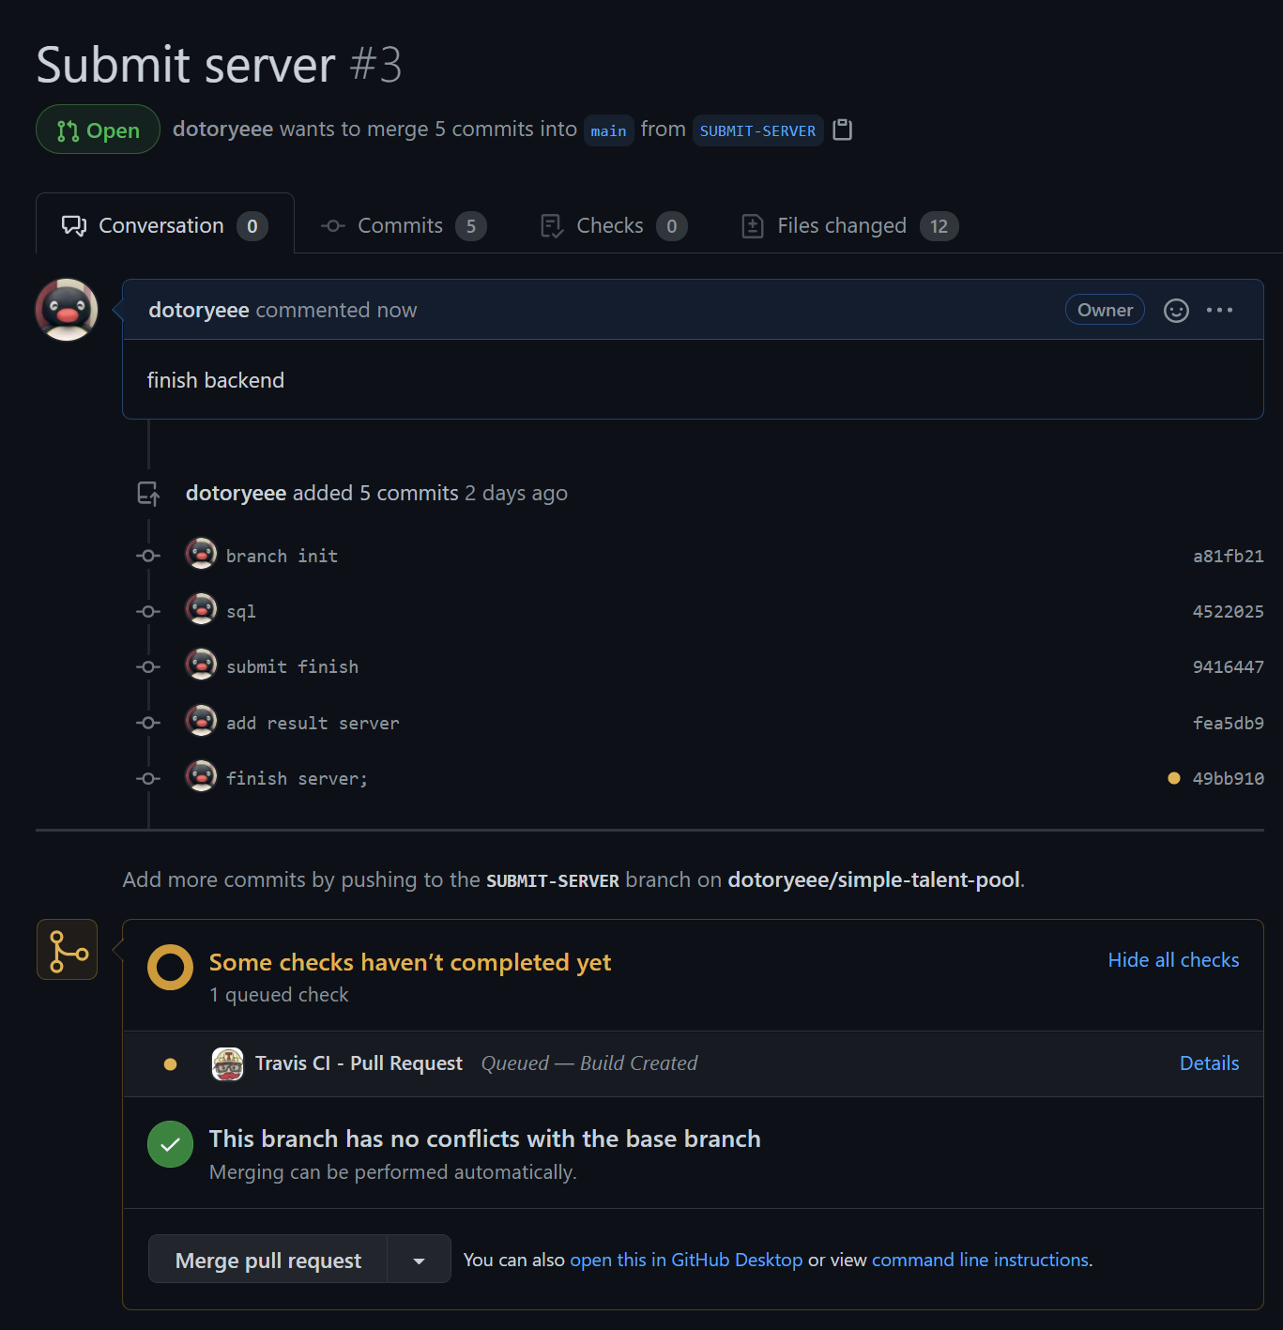
▶ Version control
PR test

Slide 21
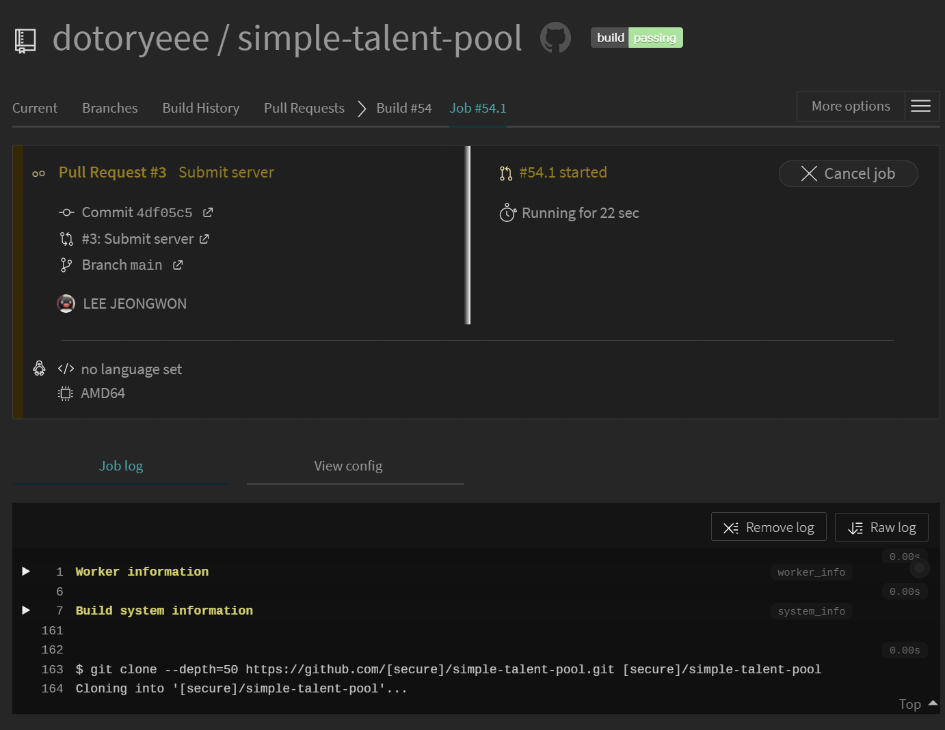
▶ Version control
travis CI

Slide 22
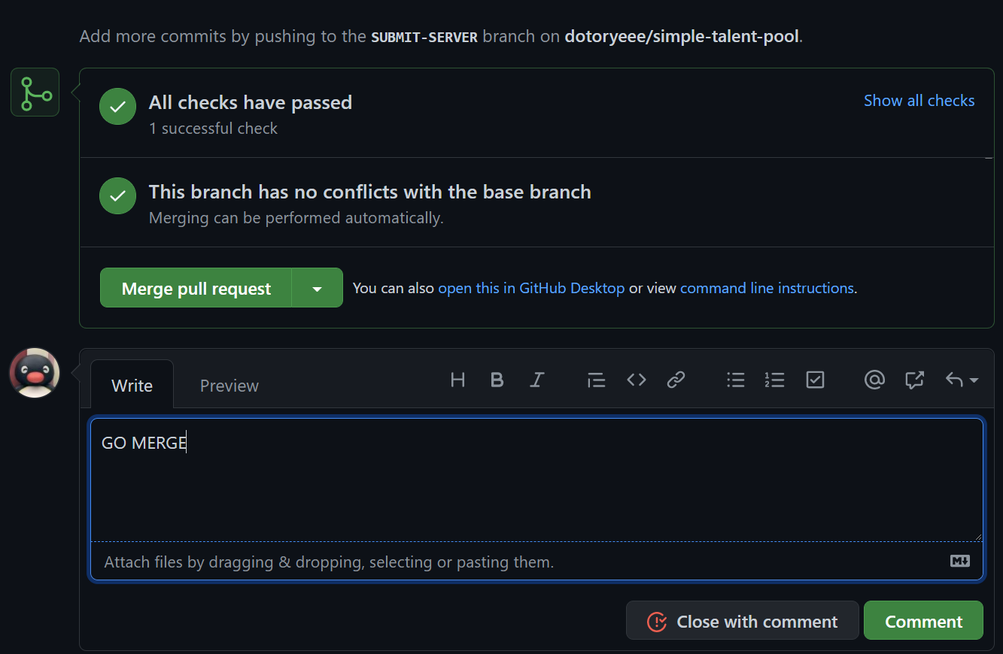
▶ Version control
test complete

Slide 23
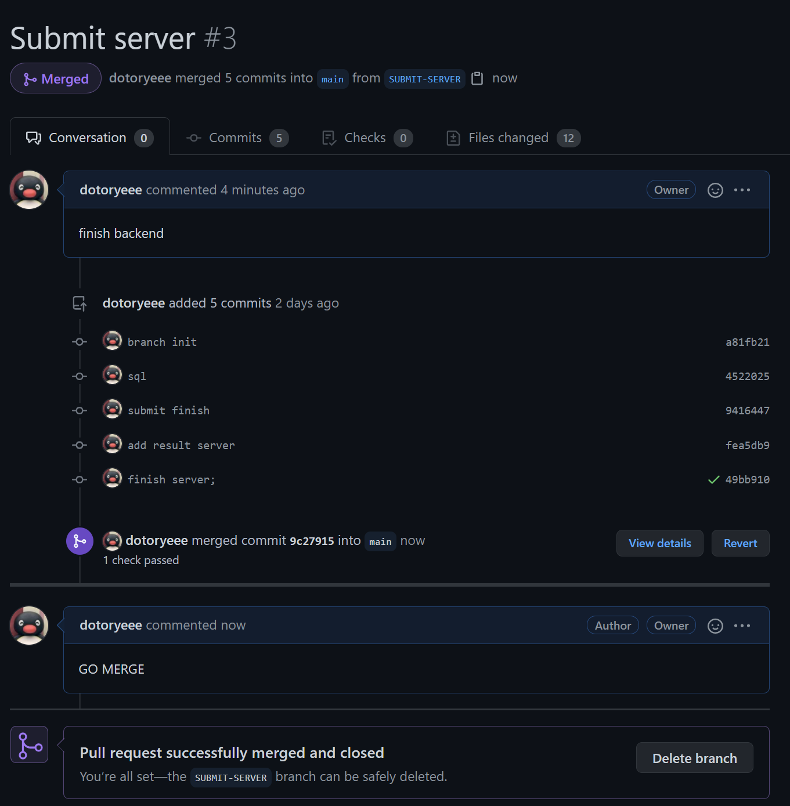
▶ Version control
Integration complete

Slide 24
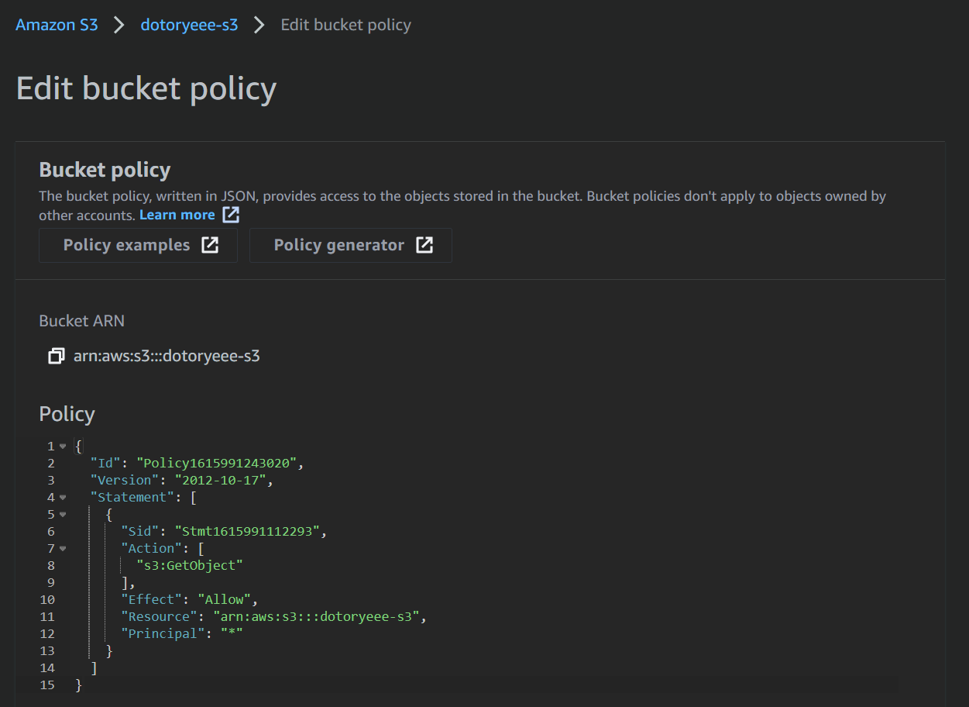
▶ static contents

Slide 25
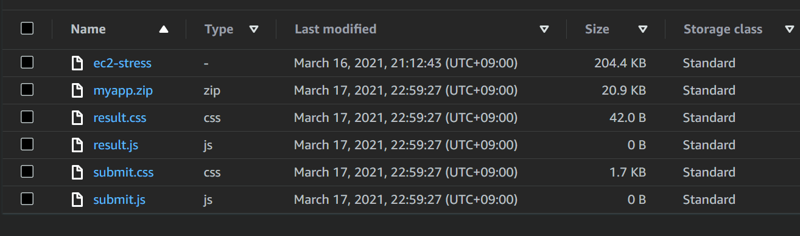
▶ static contents

Slide 26
▶ static contents

Slide 27
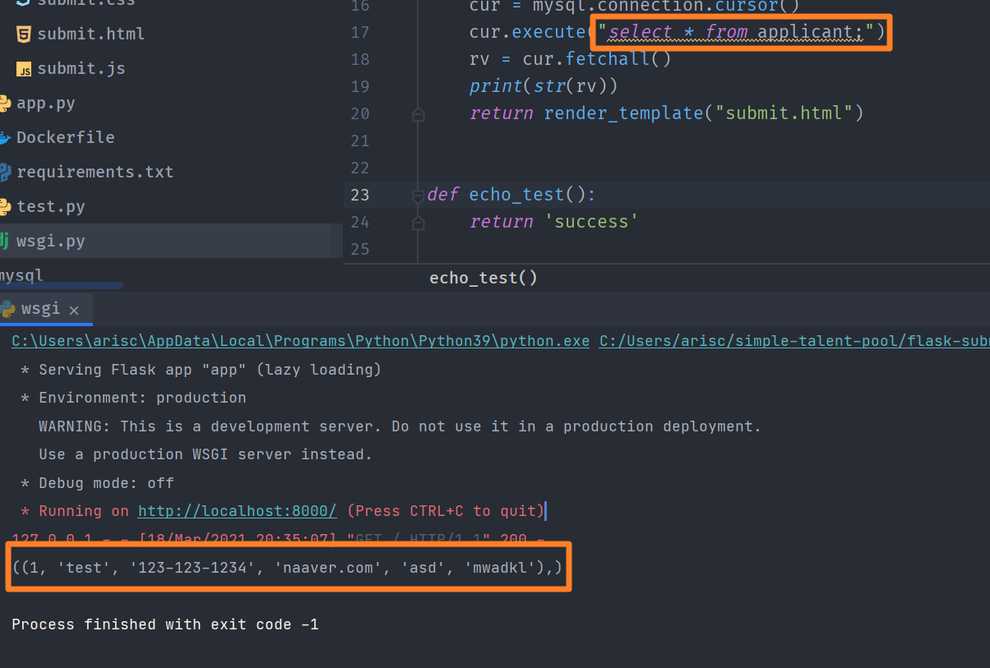
▶ static contents

Slide 28
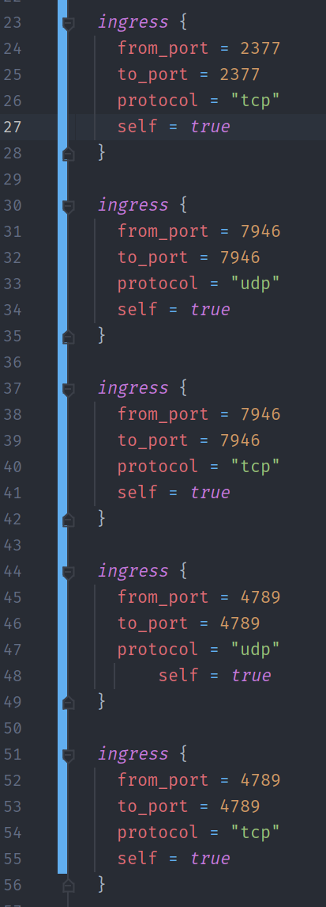
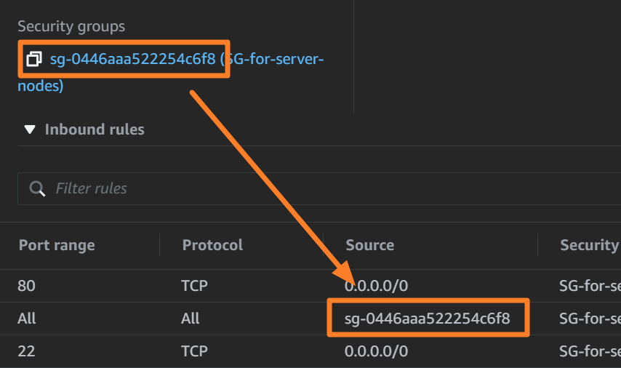
▶ MSA
SG for Swarm mode

Slide 29
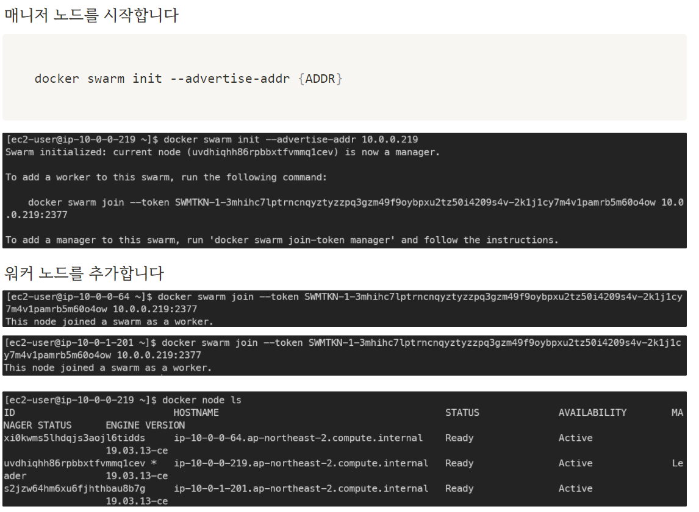
▶ MSA

Slide 30
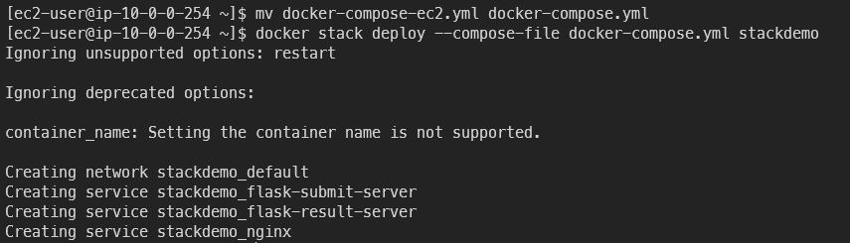
▶ MSA
Docker stack

Slide 31
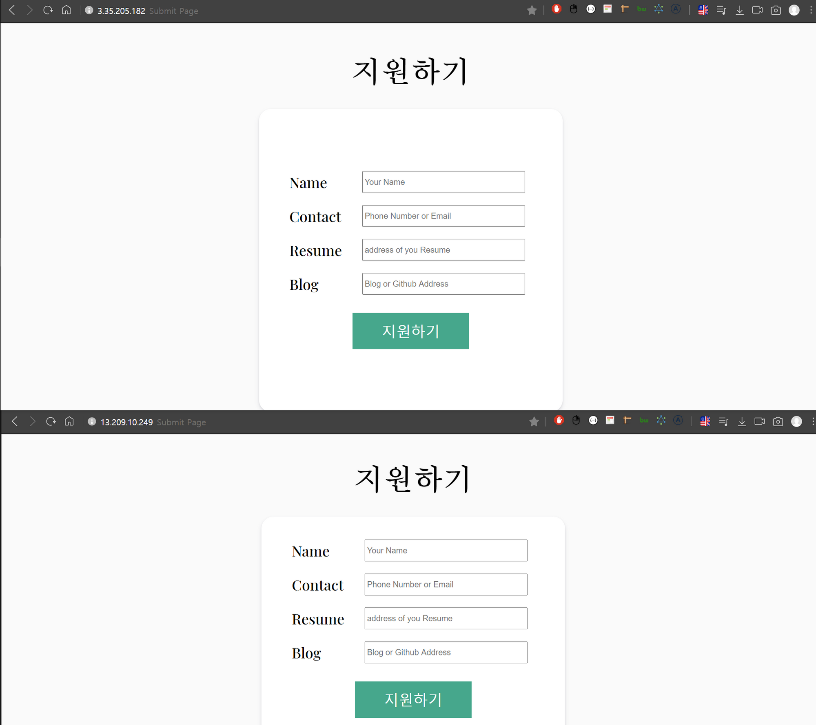
▶ MSA

