Slide 1
Cuộc thi xe tự hành
Đội: SPK_SANDBOX
Thành viên:
Trần Văn Hồ (NT)
Trần Hữu Hiếu
Nguyễn Hương Quỳnh
Nguyễn Ngọc Lê
Nguyễn Hoàng Anh Tuấn

Slide 2
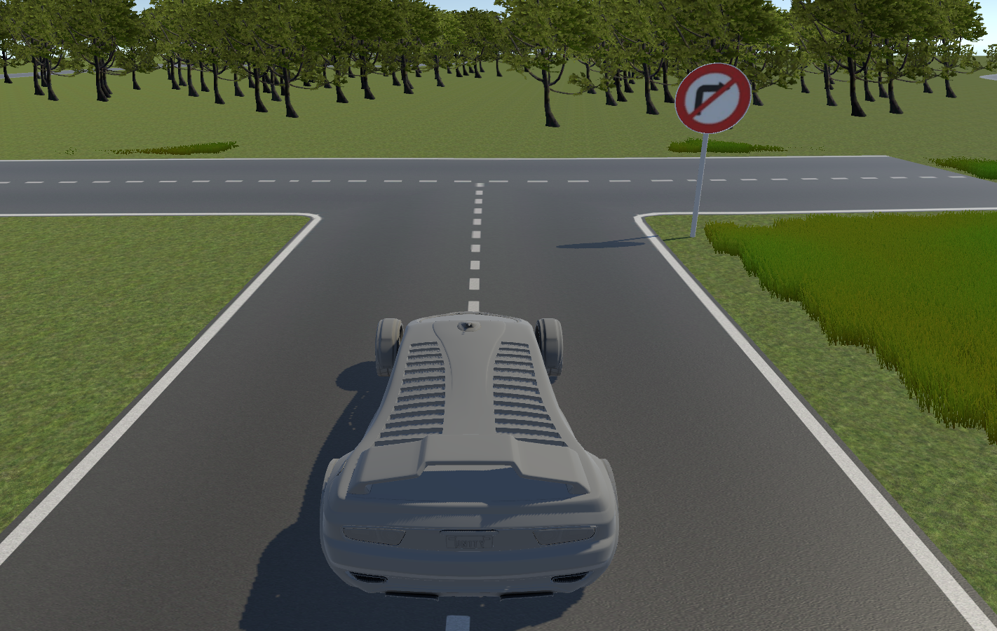

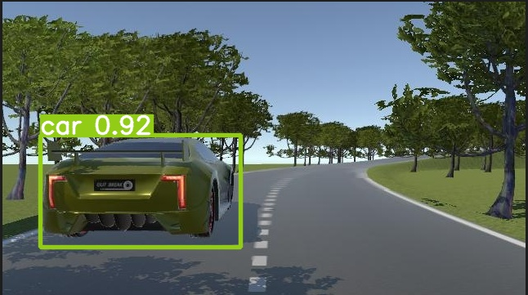
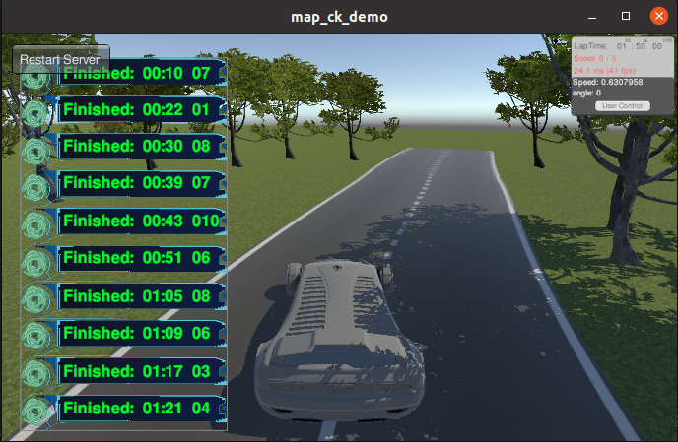
Main Issues
Lane Segmentation
Traffic Sign Detection
Controller

Slide 3
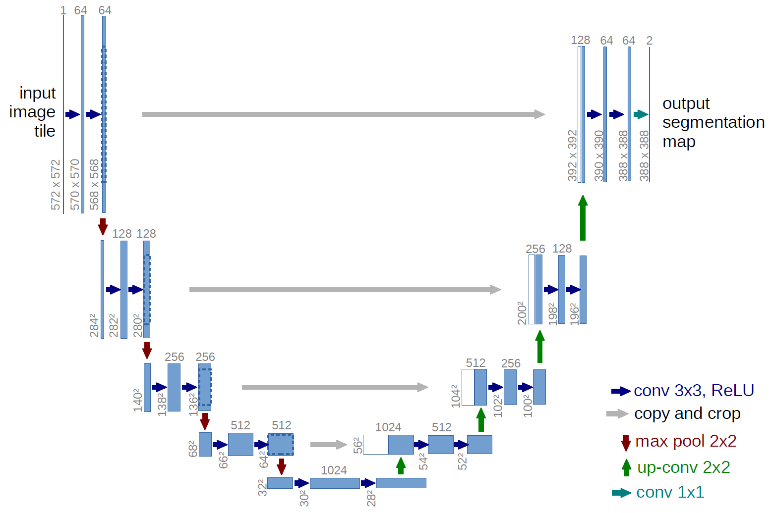
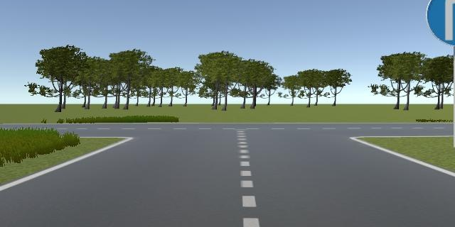


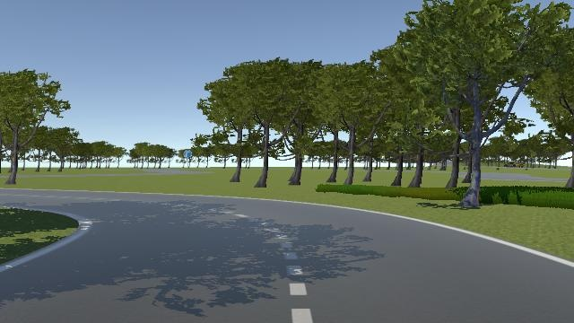
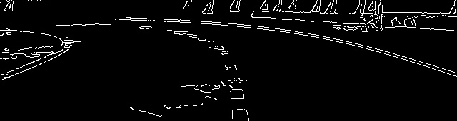
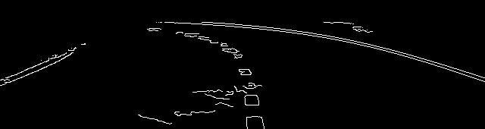
Lane Segmentation
Dataset:
Total: ⁓ 8k images Train: ⁓ 5,6k images
Val: ⁓ 1,6k images Test: ⁓ 0,8k images
Input (RGB Image)
Image Processing
UNET (Model for segmentation)
Output (Binary Image)
Ảnh trả về từ phần mềm mô phỏng
Edg Detection
(Canny, Sobel,…)
ROI Image

Slide 4
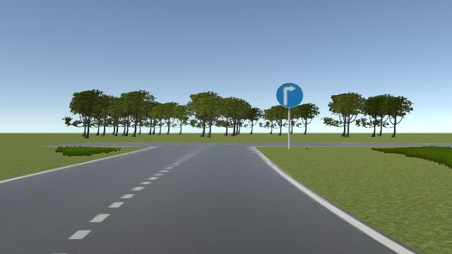
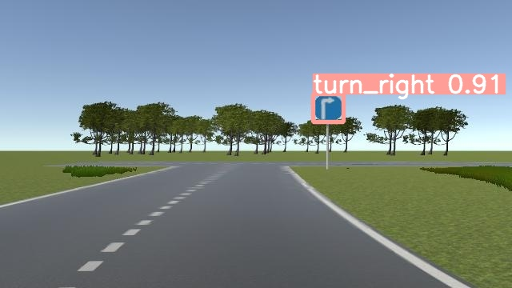
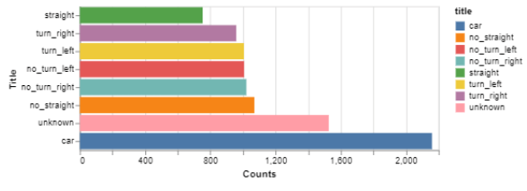
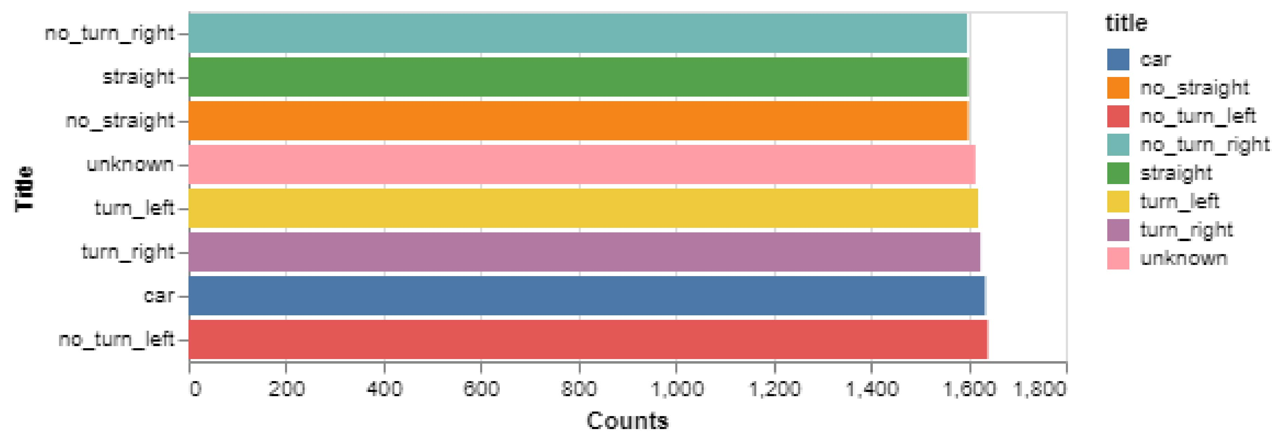
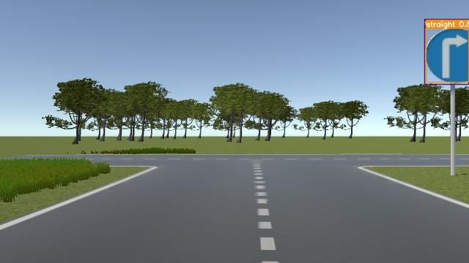
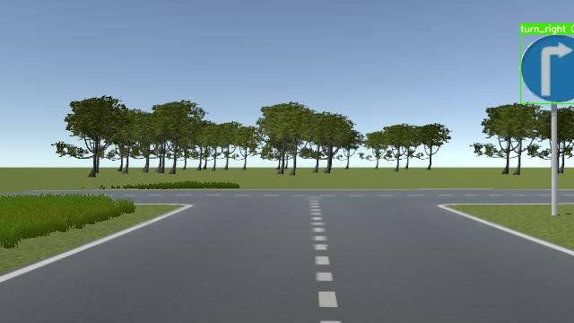
Traffic Sign Detection
Input
Yolov8n
Output
6 classes
Model | Size | Precision | Recall | mAP@0.5 | mAP@0.5:0.95
YOLOv5m | 640 | 0.995 | 0.997 | 0.993 | 0.861
YOLOv6n | 640 | 0.994 | 0.99 | 0.996 | 0.856
YOLOv7 | 640 | 0.992 | 0.993 | 0.991 | 0.835
YOLOv8n | 640 | 0.994 | 0.998 | 0.992 | 0.887
Dataset: ⁓ 9k images
Straight, confidence > 0.8
Turn right, confidence > 0.8

Slide 5
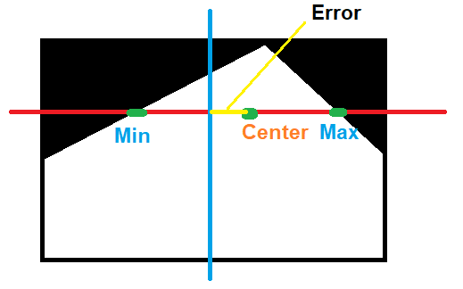
Controller
Current_Speed
PID Controller
Sendback_Angle
Angle
Error
Logic
Speed
Sendback_Speed
Traffic sign

Slide 6
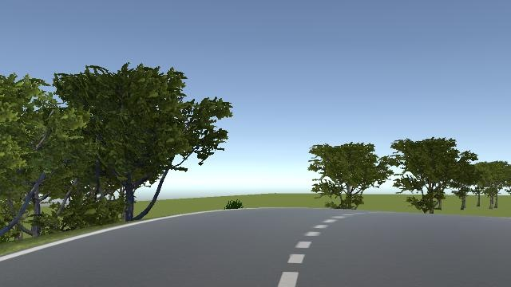

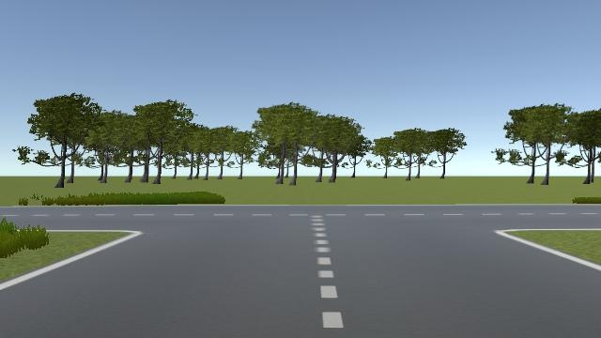


Challenges
Max $≡$ min
No max, min
Line 31 => line 45
Angle = angle +(-) 1
Straight
Turn 25
Timer
Timer

