Slide 1
GRADUATION PROJECT MID-TERM REPORT
In-Vehicle Multimedia Application
Do Trung Hieu 20141501

Slide 2
OUTLINES:
Requirements Specification
Application Structure Overview
Implementation Environment
Development Tools
Achieved Results
Remaining Problem(s)

Slide 3
Requirements
Requirements:
General:
Application shall start right after device finish boot up
Application shall run in full screen mode
GUI shall be provided
Date and Time shall be shown
Application shall provide a home screen to show general information and worked as gateway to open and switch between apps
Audio App:
Application shall be able to read and play *.mp3 files
Application shall scan for all available *.mp3 files and put into playlist
Additional metadata of audio files shall be display (e.g. singer, title, art,…)
Playback control shall be provided:
Control: Play/Pause, Next, Previous
Mode: Not-Repeat/RepeatAll/RepeatOne
Choose any position to play
User shall be able to choose any file from the scanned list to play
Application shall be able to resume playing last file after reset

Slide 4
Requirements
Requirements:
Video App:
Application shall be able to read and play *.mp4 files
Application shall scan for all available *.mp4 files and put into playlist
Each video in playlist shall be displayed with a thumbnail (cut from the original video)
Playback control shall be provided:
Control: Play/Pause, Next, Previous, Forward, Backward
Choose any position to play
User shall be able to choose any file from the scanned list to play
Application shall be able to resume playing 2 last file after reset

Slide 5


Application Structure Overview
Application Manager
View
Home
AudioView
VideoView
Model
Controller
Audio Model
Video Model
Audio Controller
Video Controller
Memory
Speakers & Display

Slide 6
GUI Overview
1_A_1
1_B_1
1_B_2
1_B_3
1_E
Time
Album Art
1
Prev
Play
Next
1_C
Song Title
Video App
1_D

Slide 7
GUI Overview
2_A
2_B_1
2_B_2
2_B_3
Time
HOME
Album art current song
Prev song
Next Song
2_E_2
2_D_1
2_D_2
The Song Name
2_E_4
The Singer Name
2_E_1
00:00
05:00
Duration Bar
2_E_3
Play
Playlist
Prev
Next
Repeat
2_F_1
2_F_2
2_F_3
2_F_4
2_F_5

Slide 8
GUI Overview
3_A
HIDE
Time
3_B
HOME
Song 1
Album art current song
Singer 1
Prev song
Next Song
Song 2
3_B_1
Singer 2
Song 3
Singer 3
3_B_2
Song 4
Singer 4
The Song Name
Song 5
The Singer Name
Singer 5
00:00
Duration Bar
05:00
Song 6
Singer 6
Play
Song 7
Playlist
Prev
Next
Repeat
Singer 7

Slide 9
GUI Overview
4_A
4_B_5
Time
HOME
4_B_1
Continue Playing
4_B_2
Thumbnail
Play
4_B_3
4_B_6
Recent Video 2
4_B_4
Recent Video 1
4_C_1
Thumbnail
Thumbnail
Thumbnail
4_C_2
Video 2
Video 3
Video 4

Slide 10
GUI Overview
5_A
5_B
5_C_2
5_C_3
BACK
Video 1
5
Play
Prev
Next
00:00
Duration Bar
05:00
5_C_1
5_D_1
5_D_2
5_D_3
5_D_4

Slide 11



Development Tools:
IDE:
Qt Creator
Framework:
Qt Framework (QMediaPlayer, QDateTime,…)
Programming Language:
C++
QML

Slide 12
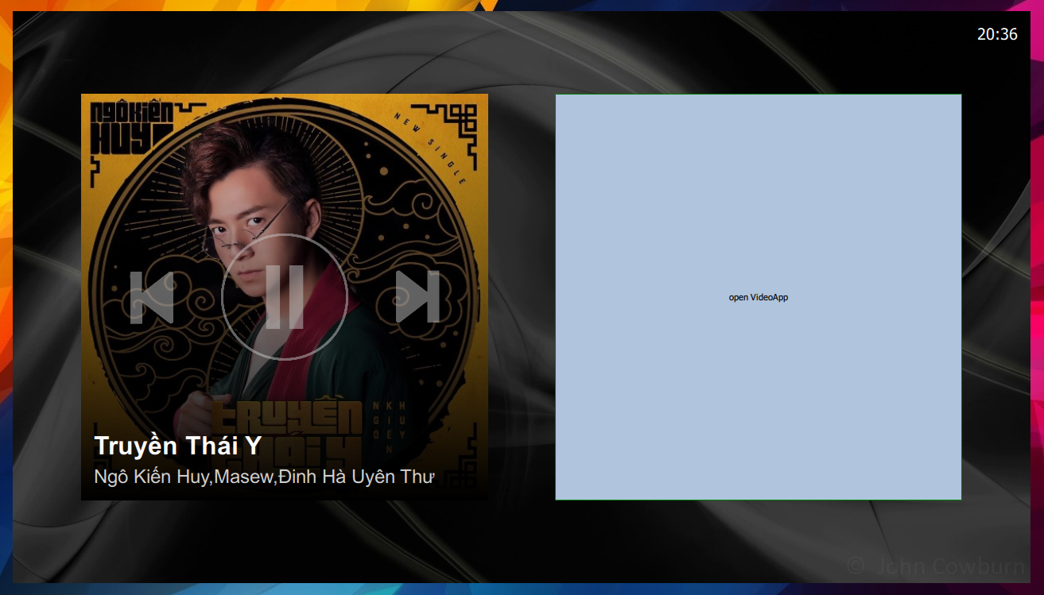
Current Progress
Home:

Slide 13
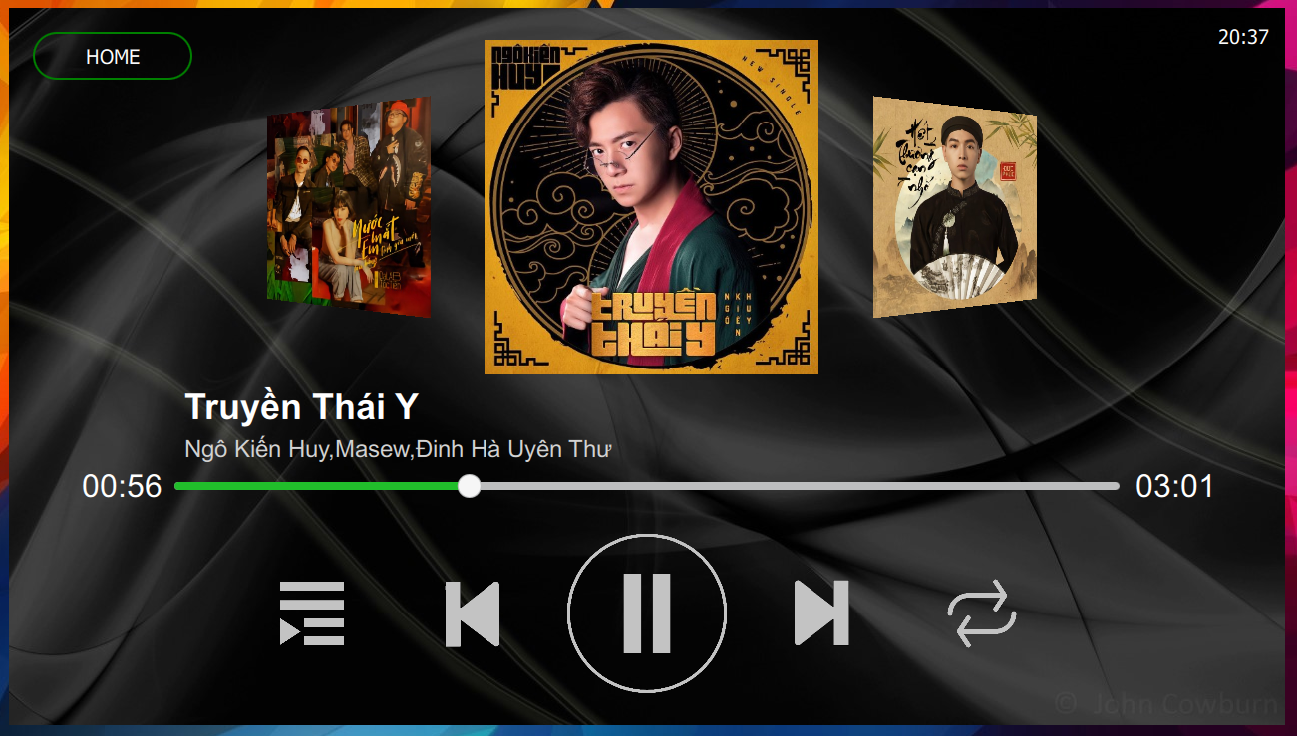
Current Progress
AudioView - Main:

Slide 14
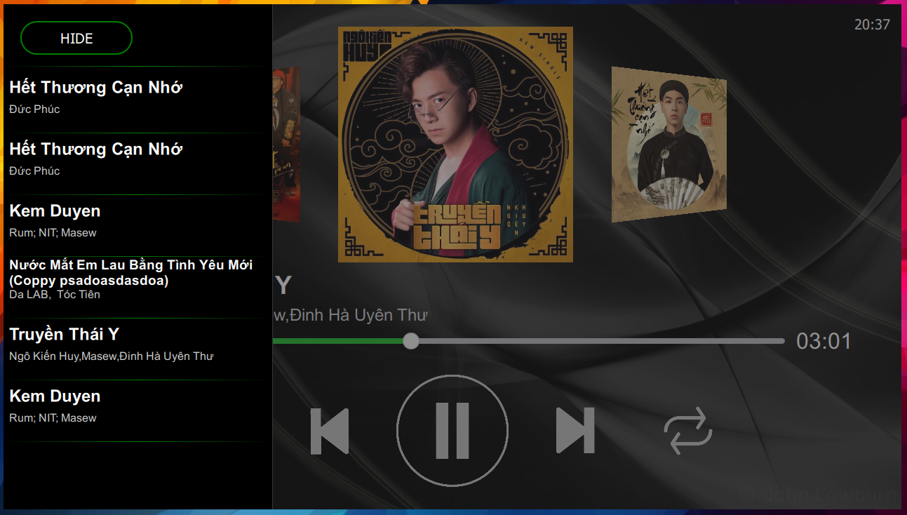
Current Progress
AudioView - Playlist:

Slide 15
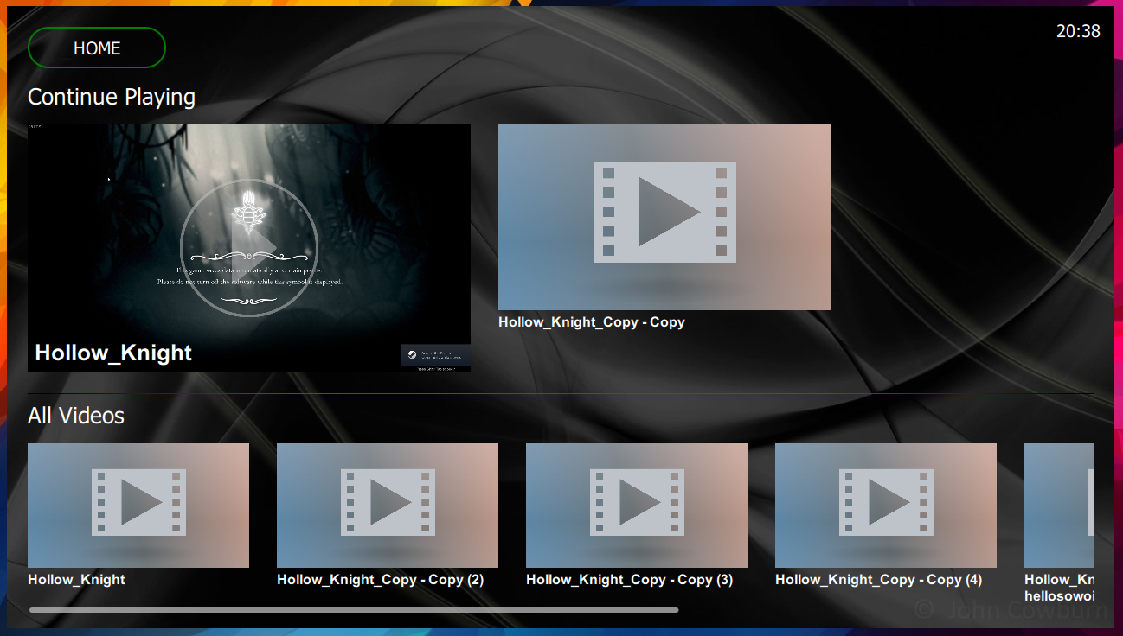
Current Progress
VideoView - Main:

Slide 16
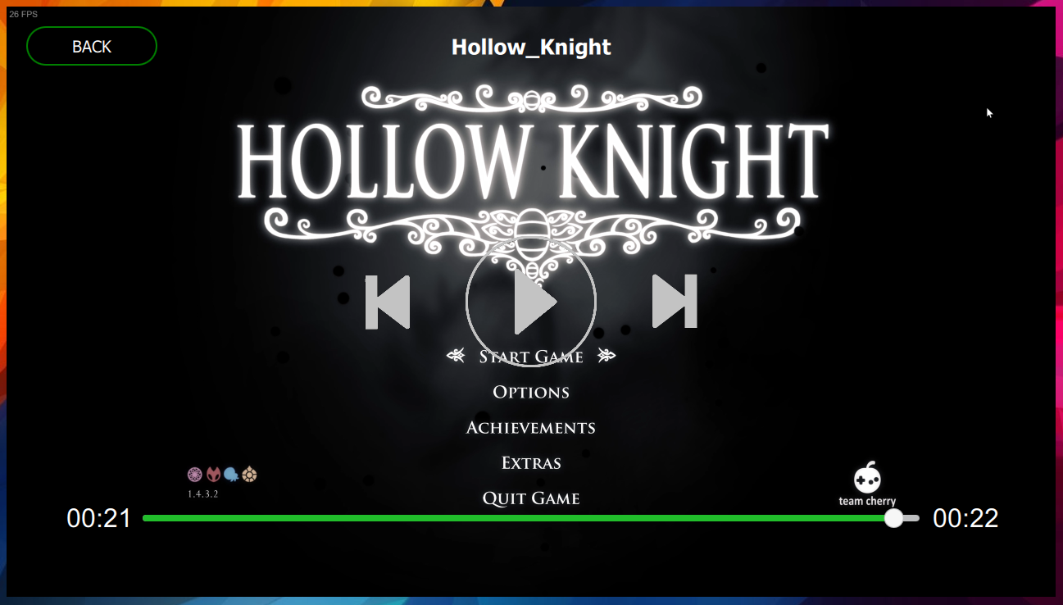
Current Progress
VideoView - Player:

Slide 17
Remaining Problem(s)
Create and display a thumbnail for video(s)
Still scan a fixed folder
Home layout needs to refactor

Slide 18
THANK YOU

