Slide 1

Project Hand pose
Group:
Đỗ Trung Kiên
Lê Đức Mạnh
Lê Hải Dũng
Nguyễn Đức Duy

Slide 2

Content:
Define a data structure struct hand Joint and hand Pose.
The Euclidean distance of every pair of joints of a hand pose and distance of each joint between two times.
Sort the array and the ID of the joint that moves the most.
Create a tree, insert node into the tree and traversal the tree.
Find the longest path of tree

Slide 3
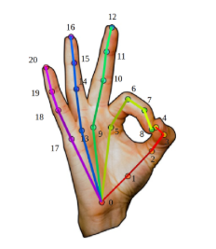
Overview
Hand pose is a set of connected joints as illustrated in the figure
Data of each joint should be captured by a sensor
Hand pose are widely used in many applications such as human machine interaction, AI or face recognition, etc…

Slide 4
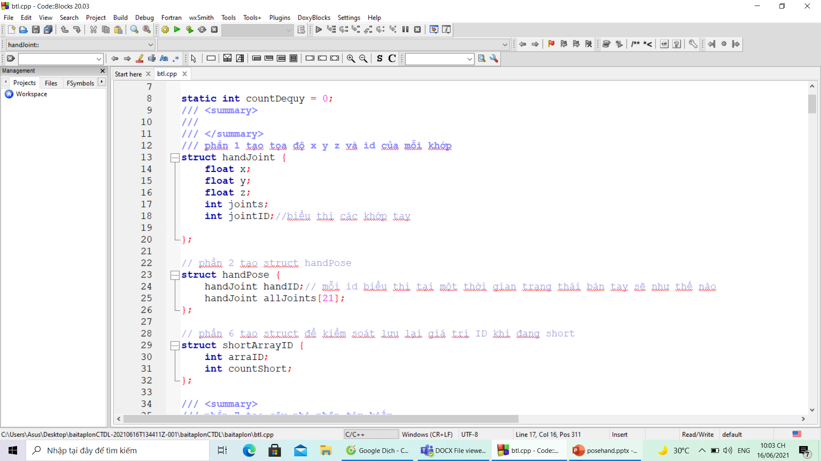
1.Define a data structure struct hand Joint and hand Pose:
Each joint is a point in 3D space with 3 coordinates (x, y, z)

Slide 5
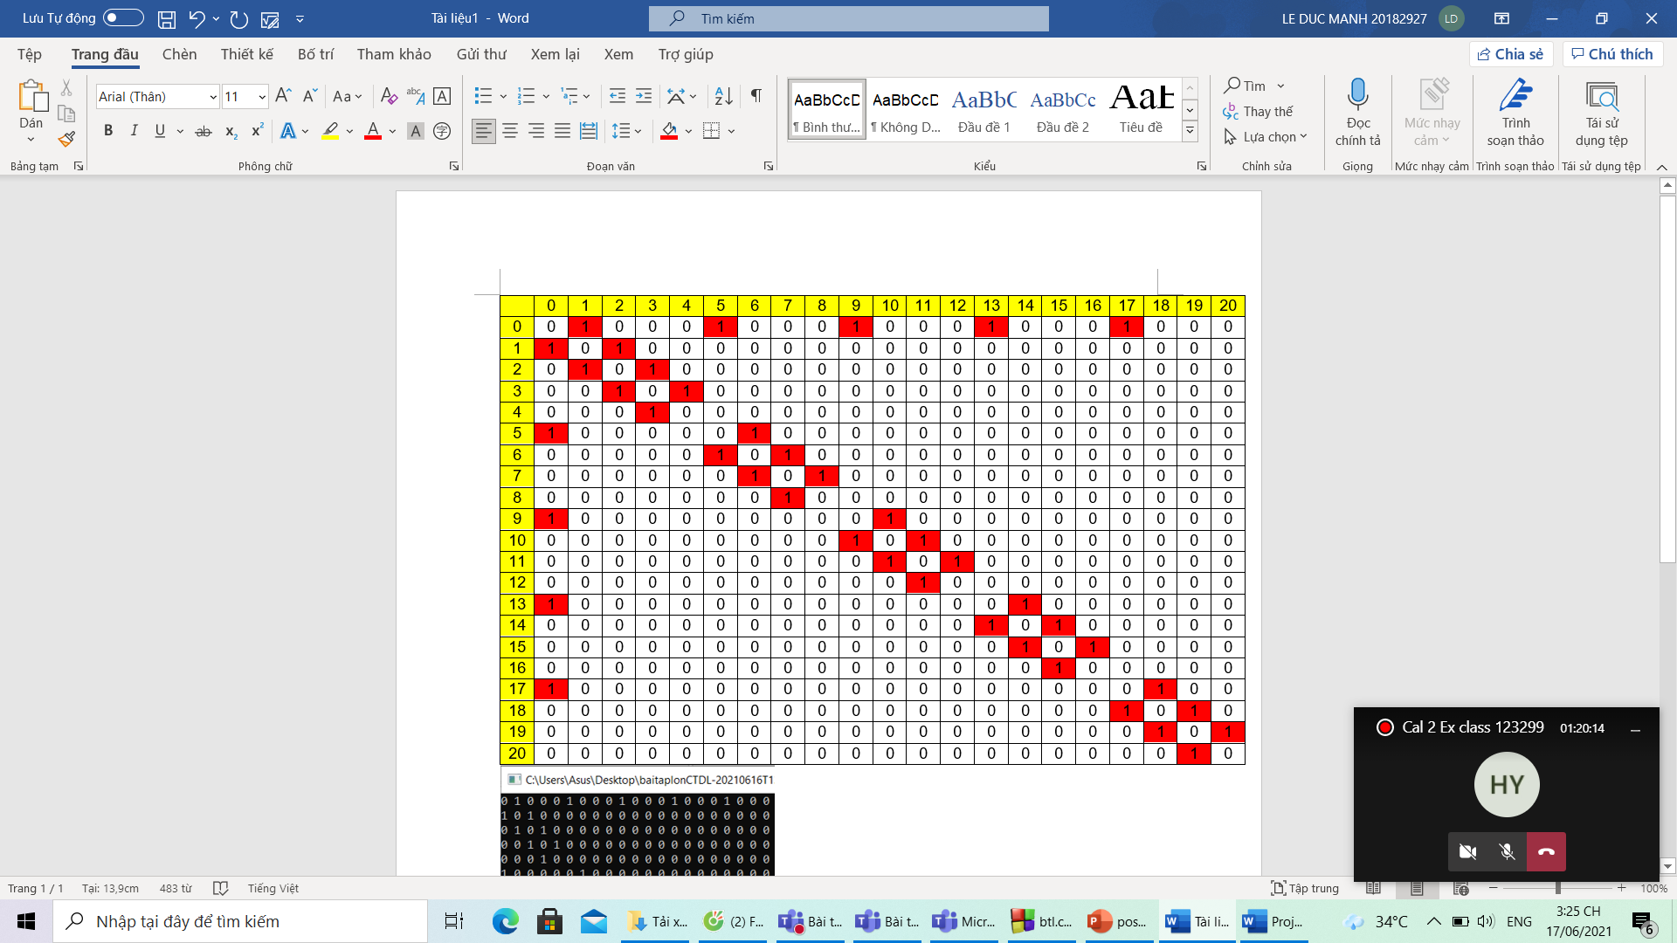
The joints connect together so we have a 2D array
Joints connected together we will save 1
The joints are not connected to each other, we will save 0

Slide 6
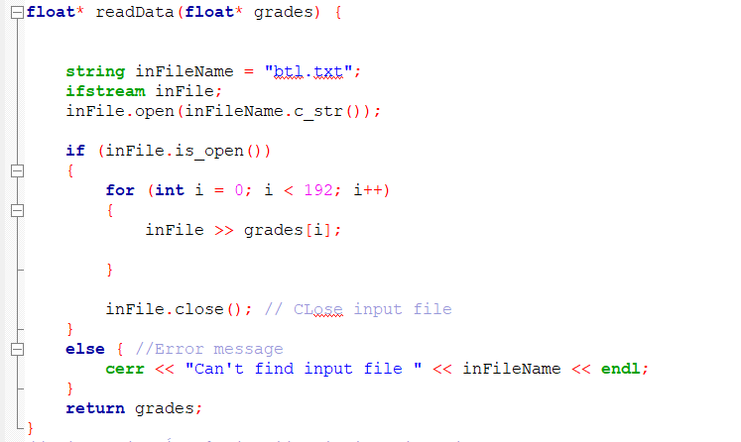
3: Read txt file

Slide 7
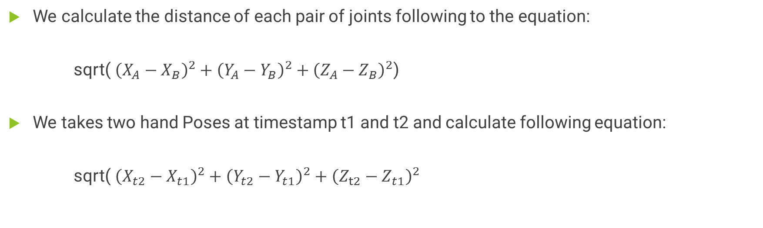
2. The Euclidean distance of every pair of joints of a hand pose and distance of each joint between two times.
We calculate the distance of each pair of joints following to the equation:
sqrt( ${\left(X_{A}−X_{B}\right)}^{2}+{\left(Y_{A}−Y_{B}\right)}^{2}+{\left(Z_{A}−Z_{B}\right)}^{2}$)
We takes two hand Poses at timestamp t1 and t2 and calculate following equation:
sqrt( ${\left(X_{t2}−X_{t1}\right)}^{2}+{\left(Y_{t2}−Y_{t1}\right)}^{2}+{\left(Z_{t2}−Z_{t1}\right)}^{2}$

Slide 8
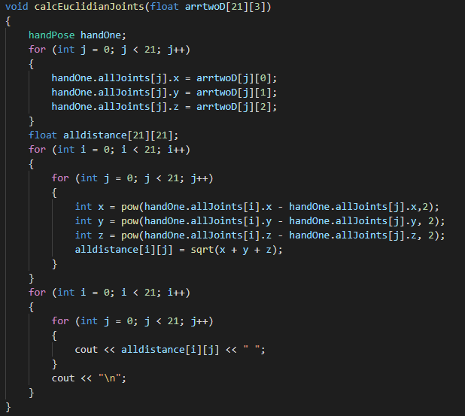
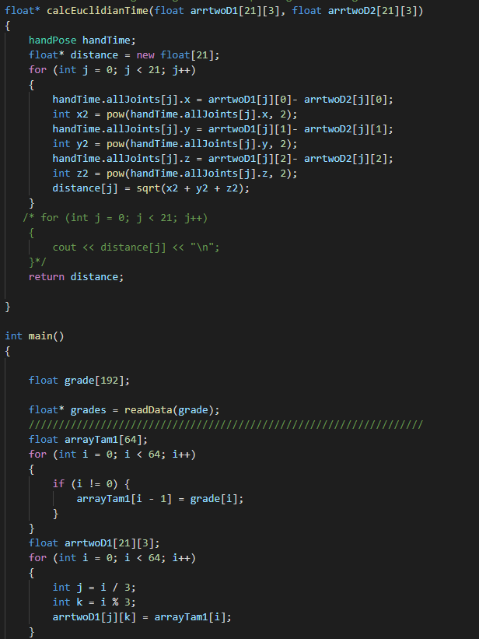

Slide 9
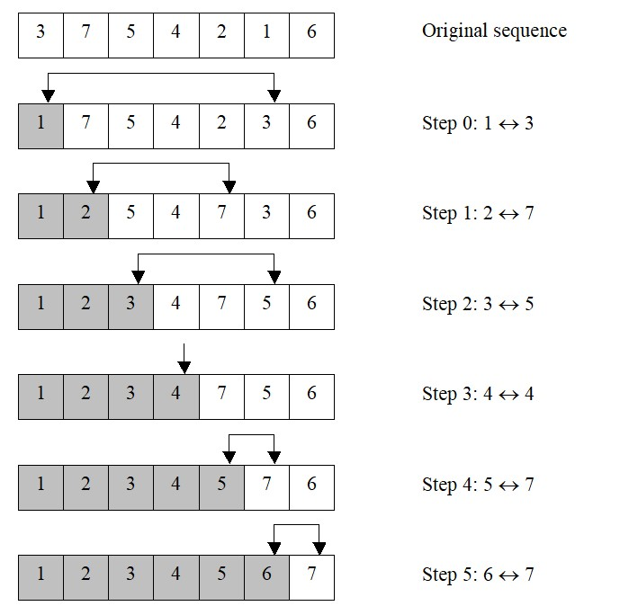
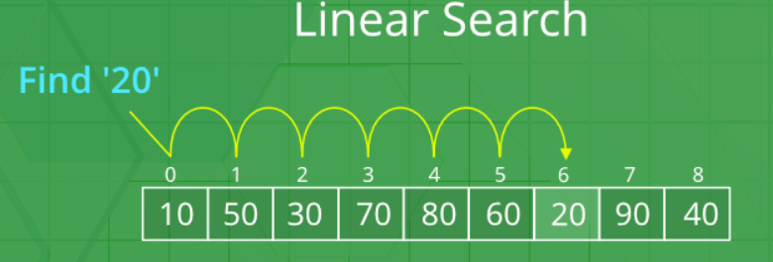
3.Sort the array and the ID of the joint that moves the most.
Sort the array
We used selection sort:
Step 1: Set MIN to position 0
Step 2: Find the smallest element in the list
Step 3: Swap with the value at position MIN
Step 4: Point to the next element
Step 5: Repeat until the entire list is sorted
the ID of the joint that moves the most
We had the joint that moves the most in sorted array as the last element of the array
We used linear search to find the ID of the joint that moves the most

Slide 10
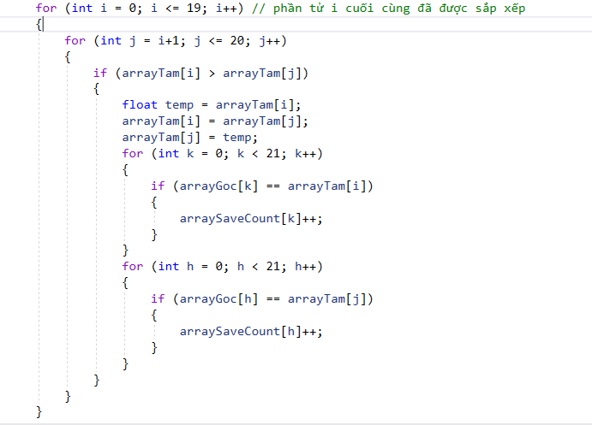

Slide 11

4. Create a tree, insert node into the tree and traversal the tree.

Slide 12
Example:
0
0
1
1
2
3
4
2
5
3
4
5
6
7
8
9
10
6
7
8
Stage 1:
We delete all the branches originating in every node except the left most branch.
We draw edges from a node to the node on the right, if any, which is situated at the same level.
Stage 2:
We choose left and right sons in the following manner:
The left son is the node, which is immediately below the given node
The right son is the node to the immediate right of the given node on the same horizontal line
9
10

Slide 13
So we have:
0
1
2
3
5
4
6
9
7
10
8
11
13
14
12
17
15
16
18
19
20

Slide 14

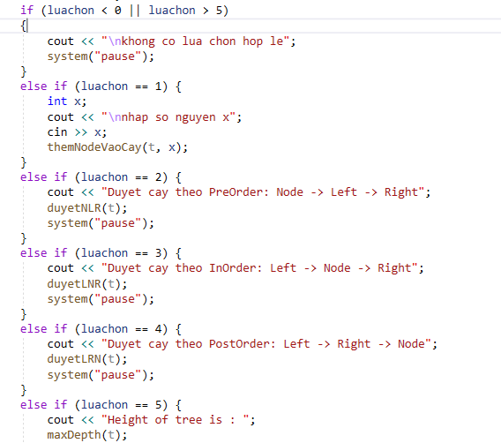
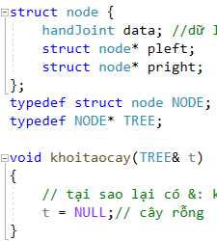
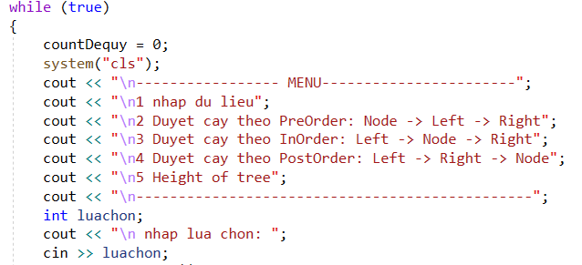
Code that create tree

Slide 15
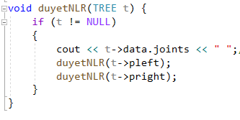
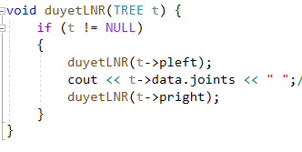
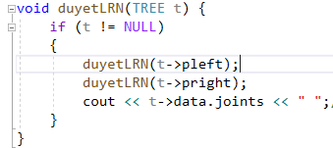
Traversal the tree:
Pre-order : Node -> Left -> Right
In-order : Left->Node->Right
Post-order : Left->Right->Node

Slide 16
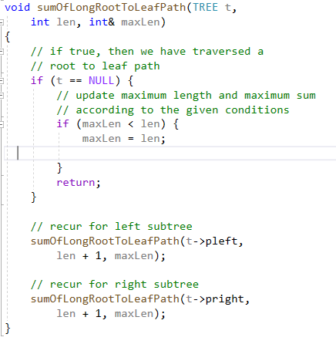
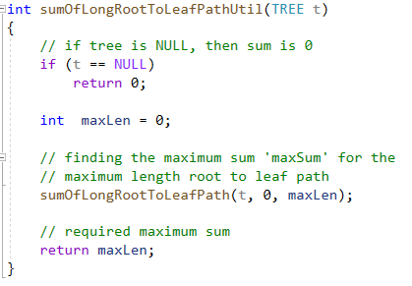
5 Find the longest path of tree

Slide 17
Thank you for listening

