Slide 1
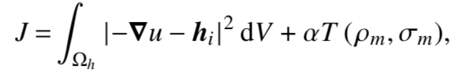
What I learned
Halbach array
Quasi one sided field
Produces strong magnetic field
Cylindrical array can have uniform stray field
Inverse problem
Minimize
Solvers:
Fenics
Magnum.fe
Magpylib
Magnum.fd

Slide 2
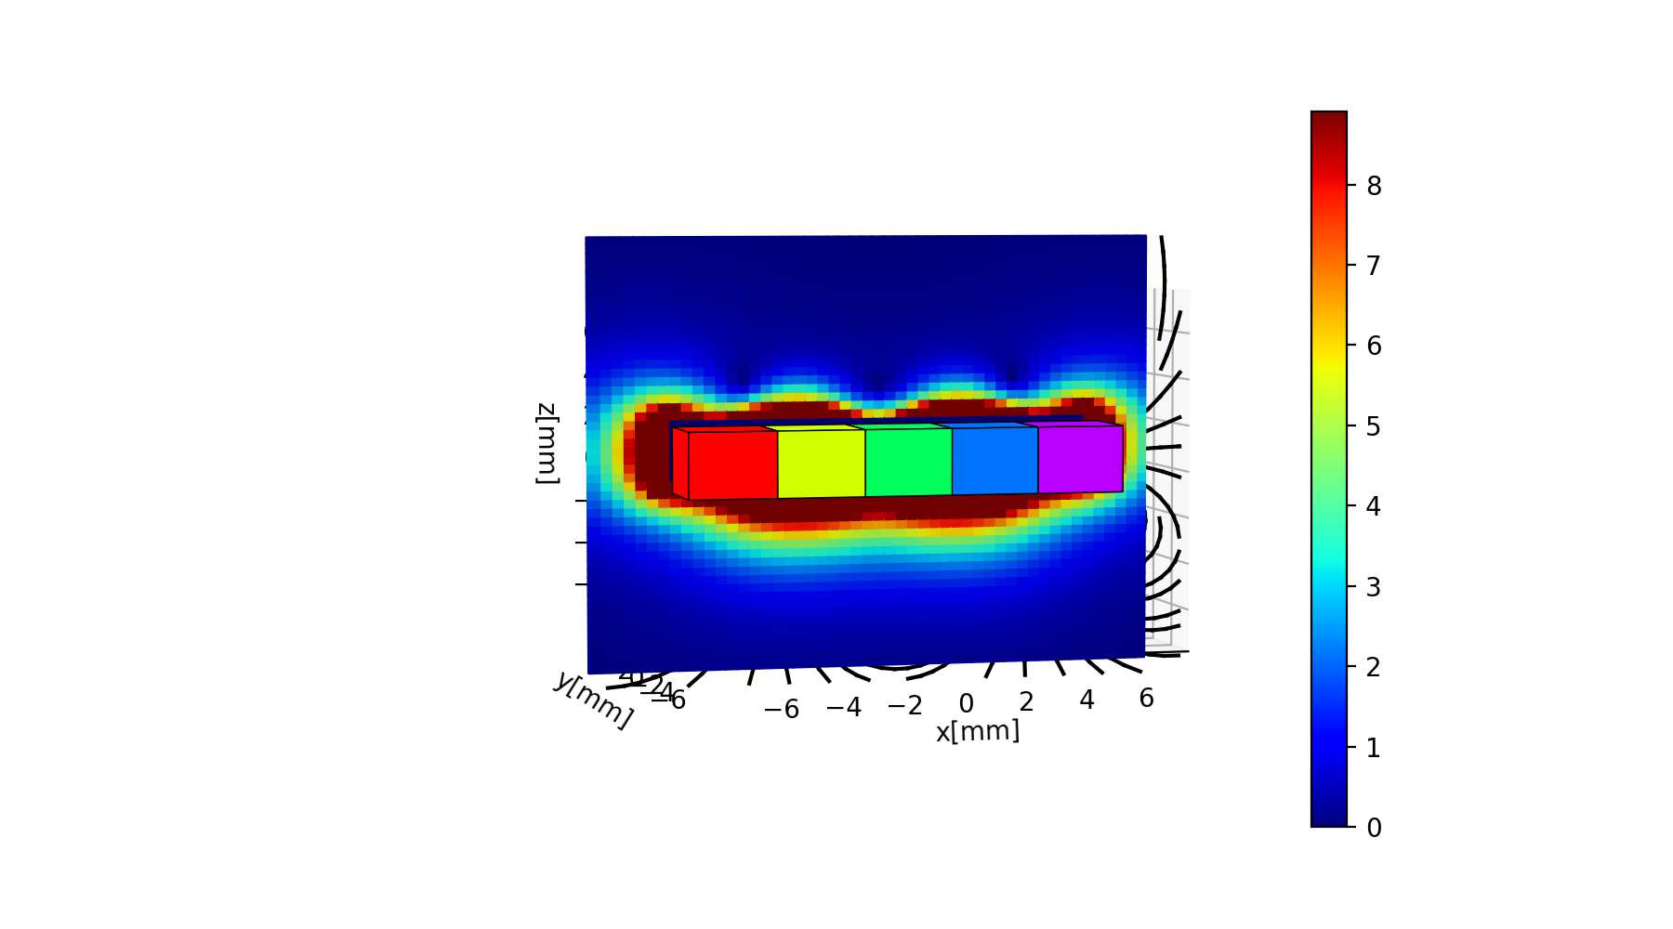
Halbach Array

Slide 3
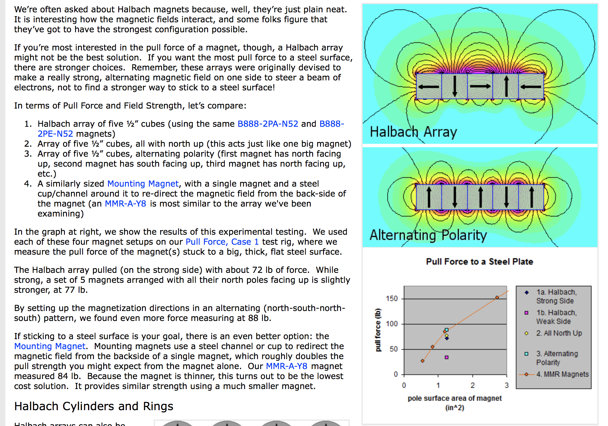

Halbach – not the strongest?
Pull force $≈$ B?

Slide 4
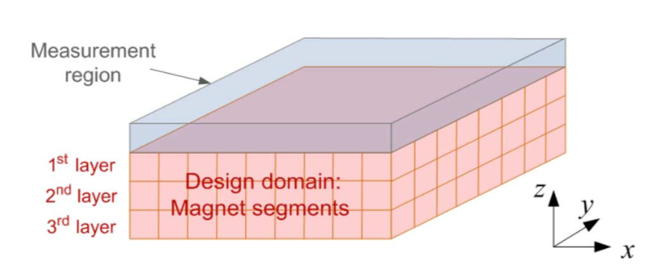
Optimization – Using CMA-ES
Objective: Maximize „sensor reading“ above the magnet array
Design space: magnetization direction on each box, 0-5
Smaller problem, 4 x 4, 2 layer -> weaker than all pointing up
Smaller problem, quasi 2D halbach array. Strongest array: ↑←↓↓↓
Notes:
Obviously not the best representation, but it works. 0-5 representation relax the problem into real optimization, but limits the change of direction in each iteration. Better present it as twice as many variables: axis and direction. Need special operator for stochastic problem (integer only, and must satisfy some constraints)

Slide 5
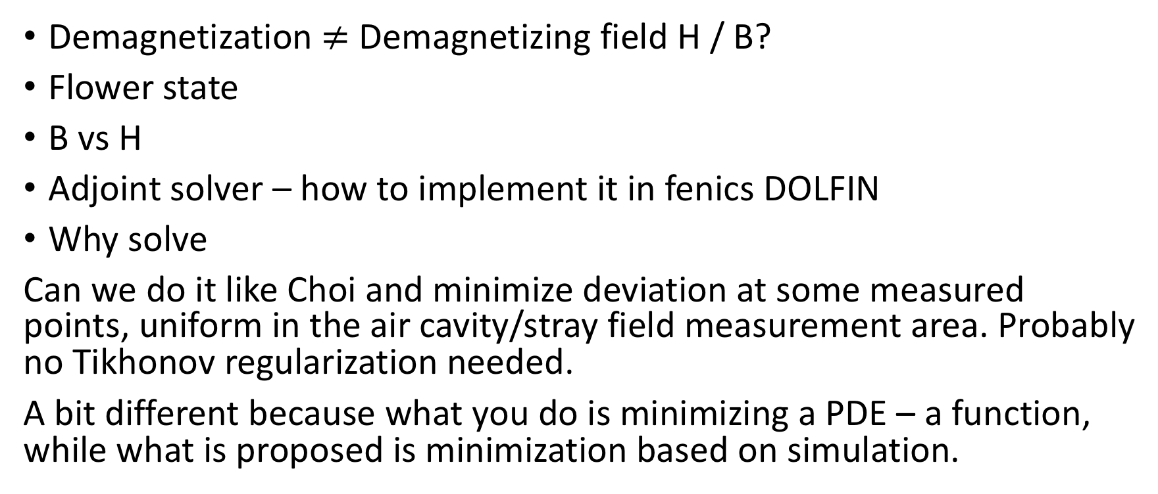
What still confuses me
Demagnetization $≠$ Demagnetizing field H / B?
Flower state
B vs H
Adjoint solver – how to implement it in fenics DOLFIN
Why solve
Can we do it like Choi and minimize deviation at some measured points, uniform in the air cavity/stray field measurement area. Probably no Tikhonov regularization needed.
A bit different because what you do is minimizing a PDE – a function, while what is proposed is minimization based on simulation.

Slide 6
Starts from all up, Optimized Array

Slide 7
Inverse problem using CMA-ES
Target: all up
Start: random

Slide 8
Finite Element Using Fenics
Issue with the magnet problem: Dirichlet and neumann boundary condition at the same points (magnet skin)
Normally, solvers can only use one. It works in fenics, but I doubt its accuracy.
People says in most solvers, the Neumann boundary condition takes precedence
Fredkin-Köhler accuracy is good. Divide the u = u1 + u2. Each u uses one boundary condition.
Fenics only handles FEM, the Fredkin-Köhler method uses FEM/BEM
Need BEM solver, available: Bempp

