Slide 1
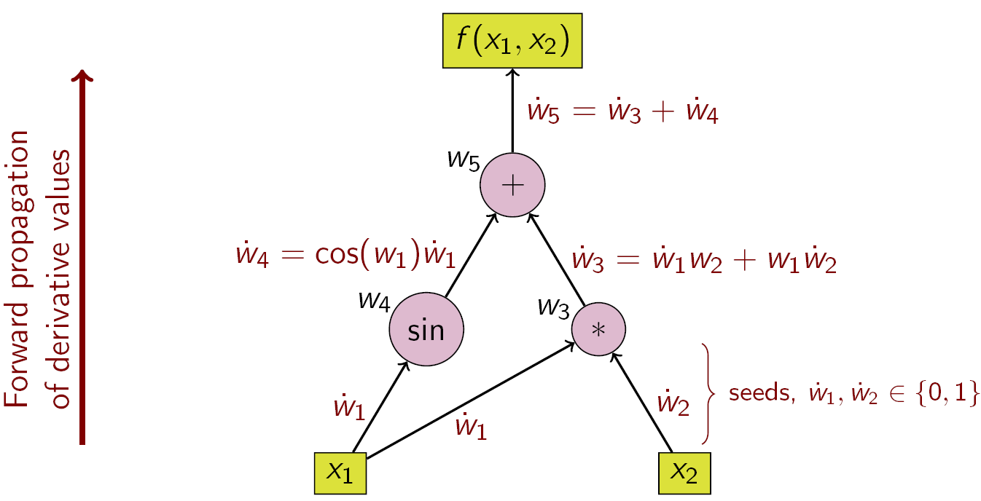
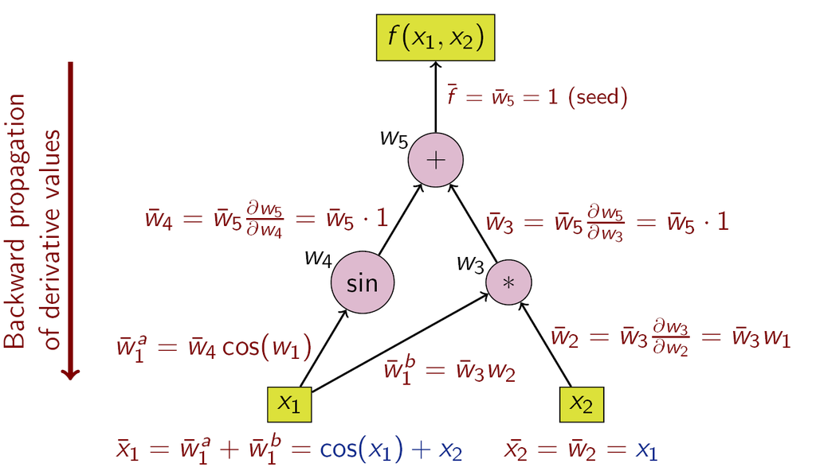
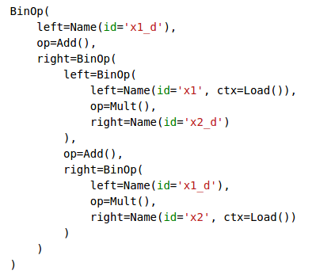
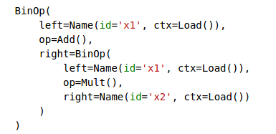
Automatic Differentiation
Presented by: Yubo “Paul” Yang
AD

Slide 2
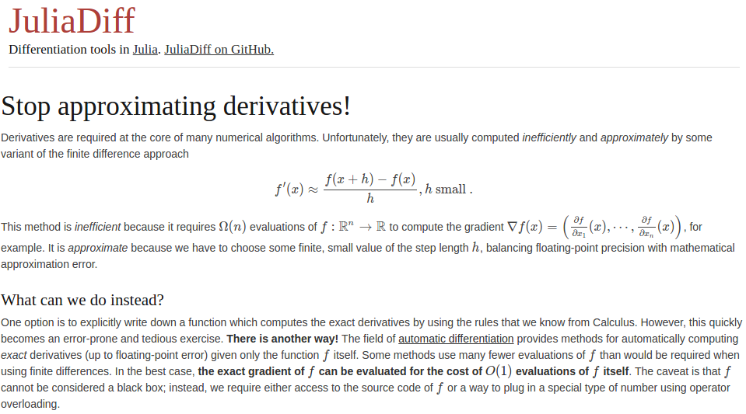
Motivation

Slide 3
Generalizable to:
Main Idea
Many algebraic functions of the form:
Can be decomposed into smooth elementary operations.
Smooth elementary operations have know exact derivatives.
Chain rule!
Wikipedia example:

Slide 4
Wikipedia Example: Forward Propagation
Start from independent variables
Say: w1=x1=0
w2=x2=0, want df/dx1
Step 1: seed
value(w2)
independent
Step 2: follow an arrow, use chain rule and known derivative
Say: left-most arrow
Keep following arrows, use chain rule and known derivatives
Viola! The answer is 1!

Slide 5
Wikipedia Example: Backward Propagation
Start from dependent variable
Say: f(x1,x2)=0, want df/dx1
dependent
Step 1: seed
Adjoint of f
value (w5)
Step 2: follow an arrow backwards, use chain rule and known derivative. Say: left-most arrow
Keep following arrows, use chain rule and known derivatives
Many arrows to follow! Results are functions of inputs!
Munch.. munch ...

Slide 6
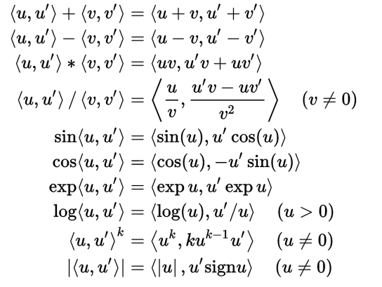
Implementation
Source Code Transformation (SCT)
Operator Overloading (OO)
ad_sct.ipynb
Dual number
Dual Arithmetic
SCT

Slide 7
Applications
Parameter Tuning
Sensitivity Analysis
Mesh Quality Optimization
Nonlinear PDEs
Stolen slides start here
Credit: Boyana Norris

Slide 8
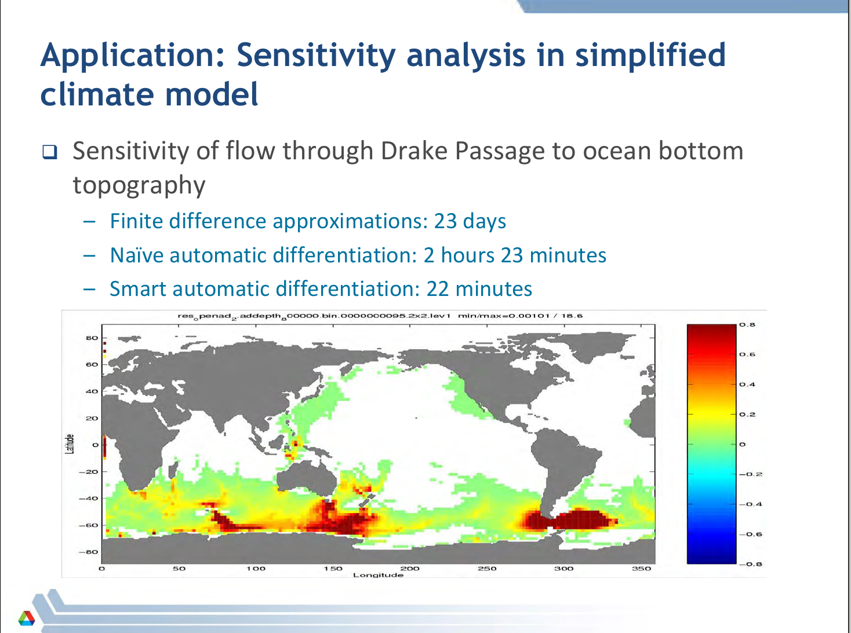

Slide 9
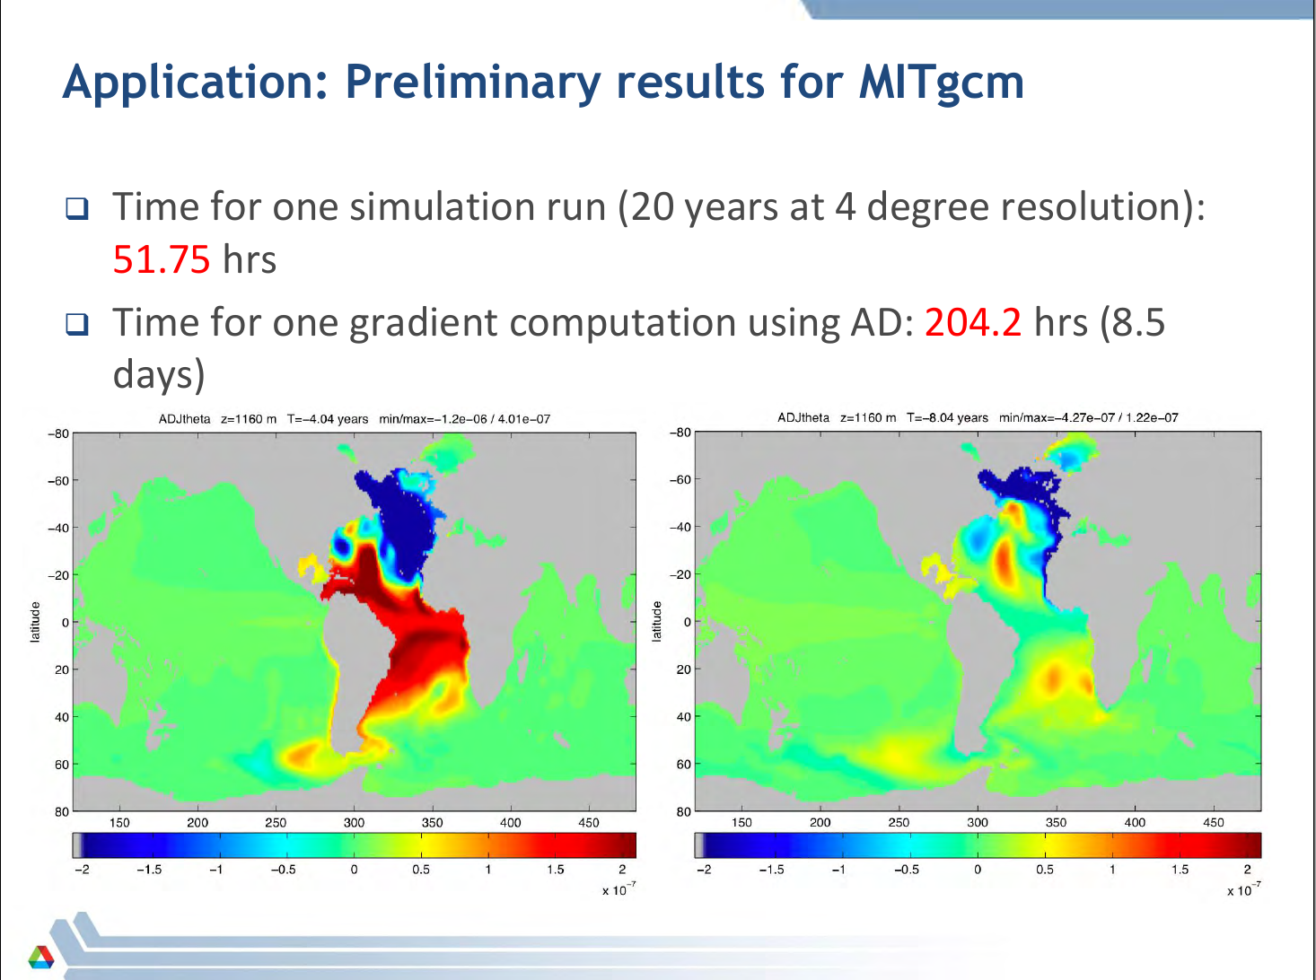

Slide 10
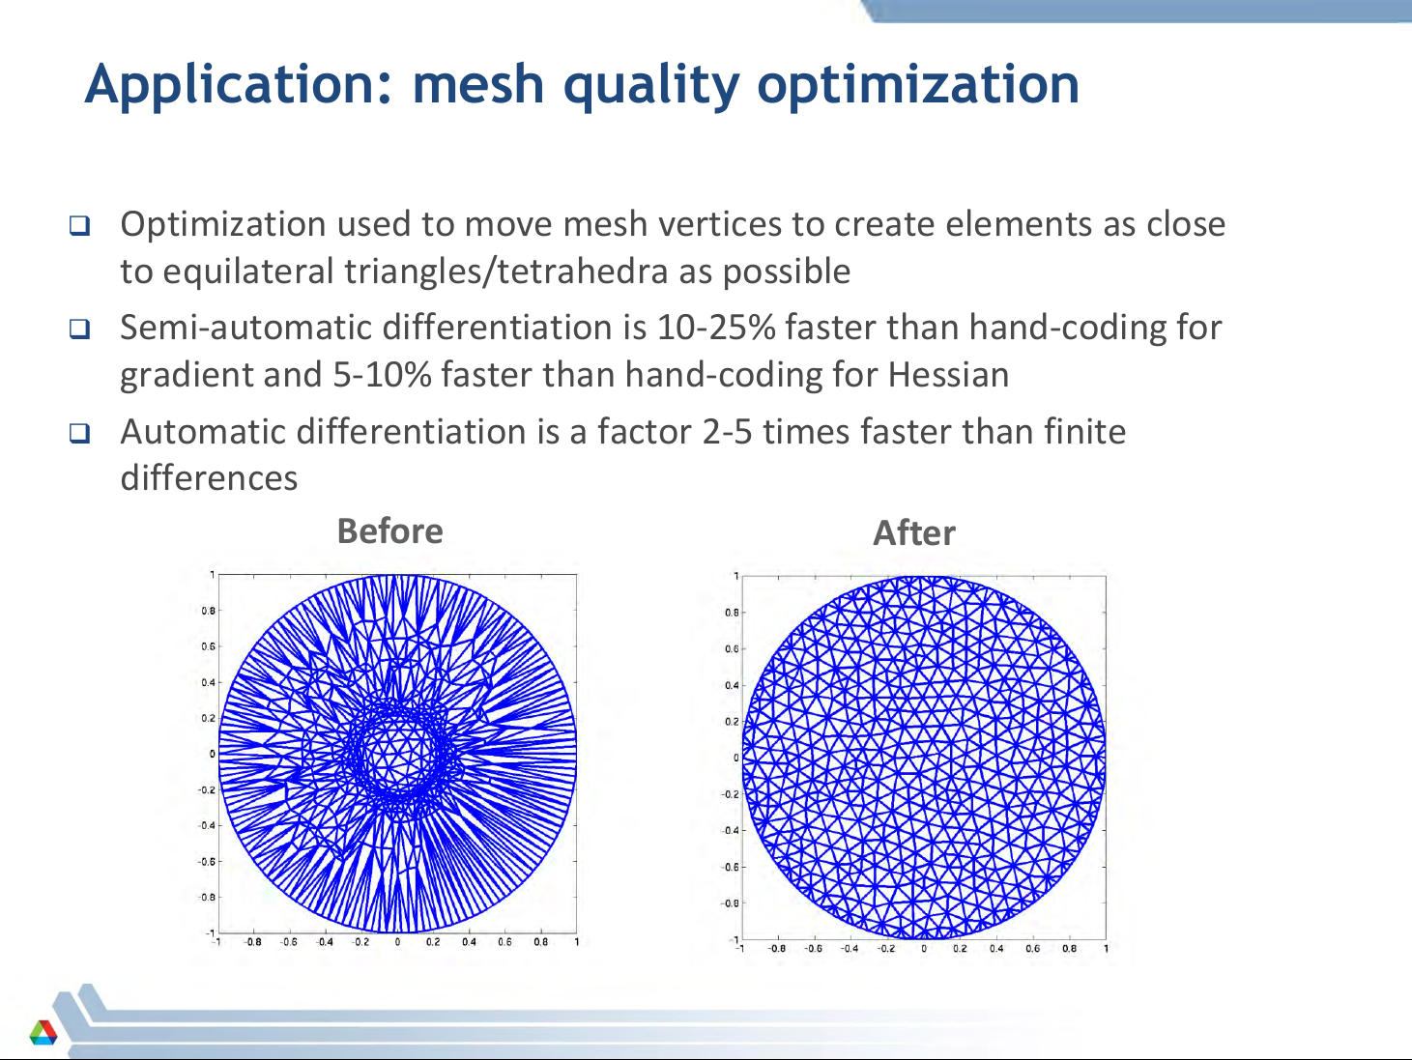

Slide 11
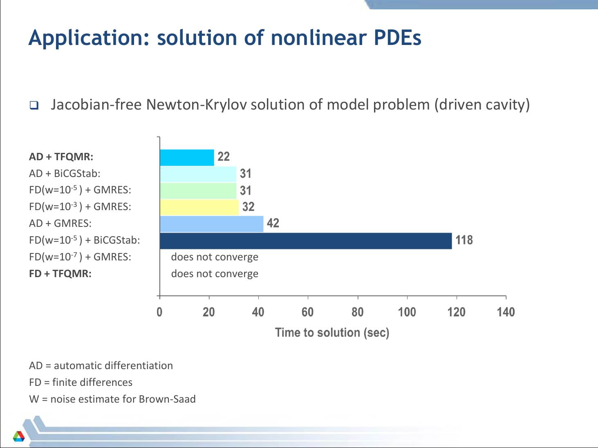

Slide 12
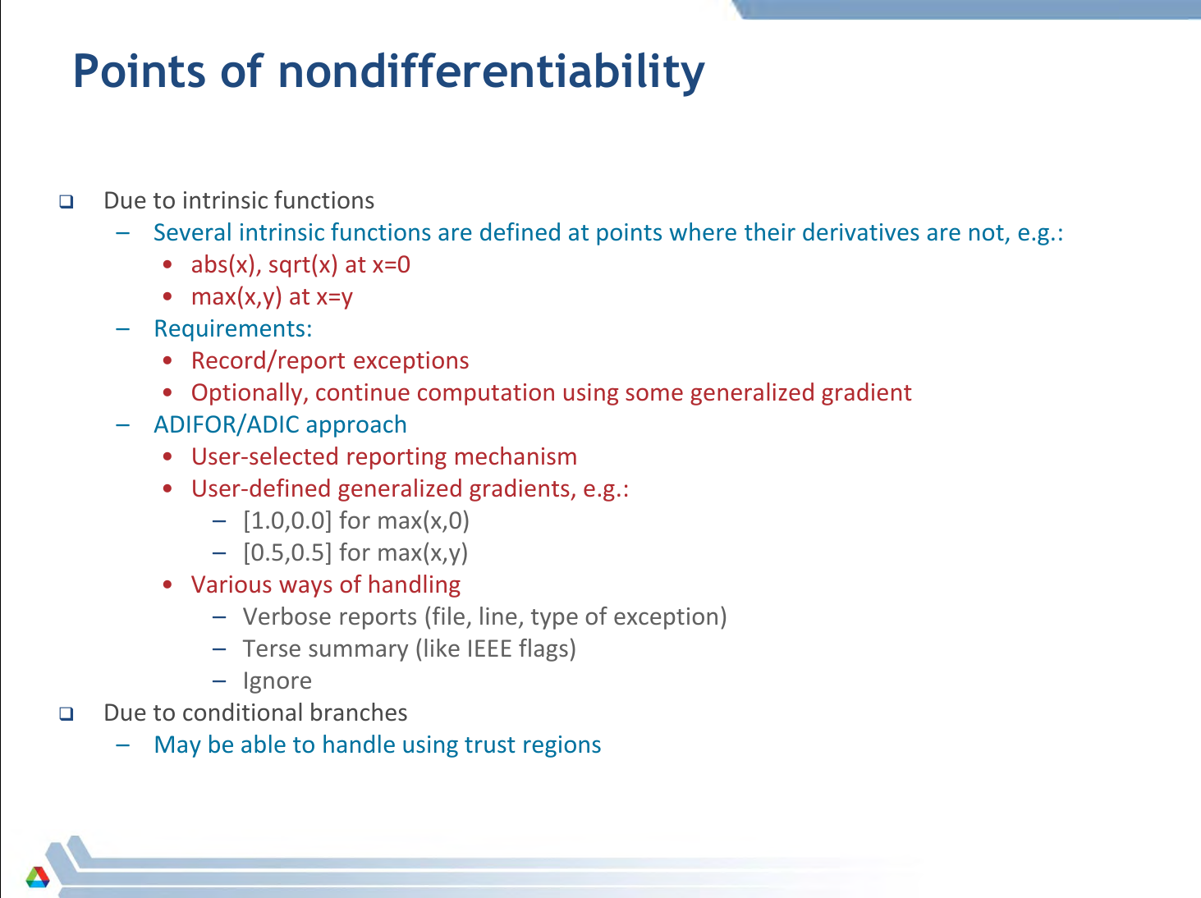

Slide 13
Conclusion
If
is a chain of smooth elementary operations.
Then disassembly + chain rule + reassembly = AD.
Source code transformation: Good for forward and reverse Hard to implement Memory intensive
Operator Overloading: Good for forward mode Easier to implement Memory efficient
Strengths of AD: Exact, Fast, No human error
Pitfall of AD: Non-differentiability

