Slide 1

El-Anis
Smart Elderly Care Platform
Presenter's : Ahmed Hany
Date : 5-12-2025

Slide 2

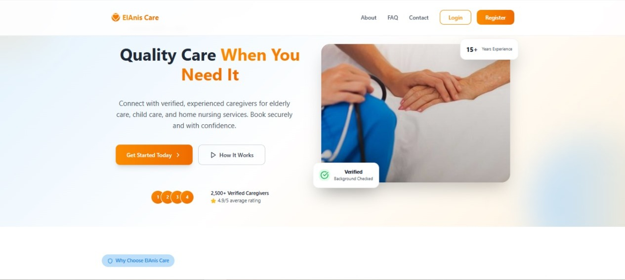
Project Idea :
El-Anis is a digital platform offering home care services for the elderly, providing access to housekeepers, nurses, and caregivers through easy booking and on-demand requests.
Brief Description of the Problem Being Solved :
1-Lack of reliable and accessible home care services for older adults.
2-Difficulty finding certified and reliable caregivers and nurses.
3-Lack of a unified platform that provides these needs to families.
4-Older adults and their relatives suffer from stress due to the lack of regular care.
Overview of the proposed solution :
El Anis offers :
1-An easy-to-use platform for booking nurses, housekeepers, and specialized caregivers.
2-A professional, trained workforce with verified reliability.
3-Transparent service ratings and genuine user reviews.
4-24/7 customer support and service guarantees.
5-Clear pricing with no hidden fees.
Unique value proposition :
1-Intense focus on unique elderly care services in the Egyptian market, home nursing, and more
2-Selection process with certificates, official documents, and rigorous training for high-quality caregivers
3-Easy-to-use platform designed for elderly users and their families
4-Instant or scheduled bookings with comprehensive service options
5-Trust and security guaranteed thanks to transparent reviews and insurance coverage

Slide 3
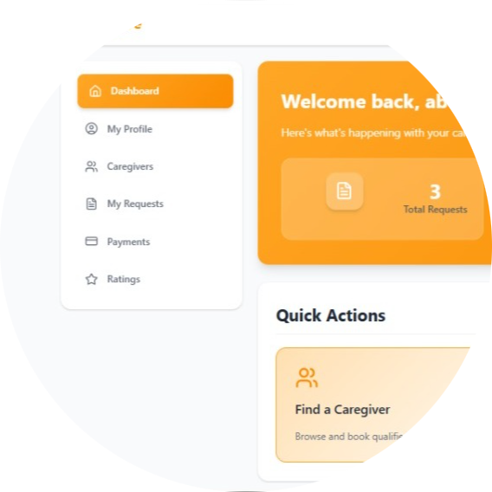

Project Wireframe & User Journey :
Visual representation of key user interfaces
1-Homepage / Landing
- Platform logo and short tagline about elderly and home care services
- Main search bar with filters (location, price range, service type)
- Quick links to “Become a Service Provider”, “How it Works”, and “Support”
2-Service Search & Filter Page
- Filters: City/Area, price range, service category (Nursing, Housekeeper, Childcare, Elderly Care)
- List of service providers as cards (photo, name, rating, price, short description)
- Sorting options (by rating, price, distance)
3-Service Provider Profile Page
- Provider photo, name, role (nurse, housekeeper, caregiver, babysitter)
- Qualifications, years of experience, service description, availability
- Rating (stars) and user reviews section
- “Send Service Request” button and basic price info
4-Customer Dashboard
- Active requests and upcoming bookings
- Request and booking history
-“My Reviews”, “My Complaints”, and “Support” sections
5-Service Provider Dashboard
- Incoming service requests with customer and service details
- Buttons: Accept, Decline, Ask for changes/negotiation
- Current jobs and completed jobs list
- Earnings overview and profile management
Customer journey :
- User signs up or logs in as a customer
- User opens the search page and applies filters (location, price range, service type)
- User browses the list of providers and opens provider profiles
- User selects a suitable provider and clicks “Send Service Request”
- User specifies required service details (type, date, time, duration, notes)
- Request is sent and shown as “Pending” while waiting for provider response
- Provider accepts or negotiates the request based on availability
- Customer and provider finalize details, then the customer proceeds to payment
- Booking is confirmed and appears in the customer dashboard
- After service completion, the customer rates the provider and writes a review
- If there is an issue, the customer can submit a complaint through the complaints section
Focus on ease of use and user experience :
1-Simple and clear navigation with separate views for customers and suppliers
2-Search and filters designed to reduce the steps and time needed to find the right supplier
3-Consistent designs across pages (cards, buttons, typography) to reduce confusion and ease of use
4-Clear status indicators for each request (pending, accepted, active, completed)
5-Powerful feedback mechanisms: section for ratings, reviews, and complaints for transparency and trust

Slide 4
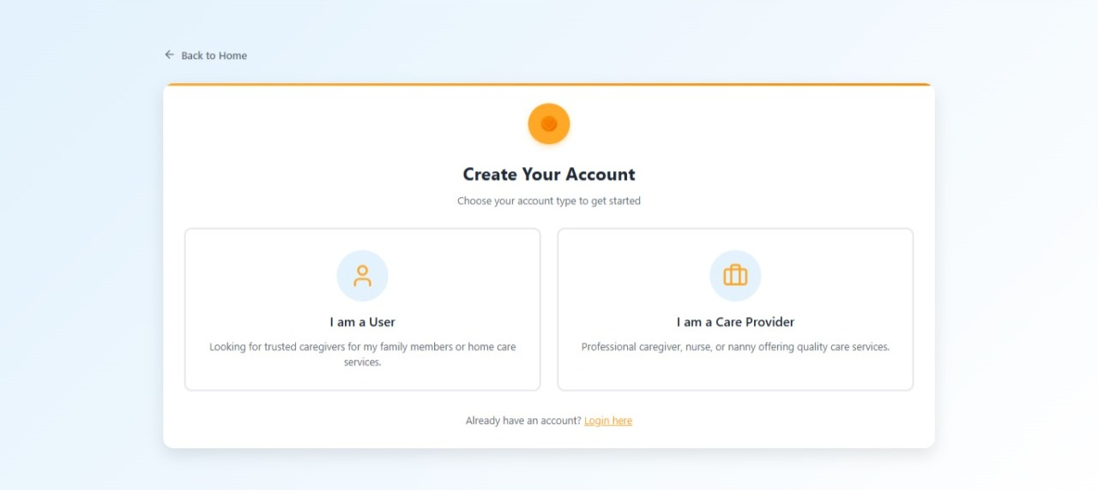

Primary users :
Elderly people, family members, and children — need reliable home care from certified professionals
Service providers (nurses, maids) — need consistent access to clients and guaranteed payments
Healthcare organizations — need quick access to qualified temporary staff
Key Features :
- Advanced search & filtering (location, price, service type)
- Provider verification & qualifications display
- Rating & review system for transparency
- Secure service request & payment processing
- Complaints & support section
- Provider dashboard with real-time notifications
How Features Solve User Problems :
For elderly and families: make it easy to find and trust the right caregiver, reduce search time, and give transparency through ratings and reviews.
For service providers: simplify finding clients, ensure safer and clearer payments, and help them build a strong reputation.
For institutions: enable fast discovery and booking of vetted professionals during staff shortages.

Slide 5
Data Structure :
Database Architecture :
Relational SQL Server database using Entity Framework Core with a code-first approach. Normalized tables with configured relationships ensure data integrity and optimal query performance.
Key Entities and Main Relationships :
User → Service Requests, Reviews, Notifications (One-to-Many)
Service Provider Profile → Categories, Availability, Working Areas, Service Requests, Reviews (One-to-Many)
Service Request → User, Service Provider, Category, Payment (Many-to-One)
Category → Service Pricing, Provider Categories, Service Requests (One-to-Many)
Payment → Service Request (One-to-One)
Review → User, Service Provider, Service Request (Many-to-One)
Data Flow: Collection → Storage → Access
1. Data Collection
Client application sends data through API controllers. Input validation happens via Data Transfer Objects (DTOs).
2. Data Storage
Entity Framework Core maps entities to database tables. Configuration classes define table structures and relationships. Data is normalized and stored in SQL Server.
3. Data Access
LINQ queries retrieve data through Entity Framework Core. Navigation properties enable efficient related data access. Eager loading optimizes query performance.
Complete Pipeline: Client → API → Validation (DTOs) → Business Logic → Entity Framework Core → SQL Server

Slide 6
Final 6: Programming Languages + Frameworks :
Programming Languages :
- C# for backend business logic and API implementation.
- TypeScript and JavaScript for building a dynamic, interactive frontend.
- SQL for managing and querying the relational database.
Frameworks and Tools :
- ASP.NET Core 8.0 Web API for the backend, handling authentication, bookings, payments, reviews, and admin operations.
- Entity Framework Core 8.0 as the ORM layer for accessing SQL Server 2022.
- ASP.NET Core Identity with JWT tokens for authentication and role-based authorization.
- React 18 for the frontend user interface.
- Tailwind CSS and/or Material UI for styling and responsive design.
- React Router v6 for client-side routing.
- Context API or Redux Toolkit for state management across the app.
Supporting Technologies :
- Microsoft SQL Server 2022 as the main relational database.
- RESTful APIs to connect web and future mobile clients with the backend services.
- Payment gateway integration (e.g., Fawry, Vodafone Cash, card payments) with PCI-DSS-compliant processing and TLS 1.3 encryption.
- Cloud hosting on Azure App Service or AWS, with monitoring via Application Insights.
- Git and GitHub for version control, with GitHub Actions for CI/CD pipelines.

Slide 7
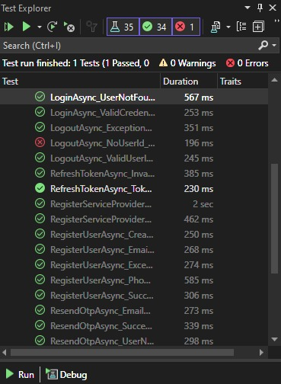
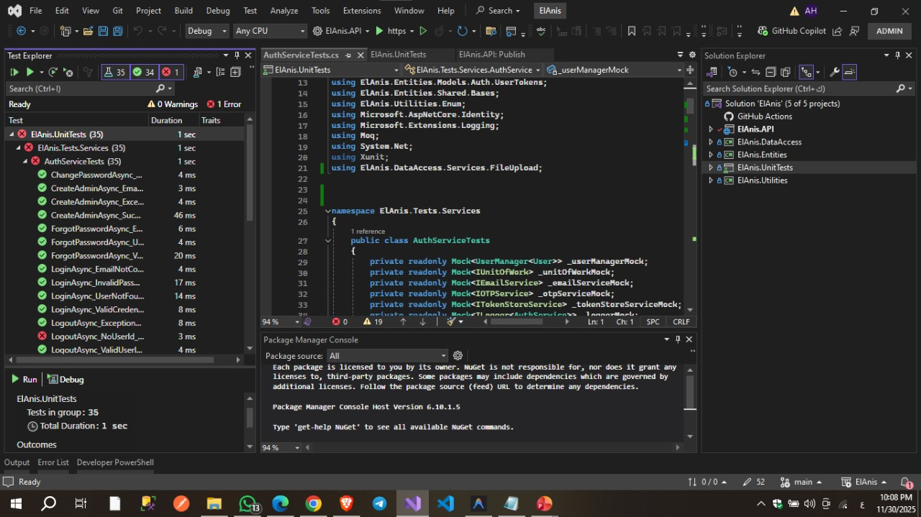
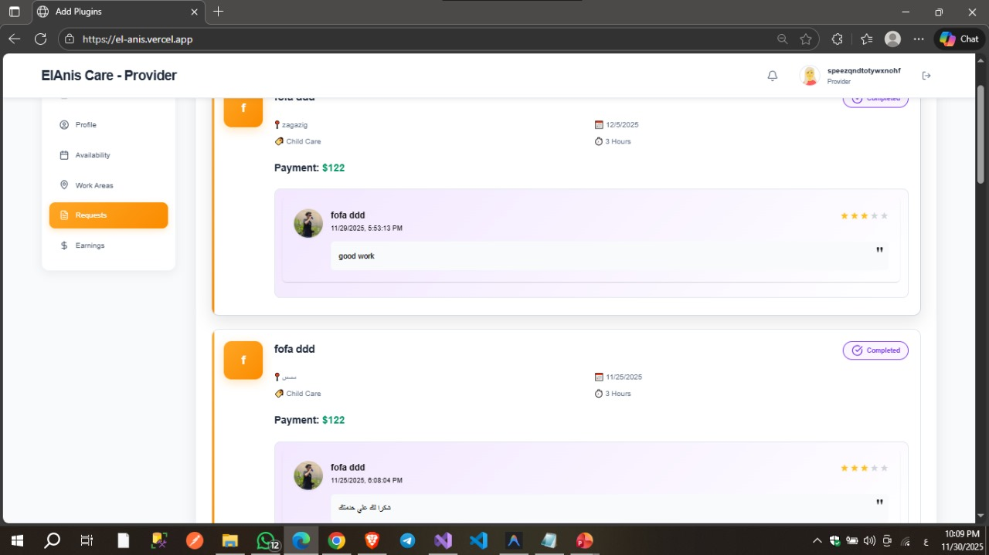
Live Application + Test
Overview of the current state of the live application :
Key testing phases:
Feedback from users:

Slide 8
Deliverables
Documentation Deliverables
Technical: Technical Specification, API Documentation (Swagger), Database Schema, Architecture Diagrams, Deployment Guide, Security Report.
User: User Manual, Admin Documentation, Provider Onboarding Guide, Troubleshooting & FAQ.
Development: Source Code Documentation, Setup Guide, Code Review Checklist, Testing Strategy, Maintenance Procedures.
Timeline & Milestones
Week 1-2: Final code review, comprehensive testing, documentation finalization, security audit.
Week 3: Production deployment, database migration, SSL setup, monitoring integration.
Week 4: Documentation delivery, training sessions, source code transfer, support transition.
Final Products
Application: Live production website, admin dashboard, mobile-responsive interface, fully functional API.
Repository: Frontend (React/TypeScript), backend (ASP.NET Core), database scripts, deployment configs, CI/CD pipeline.
Setup Files: Environment configurations, database backup scripts, security certificates, cloud templates.

Slide 9
Project Team + Roles :
Ahmed Hany Ramadan Elsayed – Full Stack Developer & Team Leader
Leads the team, designs system architecture, and works on both frontend and backend.
Diaa Samir Abdelazeem Elsadek – Frontend Developer
Builds user interfaces, implements React components, and focuses on user experience.
Ahmed Osama Samir Elsayed – Frontend Developer
Develops responsive pages, handles state management, and integrates APIs on the client side.
Abdulrahman Ali Helmy Mohamed – Backend Developer
Implements RESTful APIs, business logic, authentication, and database integration.
Mohamed Adel Fathy Moselhi – Backend Developer
Works on database design, performance optimization, and core backend services.
Wafaa Mohamed Abdelhamed – UI/UX Designer
Designs user flows, wireframes, and visual layouts, ensuring a smooth and intuitive experience.
Collaboration Methods
Communication:
Discord server for real-time communication, voice meetings, and task discussions.​
Version Control:
Git and GitHub for source code management and code reviews.​
Workflow:
Agile-inspired process with task boards (e.g., GitHub Projects or Trello) and regular
check-ins.​

Slide 10
Thank You
We believe El Anis will revolutionize elderly home care services in Egypt by connecting families
For more information or collaboration:
Email: [ahmedhanyramadan01@gmail.com]
Phone: [+201027404892]

