Slide 1
OpenInkpot – free software for e-Book readers
Mikhail Gusarov
<dottedmag@dottedmag.net>
NUUG members' meeting
08.03.2011
Oslo and Stavanger, Norway

Slide 2
Overview
State of e-Books and e-Readers
e-Ink and its peculiarities
OpenInkpot
  Why, what is it, what it is good for and how to use it?
  What's inside? (discoveries of desktop software developer in Embedded Wonderland)
  How to make device X I have to run OpenInkpot?

Slide 3
1.1 State of e-Books
Lot of e-Book sellers:
  Sony, Amazon, Apple iBooks, B&N, ...
Books are either bound to devices (Sony) or accounts (Amazon, B&N)
  Exceptions: litres.ru (literature in Russian)
DRM or DRM-free, depending on publisher's paranoia (all known DRM schemes used by big publishers are already broken)

Slide 4
1.2 Fiction e-Book formats
ePUB, FB2, DOC, RTF, plain text, TCR, Plucker, Mobi, OEB, zTXT, Palmdoc, LRF...
Every vendor liked to invent something
Mostly converged on ePUB
  Every vendor likes to invent extensions to ePUB nowadays
Strong regional preferences
  FB2 in xUSSR
  Some exotic stuff in China

Slide 5
1.3 Technical e-Book Formats
PDF, DejaVu
Support in specialized readers is mostly bad
  Much harder to render than fiction

Slide 6
2.1 e-Book Readers
Tablets
Phones, PDA
Dedicated e-Book readers
  e-Ink based: Amazon Kindle, Sony PRS
  LCD-based: obscure and obsolete

Slide 7
2.2 Tablets
Big (> 6”)
LCD screen
Well-suited for technical literature (big PDFs and DejaVu files)
Short battery life (few hours)
Android, regular Linux/X or iOS

Slide 8
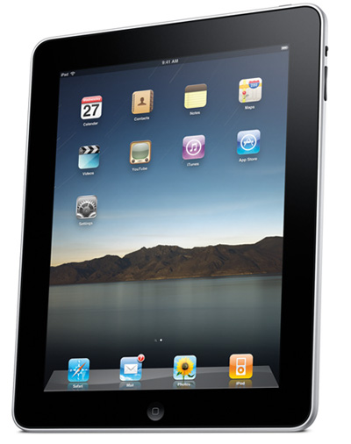
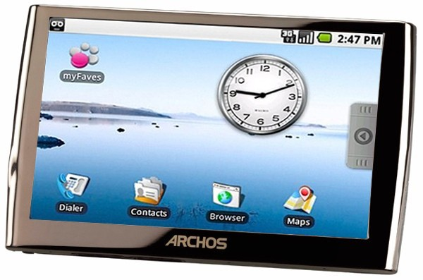
2.2.1 Tablets (2)

Slide 9
2.3 Phones, PDA
Small
LCD screen
OK for fiction
Short battery life when used as e-Book readers (ouch!)
J2ME apps, regular Linux/X, Windows Mobile

Slide 10
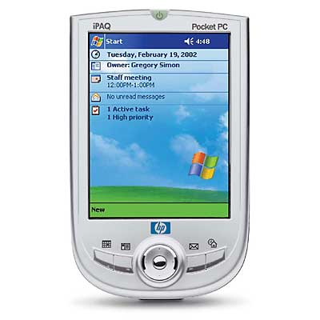
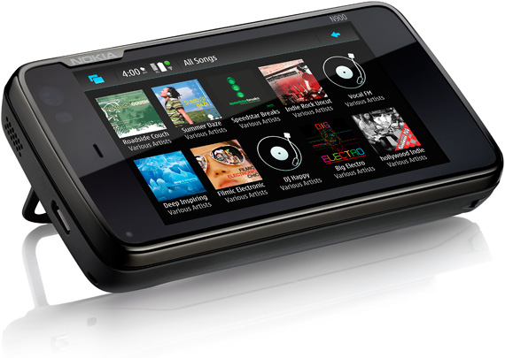
2.3.1 Phones, PDA (2)

Slide 11
2.4 Dedicated e-Book Readers
Small (≤6”)
Most have e-Ink screen
Good for fiction
Long battery life (> week)
Special Linux, Android

Slide 12
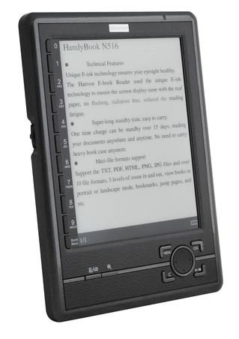
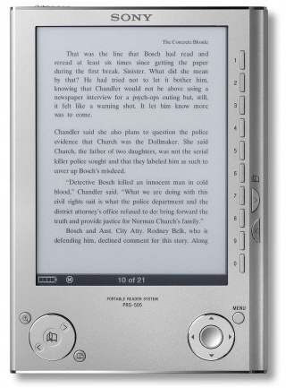
2.4.1 Dedicated e-Book devices (2)

Slide 13
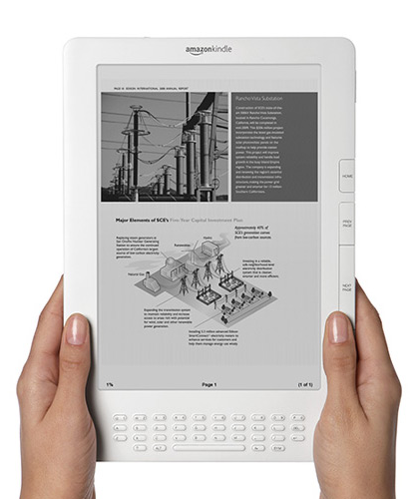
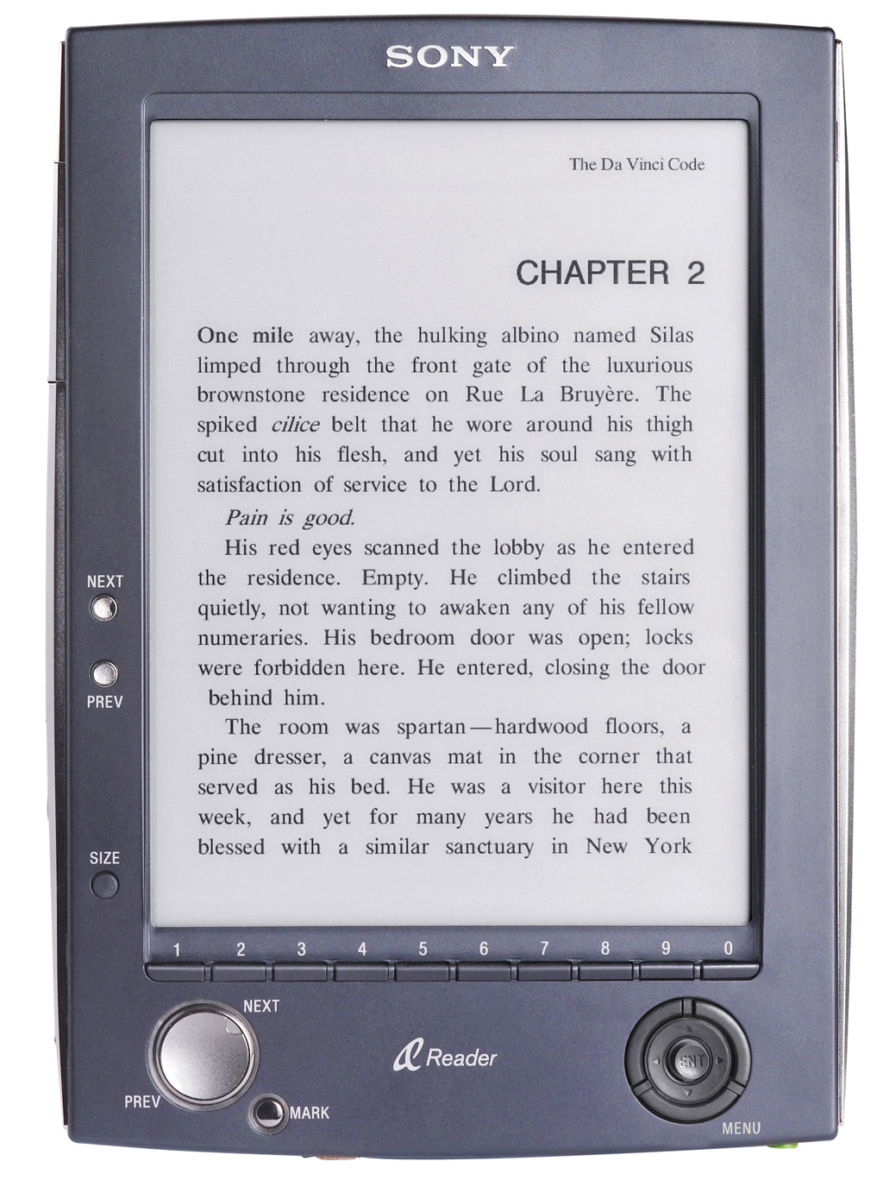
2.4.2 Dedicated e-Book devices (3)

Slide 14
2.5 Types of dedicated devices
Tightly controlled
  Produced by big publishers/manufacturers (Amazon, Sony, Apple)
  1-2 book formats available only from store by manufacturer
  Even remotely controlled (Amazon deleted “1984” from Kindle devices due to being doubleplusungood purchase by users)

Slide 15
2.6 Types of dedicated devices (2)
Free-for-all
  No integrated bookstores (“it's up to you where do you get your books”)
  Lot of book formats are supported by devices
  No Sonbig company to stomp on you if you mess with device
  China and xUSSR markets are dominated by such devices
  Device quality is often quite bad

Slide 16
3. e-Ink Features
VERY slow
  ~1 FPS
Does not consume power if image is static
  Battery lifetimes are measured in “page turns”
Black-and-white, high DPI
E-Ink Corp. monopoly → quite expensive

Slide 17
3.2 e-Ink Features – consequences
Typical GUI does not work (menus, animations, scrolls) due to slow FPS
Devices need to sleep all the time to conserve power
Grayscale strikes again (back to 198x!)

Slide 18
4. OpenInkpot
Linux distribution for e-Ink-based dedicated e-Book readers
  Libre / open source
  Open project
  Vendor-independent
  Focused on fiction books at the moment

Slide 19
4.1 What is it good for?
Reading fiction books
  FB2, ePUB, HTML, plain text, RTF are main formats
  Lots of less known formats are supported as well
Reading technical books (as good as possible on smallish slow e-Ink screens)
  PDF and DejaVu are supported
Hacking (SSH-over-USB, X)

Slide 20
4.2 Availability
Available for Hanlin V3, Hanvon N516. Sold under other names as well.
Work in progress for several other devices.
Azbooka 516 ships with OpenInkpot preinstalled.
http://openinkpot.org/wiki/Hardware

Slide 21
4.3 What's inside?
Busybox/Linux system
  Debian-derived, uses apt-get and dpkg
  Buildsystem is Debian + extra packages
glibc
X server
EFL (Enlightenment) graphics libraries
TCP/IP networking, SSH, rsync
Lots of e-Ink specific GUI

Slide 22
4.3.1 What's going to be inside soon
s/Debian derivative/OpenWRT/
  Distribution maintenance is not main target of OpenInkpot project
s/glibc/uclibc/
  Memory footprint

Slide 23
4.4 Embedded discoveries
Memory is precious:
  No GTK+
  No Perl, Python or Ruby (Openmoko FAIL)
  glibc pushes the limits
  Xlib is not useful
Some “memory-eaters” do not actually eat memory
  X server is small

Slide 24
4.5 Embedded discoveries (II)
CPU is precious
  No Perl, Python or Ruby again (Openmoko FAIL again)
  C, C++, Vala, Lua are OK
  Boot with shell scripts is slow
  Runtime dynamic linking is not free (!)
Some “CPU eaters” do not actually eat CPU:
  X server is fast

Slide 25
4.6 Embedded discoveries (III)
PC hardware is a heaven
  Every embedded device needs specific kernel
  Every embedded device needs special drivers
  Buses are not enumerable and non-standard
    Just a few wires soldered around

Slide 26
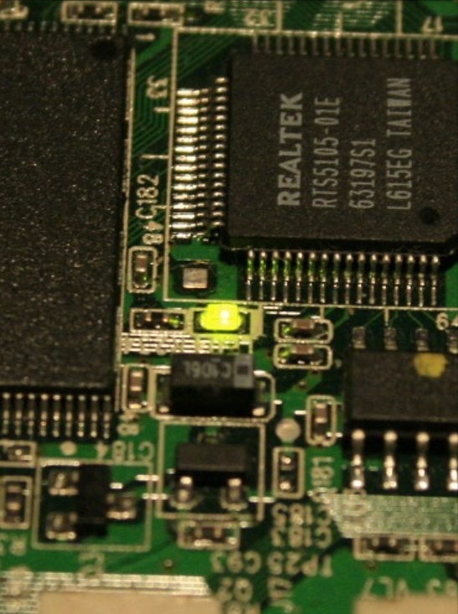
4.7 Embedded discoveries (IV)
Some hardware is funny

Slide 27
4.8 How to make OpenInkpot running on my device?
Bootloader and kernel
  Some code is released by vendor
    Except vendor is from China
      Then you can try to sue reseller, it works!
  Need to be redone to use standard Linux interfaces
    evdev, framebuffer, ALSA sound
Userspace and firmware
  Mostly “mix and match”, unless new hardware features are available

Slide 28
4.9 How to make OpenInkpot running on my device? (2)
Most kernel hackers obviously don't like to read books. Please help if you do!
Development team will help with userspace parts
  IRC, mailing list.

Slide 29
5. Contacts
Web site: http://openinkpot.org/
IRC: #openinkpot @ OFTC
Mailing list: openinkpot-hackers@openinkpot.org

Slide 30
Credits & License
Content by Mikhail Gusarov
http://dottedmag.net/
License: CC-BY-SA-3.0+
OpenOffice.org template by Raphaël Hertzog
http://raphaelhertzog.com/go/ooo-template
License: GPL-2+
Background image by Alexis Younes “ayo”
http://www.73lab.com
License: GPL-2+

