Slide 1
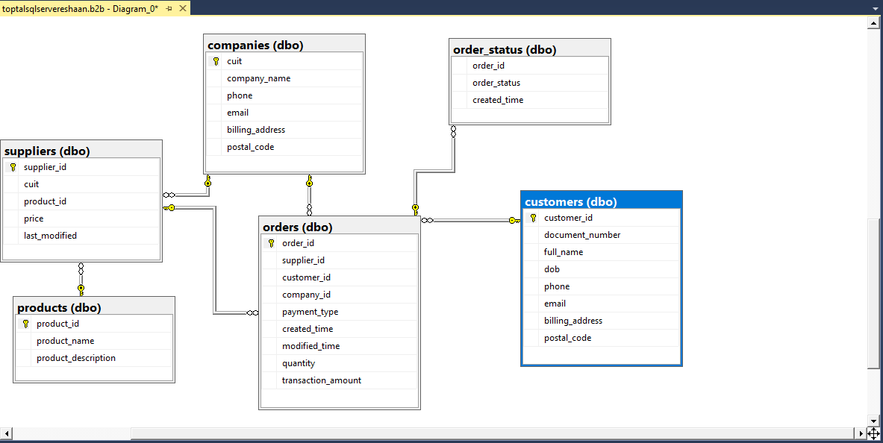
B2B Database Architecture

Slide 2
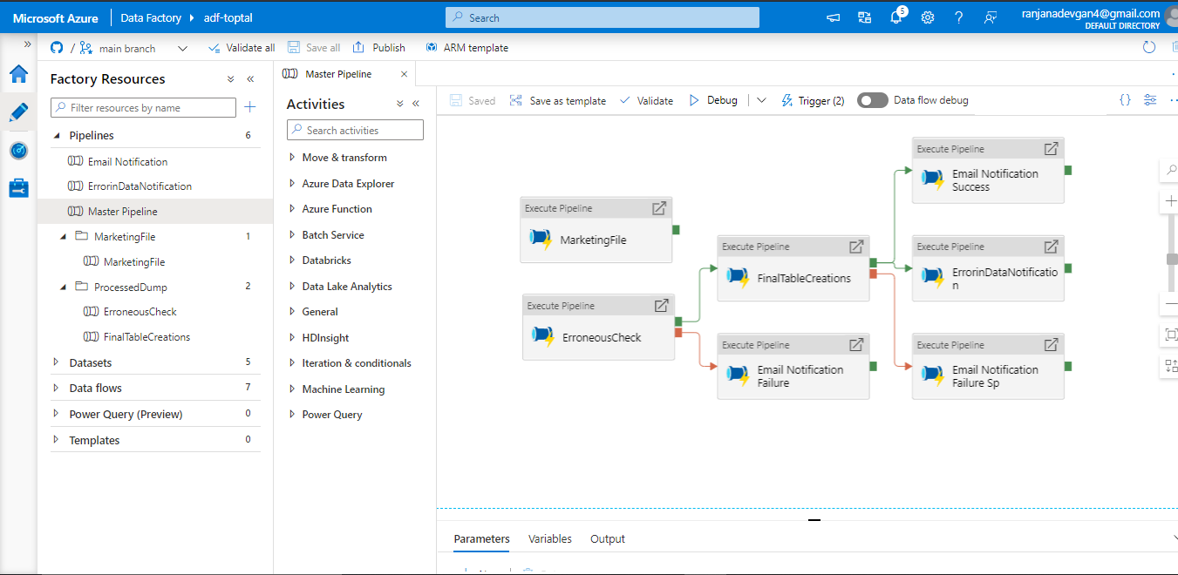
ADF, Pipeline Flow

Slide 3
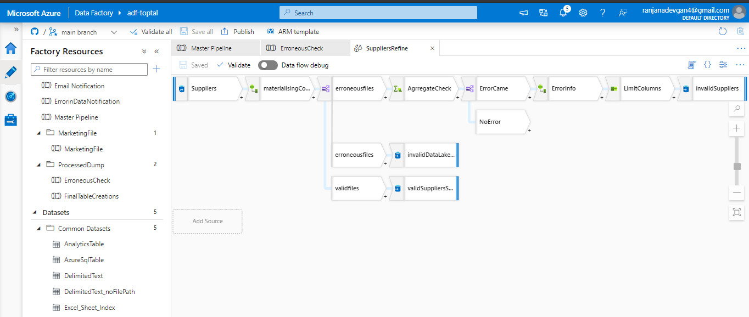
Master Flow

Slide 4
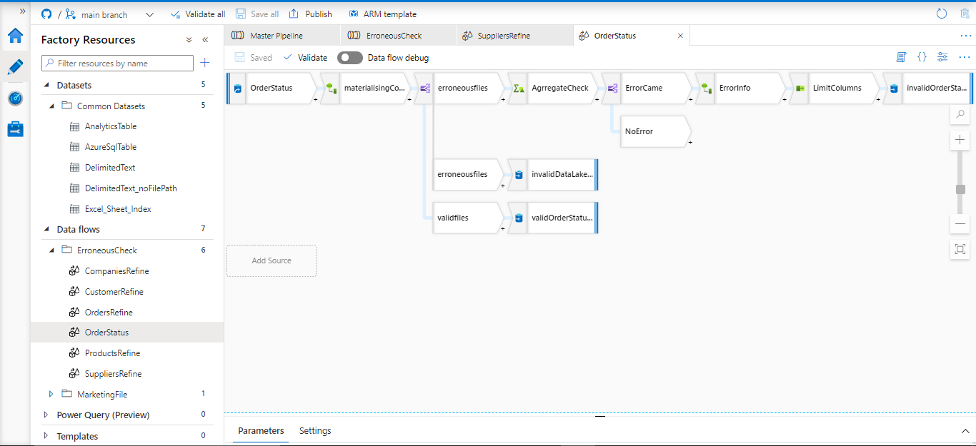
Transactional Flow

Slide 5
Notifications
1: Error in Data Notification
2: Pipeline Failure Notification
3. Success of Marketing File
4. Success of Pipeline Structure

Slide 6
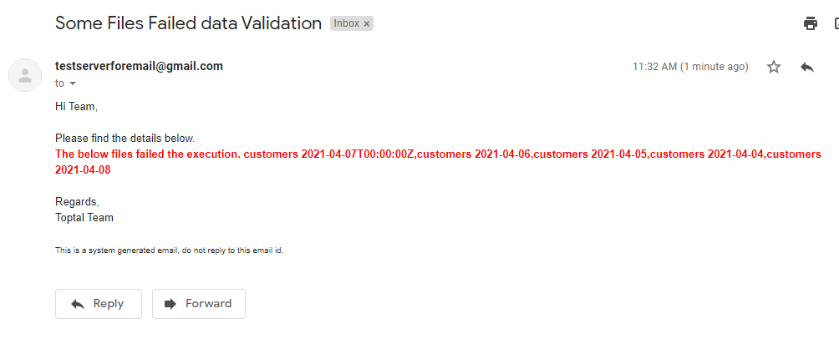
Error in Data Notification

Slide 7
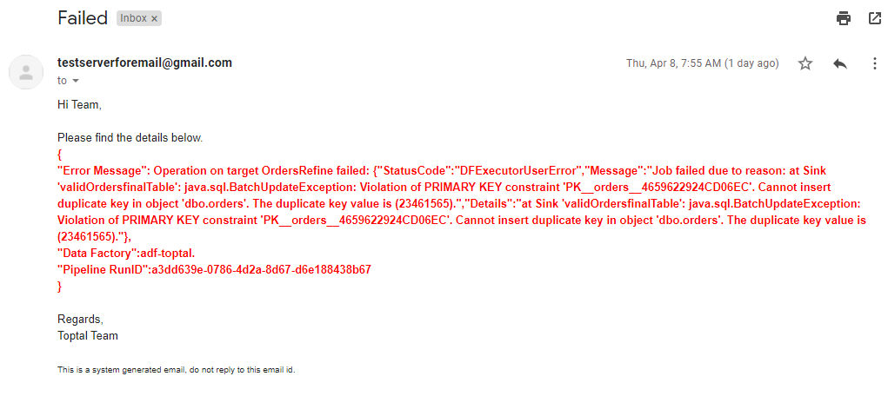
Pipeline Failure Notification

Slide 8
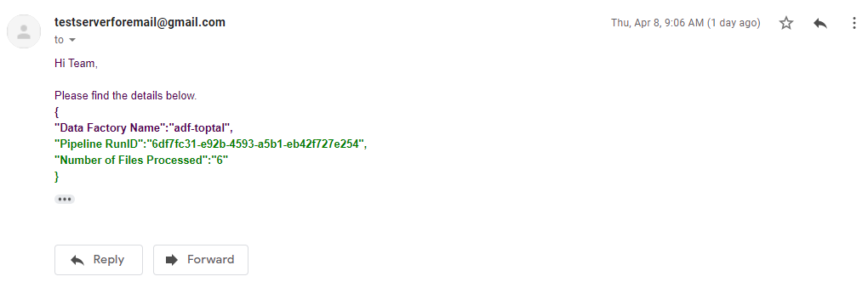
Success Marketing File

Slide 9
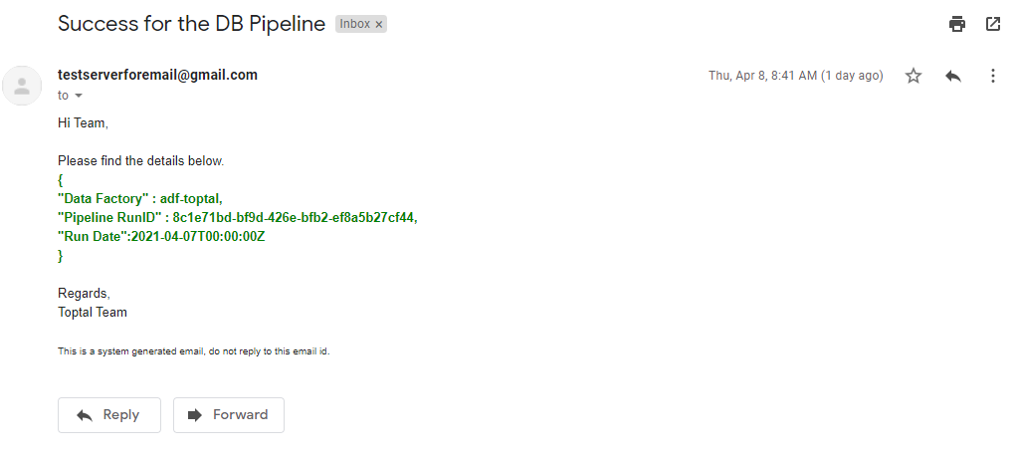
Success for Pipeline

Slide 10
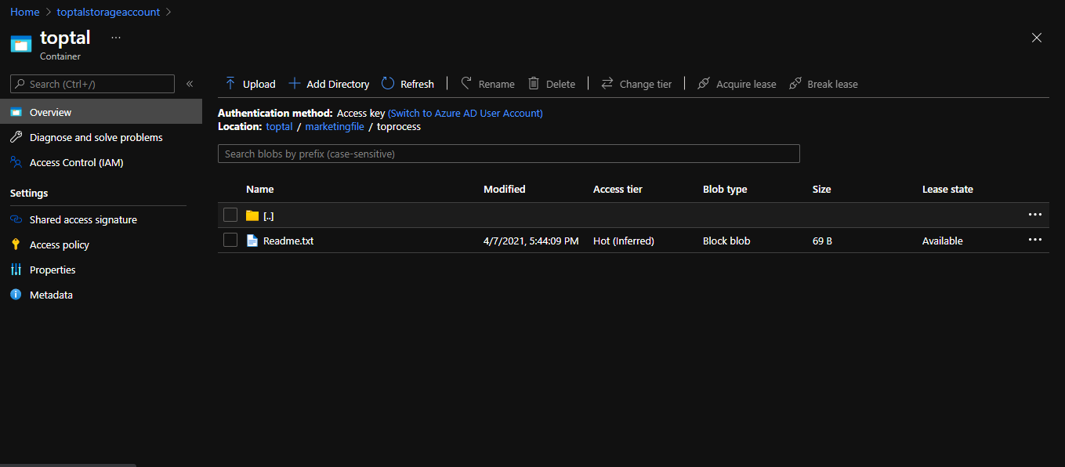
Marketing File Process

Slide 11
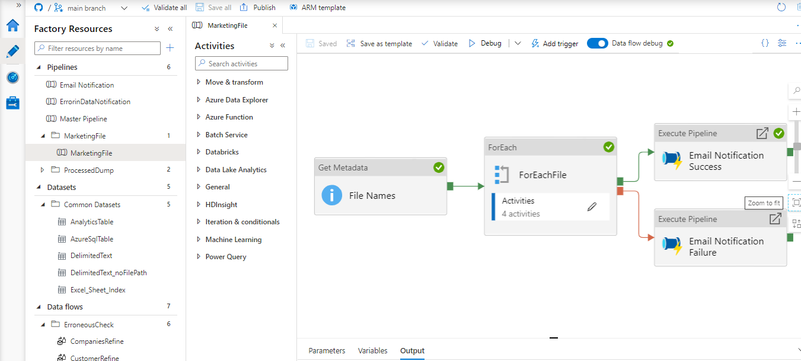

Slide 12
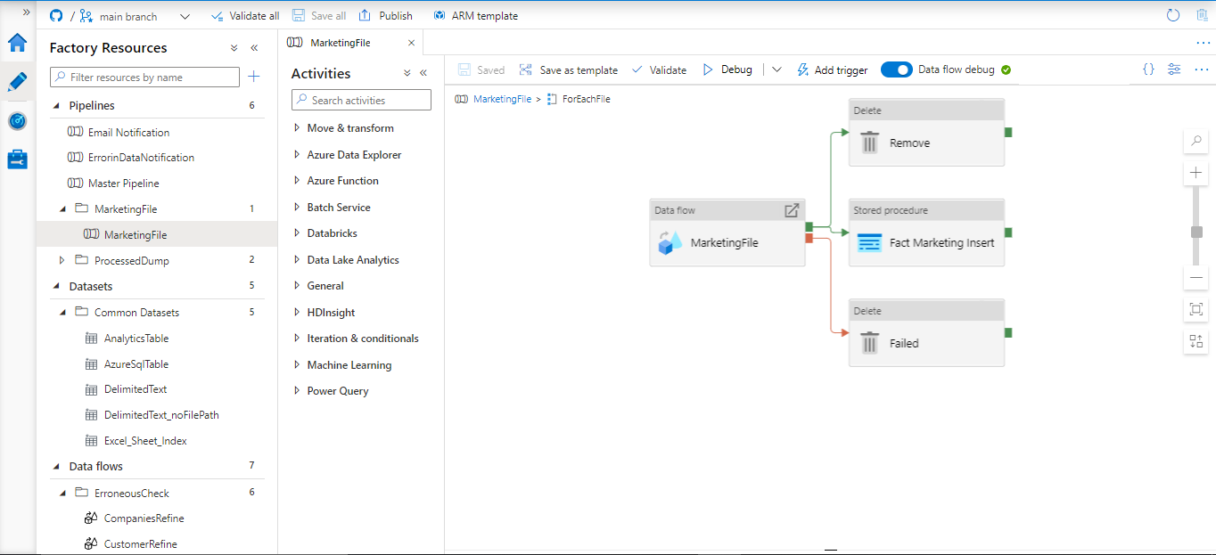

Slide 13
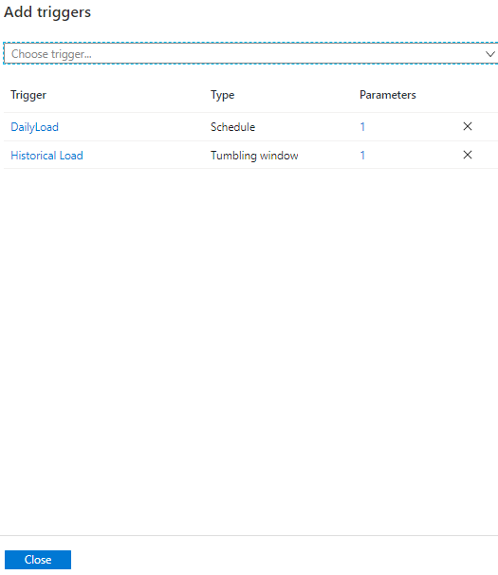
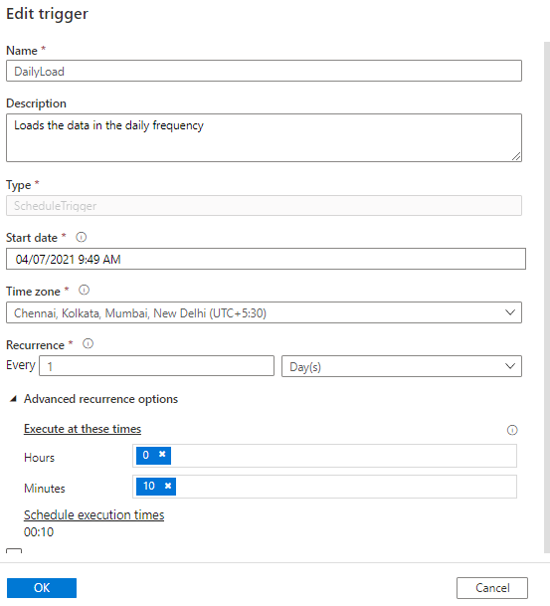
Flow Run(@addHours(formatDateTime(trigger().scheduleTime,'yyyy-MM-dd'),-24))

Slide 14
Web Log
1. Take data from Azure Web Analytics Logs
2. Use Event Hub to connect to the Logs and store it for a day time
3. Use Stream Analytics, to connect to the Event Hub and Push the Data to our final Source. Azure DB for Analytics

Slide 15
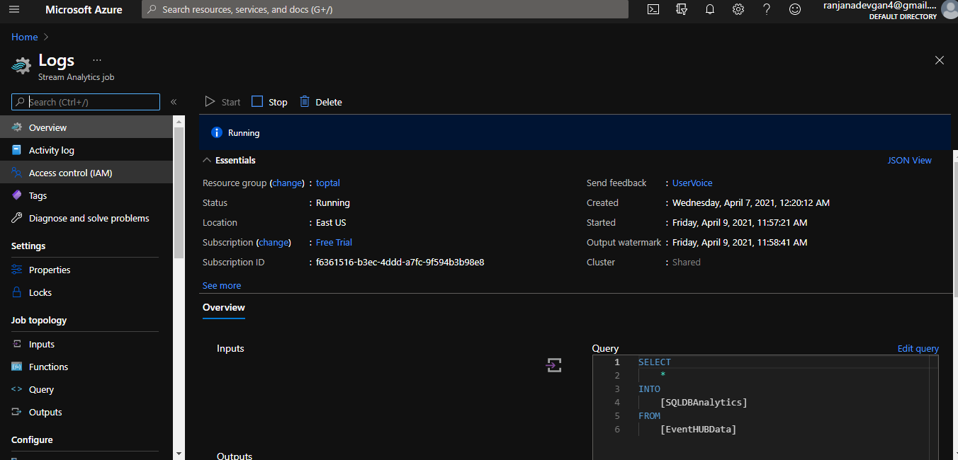

Slide 16
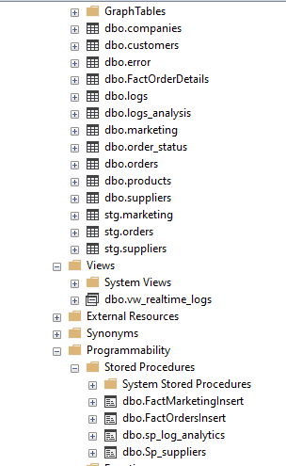
Analytics

