Slide 1




Remote Learning with WordBuilder
http://www.wordbuilderapp.com
To access these slides: https://tinyurl.com/RemoteWB
Download for free:
Notes:
Say: WordBuilder is available for free download in the following places. You can click on the image to be taken to the store. To access this presentation please visit the link in the chat box: https://tinyurl.com/RemoteWB.

Slide 2
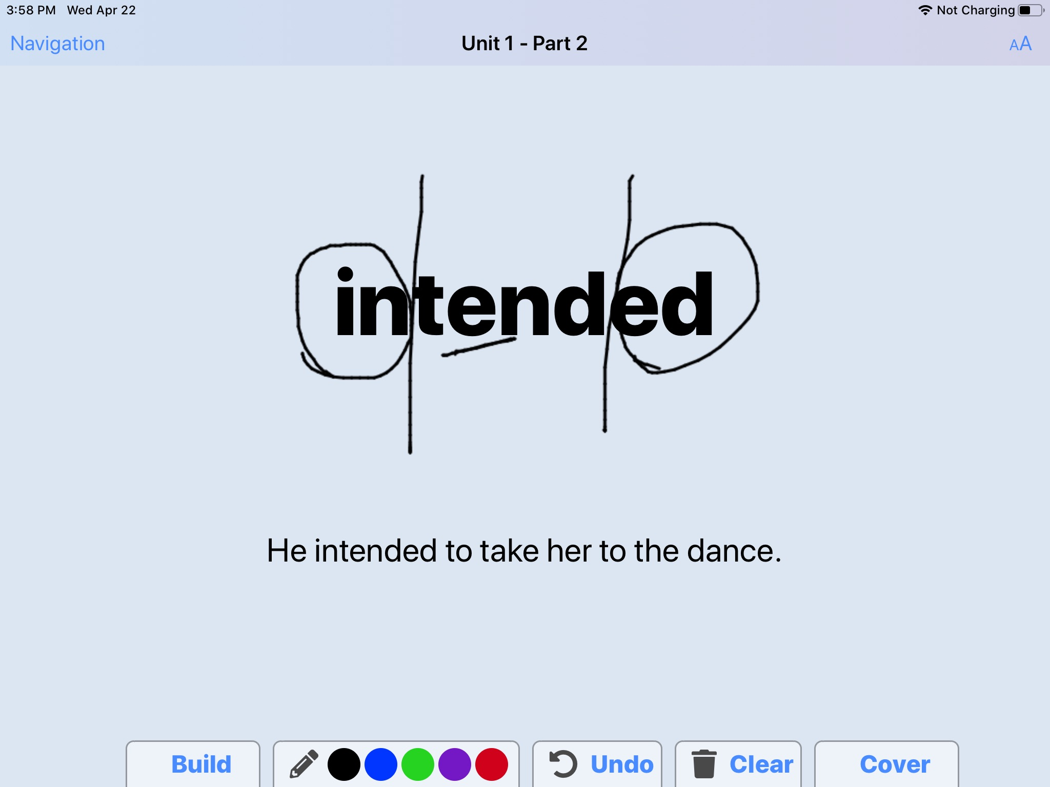
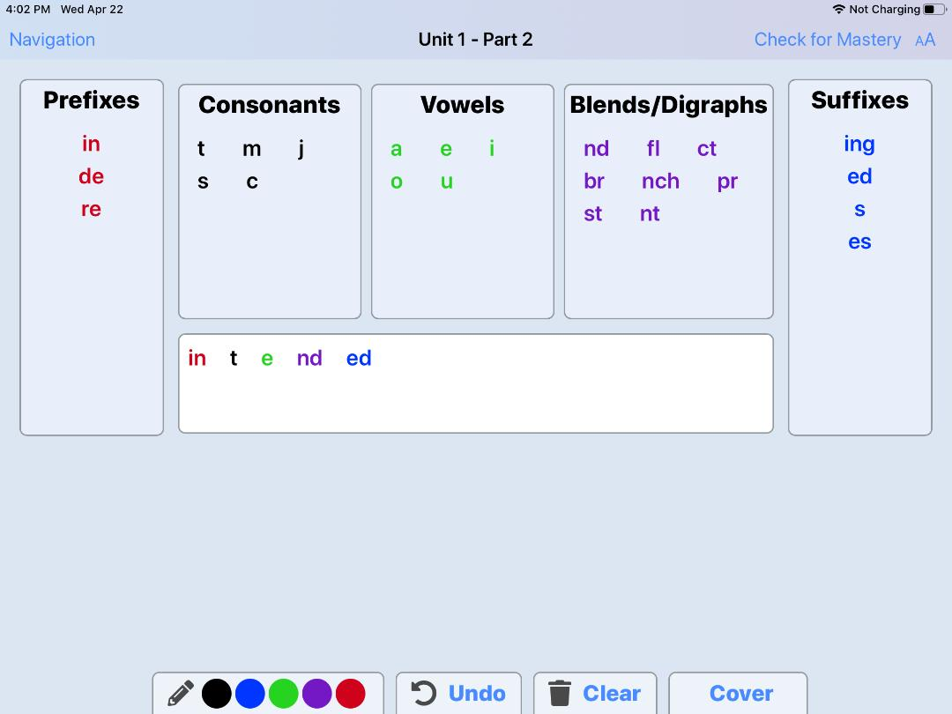
Notes:
WordBuilder is a free application that teaches older struggling readers to break down multisyllabic words into readable parts. Students then get to read the word in context, build it, and spell it.

Slide 3


Slide 4
WordBuilder in a Week
Day 1 | Day 2 | Day 3 | Day 4 | Day 5
Teacher introduces Quizlet and the “set” for the week. Provides task sheet. (15 minutes) Assign Quizlet Independent Work (IW). (5 minutes) Teacher Reviews Decoding Strategy using Google Draw. (10 minutes) | Whole class practices with WordBuilder.* (15-20 minutes) Assign Quizlet IW. (5 minutes) *Organizational tip: For whole group practice always use Part 1 of the unit you’re working on. | Play Quizlet Live (10 minutes) Continue Part 1 WB whole class. (15-20 minutes) Assign Parts 2 & 3 WB as IW for students who have devices. (5 minutes) | Meet with groups of 2-3 students who don’t have devices for small group instruction.* (20 minutes) *Teacher may wish to hold these sessions on Day 3 and 5 as well. | Show how many words you mastered. (5 minutes) Break down most challenging words together. (10 minutes) Assign Quizlet Test. Complete words in the WB unit that you didn’t get to.
Notes:
Say: Here is how WordBuilder could be used in a week of remote instruction. Each day could be 20-30 minutes of teacher lead instruction, and 20-30 minutes of student independent work.
Do: Go through brief Overview.

Slide 5
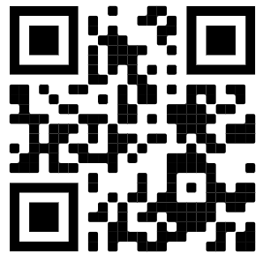
Daily Implementation Guide
Day 1 | Implementation
Teacher introduces Quizlet and the “set” for the week. Provides task sheet. (15 minutes) Assign Quizlet Independent Work (IW). (5 minutes) Teacher Reviews Decoding Strategy using Google Draw. (10 minutes) | Welcome! Adjust your screen view. Go to Quizlet: https://tinyurl.com/msyquizlet Teacher Tips for Differentiating with Technology Tiny URLs and QR Codes Put links in chat box Share the slides with students, and have them click hyperlinks. Download WordBuilder and Quizlet Apps Do take the time to teach the technology!
antidisestablishmentarianism
Notes:
Say: Welcome! Today, we’re going to start or continue learning how to break big words down into readable, smaller parts. Remember, the reason we do this is to make big words easier to read.
Do: Click animation.
Say: This is the longest word in the English dictionary, and by the time you learn this strategy and practice using it, you’ll be able to break down that word.
Do: Click animation to make it disappear.
Say: But before we start breaking down words we need to learn some prefixes/suffixes and vowel sounds. To do that we’re going to go to quizlet. You can just watch me over screen share, but eventually I’m going to ask you to follow this link on your computer.

Slide 6
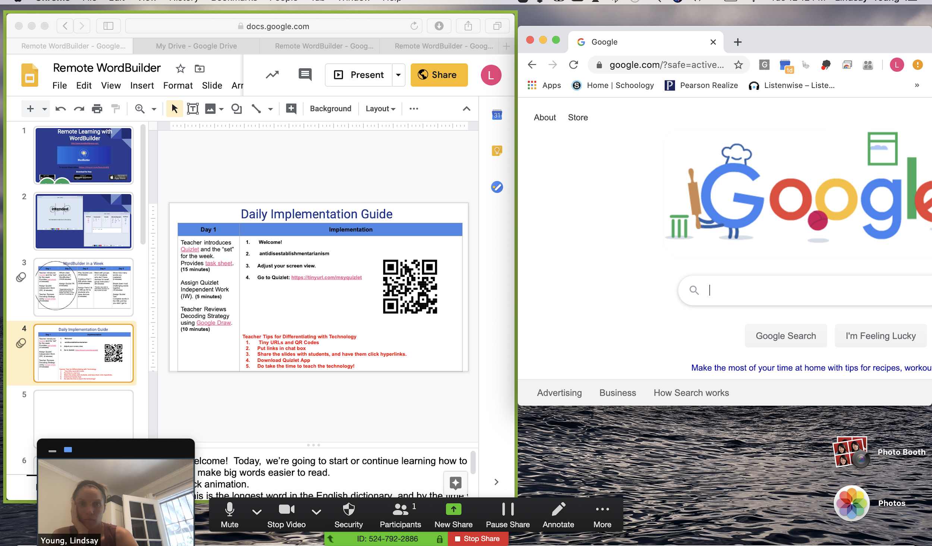
Open two screens at once.

Slide 7
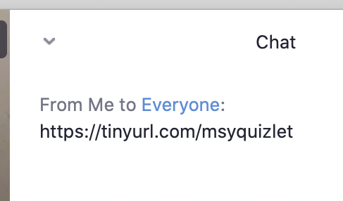



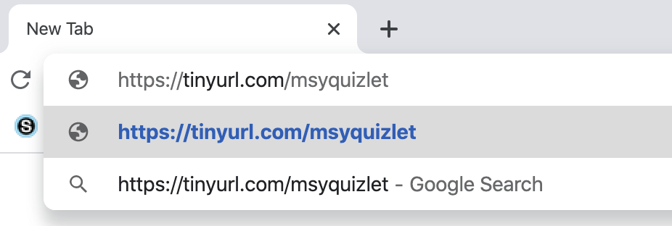

Opening a Link from a Zoom Chat Box
Step 1.
Step 4.
(Command + V on mac)
Step 2.
Step 5.
Step 3.
(Command + C on mac)

Slide 8
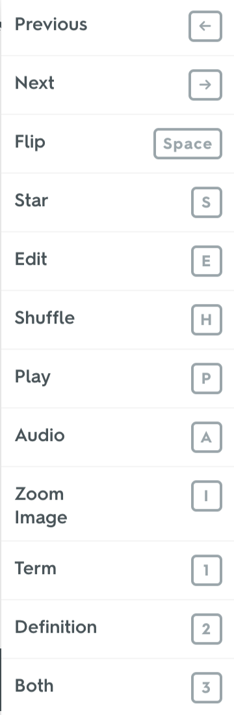
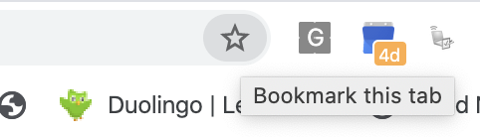
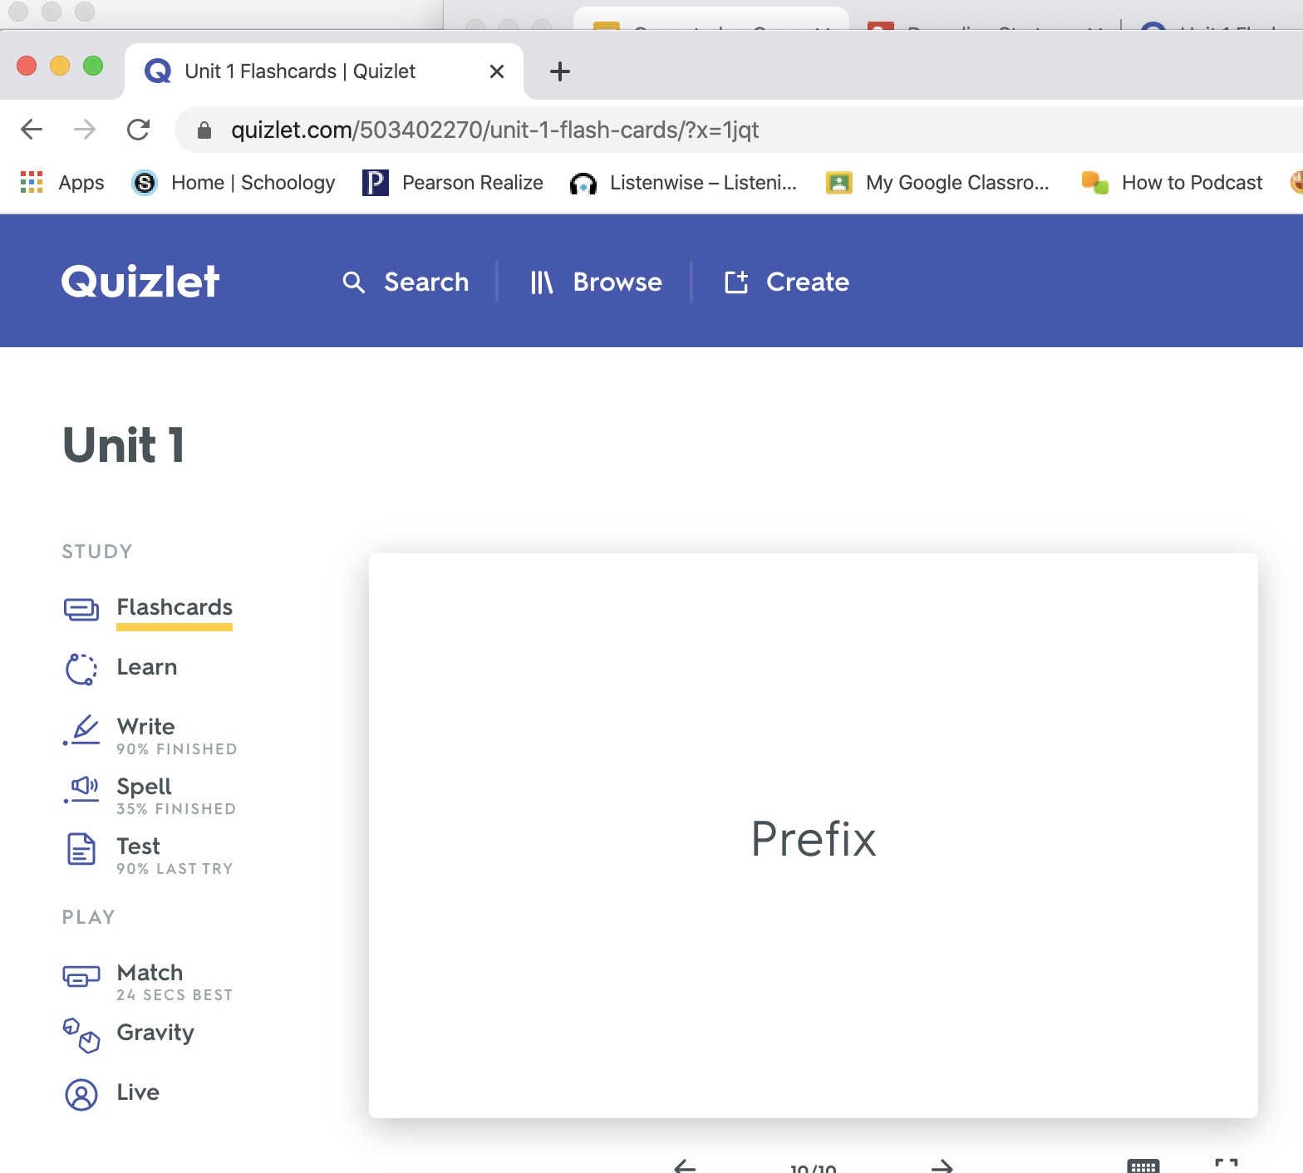
Quizlet Walkthrough
Keyboard Shortcuts
Notes:
Say: Hopefully we’re all on quizlet. I’m going to share my screen to show you the different features you’ll need to know. Remember the purpose of this is to review affixes and vowels you will need to break down big words.
Say: First we’re going to learn/review the prefixes, suffixes and vowel sounds on the flashcards together. I might ask you to respond orally-- everyone say Yes on the count of 3. I might ask you to respond in the chatbox. Everyone type Yes in the chat box.
Do: Walk through Quizlet. Show Flashcards, learn, write, and match. Live will do as a whole class and Test is a test. Show students how to go to “options” for each one, and select what they want. Show them how to use the audio. Make sure they can all go to it.

Slide 9
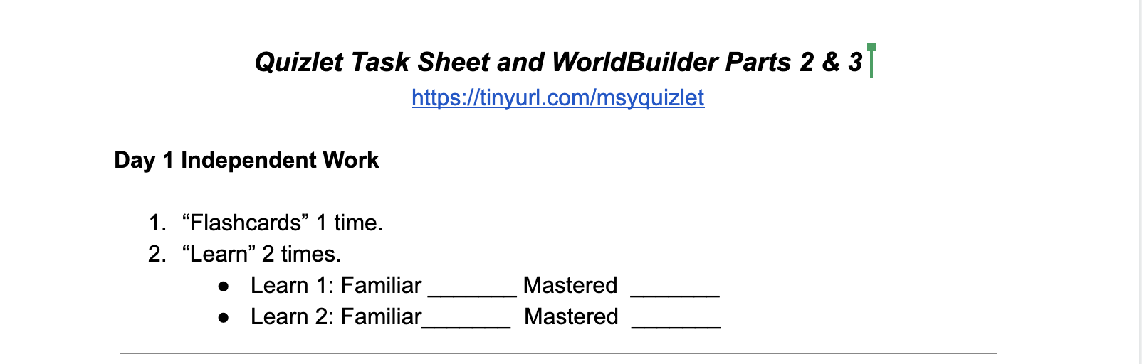
A Daily Implementation Guide
Day 1 | Implementation
Teacher introduces Quizlet and the “set” for the week. (15 minutes) Assign Quizlet IW. Provides task sheet. (5 minutes) Teacher Reviews Decoding Strategy using Google Draw. (10 minutes) | https://tinyurl.com/forcecopytaskcard
Teacher Tip: Make share options on google docs very loose for ease of access and editing. Just be sure to save a clean copy for yourself!
Notes:
Say: Who remembers how to follow a link from the chatbox?
Do: Options: Follow link, share with them via email, share slides with them. You will have to teach them how to save a copy.
Say: Let’s all save a copy together and name it just like the directions say on the top of the task card. This is your independent work. Any questions?

Slide 10
Now that we’ve reviewed those prefixes, suffixes, and vowel sounds let’s go over the decoding strategy!
panicking
Decoding Strategy:
1. Circle prefixes
2. Circle suffixes
3. Underline vowels
4. Divide the word parts
5. Say each word part
6. Blend the word
7. Try different vowel sounds
Let’s all go to Google Draw and practice.
Notes:
Say: This is a strategy to help us read and spell long words, so even if you already know how to read it please break it down because that will help you spell it. First I look for a prefix or suffix. I see ing (click animation). Next, I underline my vowels and say them /a/ (click animation) /i/ (click animation). Then I look for recognizable parts, or words. I know “pan” (click animation) and that leaves “ick” (click animation). Now I read each part pan / ick / ing, and put it together. Panicking.

Slide 11
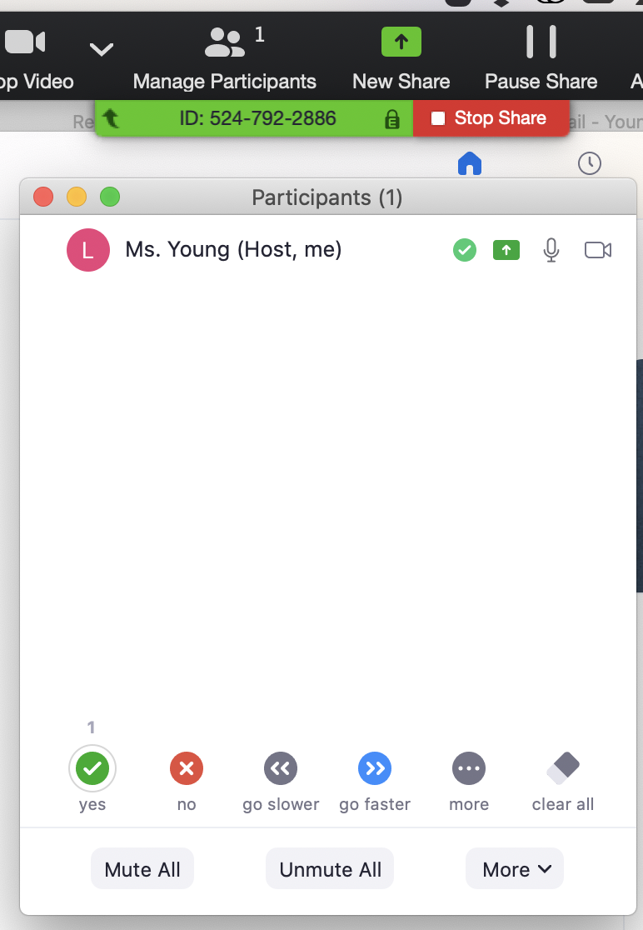
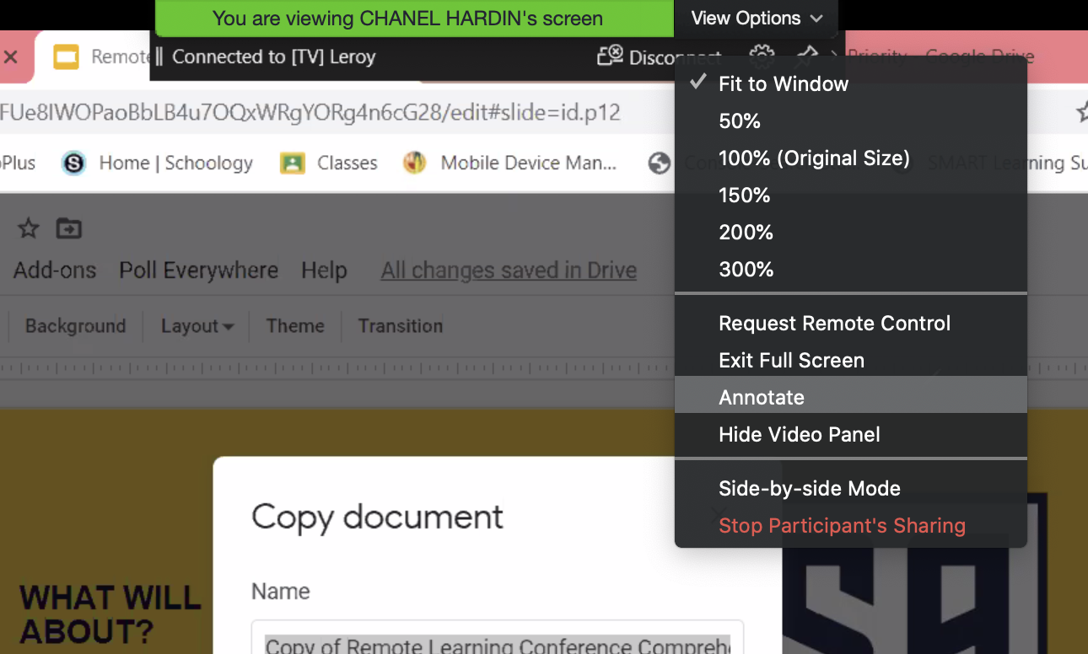
Daily Implementation Guide Example 1
Day 1 | Day 2 | Implementation
Teacher introduces Quizlet and the “set” for the week. Provides task sheet. (15 minutes) Assign Quizlet Independent Work (IW). (5 minutes) Teacher Reviews Decoding Strategy using Google Draw. (10 minutes) | Whole class practices with WordBuilder.* (15-20 minutes) Assign Quizlet IW. (5 minutes) *Organizational tip: For whole group practice always use Part 1 of the unit you’re working on.
Zoom Check
Notes:
Say: Let’s make sure everyone can annotate. You can try out all the markings in one minute.

Slide 12
Daily Implementation Guide Example 2
Day 1 | Day 2 | Implementation
Teacher introduces Quizlet and the “set” for the week. Provides task sheet. (15 minutes) Teacher Reviews Decoding Strategy using Google Draw. (10 minutes) Assign Quizlet Independent Work (IW). (5 minutes) | Whole class practices with WordBuilder.* (15-20 minutes) Assign Quizlet IW. (5 minutes) *Organizational tip: For whole group practice always use Part 1 of the unit you’re working on.
Zoom Engagement
Break Down
Everyone Breaks Down
Everyone says affixes/vowel sounds
Raise your hand if you can…
Read each part
Read the whole word
Read the sentence
Build
Annotate next to the prefix
Annotate next to the suffix
Select a student to remind us of the word or say sound as it is pulled down.
Spell
Students take turns writing parts on screen.
Mastery
Students private chat mastery to teacher.
Round Robin WordBuilder with 4-5 Students
Manipulation

Slide 13
Daily Implementation Guide Example 3
Day 1 | Day 2 | Day 3 | Day 4 | Day 5
Teacher introduces Quizlet and the “set” for the week. Provides task sheet. (15 minutes) Assign Quizlet Independent Work (IW). (5 minutes) Teacher Reviews Decoding Strategy using Google Draw. (10 minutes) | Whole class practices with WordBuilder.* (15-20 minutes) Assign Quizlet IW. (5 minutes) *Organizational tip: For whole group practice always use Part 1 of the unit you’re working on. | Play Quizlet Live. (10 minutes) Continue Part 1 whole class. (15-20 minutes) Assign Parts 2/3 as IW for students who have devices. (5 minutes) | Meet with groups of 2-3 students who don’t have devices for small group instruction.* (20 minutes) *Teacher may wish to hold these sessions on Day 3 and 5 as well. | Show how many words you mastered. (5 minutes) Break down most challenging words together. (10 minutes) Assign Quizlet Test. Complete words in the unit that you didn’t get to.
Notes:
Say: Highlighted yellow portions are whole class instruction as modeled. Independent options are circled. And quizlet is highlighted. This is just one way to do it, but I see lots of options for remote instruction with WordBuilder. It truly depends on the types of technology students have.

Slide 14
Resources
How to make a Quizlet https://quizlet.com
Create a FREE Teacher Account
Use Unit 1 as a Guide https://tinyurl.com/msyquizlet
When creating “Sets” for WordBuilder use the Scope and Sequence
Be sure to put keywords that “sound” like the target pattern. For example:
Front of card “de”
Back of card “prefix as in debate”
Check Quizlet audio to make sure the keyword sounds as it should
Include review patterns and strategy questions as need
8-12 cards per set
How to make QR Code
https://www.qr-code-generator.com
Go to the QR Code Generator Website (above)
Insert your link
Take a screenshot of the QR code
How to make a Tiny URL
https://tinyurl.com
Follow the link above and insert your long URL to make it shorter

Slide 15
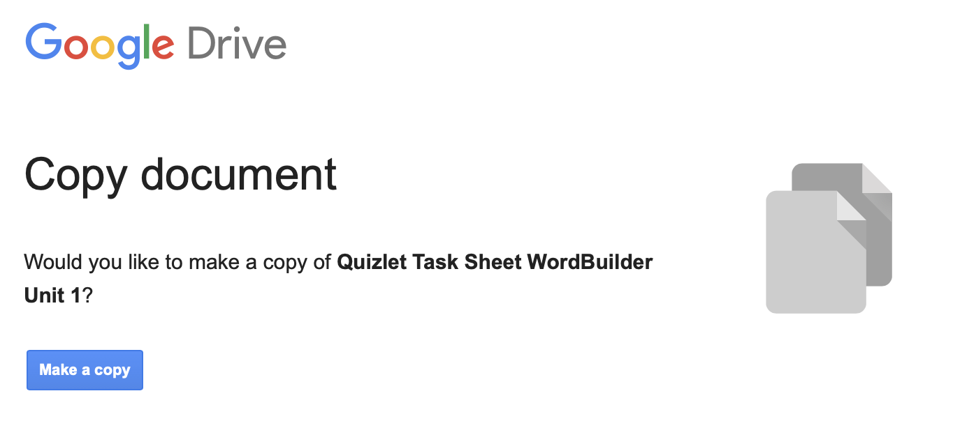
Resources Continued
How to “force” a copy on Google Docs
Copy and paste the link:
https://docs.google.com/document/d/1MW66qywjwnPZfxY-g-wqwEpSNPdVNdYrjMtdCNxLOpQ/edit?usp=sharing
Change the word “edit” to the word “copy”
https://docs.google.com/document/d/1MW66qywjwnPZfxY-g-wqwEpSNPdVNdYrjMtdCNxLOpQ/copy?usp=sharing

Slide 16
Additional Resources
This is a great site for choosing words to practice the decoding strategy with:
www.wordandphrase.info
Go to “frequency list”
Enter the target pattern with an asterisk:
Prefix: “de*”
Suffix: “*ing”
Vowel sound: “*ai*”
A frequency list will appear with words that have your target pattern.
Make sure you choose all patterns they know. For example, Unit 1:
NOT: “detain” because they don’t know /ai/
YES: “desist” has a short vowel, and does not appear in WordBuilder

Slide 17
Questions/Ideas
lindsay.young@lausd.net
Thank you!

