Slide 1
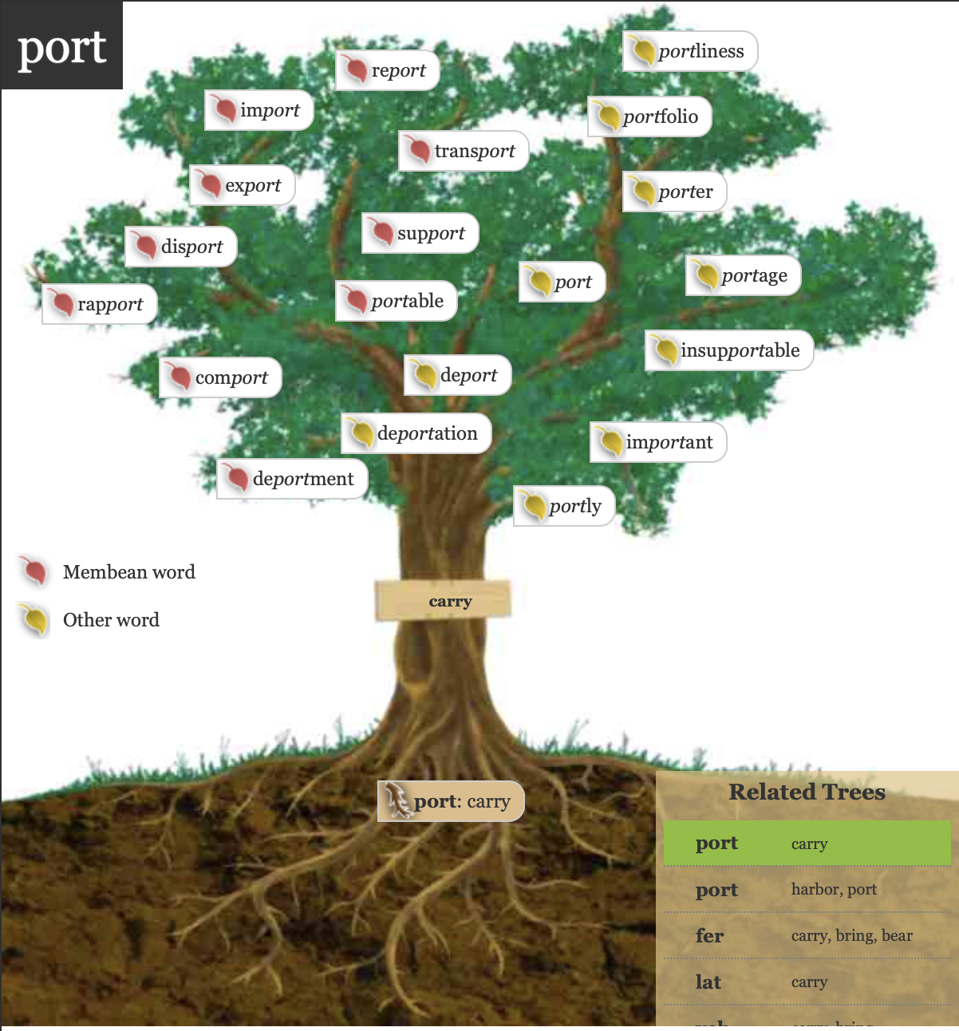
Identifying the Meanings of Word Roots
Notes:
Image from: https://www.membean.com/treelist

Slide 2
Rules
2 Teams
We will spin to see which team goes first.
You will get 1 point for each question answered correctly.
The other team can’t steal. If you don’t get it, we just go on to the next one.
2 Practice Rounds.

Slide 3
Practice for Team 1
fraction
fracture
infraction
Au
The root fract means ________.
(stretch, eat, break)

Slide 4
Practice for Team 2
tractor
attract
extract
Au
The root tract means ________.
(place, look, pull)

Slide 5
Round 1
Identify the root meaning.
Notes:
Image from: https://www.membean.com/treelist

Slide 6
audible
auditory
audio
Au
The root aud means ________.
(throw, hear, touch)

Slide 7
inspect
spectacle
perspective
Au
The root spect means ________.
(broken, good, look)

Slide 8
unity
unicorn
unicycle
Au
The root uni means ________.
(one, up, down)

Slide 9
tremble
temor
tremulous
Au
The root trem means ________.
(shake, left, fixed)

Slide 10
construct
destruct
structure
Au
The root struct means ________.
(above, hand, built)

Slide 11
Round 2
Identify the root and the meaning!
Notes:
Image from: https://www.membean.com/treelist

Slide 12
centipede
pedicure
pedestrian
Au
The root means ________.
(cross, foot, spent)
ped/pede

Slide 13
multimillionaire
multicolored
multifaceted
Au
The root means ________.
(bad, time, many)
multi

Slide 14
benefit
benign
benevolent
Au
The root means ________.
(good, over, many)
ben/bene

Slide 15
additive
additionally
addendum
Au
The root means ________.
(pain, to add, love)
add

Slide 16
maleficent
dismal
malignant
Au
The root means ________.
(under, bad, touch)
mal

Slide 17
Tiebreaker
Lightning Round
First person to enter the answer in the chatbox wins!
Notes:
Image from: https://www.membean.com/treelist

Slide 18
hypodermic
epidermis
dermatology
Au
The root derm means ________.
(skin, medicine, platform)

Slide 19




The contents of this presentation were developed under a State Personnel Development Grant (SPDG) from the US Department of Education (CALI/Award #H323A170011), Project Officer, Latisha.Putney@ed.gov. However, the contents of this presentation do not necessarily represent the policy of the US Department of Education and no assumption of endorsement by the Federal government should be made.

