Slide 1
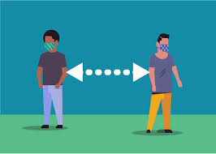
quarantine-
A period of time when a person or animal is kept apart from others in case they are carrying a disease
What is the history of this word?
Where did it come from?
Do any of the word parts remind you of another word?

Slide 2
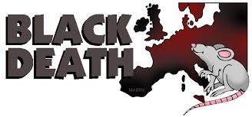
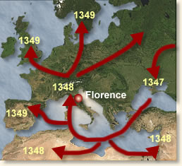
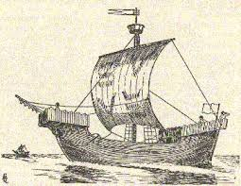
It was spread by trading ships. Fleas that lived on rats carried it, and it could be spread human to human, or surface to human.
The word “quarantine” comes from an illness, the so-called Black Death.
It swept across Europe from 1348-1351. It killed many people.

Slide 3
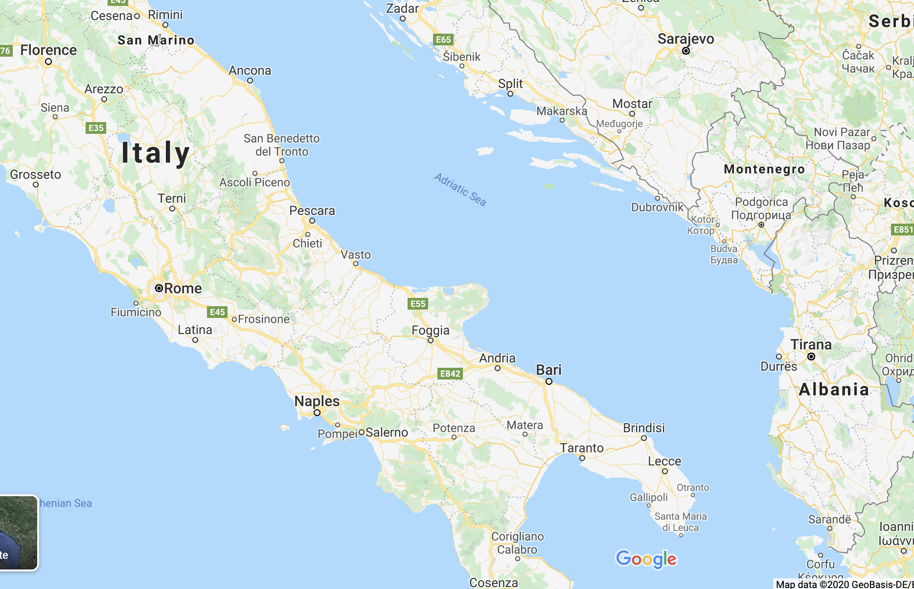
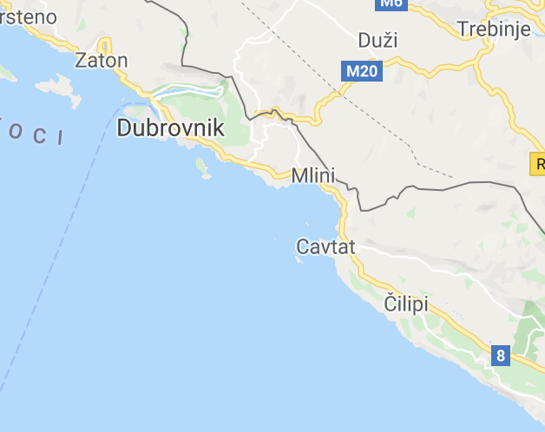
Dubrovnik, the city marked right here decided to stop the spread of the plague, ships were put into isolation on nearby islands for 30 days (trentino in Italian) for “the purpose of disinfection.”

Slide 4
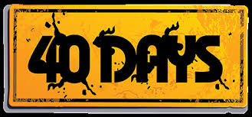
Why change to 40 days? Religion. According to Christian traditions: it rained for 40 days and 40 nights, and Jesus fasted in the wilderness for 40 days.
This idea of a 40-day period of purification had crossed over into health practices before the plague. After childbirth, for example, a new mother was expected to rest for 40 days.
Italian: quarantino
English: quarantine
Quarantine no longer means 40 days, but just a period of time to stay apart from others in case anyone is sick.

Slide 5
Your Turn
What is the history of the word “muscle”?
Fill in the blank (5 minutes).
Send your answer in a private chat to me.
I will put all your answers on a google doc, and we’ll vote for the one we think is right.
If you get the most votes, you win!
The word ‘muscle’ comes from ___________________________________ (insert 1-2 sentences).
What is the history of this word?
Where did it come from?
Do any of the word parts remind you of another word?

Slide 6
Sample Student Responses
Directions
After students send their responses put them all on one page (including the real word origin– sample below).
Be sure to correct any spelling/grammatical errors.
Have students vote. 1 point if someone chooses your answer, and 1 point if you choose the real answer.
The word 'muscle' comes from a root in Rome which means strong, and a part in the body where your strength comes from. Where 'muscle' comes from is probably difficult to place in origin.
The word muscle came from an enormous giant who was named Bob. Bob was a giant who had trillions of muscles, he was kind enough to trade his muscles for food.
The word muscle comes from Rome and it meant monstro which means monsters. And they are scary and when you see your bone you are scared.
When doctors were first looking at muscles in the biceps and calves doctors though it looked like mice running under the skin.
The word “muscle” came from the word masculine. A long time ago, men were seen as superior, because they were bigger and stronger. Men also had a lot more muscles because of them hunting all the time. Then they said, what will we call this thing that makes you strong? Well clearly, only men can be strong. And they are very masculine, so we will call it a muscle.
The word muscle comes from America. A person was stung by bees, they saw a large bump on their arm. So he rushed to the doctors and even the doctors didn't know what it is, so they decided to give it a name, muscle because it almost look like the mussel shell.
The word muscle comes from CrossFit people. The word muscle comes from the Incredible Hulk. He did too much CrossFit.

Slide 7
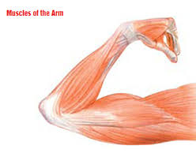
Official Answer
The word ‘muscle’ is derived from the Latin word “musculus”, which translates to “little mouse”. When physicians were first observing the musculature, it is said that they remarked that the muscles in the biceps and calves (most notably) looked like mice running under the skin.

Slide 8




The contents of this presentation were developed under a State Personnel Development Grant (SPDG) from the US Department of Education (CALI/Award #H323A170011), Project Officer, Latisha.Putney@ed.gov. However, the contents of this presentation do not necessarily represent the policy of the US Department of Education and no assumption of endorsement by the Federal government should be made.

