Slide 1

Generative Morphology
Making words with the roots we know!
Notes:
Say: Now that we know the root scrib/scribe/script let’s look at all the words we can make with the root, and since we know what it means this will help us figure out the meaning when we hear or see any of these words!

Slide 2
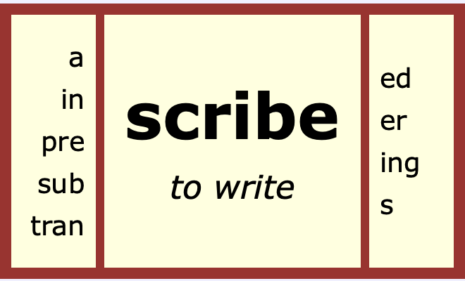
Let’s make some more words…
Make as many different words as you can in two minutes!
Notes:
Say: You can use this matrix to create some words. For example, ascribe. I can also add a suffix and make another word. Ascribed. You might have to change the spelling slightly. Notice I had to get ride of an “e” in ascribed.
Do: Give students 2 minutes to try and create as many words as they can. Count and Share as a whole class.

Slide 3
Did you make all of these?
subscribe
subscribes
subscribed
subscriber
subscribing
inscribe
inscribes
inscribed
Inscribing
inscriber
ascribe
ascribes
ascribed
ascribing
prescribe
prescribes
prescribed
prescribing
prescriber
transcribe
transcribes
transcribed
transcriber
transcribing
scribe
Notes:
Say: Did you make all of the words? Does anyone have a word that is not up here? What do we know about the meaning of all of these words? They all have to do with?
Students Respond: Writing!
Do: Divide students into groups of 2-4 and give them a box to practice reading chorally. Come back as a whole class and read all of the words.

Slide 4
Let’s make some more words…
script
de
pre
manu
tran
sub
in
con
post
tion
tive
ture
or
ed
er
Make as many different words as you can in two minutes!
Notes:
Say: You can use this word web to create some words. There are some unusual prefixes and suffixes here. Let’s read them together to make sure we know them all.
Do: Read them together and model making one word “prescription.”
Say: You have two minutes to make as many words as you can. Remember the word doesn’t have to have a prefix and a suffix.

Slide 5
What meaning do all of these words have in common?
Did you make all of these?
description
descriptive
descriptor
inscription
conscript
postscript
script
transcript
transcription
prescription
prescriptive
subscription
manuscript
Notes:
Say: Did you make all of the words? Does anyone have a word that is not up here? What do we know about the meaning of all of these words? They all have to do with?
Students Respond: Writing!
Do: Read the words as a class. Or for a fun speech to print game, call out a word and have someone find it on the board with a laser pointer.
Say: How are all of these words different?
Do: Point out that the prefixes and suffixes change the words.

Slide 6
As we hear or read words with scrib/scribe/script we will continue to add them to our personal dictionary:
Key Word- Meaning | Prefix-Meaning Negative (N) Direction (D) Intensify (I) | Root (Variants) | Root Meaning | Sample Sentence
describe/description To write down Written down | de-down (D) | scribe, scrib, script | to write written | I lost my cat, so I needed to provide a description to the animal shelter.
Word | Prefix (N/D/I) | Meaning | Sentence
1.
2.
3.
4.
5.
6.

Slide 7




The contents of this presentation were developed under a State Personnel Development Grant (SPDG) from the US Department of Education (CALI/Award #H323A170011), Project Officer, Latisha.Putney@ed.gov. However, the contents of this presentation do not necessarily represent the policy of the US Department of Education and no assumption of endorsement by the Federal government should be made.

