Slide 1


How do we figure out the meaning of words when reading?
Morphemes? (roots/affixes)
Think about a keyword
Context?
Etymology?

Slide 2
Instructional Context
The teacher provides practice for students to morphologically
problem solve by creating transparent instructional contexts.

Slide 3
1. They inscribed the memorial with the soldiers' names. 2. The original inscription in the back of the book was faded.
Step 1. Read the sentence. Find the root and cross it out.
Notes:
Students need to do this on their hand out.

Slide 4
1. They inscribed the memorial with the soldiers' names. 2. The original inscription in the back of the book was faded.
Step 2. Write the root meaning above it. Use your keyword to remember and keep the same tense.
wrote
writing
Notes:
Students need to do this on their hand out.

Slide 5
1. They inscribed the memorial with the soldiers' names. 2. The original inscription in the back of the book was faded.
Step 3. Reread the sentence and say the root meaning instead of the word.
wrote
writing
Notes:
Students need to do this on their hand out.

Slide 6
1. They inscribed the memorial with the soldiers' names. 2. The original inscription in the back of the book was faded.
Step 4. Let’s find the meaning!
Morpheme? Do you recognize any roots or affixes?
Context? Can you add words, or change the order to make it work in the sentence?
Etymology? Does it work, or do you need to check www.etymonline.com?
wrote
into or on
writing
on
Notes:
Students need to do this on their hand out.

Slide 7
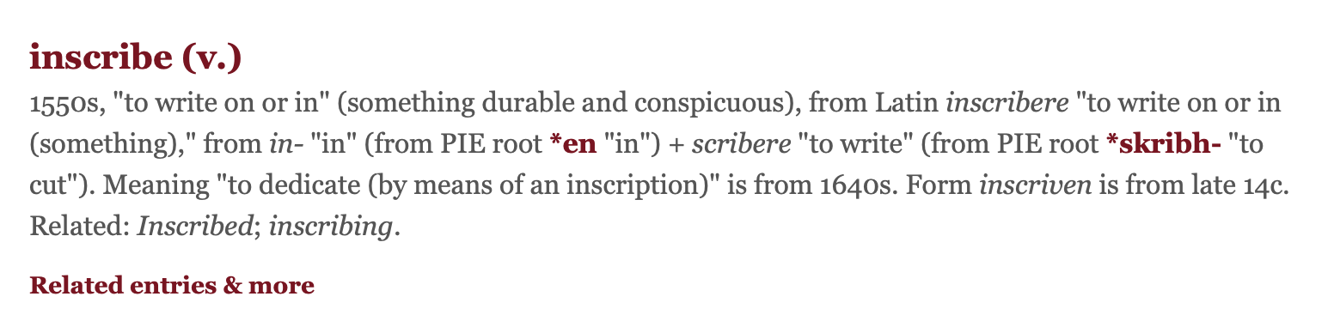
We are etymologists! www.etymonline.com

Slide 8
Add the meaning of inscribe/inscription to your personal dictionary. What do you think the prefix means/does?
Key Word- Meaning | Prefix-Meaning Negative (N) Direction (D) Intensify (I) | Root (Variants) | Root Meaning | Sample Sentence
describe/ description To write down Written down | de-down (D) | scribe, scrib, script | to write written | I lost my cat, so I needed to provide a description to the animal shelter.
Word | Prefix (N/D/I) | Meaning | Sentence
inscribe/ inscription | in (D) | Written in, or on something. | They inscribed the memorial with the soldiers’ names.
2.
3.
4.

Slide 9
Authentic Context
Throughout units of study teacher provides students the opportunity to morphologically problem solve with using Morphemes, Context, and Etymology.

Slide 10
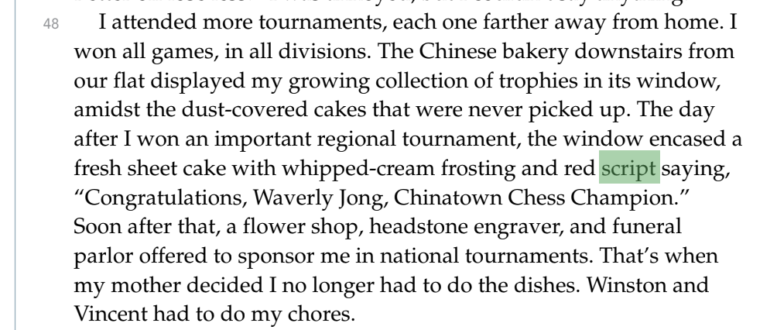
from Amy Tan’s Joy Luck Club Excerpted from myPerspectives ELA Textbook
Morphemes | (Keyword) | Context | Etymology
script-
describe
description
script-writing
not needed
to write, written

Slide 11
Add the meaning of script to your personal dictionary.
Key Word- Meaning | Prefix-Meaning Negative (N) Direction (D) Intensify (I) | Root (Variants) | Root Meaning | Sample Sentence
describe/ description To write down Written down | de-down (D) | scribe, scrib, script | to write written | I lost my cat, so I needed to provide a description to the animal shelter.
Word | Prefix (N/D/I) | Meaning | Sentence
inscribe/ inscription | in (D) | Written in, or on something. | They inscribed the memorial with the soldiers’ names.
2. script | none | writing | The window encased a fresh sheet cake with whipped cream frosting and red script saying “Congratulations!”
3.
4.

Slide 12
from Amy Tan’s Joy Luck Club Excerpted from myPerspectives ELA Textbook
Does __________ remind you of a word you are familiar with?
What does the word you are familiar with mean?
Apply that to the word in the story.
attended- attendance
division- divide
collection- collect
encased- case

Slide 13




The contents of this presentation were developed under a State Personnel Development Grant (SPDG) from the US Department of Education (CALI/Award #H323A170011), Project Officer, Latisha.Putney@ed.gov. However, the contents of this presentation do not necessarily represent the policy of the US Department of Education and no assumption of endorsement by the Federal government should be made.

