Slide 1
Review
summary
predict
literal
inference
Notes:
Say: We are going to start with a review of all of the strategies that we have learned so far, and remember we use these strategies to help us engage with what we read, or what we see—we’ve used pictures, or what we hear.
Do: You can have students do this on paper and collect to check for understanding or have them use whiteboards to make it more game like.

Slide 2
Rules
Use the word in your response.
Write the sentence on your paper.
90 seconds for each prompt.
Notes:
Say: We are going to have a little review game.
Do: Read the rules.

Slide 3
Practice
Give an example of a prediction that a fortune teller might make.
Possible Answer: I predict that you will live a long and healthy life.
Notes:
Say: Here is a practice prompt. Give an example of a prediction that a fortune teller might make. So, I know I have to use the word in my response, so I should start with I predict, what could I say, what is something a fortune teller might tell someone about their future? (Take class responses and write down. Click animation.) Okay, now we’re ready to go. Get ready for your first prompt (change slide).

Slide 4
1. Give an example of a prediction that a weatherman might make.
Notes:
Do:
Read the prompt
Set the timer for 90 seconds.
Ask for volunteers to share their responses.

Slide 5
2. Give an example of a literal question you might ask someone you just met.
Notes:
Do:
Read the prompt
Set the timer for 90 seconds.
Ask for volunteers to share their responses.

Slide 6
3. Give an example of a one sentence summary that you might see on a movie billboard about zombies.
Notes:
Do:
Read the prompt
Set the timer for 90 seconds.
Ask for volunteers to share their responses.

Slide 7
4. What is an inference you can make if someone says they can’t keep their eyes open?
Notes:
Do:
Read the prompt
Set the timer for 90 seconds.
Ask for volunteers to share their responses.

Slide 8
clarify
clarify the question
attempt to clarify
clarify your role
need to clarify
helpful to clarify
ask for clarification
Notes:
Say: Here is our final strategy. We are going to learn to clarify. Everyone say clarify. Here are the ways that this word is commonly used. Please repeat after me.
Do: Read phrases and let students repeat.

Slide 9
Rate your Knowledge
1- I don’t know it.
2- I’ve heard it, but I don’t know the meaning.
3- I can use it in a sentence.
4- I can teach it to the class.
Notes:
Say: How well do you know this word?
Do: Read the ranking system, have students hold up a finger that represents their knowledge.
Say: Okay, I see some different numbers let’s get everyone to a 4!

Slide 10
clarify
To clarify is to make something
clearer or easier to understand.
This is a good thing! If you need something clarified, you have recognized an area where information could be presented more clearly!
Notes:
Do: Read the definition and talk about how it’s okay to not understand something. Adults need clarification all of the time!

Slide 11
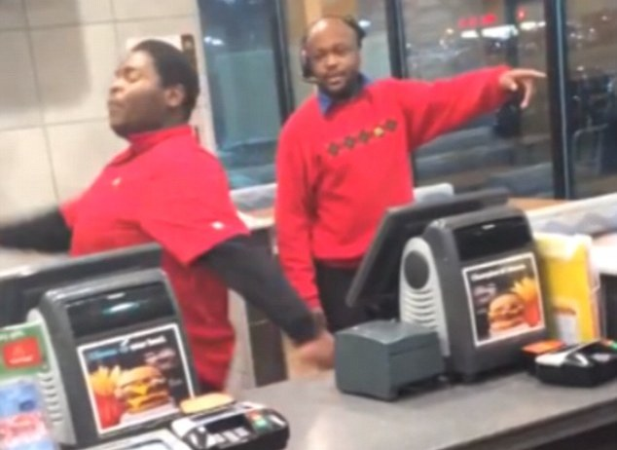
Example in the Workplace
Boss: Please put your timecard in the folder on my desk.
Employee: To clarify, do you want my timecard in the green folder on your desk, or the red folder?
Notes:
Do: Go over the example and point out that if the employee did not ask for clarification and put his/her timecard in the wrong folder he/she might not have gotten paid!

Slide 12
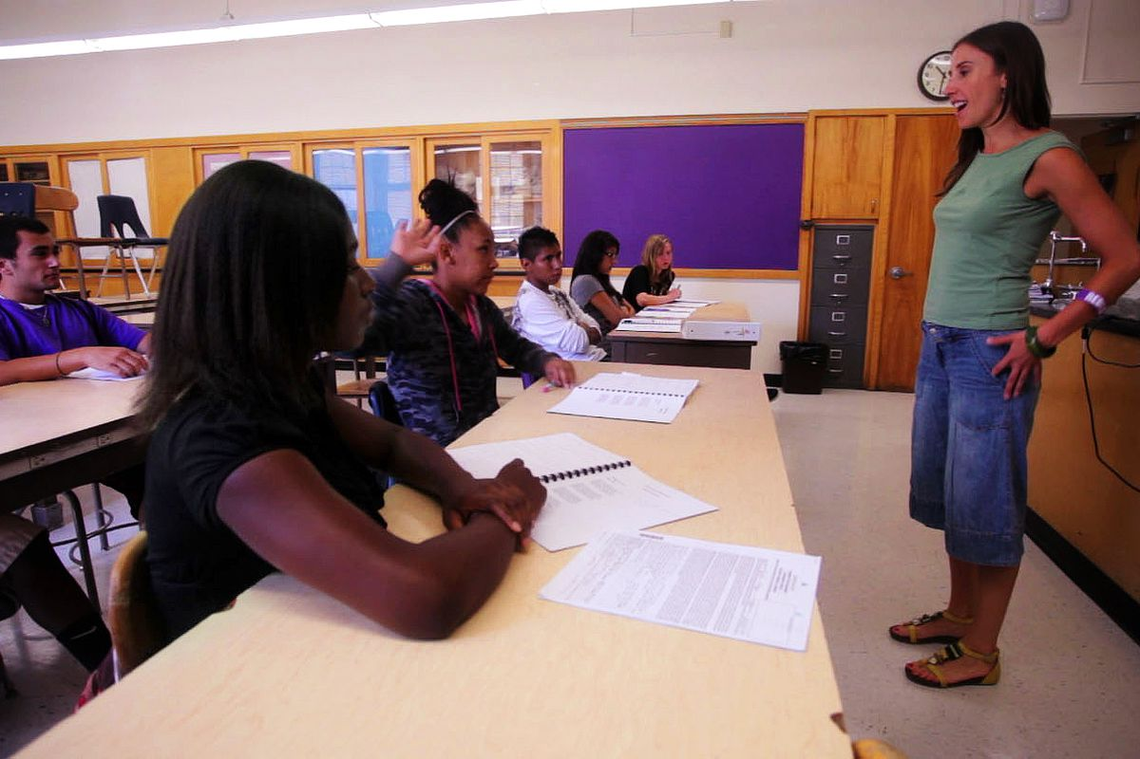
Example in School
Teacher: Please take out something to write with.
Student: To clarify, do I need a pencil, or is a pen okay?
Notes:
Do: Go over the example and say, what if the teacher didn’t allow pen? This could have resulted in a bad grade for the student.

Slide 13

Let’s use Academic Language in class!
Excuse me, I need clarification I don’t quite understand_______________________________.
Excuse me, can you clarify ______________________________________?
Notes:
Do: Encourage students to use the frames to ask clarifying questions. Explain that often people will be more willing to explain if a clarification is thoughtfully phrased. Let students practice asking for clarification with a couple of ambiguous statements you provide: “Turn your homework in whenever.” “Write an essay.” “The cafeteria is closed.”

Slide 14
Clarification vs. Questioning
Literal question- a quiz type question to ensure everyone is on the same page.
Inferential question- a conversation starter about the text.
Clarification- asks for information to be presented more clearly, so that greater understanding can be attained.
Notes:
Say: Some students have confused clarification with questioning, but let’s look at the difference, and we will also get practice on our warm-ups this week.

Slide 15

Activity
I am going to give you some lines from a poem and you will identify what you need to have clarified.
Word (W)
Sentence or Phrase (S)
This is just confusing (?)
I can’t visualize this
Please write the symbols on your paper or white board, so you have them handy, or take a picture of this slide.
Notes:
Do: Read the slides and explain the codes.
=

Slide 16
I need to have ________ clarified. I don’t quite understand _____________. Can you help me with that?
“I should have been a pair of ragged claws
Scuttling across the floors of silent seas.”
from “The Love Song of J. Alfred Prufrock”
W, S, ?,
Notes:
Do: Model how to think about asking for clarification. See possible script below and possible answers on next slide.
Say: Let’s do this together. This from a poem, “I should have been a pair of ragged claws scuttling across the floors of silent seas.” So, let’s go through this, do we know all of the words? (Students may not know ragged claws, or scuttling) You can practice putting that in the sentence frame, “I need to have a word clarified. I don’t quite understand ragged. Can you help with that? Next, go through sentences or phrases, do we understand what it means as a whole? I should have been a pair of ragged claws? Do we understand, scuttling across the floors of silent seas? Yes, we can understand it, but it still might not make sense. Can we visualize it? See it in our minds eye? Maybe it’s the whole thing that doesn’t make sense. We understand it, but we don’t get the meaning. I would put a ?, and explain that I understand the words, phrases, and I can visualize it, but I still don’t get why the author felt that way. I understand the literal meaning, but not the inference I’m supposed to be making.

Slide 17
Possible Clarifications
W- I need to have a word clarified. I don’t quite understand “scuttling.” Can you help me with that?
S- I need to have a phrase clarified. I don’t quite understand “I should have been a pair of ragged claws.” Can you help me with that?
-I need an image clarified. I can’t quite picture “the floors of silent seas.” Can you help me with that?
?- I’m not really sure what I don’t understand. I might need clarification on what the author meant. Can you help me with that?
Notes:
Say: Here are some possible ways we could have asked for clarification and as a group we would need to try and provide clarification. The great thing is that some people see things clearly that others don’t. For example, Andres might have just learned what scuttling means in his biology class, and now he can share that with his group when they ask. The second someone asks for clarification we should start trying to figure it out, and one way we can do that is to look at google images. This is especially true for words that I don’t understand.

Slide 18
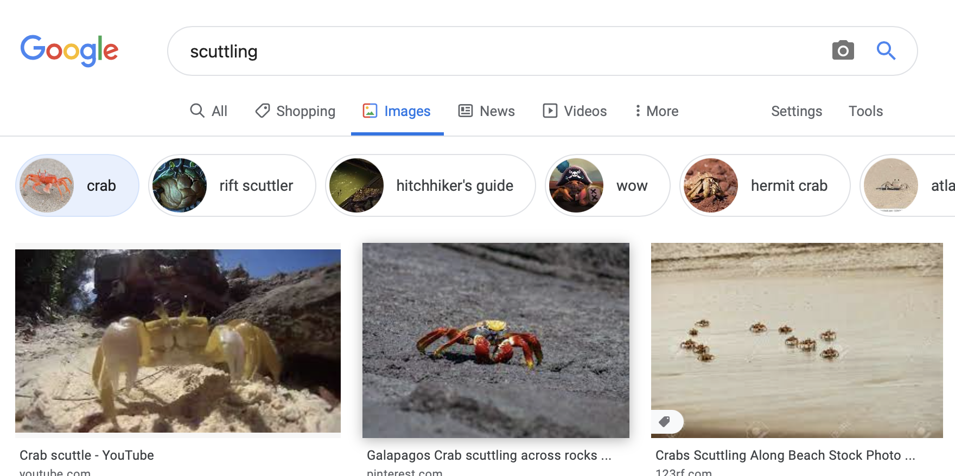
Using Google Images to Provide Clarification
Type the word in google search
Click images
Scroll through to see if you can get the gist of the word using the images.
If nothing appears that makes sense try entering surrounding words, e.g., “scuttling across.”
Notes:
Say: So, one way we can clarify words is to use google images. This gives us a better idea than the dictionary sometimes which may give us other words we don’t know the meaning of, so try to enter the word or phrase into google images, to get the gist of the word. See what happens when I entered scuttling? This gives me an idea that this is something a crab does, looks kind of like scurrying or quickly moving. We will continue to practice clarifying with our warm-ups!

Slide 19




The contents of this presentation were developed under a State Personnel Development Grant (SPDG) from the US Department of Education (CALI/Award #H323A170011), Project Officer, Latisha.Putney@ed.gov. However, the contents of this presentation do not necessarily represent the policy of the US Department of Education and no assumption of endorsement by the Federal government should be made.

