Slide 1
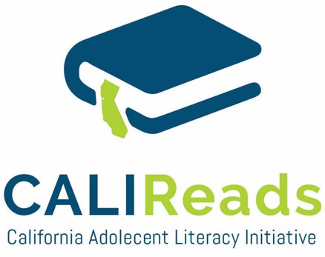
Addressing Unfinished Learning
Session 3
Selecting Interventions Based on Data
Presented by:
Susan Van Zant
suvanzant@aol.com

Slide 2

Addressing Unfinished Learning Sessions
Session 1
Appropriate middle school screeners
Session 2
Administer screeners and interpret results
Session 3
Selecting interventions based on data
Session 4
Progress Monitoring

Slide 3

Objectives: Session 3
Understand how intervention is related to the Multi-Tiered Systems of Support (MTSS) model
Learn about Tier II and Tier III secondary intervention programs
Identify key components of these programs
Understand how assessment informs instruction delivered in each tier and when students move between tiers
Notes:
Should this slide indicate what will be learned?

Slide 4


Agenda
Review MTSS Tier I, II, III
Selecting a Tier II Intervention Program
Selection a Tier III Intervention Program
Movement Through the Tiers

Slide 5
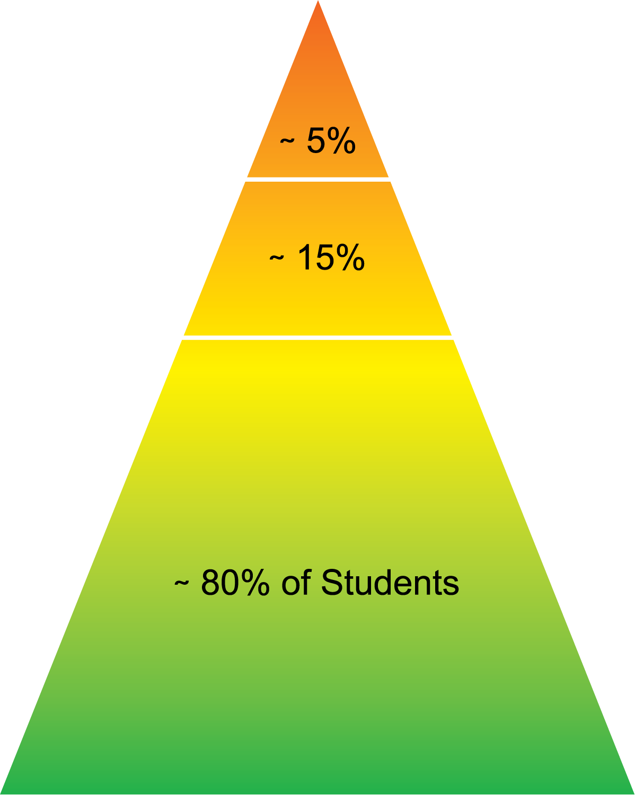
Multi-Tiered Systems of Support (MTSS) Three-Tier Model
Tier III: Intensive Intervention
Below Basic
Tier II: Strategic Supplemental Intervention
Basic
Tier I: Core Reading Program
Proficient & Advanced
Notes:
Using a model of MTSS, best ensures that a school meet the needs of every student. For students not meeting benchmark, Tier ii and iii instruction can help students who need extra support.
The focus of our discussion today, is what kind of curricula can you offer to students who are not meeting benchmark in core instruction and according to your sequence of assessments, need targeted reading support?

Slide 6

Intervention for Adolescent Students
It is NOT too late!!!
Explicit reading instruction continues to be key (ex., modeling, feedback, and practice)
Older struggling readers benefit from multicomponent interventions.
Reading comprehension gains are likely to be significantly smaller than foundational skills.
Results take time - multi-year interventions have greatest success.
Notes:
Highlight these 5 points
I added this slide because seems important to highlight some differences about intervention in secondary.
INTERNAL NOTES
Response to Intervention With Secondary School Students With Reading Difficulties (2012)
Sharon Vaughn, PhD¹ and Jack M. Fletcher, PhD²
students with reading difficulties, the secondary (Tier 2) treatment in addition to the enhanced classroom instruction (Tier 1) was associated with gains in decoding, reading fluency and comprehension (d = 0.16) over similar students who only received the enhanced classroom instruction (Tier 1).
Study link: https://www.ncbi.nlm.nih.gov/pmc/articles/PMC3356920/
Solis, M., Miciak, J., Vaughn, S., & Fletcher, J. M. (2014). Why intensive interventions matter: Longitudinal studies of adolescents with reading disabilities and poor reading comprehension. Learning Disability Quarterly, 37(4), 218-229.
Table 1 provides a summary of findings from previous research with struggling readers in Grades 4 to 10 with reading difficulties as it pertains to instructional practices, student learning needs, and intervention practices

Slide 7

Considerations for Selecting an Intervention Program
Type of learner
Teacher skill level
Program complexity
Training requirement
Program cost
Reading/language arts program
Instructional support/time
Classroom setting/grouping
Assessment plan

Slide 8
Middle School Assessment Sequence
Reading Comprehension (e.g., MAZE)
Score below Benchmark
Reading Fluency (e.g., MASI-R or DIBELS)
Score below 40th percentile
Decoding and Word Recognition (e.g., CORE Phonics Survey)
Score at intensive level

Slide 9
Reading Skills
Most adolescent struggling readers need support across multiple skills and will benefit from interventions that integrate reading skills.
Notes:
What's important here is that students who have struggled in reading through middle school are likely to need support in multiple areas of reading. Your data should indicate whether you need to target one area, or whether students need support across multiple components. Today, I'll show you some interventions that emphasize one area of reading, but I'll also show you interventions that integrate multiple reading components of phonics, vocabulary, fluency, and text comprehension.

Slide 10
Some Research-Based Tier II Programs: Secondary
English 3-D
Achieve 3000
Third Quest
Read Naturally
READ 180
REWARDS
SIPPS Challenge

Slide 11
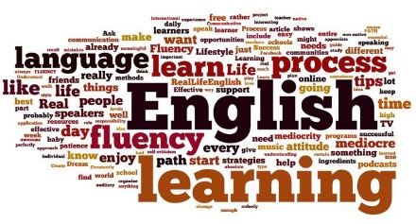
English 3-D
Designed for long-term English language learning
Focus on academic language
Focus on speaking and listening skills through daily opportunities in accountable class discussions, peer collaboration, and group presentations
Develops writing skills for summarizing, justifications, argument and research
Notes:
Reading comprehension issues are common for students who speak English as a second language and have low levels of English proficiency. Programs like English 3-D support the development of English academic language.

Slide 12


Achieve 3000
Online differentiated reading program designed to deliver daily nonfiction comprehension reading and writing activities for all readers with a focus on struggling readers and ELL students.
Software deliver differentiated assigned at 12 different reading levels
Students practice for 20 minutes per day
There are 40 activities for each semester

Slide 13

Third Quest
Builds on foundational reading skills through a balance of narrative fiction, informational text.
Students must read 60-110 words per minute on fifth grade level text to participate.
Research-based lessons include work with sophisticated vocabulary, word study, comprehension and fluency.
Program provides study skills and connections with the Common Core State Standards.

Slide 14

Read Naturally
Designed to improve reading fluency using combinations of books, audiotapes and computer software
Three main strategies:
Repeated reading of text –develop oral reading fluency
Teacher modeling of story reading
Systematic monitoring of student progress
Notes:
Demonstrated efficacy in reading fluency

Slide 15


Read 180
Research proven program designed for students who are reading 2 or more years below grade level
Delivered in 90-minute sessions that include whole-group, three small group rotations and a whole class wrap up
Small group rotations include:
Teacher directed instruction –comprehension skills
Independent reading - fluency
Adaptive computer application - phonics/decoding – progress monitoring
Notes:
According to What Works Clearinghouse, has high efficacy in fluency and comprehension.

Slide 16

REWARDS
Specialized reading program designed to:
Teach students a flexible strategy for decoding multisyllabic words
Increase reading fluency
Expand vocabulary and comprehension skills.
Program is composed of 25, 40-50 minute lessons
*ESSA classification: Wanzek, J., Vaughn, S., Roberts, G., & Fletcher, J. M. (2011). Efficacy of a Reading Intervention for Middle School Students with Learning Disabilities. Exceptional Children, 78(1), 73-87. doi:10.1177/001440291107800105
Notes:
Response to Intervention With Secondary School Students With Reading Difficulties (2012)
Sharon Vaughn, PhD¹ and Jack M. Fletcher, PhD²
students with reading difficulties, the secondary (Tier 2) treatment in addition to the enhanced classroom instruction (Tier 1) was associated with gains in decoding, reading fluency and comprehension (d = 0.16) over similar students who only received the enhanced classroom instruction (Tier 1).
Study link: https://www.ncbi.nlm.nih.gov/pmc/articles/PMC3356920/

Slide 17

SIPPS - Challenge
Focused on developing phonics/decoding skills as well as fluency and comprehension
Program includes intensive multisensory instruction designed for students diagnosed with dyslexic that can be added to the 16 very structured routines
Requires significant teacher training and follow-up support in the use of 16 very specific routines.

Slide 18
Some Research-Based Tier III Programs: Secondary
Read 180 + System 44
Read Naturally
Wilson Reading
SIPPS Plus

Slide 19
Read 180 + System 44
System 44:
Foundational reading program for most challenged students focuses on the development of foundational phonics skills.
The recommended class size is 15-21 students
Delivered in 90-minute sessions
Includes small group rotations
Adaptive computer application
Small-group teacher lead instruction
Independent reading/assignments

Slide 20
Read Naturally
Designed to improve reading fluency using combinations of books, audiotapes and computer software
Three main strategies:
Repeated reading of text –develop oral reading fluency
Teacher modeling of story reading
Systematic monitoring of student progress
Signs for Sounds is an explicit phonics program paired with spelling and irregular high-frequency words.
Notes:
https://ies.ed.gov/ncee/wwc/InterventionReport/409
https://ies.ed.gov/ncee/wwc/InterventionReport/408

Slide 21

Wilson
Tier 3: Structured literacy program based on:
Phonological coding research
Orton-Gillingham principles used with students diagnosed with dyslexia.
Directly and systematically focuses upon:
Sound-symbol relationships
Morphology
Fluency
Vocabulary
Comprehension
Teachers should be certificated to teach the program.
Notes:
https://ies.ed.gov/ncee/wwc/InterventionReport/547
Strong efficacy in alphabetics

Slide 22

SIPPS Plus
Reading/phonics program for students reading below the 3rd grade level
16 very structured routines that teachers must follow exactly as written
Intensive multisensory instruction designed for students diagnosed with dyslexia can be added to the original SIPPS routines
Daily reading assignment designed to increase fluency and comprehension

Slide 23
Three-Tier Model
Tier III: Intensive Intervention
Assessment data determines how and when students move between tiers.
Tier II: Strategic Supplemental Intervention
Tier I: Core Reading Program

Slide 24

Movement Through the Tiers
Movement through the tiers should be dynamic.
Interventions/services in each tier are based on specific skills-based needs of students.
Needs are determined by assessment, starting with universal screening.
Data-based monitoring of progress allows the system to be responsive to the changing need of students.
Students enter and exit tiers as needed and stay in tiers above Tier I no longer than necessary.

Slide 25
More Objectives: Session 3
Understand the relationship of intervention to the Multi-Tiered Systems of Support (MTSS) model
Learn about Tier II and Tier III secondary intervention programs
Identify key components of these programs
Understand how assessment informs instruction delivered in each tier and when students move between tiers
Next Session 4: Progress monitoring

Slide 26



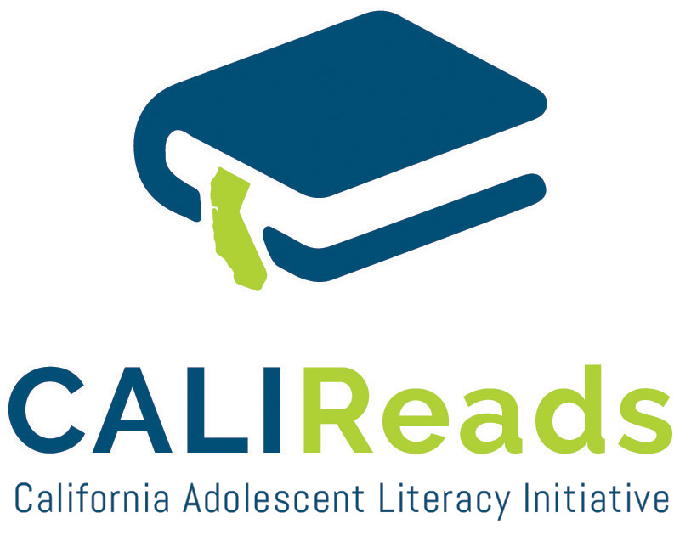
CALI Reads is a project funded by the Office of Special Education Programs in partnership with the California Department of Education, Special Education Division. The project is coordinated and administered through the Napa County Office of Education. The contents of this website were developed under a State Personnel Development Grant (SPDG) from the US Department of Education (CALI/Award #H323A170011), Project Officer, david.guardino@ed.gov. However, the contents of this site not necessarily represent the policy of the US Department of Education and no assumption of endorsement by the Federal government should be made.

