Slide 1
ExoNet
Classifying Kepler exoplanet candidates
Adedokun Owoyomi
ITAI 2372 Final Project, Implementation Track
May 2026
ExoNet - ITAI 2372 Final Project - Adedokun 1 / 12

Slide 2
The problem
Kepler watched 150,000+ stars looking for transits.
It produced thousands of transit-like signals.
Each one needs to be vetted by hand: real planet, instrument noise, or eclipsing binary?
Vetting is slow expert work.
TESS keeps adding more candidates to the queue.
Question: can a small ML model do a good first-pass triage?
ExoNet - ITAI 2372 Final Project - Adedokun 2 / 12

Slide 3
What I built
A supervised classifier:
- Input: 10 features per candidate (orbit, planet, host star).
- Output: CONFIRMED or FALSE POSITIVE, with a probability.
Delivered as a small Python CLI:
- python -m src.main train
- python -m src.main predict --koi-period ... (etc)
- pytest
ExoNet - ITAI 2372 Final Project - Adedokun / 12

Slide 4
Data
Source: NASA Exoplanet Archive, Kepler KOI cumulative table.
- Initial size: about 9,500 KOIs.
- After dropping CANDIDATE rows (label undecided): ~7,500 rows.
- Roughly balanced between CONFIRMED and FALSE POSITIVE.
Cached locally on first download.
Synthetic-data fallback if the archive is unreachable.
ExoNet - ITAI 2372 Final Project - Adedokun / 12

Slide 5
The 10 features
Orbit
- koi_period (days), koi_duration (hr), koi_depth (ppm)
Candidate planet
- koi_prad (Earth radii), koi_teq (K), koi_insol (Earth flux), koi_model_snr
Host star
- koi_steff (K), koi_slogg (log g), koi_srad (solar radii)
Picked these because (1) they are dense in the dataset and (2) they map to what astronomers actually look at.
ExoNet - ITAI 2372 Final Project - Adedokun 5 / 12

Slide 6
Pipeline
1. Load CSV from NASA archive (or cached copy).
2. Coerce features to numeric, drop empty rows, median-impute NaNs.
3. Drop CANDIDATE rows. Map labels to 0 / 1.
4. Stratified 80 / 20 train / test split (seed = 42).
5. Fit RandomForestClassifier (300 trees, balanced weights).
6. Score on test set, save model + metrics + confusion matrix.
ExoNet - ITAI 2372 Final Project - Adedokun 6 / 12

Slide 7
Why Random Forest
Considered a small neural net first.
Decided against it because:
- Dataset is small (~7,500 rows) and tabular. Trees usually win at this scale.
- Random Forest does not need feature scaling.
- Gives feature importances I can talk about (coming up next).
- Way easier to defend in a presentation.
Future work: try XGBoost on the same split as a comparison.
ExoNet - ITAI 2372 Final Project - Adedokun 7 / 12

Slide 8
Results on real Kepler data
Test set size: 1,518 rows
Accuracy 0.926
Precision 0.883
Recall 0.918
F1 0.900
ROC-AUC 0.976
Beat the success criteria from the proposal (>=0.85 acc, >=0.92 ROC-AUC).
ExoNet - ITAI 2372 Final Project - Adedokun 8 / 12

Slide 9
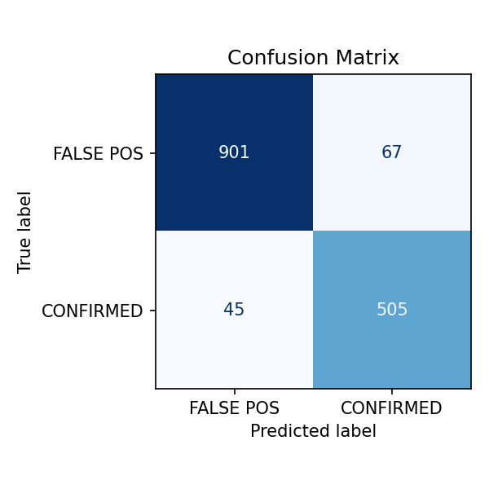
Confusion matrix
Most errors are false positives flagged as confirmed (67 cases).
Could lower the decision threshold if precision matters more than recall for the use case.
ExoNet - ITAI 2372 Final Project - Adedokun 9 / 12

Slide 10
Top features by importance
1. koi_prad (planetary radius) 0.231
2. koi_model_snr (transit signal-to-noise) 0.149
3. koi_period (orbital period) 0.128
4. koi_depth (transit depth, ppm) 0.101
5. koi_insol (insolation flux) 0.097
These line up with what astronomers actually look at when triaging candidates by hand. That is a sanity check that the model has learned something reasonable, not a shortcut.
ExoNet - ITAI 2372 Final Project - Adedokun 10 / 12

Slide 11
Limitations and future work
What this project does not do (yet):
- Only a single train/test split. K-fold CV would give better confidence intervals.
- Only a Random Forest baseline. Worth comparing to XGBoost or LightGBM.
- Trained only on Kepler data. TESS uses similar features and would be the obvious next dataset.
- No web UI or hosted demo. Just a CLI for now.
ExoNet - ITAI 2372 Final Project - Adedokun 11 / 12

Slide 12
Thank You
Repo: FP_GROUP04_ADEDOKUN OWOYOMI _ITAI2372
Run it: python -m src.main train
Data: NASA Exoplanet Archive, Kepler KOI cumulative table
ExoNet - ITAI 2372 Final Project - Adedokun 12 / 12

