Slide 1

.NET Analyzers
Jan Křivánek
Microsoft
Jan.Krivanek@microsoft.com

Slide 2
Materials
dotutils.net/wug-talk
For long lived linking: dotutils.net/wug-talk-analyzers

Slide 3
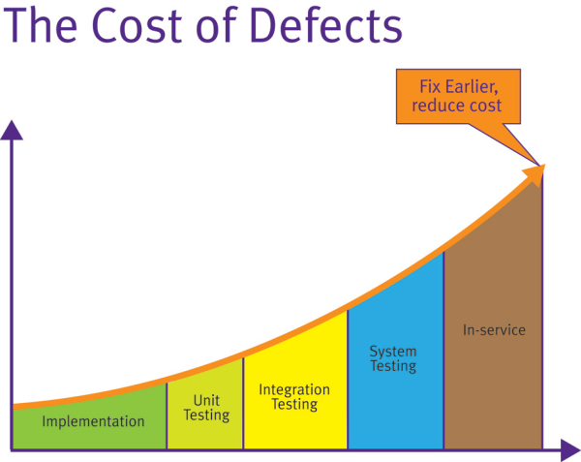

Motivation
Cost of defects
Complexity of the build process
> dotnet build /pp

Slide 4
Agenda
Roslyn Analyzers
Configuration
Defaults
Custom Analyzers
Troubleshooting
MSBuild Checks
Configuration
Defaults
Custom Analyzers
Troubleshooting

Slide 5
Roslyn analyzers – configuration
editorconfig (sdk/VS template)
dotnet_diagnostic.rule.severity
MSBuild knobs:
TreatWarningsAsErrors
WarningsAsErrors
WarningsNotAsErrors
NoWarn

Slide 6
Roslyn analyzers – defaults
Defaults: Code Analysis - Enabled rules
AnalysisLevel (vs AnalysisMode)

Slide 7
Roslyn analyzers – custom
Tutorial
Steps
Install VS extension development workload
Instantiate Analyzer with code fix template
Run through vsix project
Experiment with MSBuild knobs for diagnostic id
Build package, reference in sample project

Slide 8
Roslyn analyzers – troubleshooting
ReportAnalyzer property > dotnet build /p:reportanalyzer=true
MSBuild binlog

Slide 9
MSBuild BuildCheck – defaults
Only SDK/CLI, only via explicit opt-in
> dotnet build /check
Couple inbox rules: documentation

Slide 10
MSBuild BuildCheck – configuration
editorconfig – documentation
build_check.rule.severity
MSBuild knobs:
MSBuildTreatWarningsAsErrors
MSBuildWarningsAsErrors
MSBuildWarningsNotAsErrors

Slide 11

MSBuild BuildCheck – custom
Tutorial - not yet
Steps
nuget.org/packages/Microsoft.Build.Templates
Pack, Reference

Slide 12

Questions
Jan Křivánek
Microsoft
Jan.Krivanek@microsoft.com

