Slide 1
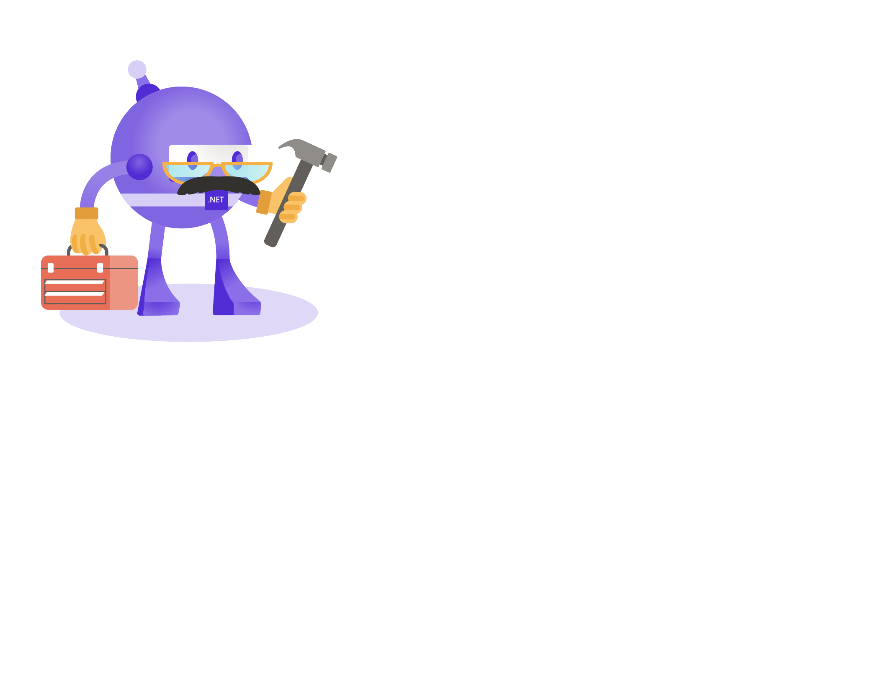
Hacking and securing MSBuild
Jan Krivanek

Slide 2
Materials
dotutils.net/wug-talk
For long lived linking: dotutils.net/wug-talk-securing-msbuild

Slide 3
Agenda
MSBuild intro
Extendibility intro
Use cases of extending and prevention

Slide 4
What is MSBuild?
Engine – performs the build
Exposed via CLI and API
Language – allows to define the build
4 entities: Properties, Items, Targets, Tasks
Common Targets – predefined behavior of the build
Shipped with SDK and VS

Slide 5
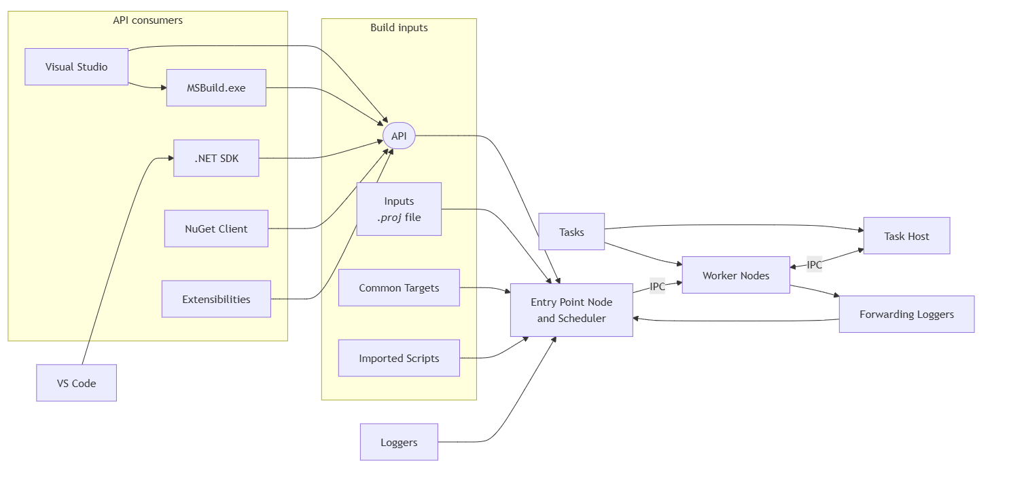
What is MSBuild?
Notes:
```mermaid---title: MSBuild engine parts---flowchart LR subgraph Build inputs I["`Inputs _.proj_ file`"] API([API]) CT[Common Targets] IS[Imported Scripts] end VSC[VS Code] --> SDK[.NET SDK] subgraph API consumers VS[Visual Studio] --> API MSB[MSBuild.exe] --> API SDK[.NET SDK] --> API NC[NuGet Client] --> API E[Extensibilities] --> API end VS --> MSB API & I --> EN[Entry Point Node and Scheduler] CT --> EN IS --> EN T[Tasks] --> WN T[Tasks] --> TH EN --IPC--> WN[Worker Nodes] WN <--IPC--> TH[Task Host] L[Loggers] --> EN WN --> FW[Forwarding Loggers] --> EN```

Slide 6
What can be extended?
Engine
Environment variables
Discovered Plugins
API/CLI injected plugins
.rsp files
Scripts injected plugins
Language
Custom tasks
Common Targets
Auto-discovered imports (Directory.Build.[props|targets])
Generated imports (.g.[props|targets])
User imports (<Import Project=“…”>)
‘magic’ properties

Slide 7

Sample of code execution (Language extending)
⁠
Custom task (RoslynCodeTaskFactory, AssemblyTaskFactory)
Custom task factory
Exec (UNC)
DownloadFile
Redefine common target
Design Time Build!
Prevention: Operate only on trusted code
Configure Trust Settings
Currently no ability to disable custom or certain tasks
Notes:
Sample of exec with share
Tools -> Options -> Trust settings
(https://devblogs.microsoft.com/visualstudio/improving-developer-security-with-visual-studio-2022/)

Slide 8
Engine extending – Environment variables
Important Recognized Environment Variables
Traits
ChangeWaves
Recognizing environment variables as implicit properties
Prevention: BC0103 BuildCheck

Slide 9
Engine extending – Discovered Plugins
SdkResolvers folder in sdk/VS installation
SDK
ProjectCachePlugin
Prevention: Install MSBuild to location with controlled R/W access

Slide 10
Engine Extending – CLI, .rsp
Loggers
Magic properties
DependsOn
PreBuildEvent
Response file
MSBuild.rsp
Directory.Build.rsp
Prevention:
Environment variables checking
-noAutoResponse
Installing MSBuild into location with restricted R/W access
Notes:
- env vars trace in binlog
- response file trace in binlog

Slide 11
Common Targets Extending - .props|.targets
Directory.Build.[props|targets]
dotutils.net/build-helpers/Directory.Build.targets
Danger of Downloads
.user file
[before|after].{solution}.targets
Bonus: .suo
Prevention:
Empty Directory.Build.[props|targets]
Review files in project dir

Slide 12
Common Targets Extending - .props|.targets
MSBuildExtensionsPath
MSBuildUserExtensionsPath
Those are properties! (CLI, .rsp, env vars – all apply here)
Prevention: $(ImportUserLocationsByWildcardBefore{ImportingFileNameWithNoDots})
dotnet build /p:ImportUserLocationsByWildcardBeforeMicrosoftCommonProps=false

Slide 13
Common Targets Extending – nuget.g.[props|targets]
Build logic auto-included from build
Build buildTransitive buildMultitargeting
Visible in binlog
Prevention: ExcludeAssets

Slide 14
Summary
Custom Tasks
Common Targets redefine, Common Targets hooking
DownloadFile, Exec (incl from UNC)
Logic inject via CLI, Env, .rsp files
Logic inject via Directory.Build.[props|targets]
Logic inject via MSBuild[User]ExtensionsPath (incl custom location)
Logic inject from .user, .suo, [before|after].{solution}.targets files
Logic inject from nugets

Slide 15
Thank you!

Slide 16
Questions
Jan Křivánek
Microsoft
Jan.Krivanek@microsoft.com

