Slide 1
Advanced Reinforcement Learning
Midterm Project: Using DQN to play Flappy Bird
Student: Tran Van Do
ID: 20010737
Advisor: Vu Hoang Dieu
Hanoi, May 21th, 2024
1

Slide 2
Table of contents
INTRODUCTION
ENVIRONMENT
IMPLEMENTATION
HYPERPARAMETER AND FUNCTION
TRAINING
EVALUATION
2

Slide 3
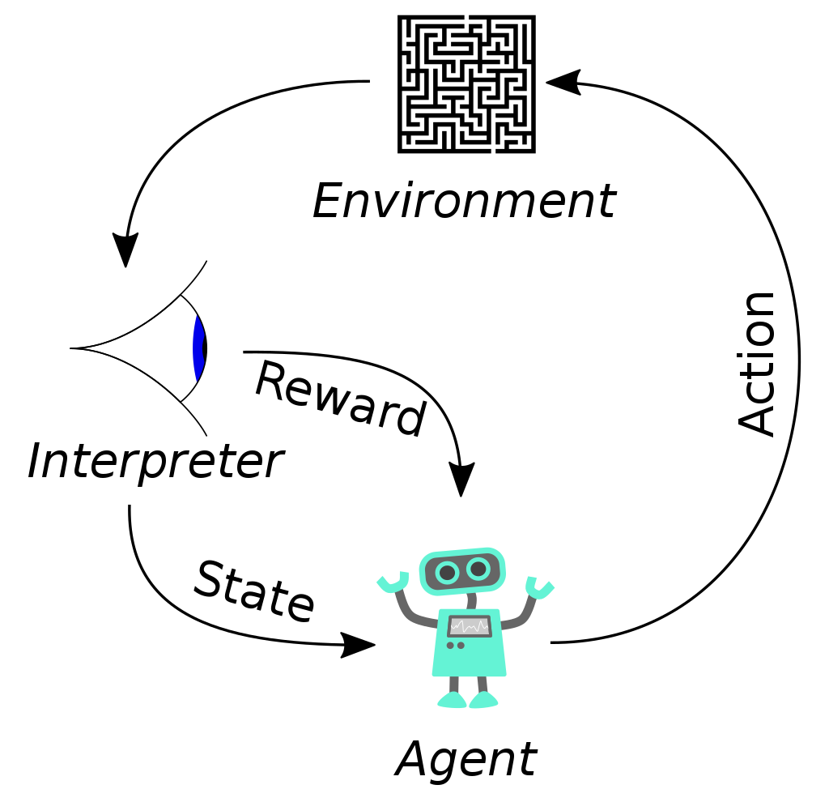
INTRODUCTION 1. Reinforcement learning
Agent and Environment
State
Action
Reward
Policy
Value Funtion
Q – Function (Action-Value Function)
Model of the Enviroment
3

Slide 4

INTRODUCTION 2. Q-Learning
Q-Function:
Q-learning:
4

Slide 5
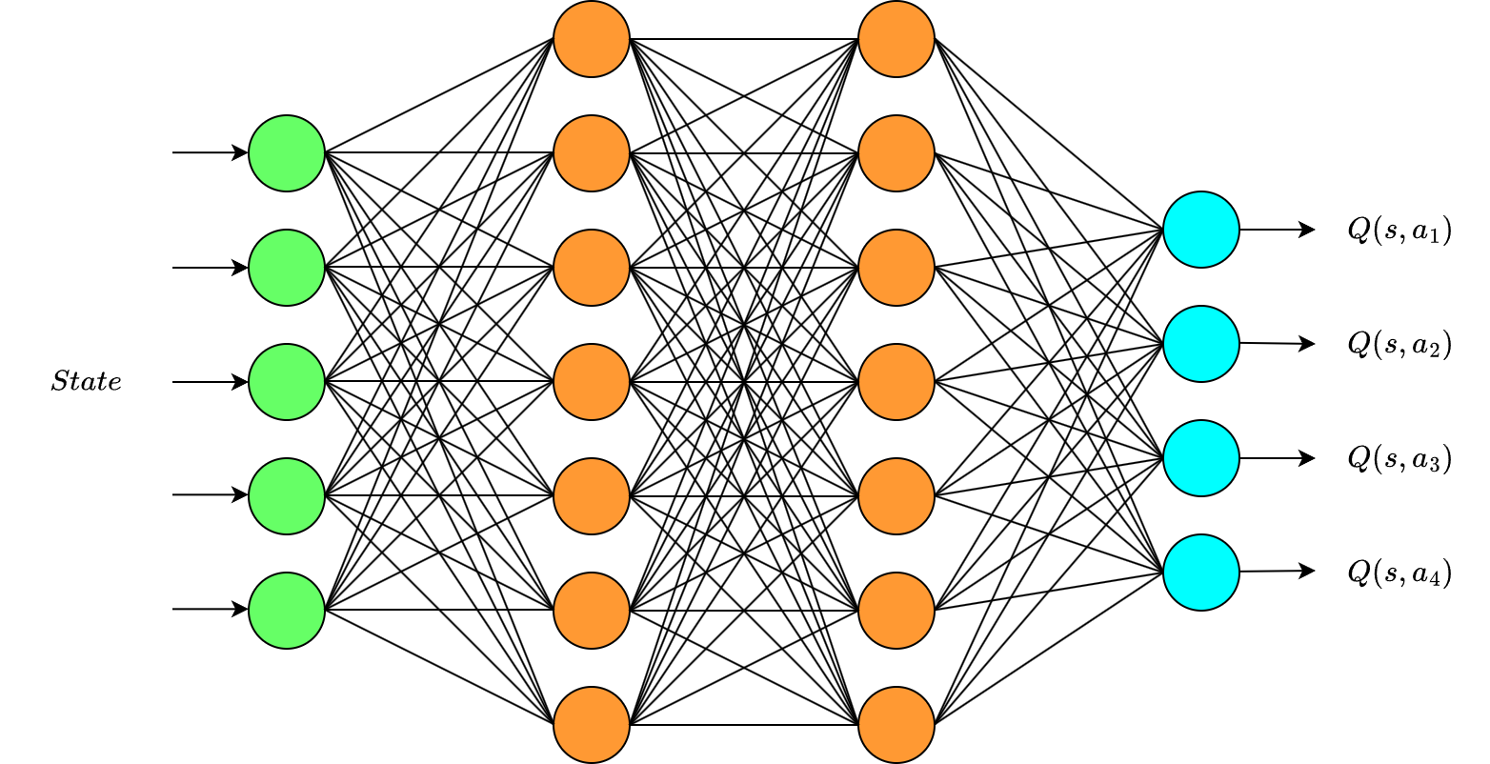
INTRODUCTION 3. Deep Q-Networks (DQN)
Neural Network predicts Q-value
5

Slide 6

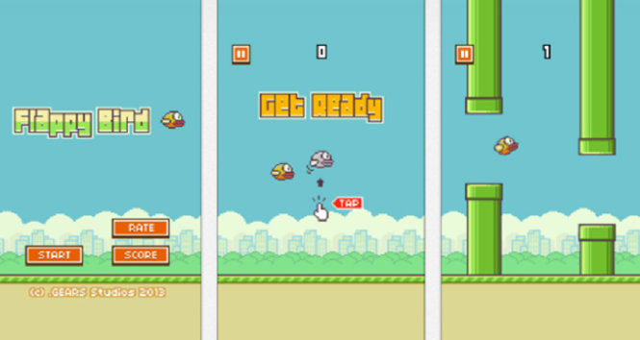
II. ENVIRONMENT
Flappy Bird game
Designer: Nguyen Ha Dong
Pulisher: Gears
Release: 2013
Game play:
Faby automatically descends and only ascends when the player taps the touchscreen. Each successful pass through a pair of pipes awards the player one point. Colliding with a pipe or the ground ends the gameplay.
6

Slide 7
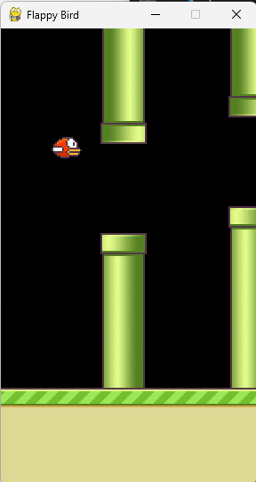
II. ENVIRONMENT
Action Space: 2 actions
0 : NOOP
1 : flap wings
Observation Space:
The observation will be the RGB image that is displayed to a human player with observation space Box(low=0, high=255, shape=(512, 288, 3), dtype=np.uint8).
Rewards: -1, 0, 1
You get +1 every time you pass a pipe, otherwise +0.0 for each frame where you don't collide against the top and bottom bounds, or against a pipe and -1 when you collide against the top and bottom bounds, or against a pipe.
7

Slide 8
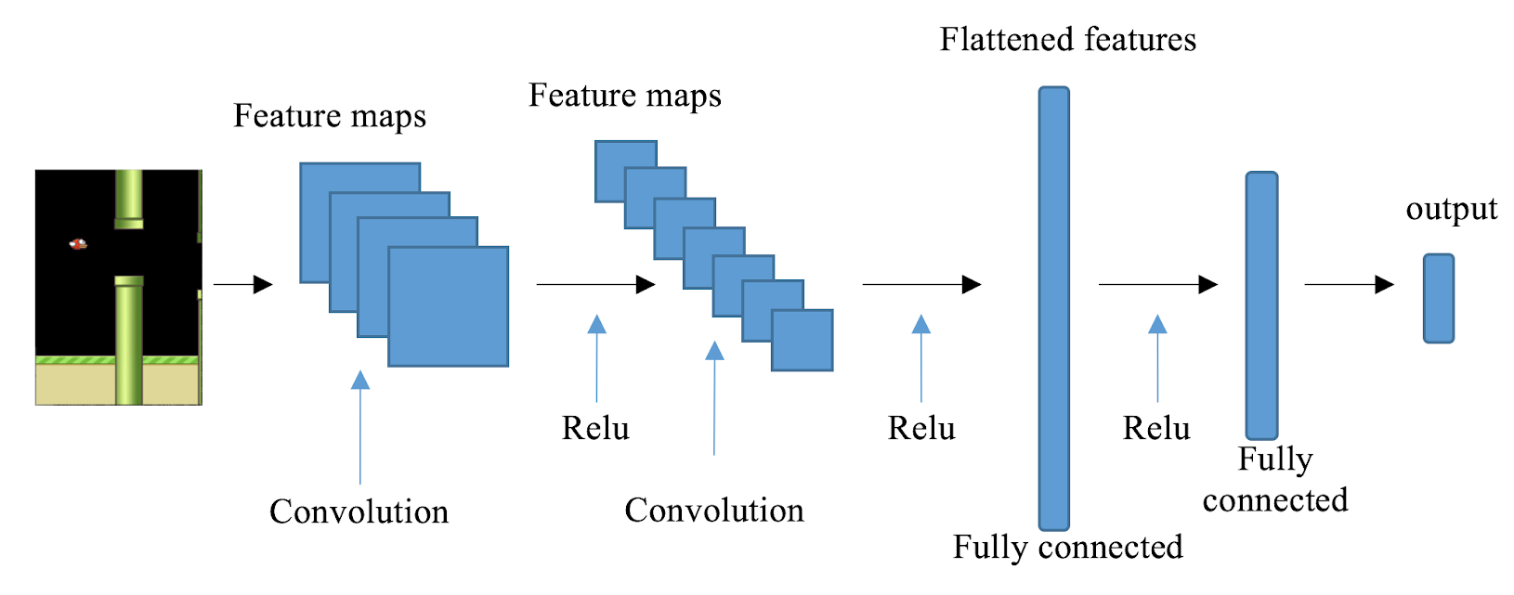
III. IMPLEMENTATION 1. Deep Q-Network (DQN)
DQN network: includes 3 2D Convolution layers and 2 Fully Connected layers with activation as ReLU.
input_shape=[4,84,84]
Conv2d(4,32,kernel_size=4,stride=2), ReLU
Conv2d(32,64,kernel_size=3,stride=2), ReLU
Conv2d(64,64,kernel_size=2,stride=1), ReLU
Linear(conv_out_size, 512), ReLU
Linear(512, 2)
8

Slide 9
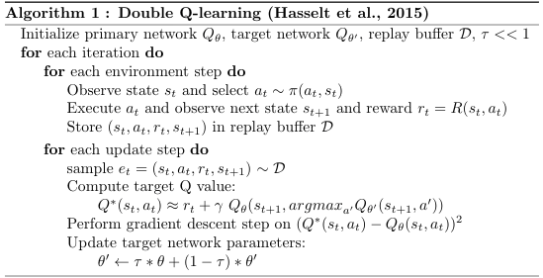
III. IMPLEMENTATION 2. Double DQN
Double DQN Network: Online Network and Target Network both use the same model as DQN Network
Double DQN algorithm “Deep Reinforcement Learning with Double Q-learning” (Hasselt et al., 2015)
9

Slide 10

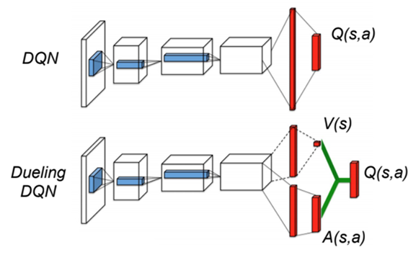
III. IMPLEMENTATION 3. Dueling DDQN with Prioritized Experience Replay
DQN Dueling Network: includes 3 2D Convolution layers and 2 Fully Connected layers for state value (V) and 2 Fully Connected layers for advantage value (A).
The last module uses the following mapping:
input_shape=[4,84,84]
conv = {Conv2d(4,32,kernel_size=4,stride=2), ReLU
Conv2d(32,64,kernel_size=3,stride=2), ReLU
Conv2d(64,64,kernel_size=2,stride=1), ReLU}
fcv = {Linear(conv_out_size, 512), ReLU
Linear(512, 1)}
fca = {Linear(conv_out_size, 512), ReLU
Linear(512, 2)}
output = fcv(conv(input)) + fca(conv(input)) - fca(conv(input)).mean()
10

Slide 11
IV. HYPERPARAMETER AND FUNCTION 1. Hyperparametter
ACTIONS = [0,1] # Action of Agent
EXPERIENCE_BUFFER_SIZE = 2000 # Size of buffer experience
STATE_DIM = 4 # Number of images in one train
GAMMA = 0.99
EPSILON_START = 1 # Epsilon, decreasing with each epochs
EPSILON_FINAL = 0.001
EPSILON_DECAY_FRAMES = (10**4)/3
MEAN_GOAL_REWARD = 10 # Number of goals to achieve
BATCH_SIZE = 32 # Batch_size: Number of buffers per training session
MIN_EXP_BUFFER_SIZE = 500 # Minimum of Buffer Experience memory to be able to train
SYNC_TARGET_FRAMES = 30 # Frame frequency to synch Target Network for Online Network
LEARNING_RATE = 1e-4
SKIP_FRAME = 2 # number of frames performed with the previous action
# Policy for each game's restart.
INITIAL_SKIP = [0,1,0,1,0,1,0,0,0,1,0,1,0,1,0,1,0,0,0,0,0,0,0,1,0,1,0,1,0,1,0,1,0,1]
EPOCHS_MAX = 5000 # Maximum number of training epochs
11

Slide 12
IV. HYPERPARAMETER AND FUNCTION 2. Function
Preprocess state for training
Cropping image regions does not affect training.
Resize the image to 84x84 size
Use a layer of Filter2D to sharpen the image
Convert to black and white image, bring pixel value to about 0-1.
12

Slide 13
IV. HYPERPARAMETER AND FUNCTION 2. Function
Creat Agent
reset: Restart game with fix 34 action to start game in INITIAL_SKIP
step: Takes a action -> return reward.
append (state, action, reward, done, next_state) to Experimence buffer with Agent for DQN and DDQN
append ((state, action, reward, done, next_state), p) to Experimence buffer with Agent for Dueling DDQN with PER
13

Slide 14
IV. HYPERPARAMETER AND FUNCTION 2. Function
ExperienceBuffer
__init__(self,capacity) : initial memory Experience Buffer:
append(self,exp): append Experience buffer
sample(self,batch_size): sample: get sample in memory buffer with size=batch_size
ExperienceBufferPER
__init__(self,capacity) : initial memory Experience buffer and priority
append(self,exp,p): append Experience buffer and prority
sample(self,batch_size): get sample in memory buffer with size=batch_size with probability based on priority
14

Slide 15
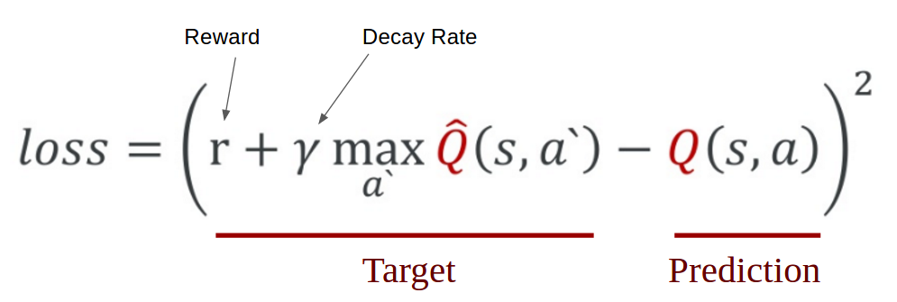
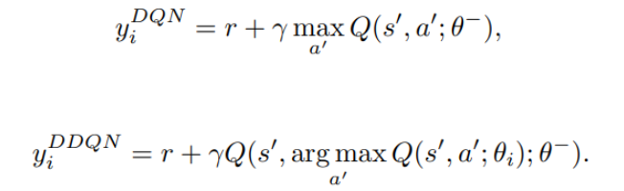
IV. HYPERPARAMETER AND FUNCTION 2. Function
Calculate Loss for DQN: calc_loss_DQN
Calculate Loss for DDQN: calc_loss_DDQN
15

Slide 16
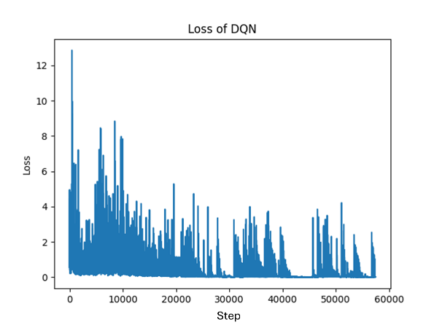
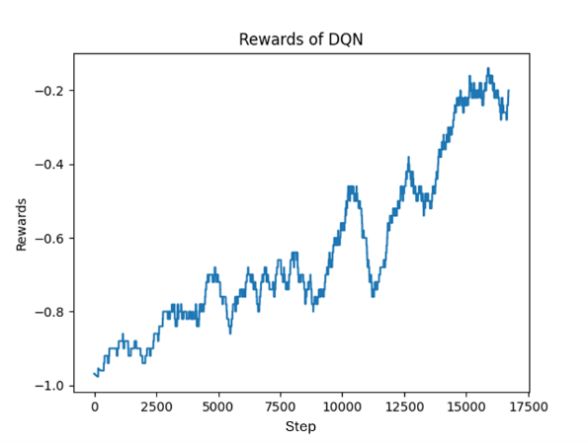
V. TRAINING 1. Deep Q-Network with experience replay
Model was trained with 2000 epochs
16

Slide 17
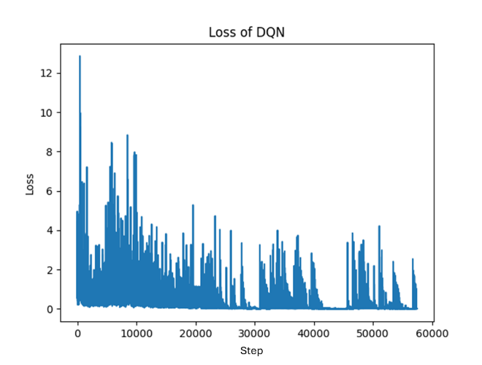
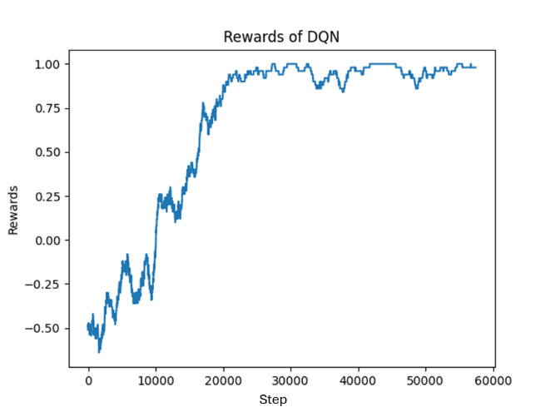
V. TRAINING 1. Deep Q-Network with experience replay
Model was continued training for another 5000 epochs
17

Slide 18
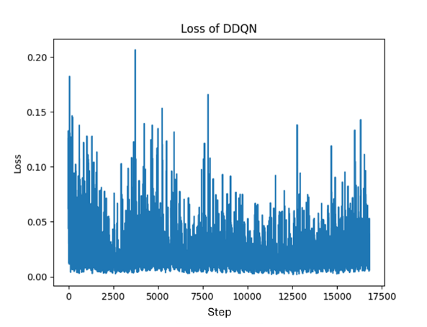
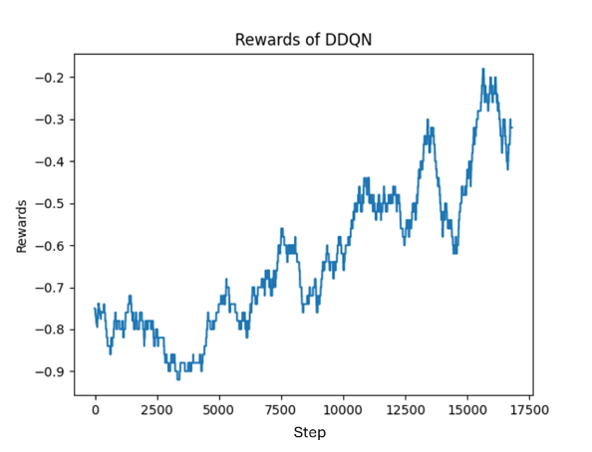
V. TRAINING 2. Double DQN
Model was trained with 2000 epochs
18

Slide 19
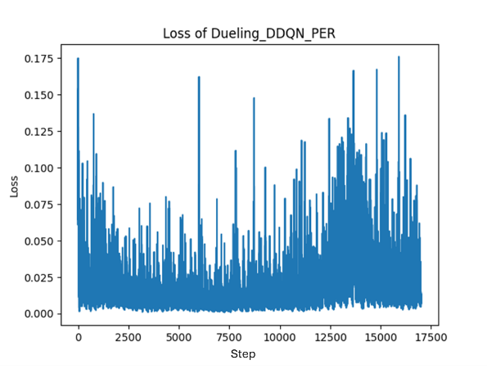
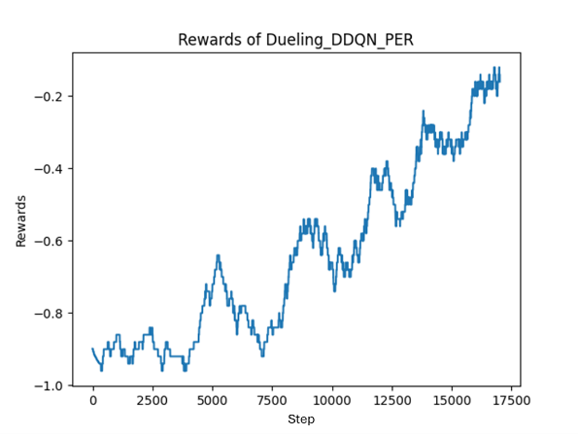
V. TRAINING 3. Dueling DDQN with Prioritized Experience Replay
Model was trained with 2000 epochs
19

Slide 20
VI. EVALUATION
Due to insufficient resources for the training process, Google Colab was used to use T4 GPU.
Due to limitations in GPU usage time, the first time the 3 models were trained with several epochs of 2000. Model DQN was continued training for another 5000 epochs.
With a training amount of 2000 – 5000 epochs, the Agent can only achieve a score of 1. But, as the results show, the model training process is likely to improve with continued training.
20

Slide 21
VI. EVALUATION
Challenges encountered and how they were addressed.
Challenges encountered:
- Select hyperparameters:
+ Decrease of epsilon after each game
+ Number of epochs for training: due to limited computational resources.
How we were addressed:
- Use multiple Google accounts to get computing resources.
- Training tests to choose a reasonable epsilon reduction.
21

Slide 22
End. Thank you.
22

