Slide 1
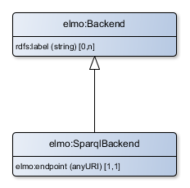
Resources of type elmo:SparqlBackend map to the class SparqlBackend
endpoint is the location of the repository

Slide 2
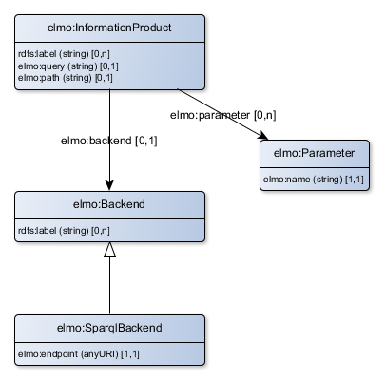
Resources of type elmo:InformationProduct map to the class AbstractInformationProduct
values of elmo:parameter are used to populate the list of filters
If the backend is of type SparqlBackend, then the resource maps to the class SparqlBackendInformationProduct

Slide 3
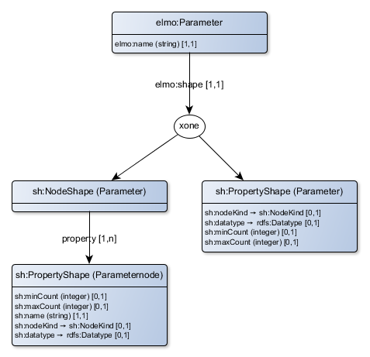
Warning: not all elements of the current elmo:vocabulary are mapped to corresponding Java classes.
Resources of type elmo:Parameter map to the class AbstractElementaryFilter
If the value of sh:datatype is xsd:string, then the Resource maps to the class StringFilter

