Slide 1
Semester Summary
By ChunxuGao

Slide 2
Work Review
Aim:
Gene-Gene-Interaction differentiation between tumor and normal samples.
Experiment:
Samples: TCGA-LUSC、TCGA-LUAD
Proof: KEGG-pathways

Slide 3
Model
Gene-To-Gene-Expression-Interaction-Matrix, using level-3 RNA-seq exon expression data.

Slide 4
 |  |  | Tumor |  |  |  | Normal
 |  |  | St1 | St2 | St3 | … | Sn1 | Sn2 | Sn3
G1 | I11 | E111
 |  | E112
 | I12 | E121
 |  | E122
 | I13 | E131
 |  | E132
 | I14 | E141
 |  | E142
G2 | I21 | E211
 |  | E212
 | I22 | E221
 |  | E222
 | I23 | E231
 |  | E232
 | I24 | E241
 |  | E242

Slide 5
Method
K-S Test between two matrix.
Test whether they obey same distribution.
YES: No difference, P-VALUE large. (> 0.5%)
No: Have difference, P-VALUE tiny. (< 0.5% )

Slide 6
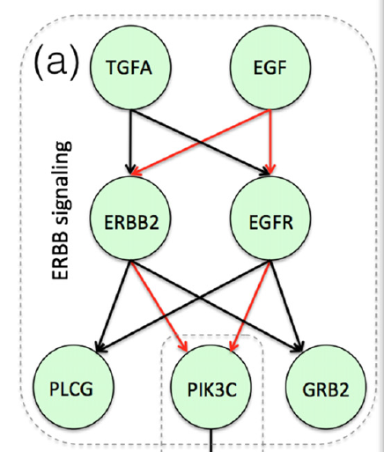
Preliminary Results
Using simple median compression to the matrix.
Data Sets: TCGA-LUSC
Fail prediction:
EGFR-PLCG
EGFR-PIK3C

Slide 7
Next Work
Matrix Compression Methods.
Find more gene pathways to summarize the method.

Slide 8
Thank You!

