Slide 1
Interspeech 2020&Datatang AESRC Track1 总结
队伍:Z2-ZJU初心者
成员:张展(讲解人) 赵鼎 俞斌 马意彭

Slide 2
参赛总结
相关资料的查找
网络结构
实验结果
思考与总结

Slide 3

Introduction About Track 1
Utterance(sequence) $→$ Class
Related Works
Audio Scene Classification
Speaker Classification
Utt
Model
Class

Slide 4
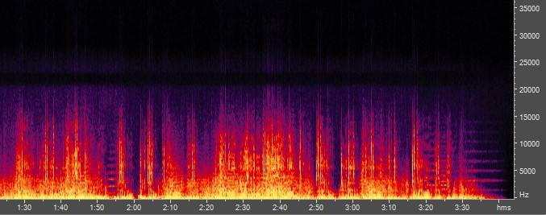
Audio Scene Classification
http://dcase.community/
Detection and Classification of Acoustic Scenes and Events
频谱图
图像识别模型
Scene

Slide 5
Speaker Classification
d-vector
x-vector
频谱图
Frame 0
Model
Aggregation
Layer
Frame 1
Model
Model
Speaker
Frame 2
Model

Slide 6
Accent Classification
口音是什么？
带有个人、地方语言特征的话音
说普通话有“口音”：基本发音单位与普通话不同
eg:四川平翘舌; 日本俄罗斯卷舌
频谱图
Frame 0
Model
Aggregation
Layer
Frame 1
Model
Model
Accent
Frame 2
Model

Slide 7
Accent Classification
采用ASR识别的基本发音单位音素作为区分的特征
ASR框架
频谱图
Jasper
SelfAttn
Aggregation
Layer
Linear
Accent

Slide 8
Accent Classification: Input Features
torchaudio.compliance.kaldi 40-dim Fbank
SpecAugment
频谱图
Frame 0
Model
Aggregation
Layer
Frame 1
Model
Model
Accent
Frame 2
Model

Slide 9
Accent Classification: Backbone
seq2seq，参考ASR框架
CNN, CNN+RNN, Attention Based
频谱图
Frame 0
Model
Aggregation
Layer
Frame 1
Model
Model
Accent
Frame 2
Model

Slide 10
Accent Classification: Backbone
这里我们训练Transformer经常失败
采用了一个CNN+CTC的框架， Jasper
频谱图
Frame 0
Model
Aggregation
Layer
Frame 1
Model
Model
Accent
Frame 2
Model

Slide 11
Accent Classification: Backbone

Slide 12

Accent Classification: Backbone
由于基于CTC采用了条件独立假设，在Jasper之后增加了Self-Attention来捕捉关联性
$d_{model}=256, ff=1024,n_{layers}=3$
频谱图
Jasper
SelfAttn
Aggregation
Layer
Linear
Accent

Slide 13
Accent Classification: Aggregation
参考Baseline的Statistical pooling，求时间维度上的mean, std
频谱图
Frame 0
Model
Aggregation
Layer
Frame 1
Model
Model
Accent
Frame 2
Model

Slide 14
Training
Stage 1 (librispeech dataset)&Stage 2 (AESRC dataset)
采用CTC Loss训练基于音素的ASR模型
频谱图
Jasper
Phoneme
CTC Loss

Slide 15

Training
Phoneme
CTC Loss
Stage 3
ASR + Accent Classification联合训练
$loss=0.1loss_{ctc}+0.9loss_{ce}$
频谱图
Jasper
SelfAttn
Aggregation
Layer
Linear
Accent
CE Loss

Slide 16
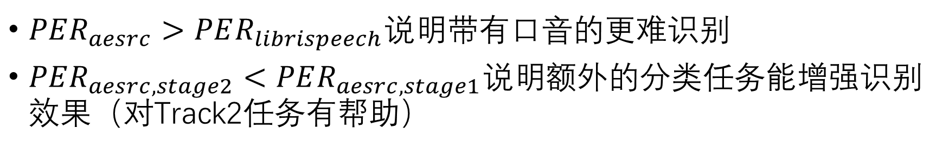
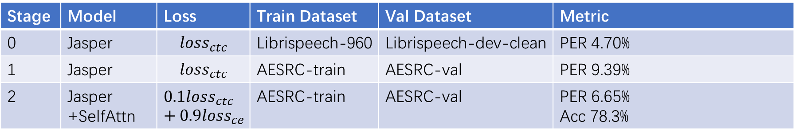
Training
Stage | Model | Loss | Train Dataset | Val Dataset | Metric
0 | Jasper | $$loss_{ctc}$$ | Librispeech-960 | Librispeech-dev-clean | PER 4.70%
1 | Jasper | $$loss_{ctc}$$ | AESRC-train | AESRC-val | PER 9.39%
2 | Jasper +SelfAttn | $$0.1loss_{ctc}+0.9loss_{ce}$$ | AESRC-train | AESRC-val | PER 6.65% Acc 78.3%
* Phone Error Rate(PER)
* 训练环境 Tesla P100*4, Intel(R) Xeon(R) CPU E5-2640 v4 @ 2.40GHz, 128GB
$PER_{aesrc}>PER_{librispeech}说明$带有口音的更难识别
$PER_{aesrc,stage2}<PER_{aesrc,stage1}$说明额外的分类任务能增强识别效果（对Track2任务有帮助）

Slide 17
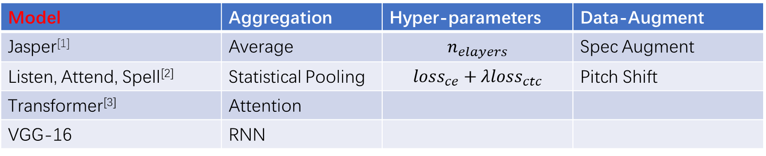
Discussion
Model | Aggregation | Hyper-parameters | Data-Augment
Jasper^{[1]} | Average | $$n_{elayers}$$ | Spec Augment
Listen, Attend, Spell^{[2]} | Statistical Pooling | $$loss_{ce}+λloss_{ctc}$$ | Pitch Shift
Transformer^{[3]} | Attention
VGG-16 | RNN
Transformer > LAS > CTC
(https://github.com/espnet/interspeech2019-tutorial)
[1] Li, Jason & Lavrukhin, Jasper: An End-to-End Convolutional Neural Acoustic Model. 71-75. 10.21437/Interspeech.2019-1819.
[2] W. Chan, N. Jaitly, Q. Le and O. Vinyals, "Listen, attend and spell: A neural network for large vocabulary conversational speech recognition," ICASSP.2016.
[3] Y. zhao, J. Li, X. Wang and Y. Li, "The Speechtransformer for Large-scale Mandarin Chinese Speech Recognition," ICASSP.2019

Slide 18
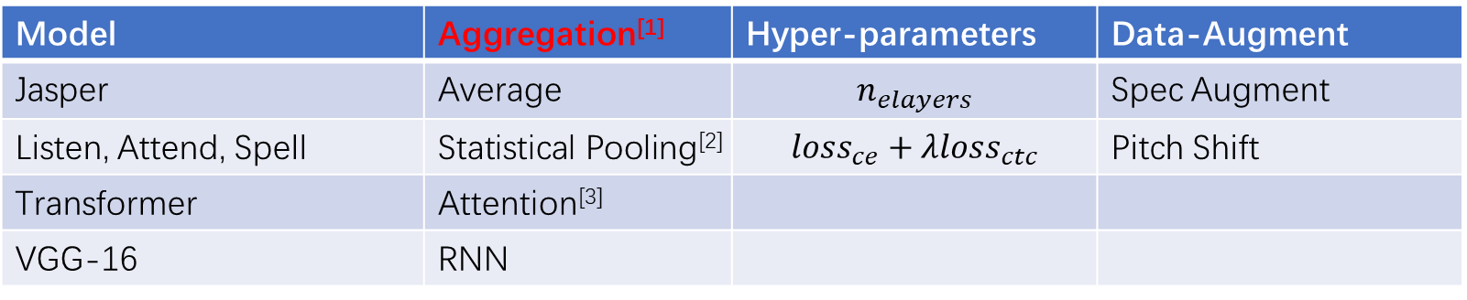
Discussion
Model | Aggregation^{[1]} | Hyper-parameters | Data-Augment
Jasper | Average | $$n_{elayers}$$ | Spec Augment
Listen, Attend, Spell | Statistical Pooling^{[2]} | $$loss_{ce}+λloss_{ctc}$$ | Pitch Shift
Transformer | Attention^{[3]}
VGG-16 | RNN
(a) LSTM-based d-vector baseline. (b) Basic attention layer.
[1] W. Xie, A. Nagrani, J. S. Chung and A. Zisserman, "Utterance-level Aggregation for Speaker Recognition in the Wild," ICASSP.2019
[2] D. Snyder, D. Garcia-Romero, G. Sell, D. Povey and S. Khudanpur, "X-Vectors: Robust DNN Embeddings for Speaker Recognition," ICASSP.2018
[3] F. A. Rezaur rahman Chowdhury, Q. Wang, I. L. Moreno and L. Wan, "Attention-Based Models for Text-Dependent Speaker Verification," ICASSP.2018

Slide 19
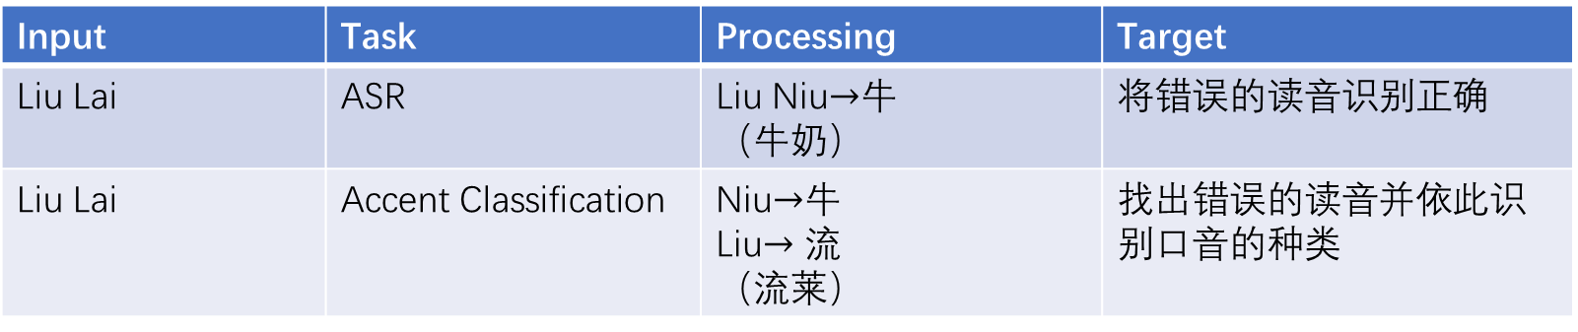
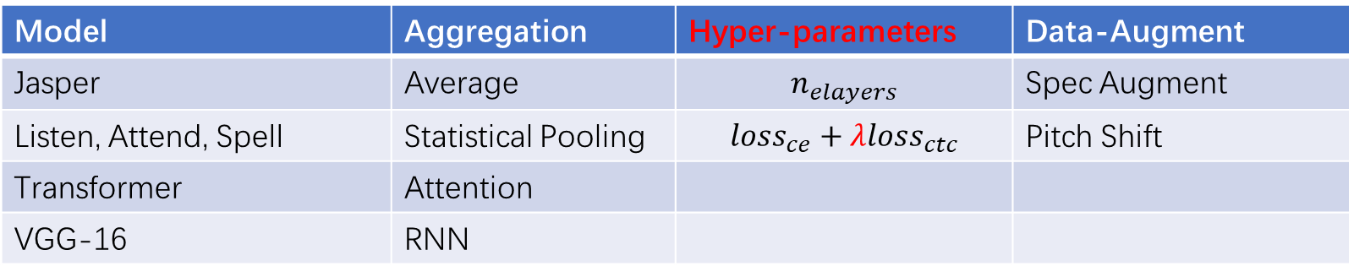
Discussion
Model | Aggregation | Hyper-parameters | Data-Augment
Jasper | Average | $$n_{elayers}$$ | Spec Augment
Listen, Attend, Spell | Statistical Pooling | $$loss_{ce}+λloss_{ctc}$$ | Pitch Shift
Transformer | Attention
VGG-16 | RNN
识别与口音分类之间的矛盾：
Input | Task | Processing | Target
Liu Lai | ASR | Liu Niu$→$牛 （牛奶） | 将错误的读音识别正确
Liu Lai | Accent Classification | Niu$→$牛 Liu$→流$ （流莱） | 找出错误的读音并依此识别口音的种类

Slide 20
感谢各位老师、同学与前辈！

