Slide 1







The Multi-Accent Team
System Description for AESRC2020
Xiaoshuo Xu
Yuekai Zhang
Sining Sun
Songjun Cao
Yueteng Kang
Long Ma
Tencent Co.Ltd, Beijing, China
Johns Hopkins University, Baltimore, USA

Slide 2
Track2: Accent ASR Task
Method | Dev (Avg WER%) | Test (Avg WER%)
Transformer ASR | 4.05 | - (no submission)
Wav2vec2.0 | 3.63 | 4.05
Rank 1st
Overview
Transformer Method (Quick Intro)
Wav2vec 2.0 Background
Wav2vec 2.0 Training
Wav2vec 2.0 Decoding
Conclusion

Slide 3
Transformer Method
Toolkit: ESPnet
Data: Accent 160 hrs w/ Noise Augmentation + Librispeech 960hrs
Model | #attention heads | Attention dim | Feed forward Units
Transformer Base (12 enc + 6 dec) | 8 | 512 | 1024
Transformer Large (12 enc + 6 dec) | 8 | 768 | 2048
Two Stage Training: Pretrain (supervised) + Finetune

Slide 4
Takeaways
Shallow Fusion with better LM always helps!
RNN LM Transformer LM Large Transformer LM
Data augmentation helps low-resource accent data.
160 Hrs * 8: original, noise, babble, music, reverb, volume, speed 0.9, speed 1.1
Two Stage Training Matters!
First, training with all data would be better than librispeech data only. Then fine-tune with accent data would give better performance.

Slide 5
Results
Model | Two Stage Trainning | WER (on dev set)
Transformer + rnn LM | Pretrain: Librispeech Fine-tune：Accent Aug | 5.15
Transformer Large + rnn LM | Pretrain: Librispeech+ Accent Aug Fine-tune: Accent Aug | 4.47
Transformer Large + transformer LM | Pretrain: Librispeech+ Accent Aug Fine-tune: Accent Aug | 4.30
Transformer Large + transformer LM large | Pretrain: Librispeech+ Accent Aug Fine-tune: Accent Aug | 4.08

Slide 6
Wav2vec 2.0 Intro: self-supervised audio pretrain technology by Facebook
Wav2vec
VQ-Wav2vec
Wav2vec 2.0
Interspeech 2019
ICLR 2019
NIPS 2020
Advantage:
Suitable for Low-resource Task: Low-resource Language, Accent, Domains
SOTA results on Librispeech
https://arxiv.org/pdf/2010.11430.pdf
Could combine with other techniques
e.g. Pushing the Limits of Semi-Supervised Learning for Automatic Speech Recognition: conformer + wav2vec2.0 + specaug + noise student training w/ Libri-light

Slide 7
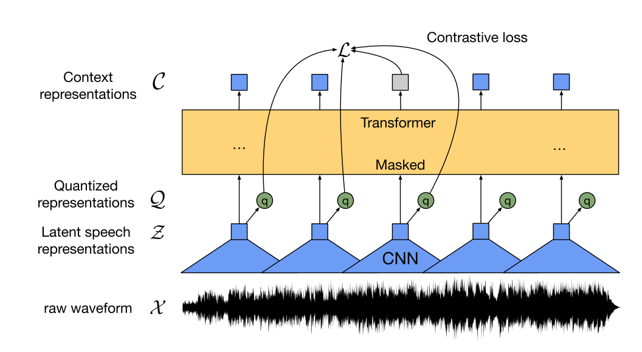
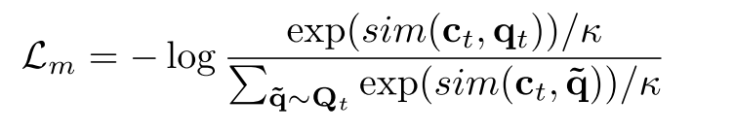
Wav2vec 2.0 Intro: self-supervised audio pretrain technology by Facebook
Self-supervised pretraining: using unlable audios
Supervised fine-tune: using leared latent speech representations
https://arxiv.org/abs/2006.11477

Slide 8
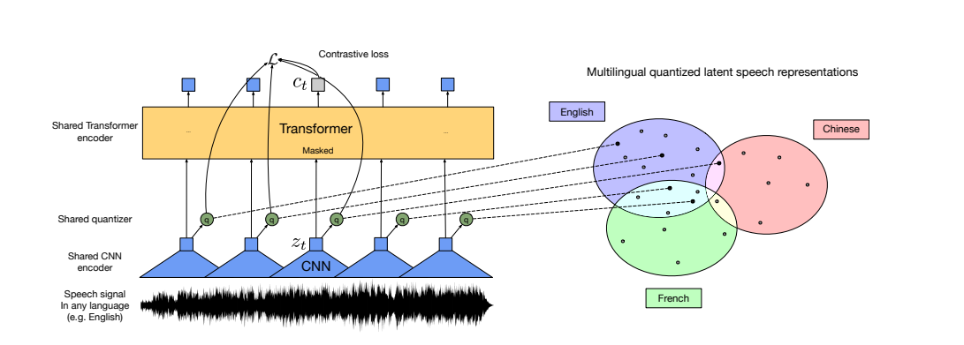
Wav2vec 2.0 Intro: self-supervised audio pretrain technology by Facebook
Latent discrete speech representations are shared across languages (accents)
https://arxiv.org/pdf/2006.13979.pdf

Slide 9
Finetuning Acoustic Model
Model: Wav2vec 2.0
Wave encoder: pretrained on Librispeech data only
Transformer encoder: 24-layer transformer encode layer, pretrained
Top layer: fully-connect layer, used for finetuning
Modeling Unit: Phone (thus the top lay has a few parameters)
It seems modeling units like BPE work worse
Perphas introducing many new parameters is bad
Training Loss: CTC
Finetuning Procedure:
Fix wave encoder and fransfomrer encoder, and train only the top layer first
Then train transformer encoder and the top layer
Data augmentation

Slide 10
Language Model (LM)
4-Gram Word LM
Train N-gram models on Librispeech and Accent training transcription separately (N = 3, 4, 5)
Find the optimal mix weights on Accent dev, transcription
4-Gram model achieves a perplexity of 47
Combine with a Tire tree (not fst) for beamsearch
Word Transformer LM
Train Transformer models on the combination of Librispeech and Accent traning transcription (1: 1, 1: 8)
6-layer, 12-layer and 24-layer Transformers are explored
Slightly lower perplexity but comparable WER
Not used for test

Slide 11
Language Model
Encoder-decoder Architecture ?
We do experiment transformer decoder
It works comparably to the encoder architecutre
More time to decode
Wordpiece Transformer Model
Motivation: exploit multi-levels language information
Rescore the top 100 candidates generated from beamsearch results

Slide 12
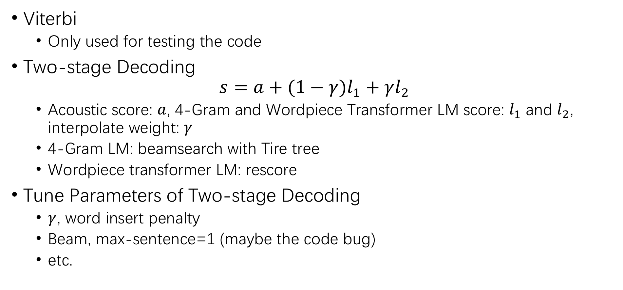
Decoding
Viterbi
Only used for testing the code
Two-stage Decoding
$$s=a+(1−γ)l_{1}+γl_{2}$$
Acoustic score: $a$, 4-Gram and Wordpiece Transformer LM score: $l_{1}$ and $l_{2}$, interpolate weight: $γ$
4-Gram LM: beamsearch with Tire tree
Wordpiece transformer LM: rescore
Tune Parameters of Two-stage Decoding
$γ$, word insert penalty
Beam, max-sentence=1 (maybe the code bug)
etc.

Slide 13
Experimential Results
Model | Setting | WER (on dev. set)
Effectiveness of data augmentation
Wav2Vec 2.0 | Training data + Viterbi | 5.61
Wav2Vec 2.0 | Data augmentation + Viterbi | 5.45
Comparison between 4-Gram and 12-layer word Transformer LM
Wav2Vec 2.0 + 4-Gram (2: 8) | Data augmentation + Beam 50 | 3.96
Wav2Vec 2.0 + 12-layer Word Transformer LM | Data augmentation + Beam 50 | 4.01
Further optimization & Comparison to our Transformer ASR method
Wav2Vec 2.0 + 4-Gram (1: 9) | Data augmentation + Tune parameters of decoding | 3.71
Wav2Vec 2.0 + 4-Gram (1: 9) + Wordpiece Transformer LM | Data augmentation + Tune parameters of decoding + Rescore | 3.64
Transformer Large + Transformer LM large | Pretrain: Librispeech+ Accent Aug Fine-tune: Accent Aug | 4.08

Slide 14
Some Important Points
Pretraining is important
Different schemes may have different results
Difference between Wav2vec2.0 and Transformer ASR
24-layer vs 12-layer
Wave encoder vs Fbanks
Unsupervised pretraining vs supervised pretraining
Data augmentation
LM
Word 4-Gram vs Wordpiece Transformer
Multi-level LMs
Decoding parameters

Slide 15
Tools
Coding Language: Python, C/C++
Library: torch, espnet, fairseq, kaldi

Slide 16
Q & A

Slide 17
Thank you!

