Slide 1

2024 I 10 I 27 I
Sleep Efficiency
Team7
Honglin Wang
Jun Ma
Zihui Yao
Instuctor:Arash Shamseddini

Slide 2
Contents
01
02
03
04
Introduction
Methodology
Results
Conclusion

Slide 3
Introduction
Sleep Efficiency
Sleep is an essential part of human health. It helps repair body, regenerate tissues, build bones , build muscle, and strengthen the immune system.
Dataset containing 452 observations, and 14 variables(11 numeric columns ) is used for analyzing the relationship between some variables related to sleep quality. ^{[1]}
14 Variables in the dataset record the age, gender, bedtime, wakeup time, sleep duration, sleep efficiency, REM sleep percentage, deep sleep percentage, light sleep percentage, awakenings, caffeine consumption, alcohol consumption, smoking status, and exercise frequency. ^{[2]​}
Sleep time = REM Sleep + Light Sleep + Deep Sleep
*Rapid eye movement (REM) sleep is the stage of sleep where most dreams happen.

Slide 4
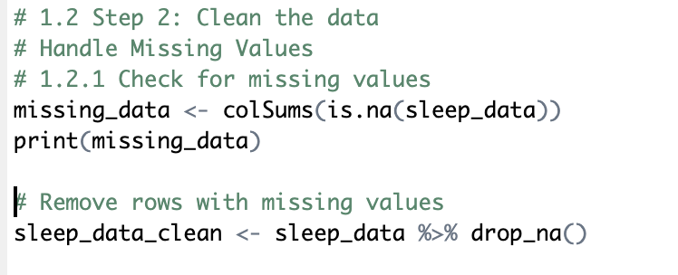
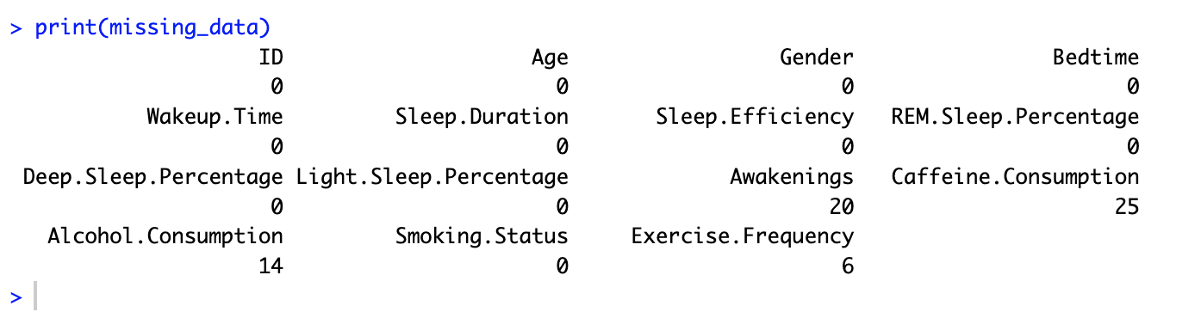
Methodology
Step 1: Check for Missing Values

Slide 5

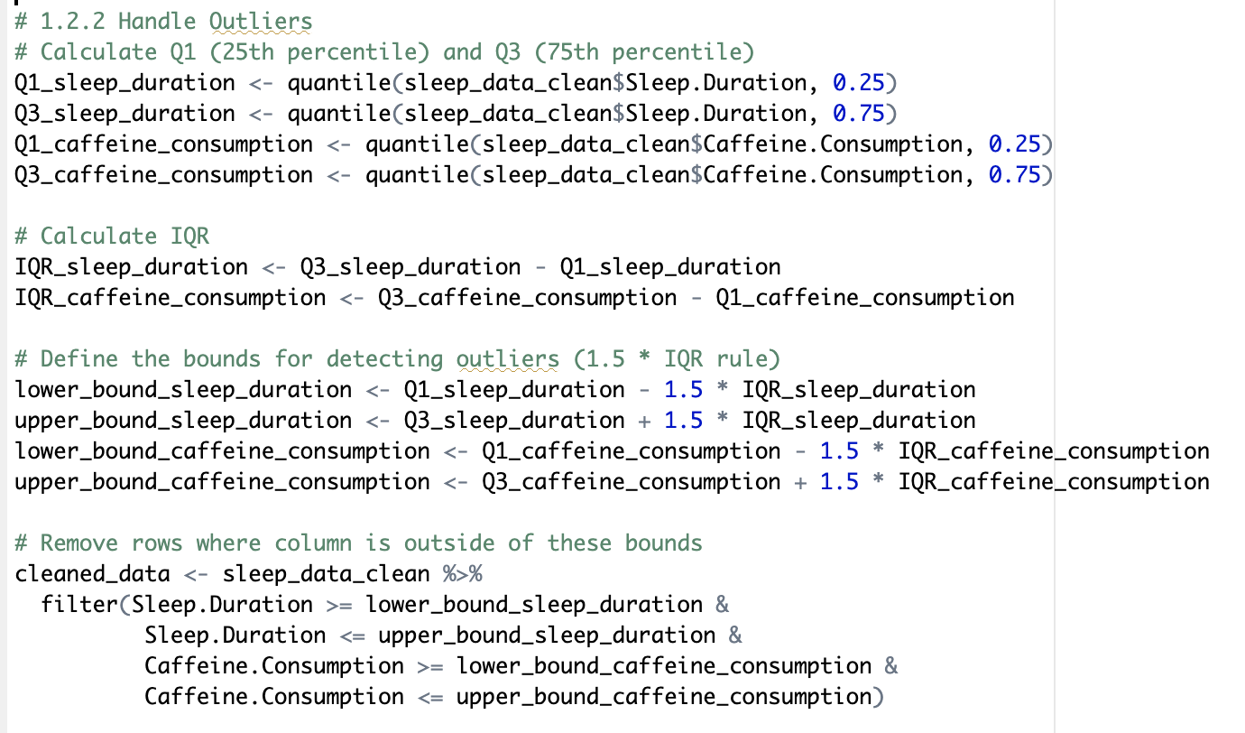
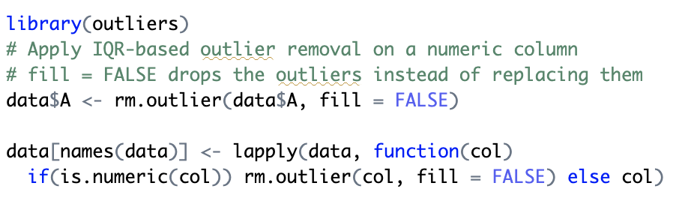
Methodology
Step 2: Handle Outliers
Method 1
Method 2

Slide 6
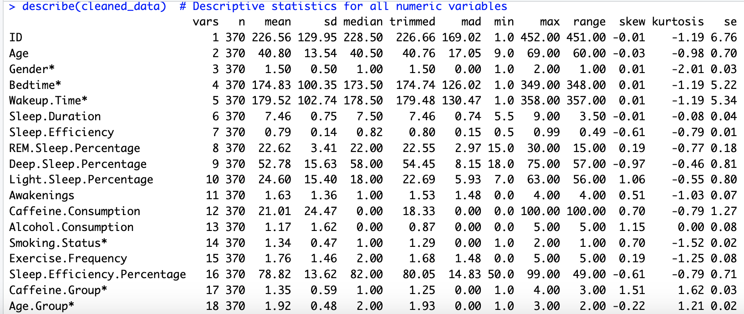
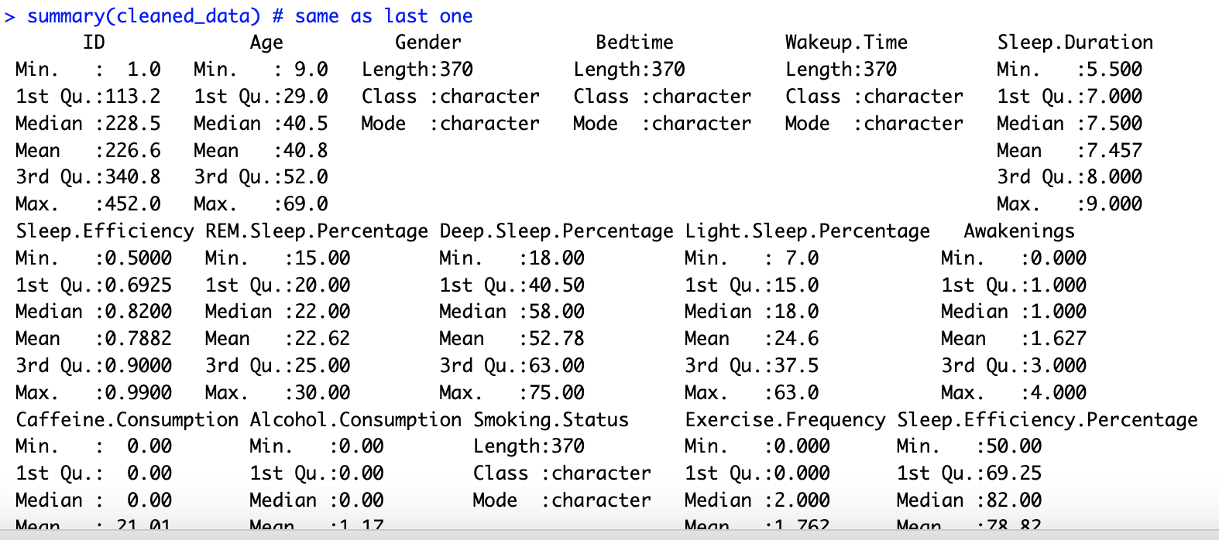
Methodology
Step 3: Descriptive Statistics
describe(){psych}
summary(){base}

Slide 7
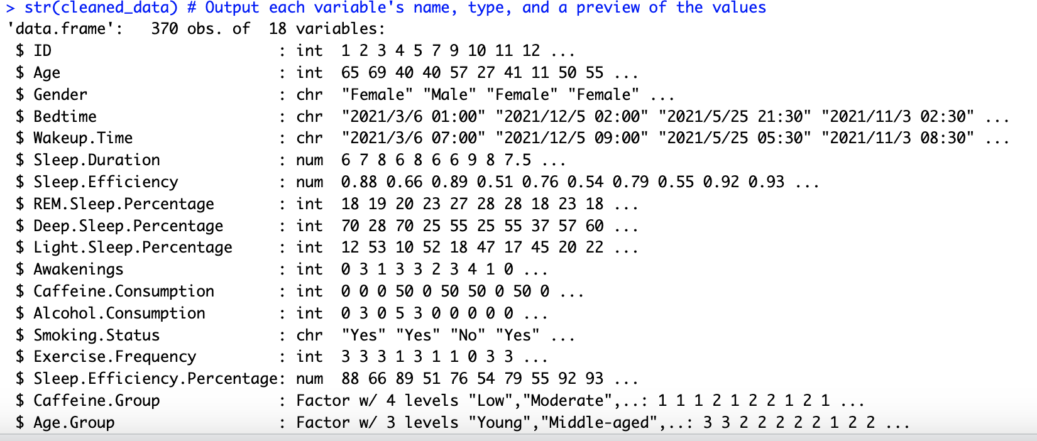
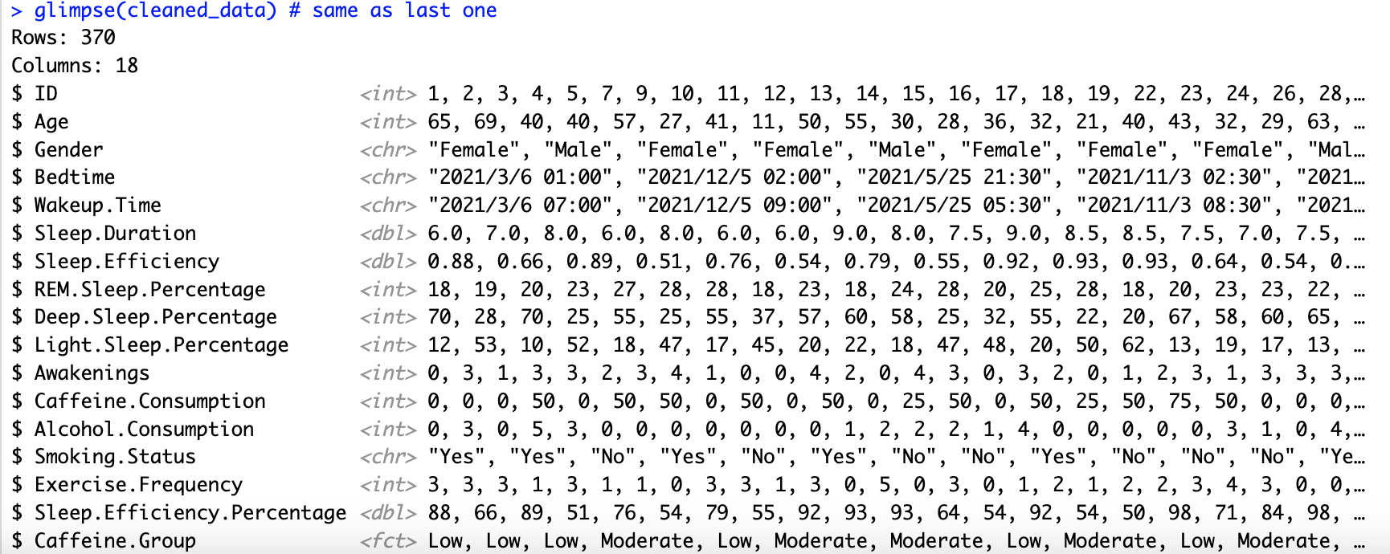
Methodology
Step 3: Descriptive Statistics
str(){utils}
glimpse(){dplyr}

Slide 8
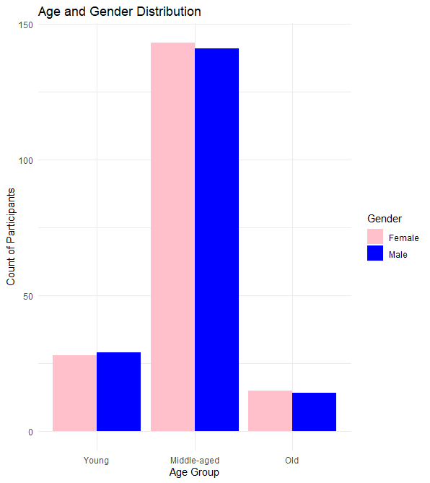
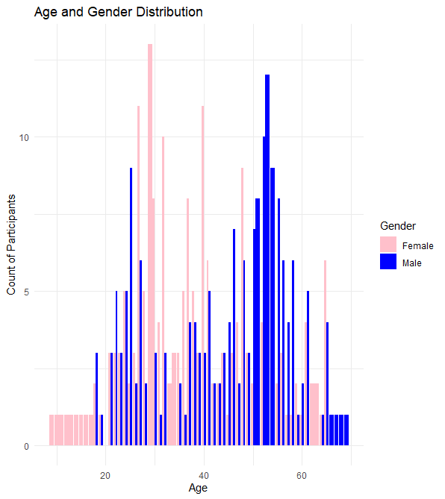
Results
*Globally, the sex ratio at birth and in childhood is over 100, indicating more boys than girls. At ages 15-20, this male bias continues, largely due to countries like China and India. However, the ratio decreases with age: by age 50, it's nearly even (close to 100), and by age 70, there are only about 86 men per 100 women. Among those 100 years and older, the ratio drops significantly to just 24 men per 100 women.^{[3]}

Slide 9
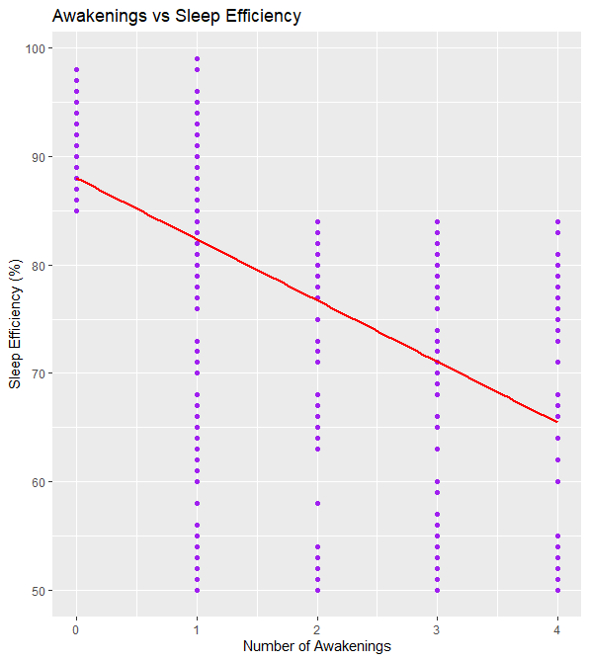
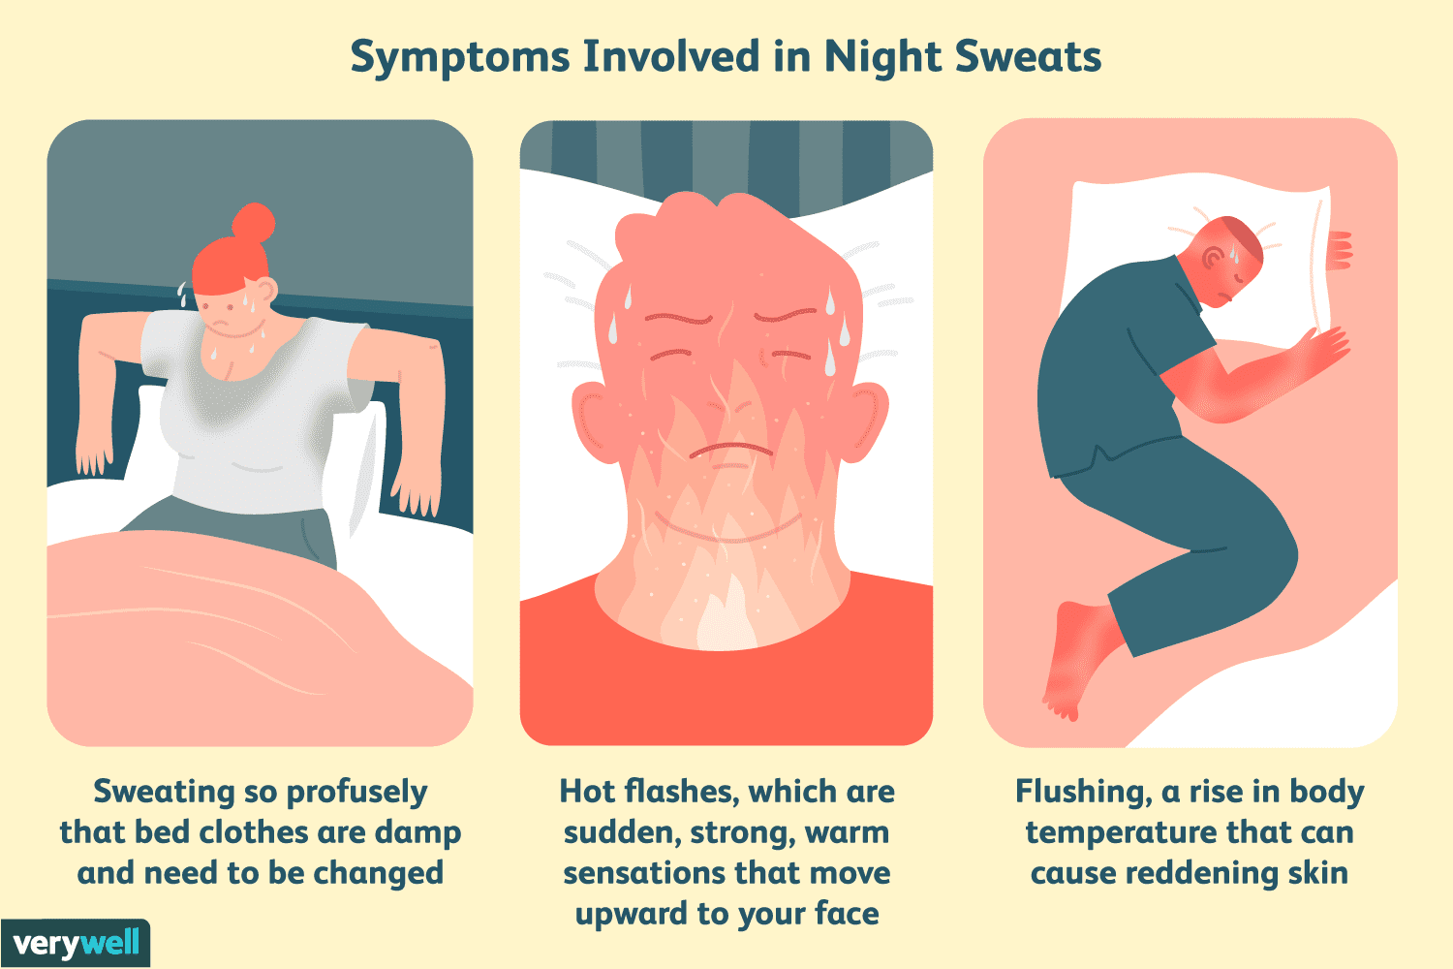
Results

Slide 10
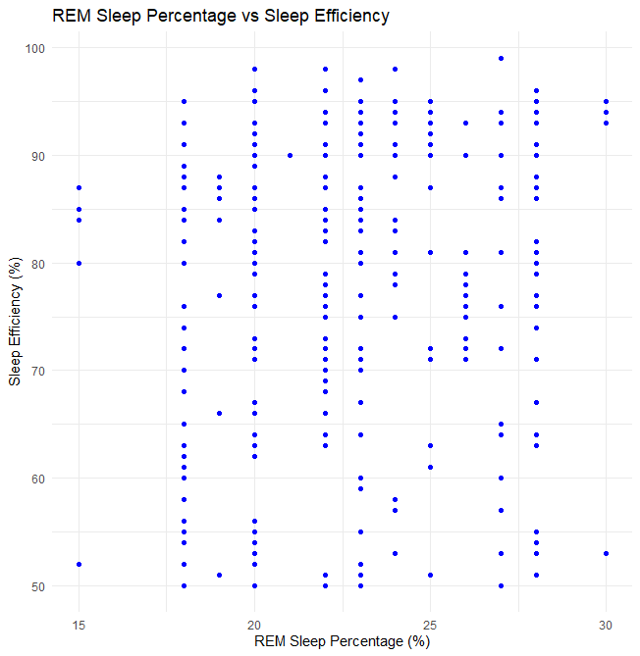
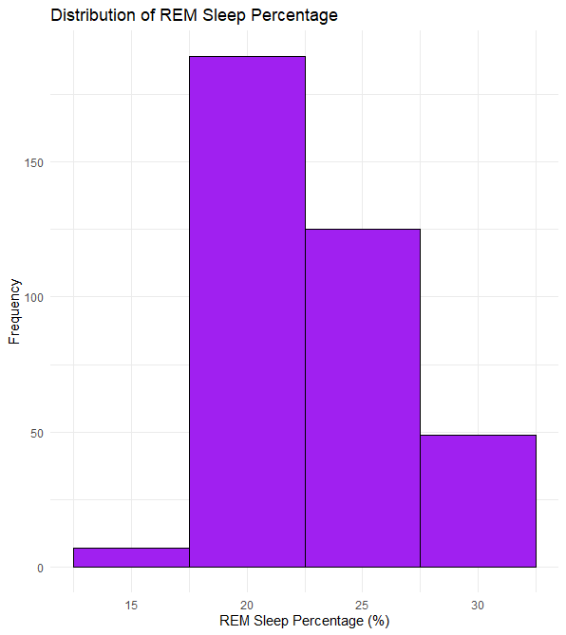
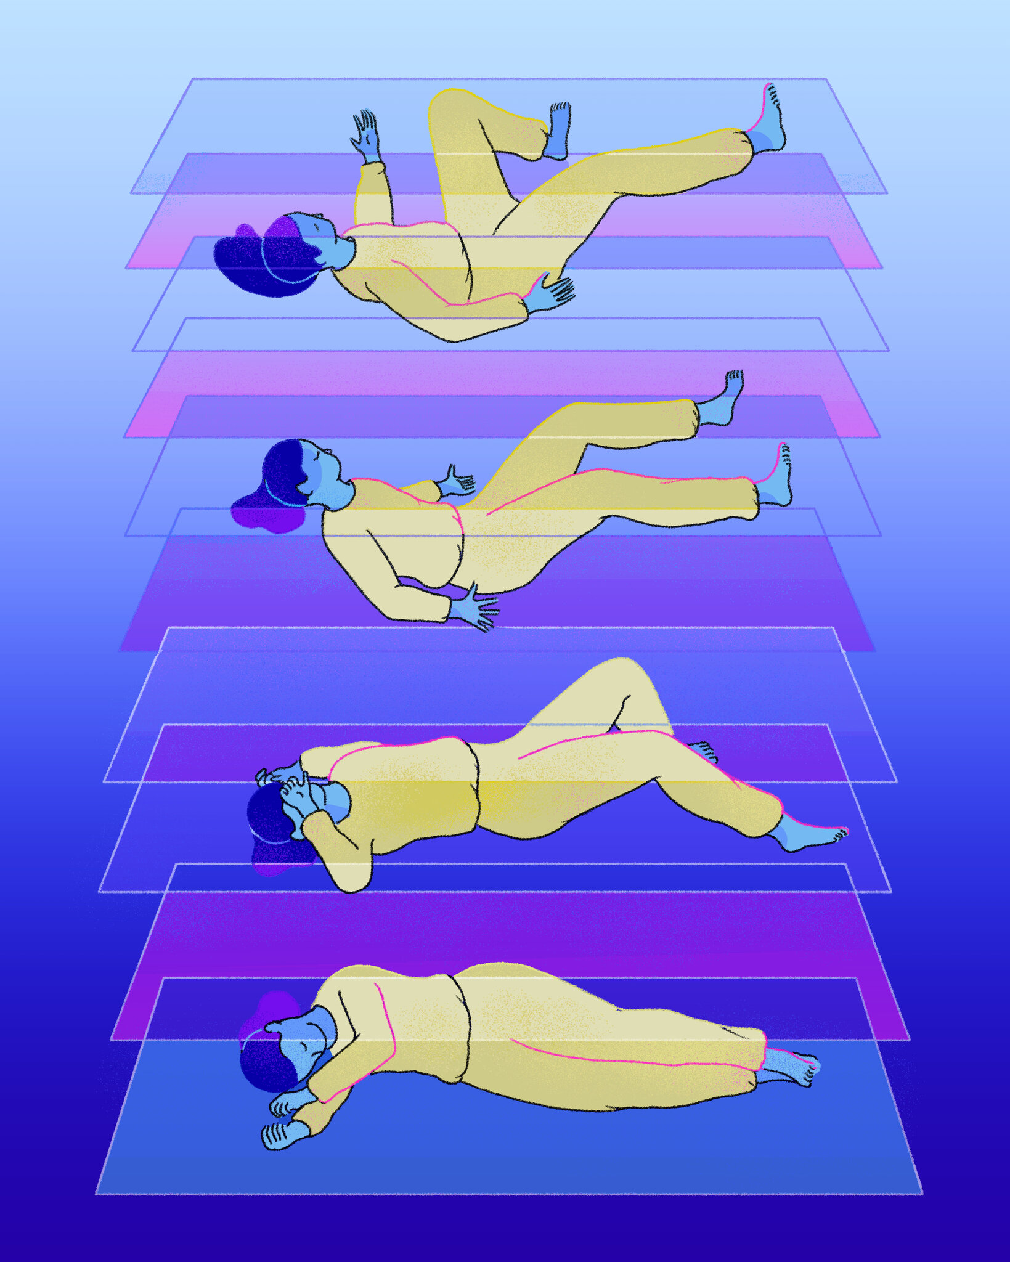
Results

Slide 11
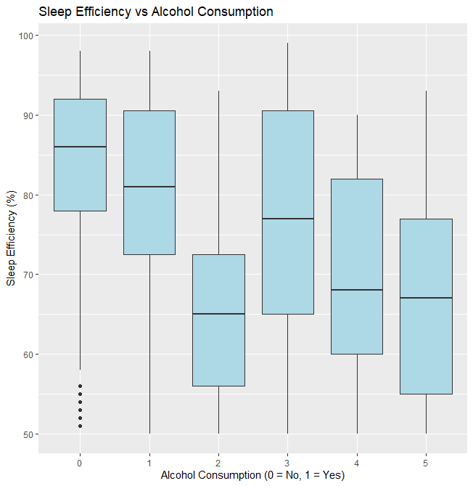
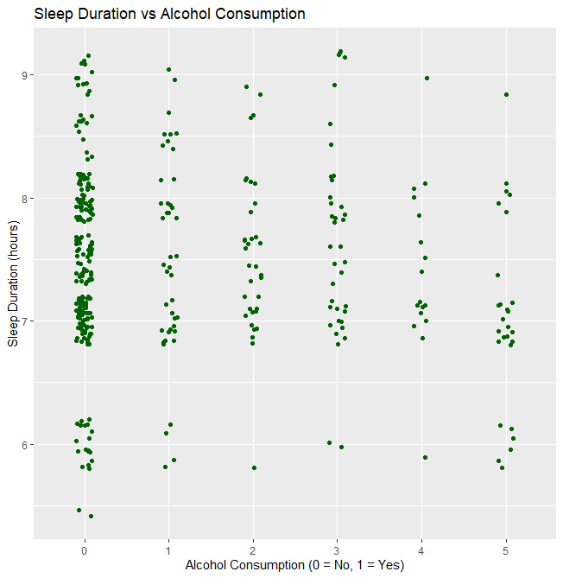
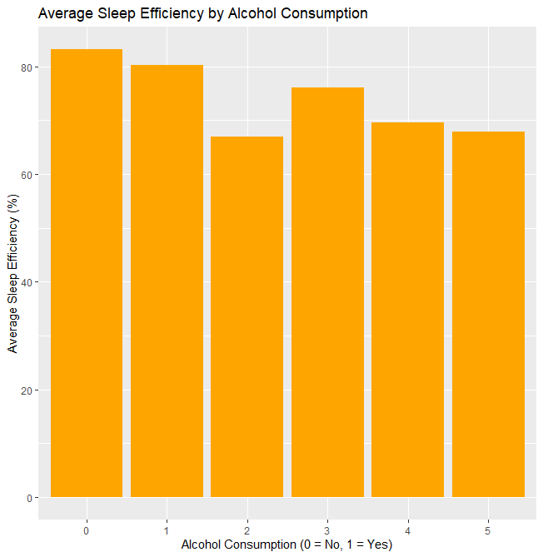
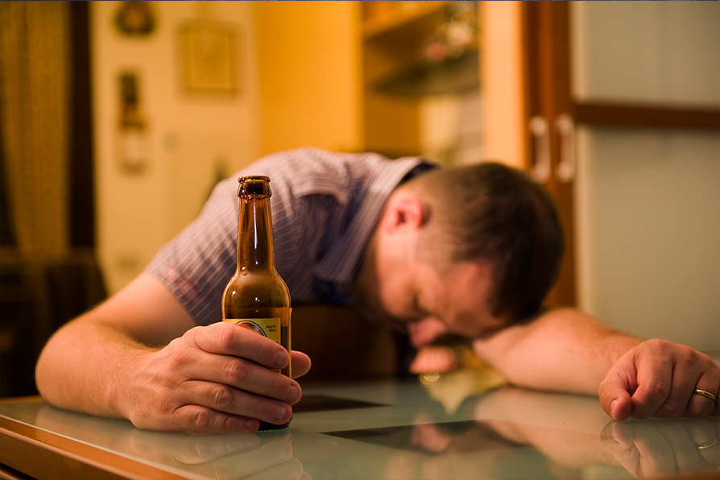
Results
Non-drinkers is the highest
Higher alcohol consumption
with shorter sleep durations
Average sleep efficiency as alcohol intake rises

Slide 12

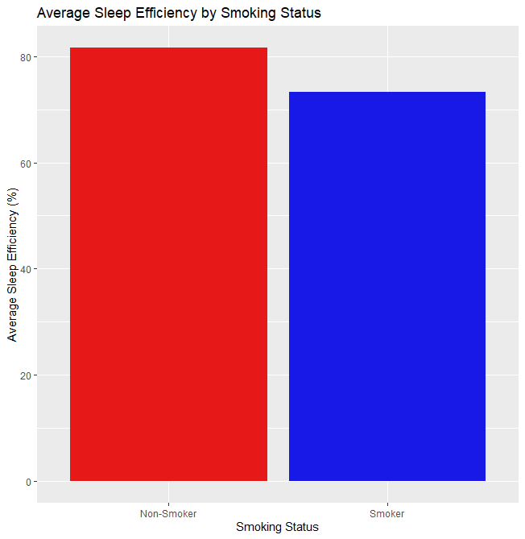

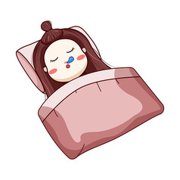
Results

Slide 13
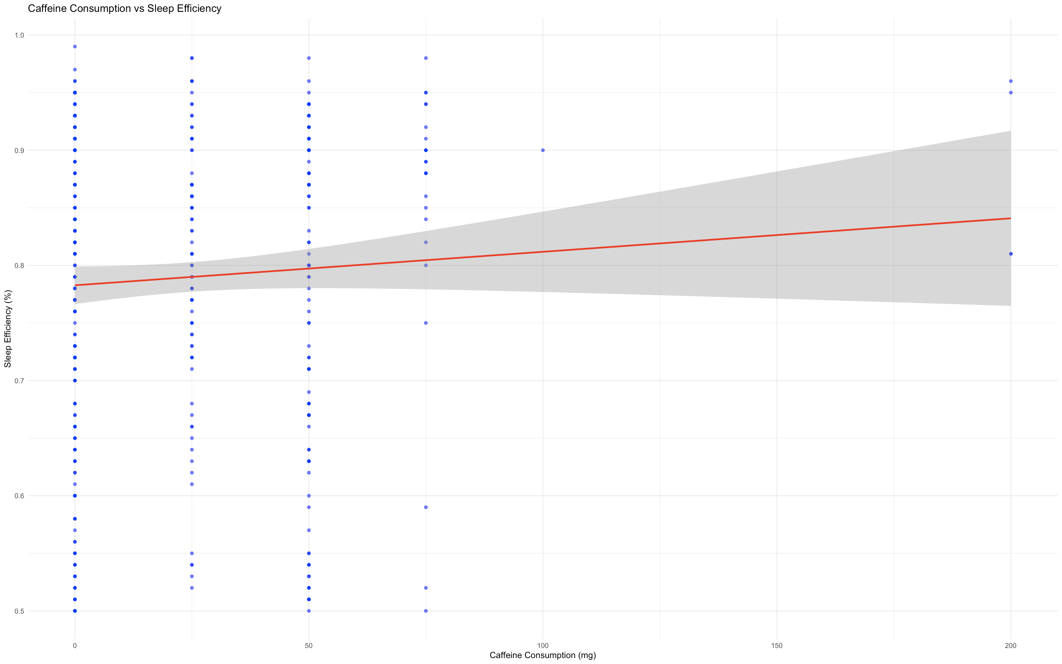
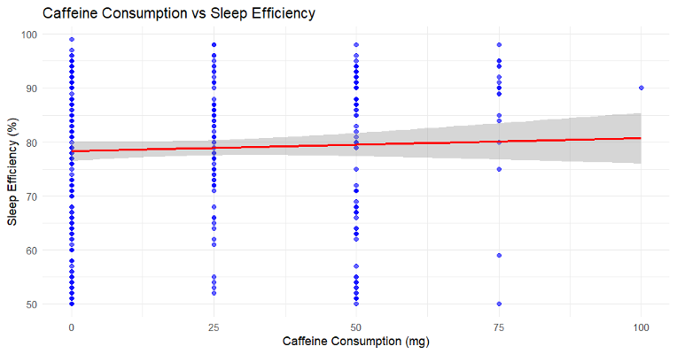
Results

Slide 14
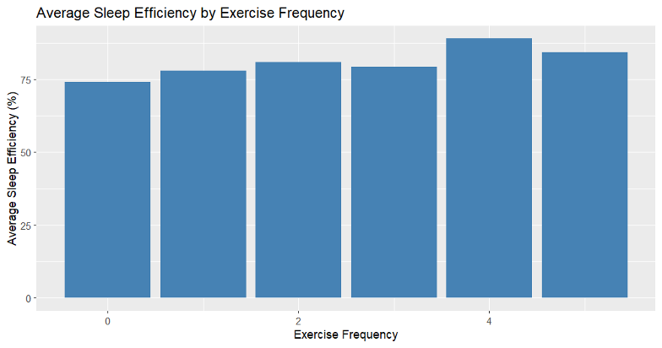
Results

Slide 15
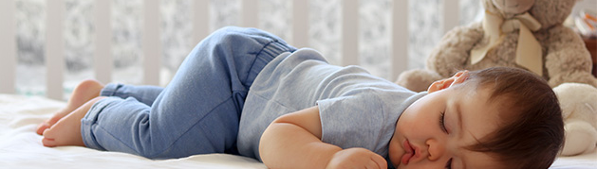
Conclusion
Summary of Key Findings:
Awakenings and alcohol negatively impact sleep efficiency
Exercise improves sleep quality
Caffeine has less impact than expected

Slide 16
Go to bed and wake up at the same time.
Avoid alcohol before bedtime
Moderate caffeine consumption
Create a Sleep-Friendly Environment
Recommendations:
Engage in Regular Exercise
Quit or Reduce Smoking

Slide 17
Thanks for Listening
Any Question？

Slide 18
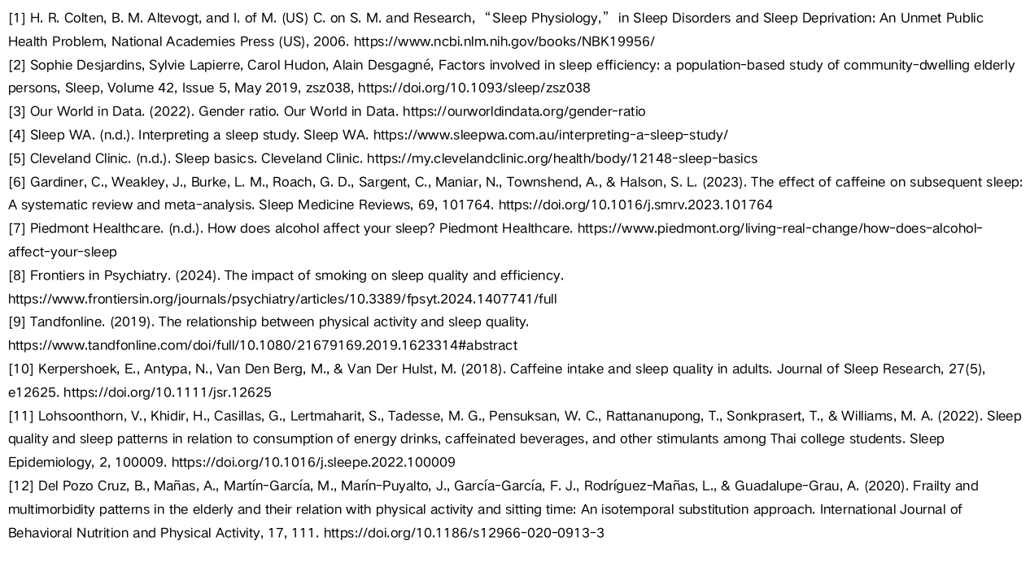
Reference list

