Slide 1
Computer Vision
Final Project
Panorama Stitching
Zhe ZHANG, 1754060
Kaixin CHEN, 1753188
Yunxin SUN, 1551534
School of Software Engineering
Tongji University
Spring 2020

Slide 2
Content
SURF
Xxx
Yyy
zzz
SIFT
Xxx
Yyy
zzz
Fast Panorama Stitching on Mobile
Current Approaches
Summary
Color and Luminance Compensation
Optimal Seam Finding and Image Labeling
Image Blending
Results
Notes:
第三部分我们研究mobile端的快速全景拼接算法

Slide 3
Current Approaches
transition smoothing: reduce color differences between source images to make seams invisible and remove stitching artifacts
Alpha blending: fast transition smoothing approach, but it cannot avoid ghosting problems caused by object motion and small spatial alignment errors
Gradient Domain Image Blending approaches: can reduce color differences and smooth color transitions using gradient domain operations, producing high-quality composite images
optimal seam finding: search for seams in overlapping areas along paths where differences between source images are minimal
combination: optimal seams first, if seams and stitching artifacts are visible, transition smoothing to reduce color differences to hide the artifacts then
graph cut -> find optimal seams
poisson blending -> smoothing color transitions
Notes:
现在的panorama stitching approaches主要分为两大类，transition smoothing和optimal seam finding以及二者的结合
其中graph cut是现在用的比较多的方法

Slide 4
Current Approaches Problem
computational and memory costs are high
pixels are easy saturated in color correction
don't work well for source images in very different colors and luminance
linear blending, moving objects on the overlapping areas will cause ghosting artifacts
Solution
don't need to keep all source images in memory due to the sequential stitching
dynamic programming for optimal seam finding allowing image labeling much faster than using graph cut
combination of color correction and image blending
high-quality panoramic images from long image sequences with very different colors and luminance
work well on both indoor and outdoor scenes
Notes:
但是这些算法存在一些问题，比如图像颜色和光照的差别很大的图像效果非常差
Mobile也存在些自己的约束，比如memory少等等问题

Slide 5
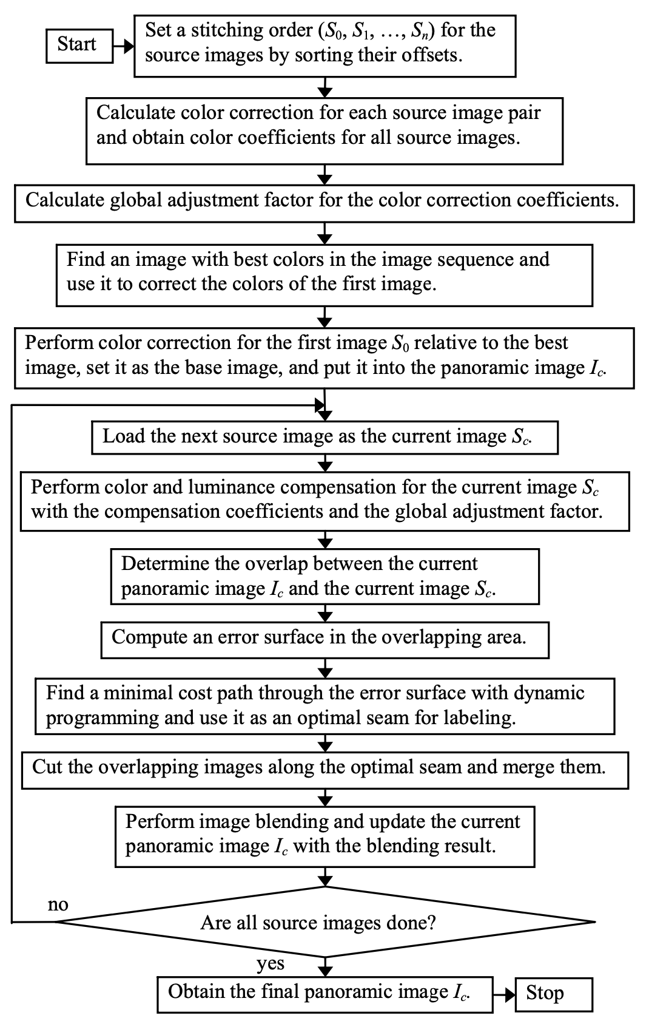
Summary
Fast Panorama Stitching for High-Quality Panoramic Images on Mobile Phones Yingen Xiong and Kari Pulli, Member, IEEE
Color Correction
color correction for all source images to reduce color differences
smoothen remaining color transitions between adjacent images
Image Labeling
error surface is constructed with squared differences between overlapping images
low-cost path is found through the error surface by dynamic programming and used as an optimal seam to create labeling
Image Blending Operations
linear blending -> source images are similar in color and luminance
poisson blending -> colors remain too different
Notes:
我们的算法来自这篇论文，主要分为三大个模块
首先进行color correction

Slide 6
Summary
Color Correction
color correction for all source images to reduce color differences
smoothen remaining color transitions between adjacent images
Image Labeling
error surface is constructed with squared differences between overlapping images
low-cost path is found through the error surface by dynamic programming and used as an optimal seam to create labeling
Image Blending Operations
linear blending -> source images are similar in color and luminance
poisson blending -> colors remain too different
Notes:
之后进行最优接缝的寻找和image labeling

Slide 7
Summary
Color Correction
color correction for all source images to reduce color differences
smoothen remaining color transitions between adjacent images
Image Labeling
error surface is constructed with squared differences between overlapping images
low-cost path is found through the error surface by dynamic programming and used as an optimal seam to create labeling
Image Blending Operations
linear blending -> source images are similar in color and luminance
poisson blending -> colors remain too different
Notes:
第三步进行图像融合

Slide 8
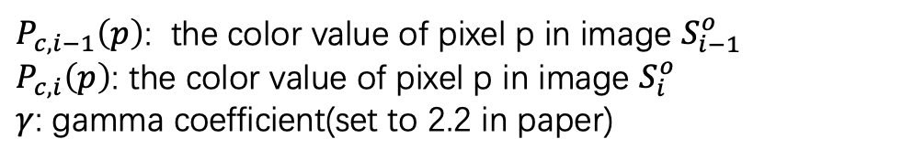
Color and Luminance Compensation
Basic idea: compute light averages in the overlap area by linearizing the gamma-corrected RGB
Suppose $S_{i−1}$ and $S_{i}$ are adjacent images, $S_{i−1}^{o}$ and $S_{i}^{o}$ are where image overlap
$P_{c,i−1}\left(p\right)$: the color value of pixel p in image $S_{i−1}^{o}$
$P_{c,i}\left(p\right)$: the color value of pixel p in image $S_{i}^{o}$
$γ$: gamma coefficient(set to 2.2 in paper)
Notes:
颜色和光照校正的核心思想其实还是 gamma校正
主要分为两个步骤
第一步是aci也就是相邻两个图像重叠区域的一个校正因子

Slide 9
Color and Luminance Compensation
Basic idea: compute light averages in the overlap area by linearizing the gamma-corrected RGB
$g_{c}$: global adjustment in the whole image sequence for each color channel $c$
Solve the least-squares equation
Notes:
第二个是最优一个方程组得到的全局调整因子，这里我们用导数=0的闭式解来做

Slide 10
Color and Luminance Compensation
Basic idea: compute light averages in the overlap area by linearizing the gamma-corrected RGB
Notes:
最终我们综合这两个调整因子
对原像素做一个gamma校正

Slide 11
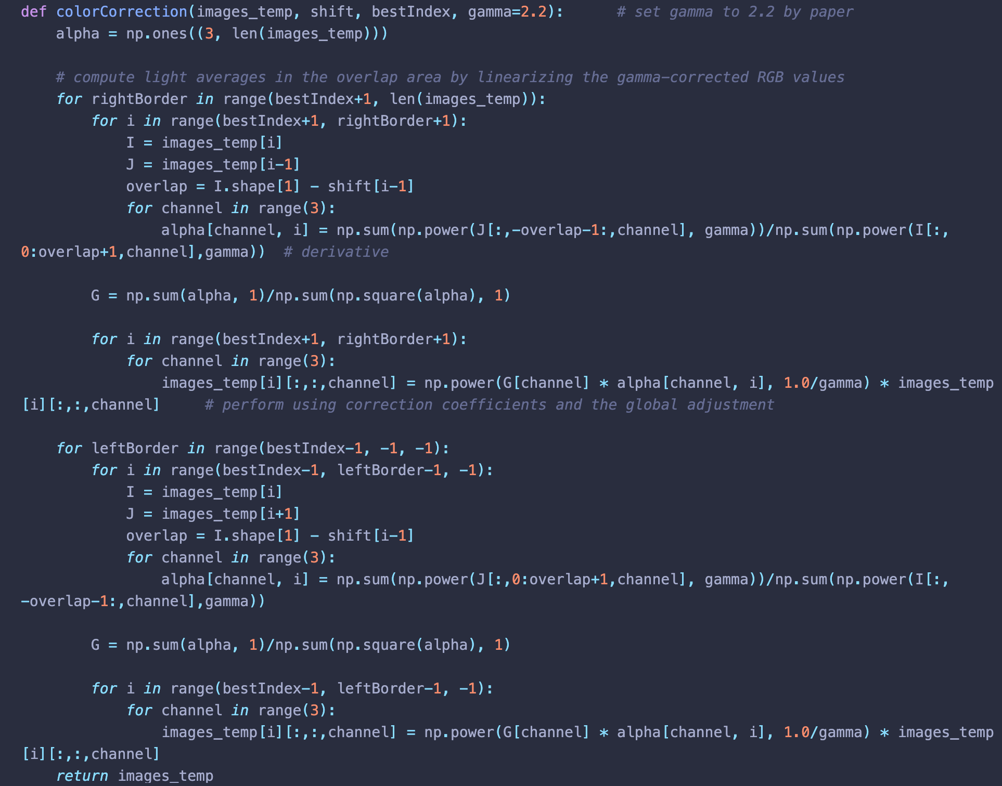
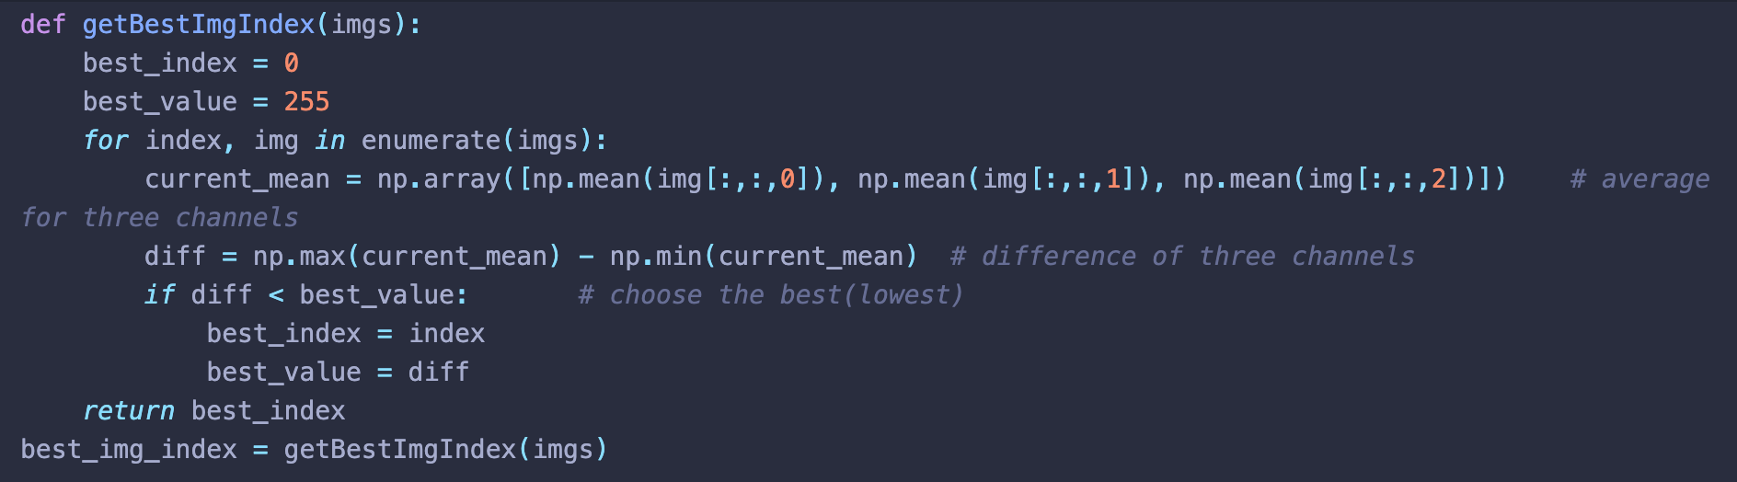
Color and Luminance Compensation
Notes:
这是我们的实现
首先要找到一张最优图片，这个其实偏重主观审美
我们采用的是寻找三个通道的均值极差越小越好（这个主要用在white balancing上）

Slide 12
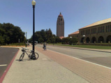
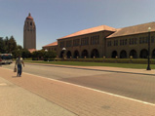
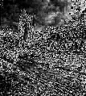
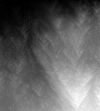
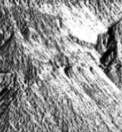
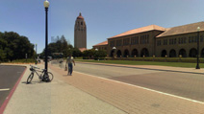

Optimal Seam Finding and Image Labeling
Input images
e: error surface $e={(I_{c}^{o} − S_{c}^{o})}^{2}$
E: cumulative minimum squared difference
All possible paths
Optimal path $m_{c}$: tracking back the paths with a minimal cost from bottom to top
Panorama image
Notes:
第二部分我们最核心的是三个步骤
首先在颜色校正的基础上计算error surface
然后通过dynamic programming的方法一行行扫描error surface，计算一个累积的最小平方差
第三部就是通过回溯在所有可能的path中找到最优的一条接缝

Slide 13
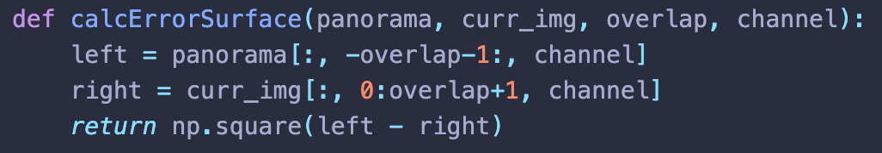
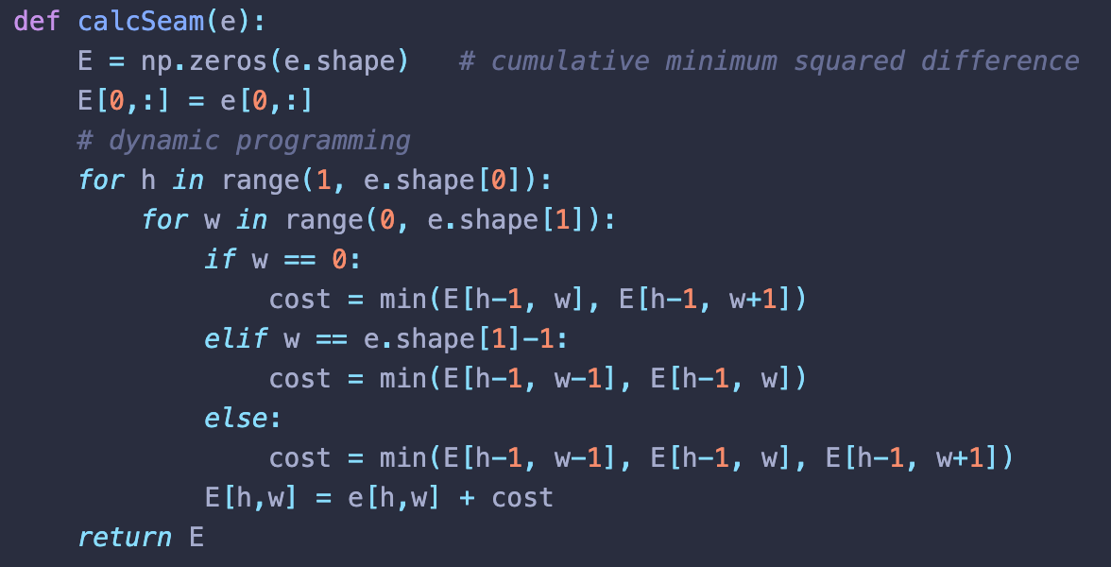
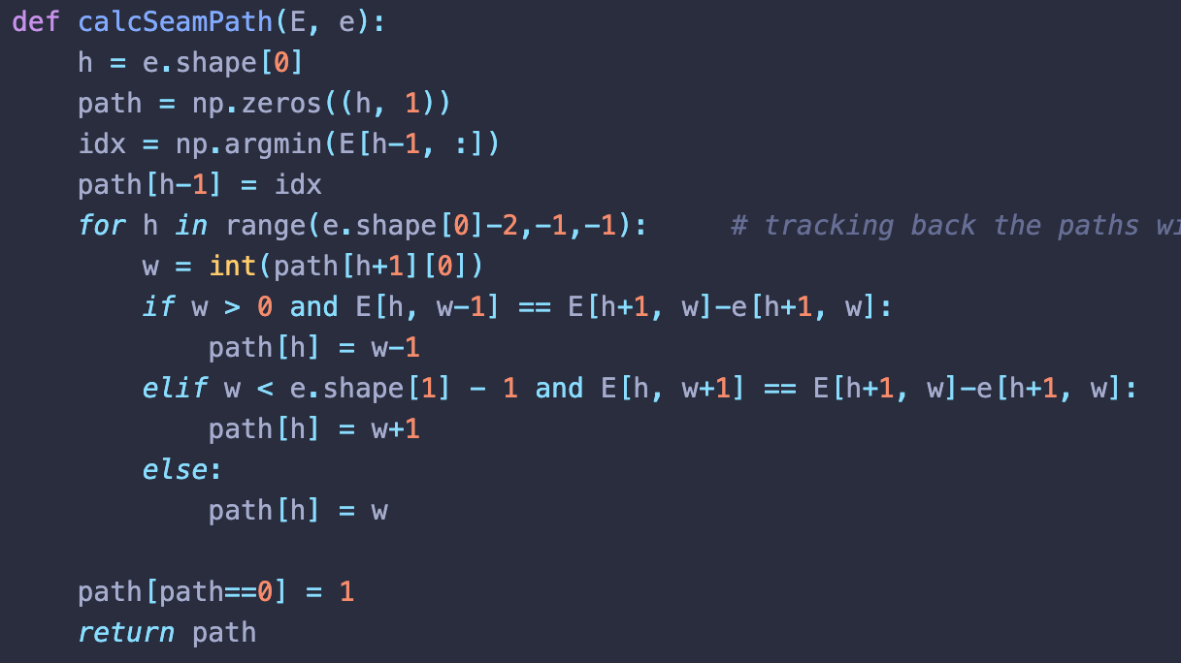
Optimal Seam Finding and Image Labeling
Input images
Panorama image
Notes:
这是我们每个模块的实现

Slide 14
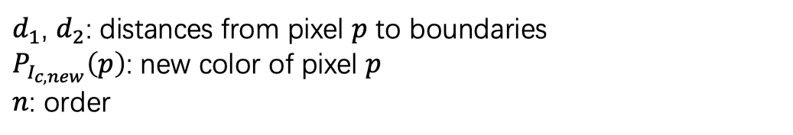
Image Blending
Simple linear blending: images are similar in color and luminance after color correction
$δ$ pixels width on both sides of the seam
$d_{1}$, $d_{2}$: distances from pixel $p$ to boundaries
$P_{I_{c,new}}\left(p\right)$: new color of pixel $p$
$n$: order
Notes:
最后一部分就是在接缝找到的基础上进行拼接，也就是图像融合
我们是找到两大个方法
简单线性融合，这个比较简单我们就略过了

Slide 15
Image Blending
Poisson blending: perform image blending in the gradient domain
$(G_{x},G_{y})$: gradients of source images using the labeling obtained using optimal seams
solve linear practical differential equation by fixing the colors at the seam and solving new colors $I(x,y)$ ​ over the gradient field
Notes:
第二种是泊松融合，其实使用的是梯度的信息
第三行公式是我们的一个离散展开

Slide 16


Results
Notes:
最后是我们的实现效果
这组图像的颜色差异很大，上面的是没有做颜色校正的

Slide 17
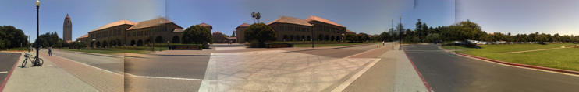
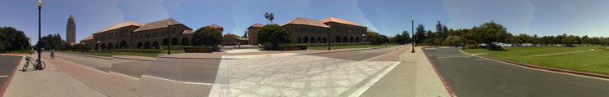

Results
Notes:
这组图第一个是没做颜色校正的
第二个是没做融合的，可以看到明显的锯齿接缝

